Slide 1
SUBELEMENT E1
COMMISSION’S RULES
[6 Exam Questions - 6 Groups]
Notes:
Extra Question Pool 2016. The Western Washington Ham Training Team makes these slides available to teach Amateur Technician Radio Licensing Classes. Daniel Stevens KL7WM, Training Coordinator, Howard Swartz, W7HS, Slide master, Dustin Lomax, KF7FK, Leading Instructor, LW Abel, K7LWA, Enthusiasm Leader.

Slide 2
E1A Operating Standards: frequency privileges; emission standards; automatic message forwarding; frequency sharing; stations aboard ships or aircraft
E1B Station restrictions and special operations: restrictions on station location; general operating restrictions, spurious emissions, control operator reimbursement; antenna structure restrictions; RACES operations
E1C Station control: definitions and restrictions pertaining to local, automatic and remote control operation; control operator responsibilities for remote and automatically controlled stations
E1D Amateur Satellite service: definitions and purpose; license requirements for space stations; available frequencies and bands; telecommand and telemetry operations; restrictions, and special provisions; notification requirements
E1E Volunteer examiner program: definitions, qualifications, preparation and administration of exams; accreditation; question pools; documentation requirements
E1F Miscellaneous rules: external RF power amplifiers; national quiet zone; business communications; compensated communications; spread spectrum; auxiliary stations; reciprocal operating privileges; IARP and CEPT licenses; third party communications with foreign countries; special temporary authority

Slide 3
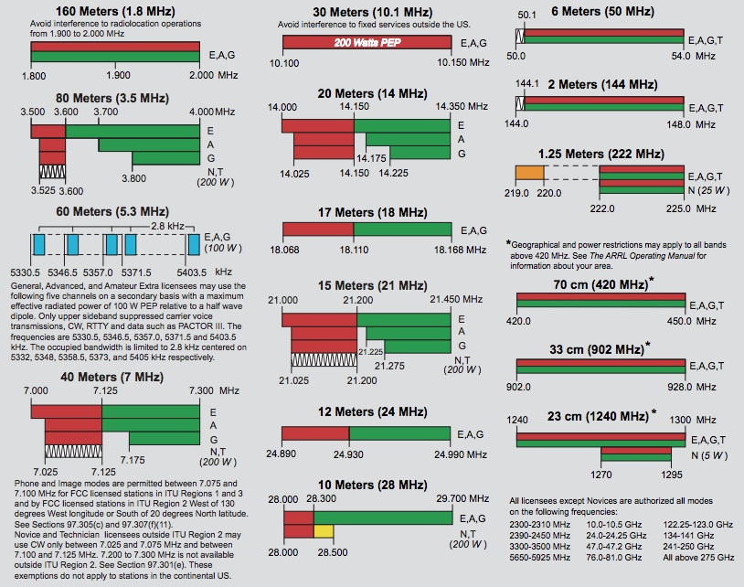
Band Plan

Slide 4
E1A Operating Standards:
frequency privileges; emission standards; automatic message forwarding; frequency sharing; stations aboard ships or aircraft

Slide 5
E1A01 When using a transceiver that displays the carrier frequency of phone signals, which of the following displayed frequencies represents the highest frequency at which a properly adjusted USB emission will be totally within the band?
A. The exact upper band edge
B. 300 Hz below the upper band edge
C. 1 kHz below the upper band edge
D. 3 kHz below the upper band edge

Slide 6
E1A01 When using a transceiver that displays the carrier frequency of phone signals, which of the following displayed frequencies represents the highest frequency at which a properly adjusted USB emission will be totally within the band?
A. The exact upper band edge
B. 300 Hz below the upper band edge
C. 1 kHz below the upper band edge
D. 3 kHz below the upper band edge

Slide 7
E1A02 When using a transceiver that displays the carrier frequency of phone signals, which of the following displayed frequencies represents the lowest frequency at which a properly adjusted LSB emission will be totally within the band?
A. The exact lower band edge
B. 300 Hz above the lower band edge
C. 1 kHz above the lower band edge
D. 3 kHz above the lower band edge

Slide 8
E1A02 When using a transceiver that displays the carrier frequency of phone signals, which of the following displayed frequencies represents the lowest frequency at which a properly adjusted LSB emission will be totally within the band?
A. The exact lower band edge
B. 300 Hz above the lower band edge
C. 1 kHz above the lower band edge
D. 3 kHz above the lower band edge

Slide 9
E1A03 With your transceiver displaying the carrier frequency of phone signals, you hear a station calling CQ on 14.349 MHz USB. Is it legal to return the call using upper sideband on the same frequency?
A. Yes, because you were not the station calling CQ
B. Yes, because the displayed frequency is within the 20 meter band
C. No, the sideband will extend beyond the band edge
D. No, U.S. stations are not permitted to use phone emissions above 14.340 MHz

Slide 10
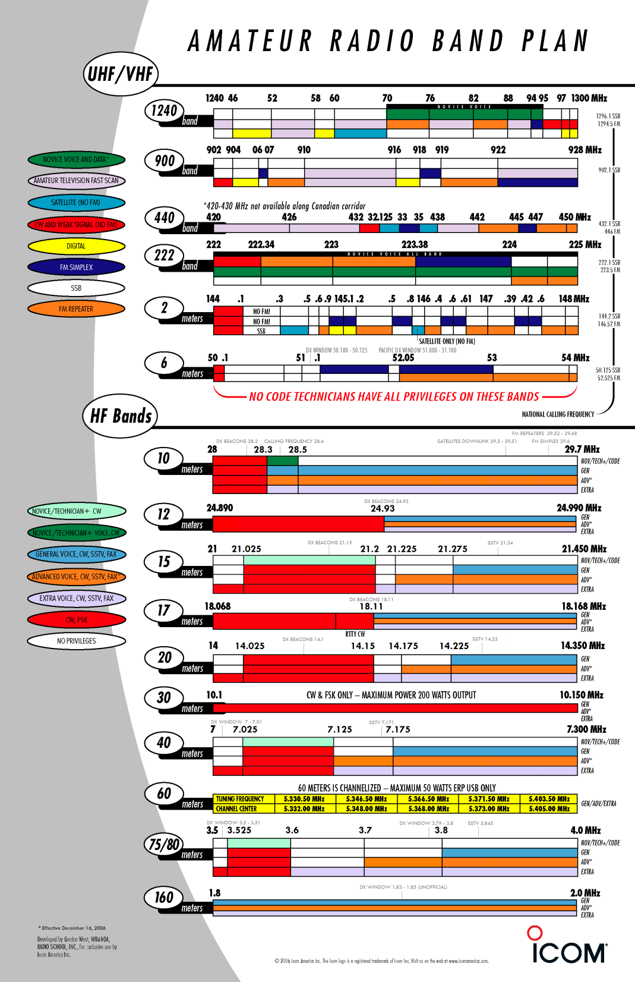
E1A03 With your transceiver displaying the carrier frequency of phone signals, you hear a station's CQ on 14.349 MHz USB. Is it legal to return the call using upper sideband on the same frequency?
A. Yes, because you were not the station calling CQ
B. Yes, because the displayed frequency is within the 20 meter band
C. No, the sideband will extend beyond the band edge
D. No, U.S. stations are not permitted to use phone emissions above 14.340 MHz

Slide 11
14.349 MHz + 3 KHz = 14.352 MHz.
Carrier Frequency
Lower
Side band
Upper
Side band
Carrier Frequency
-2.8 KHz
Carrier
- 300 Hz
Carrier
+300 Hz
Carrier Frequency
+2.8 KHz

Slide 12
E1A04 With your transceiver displaying the carrier frequency of phone signals, you hear a DX station calling CQ on 3.601 MHz LSB. Is it legal to return the call using lower sideband on the same frequency?
A. Yes, because the DX station initiated the contact
B. Yes, because the displayed frequency is within the 75 meter phone band segment
C. No, the sideband will extend beyond the edge of the phone band segment
D. No, U.S. stations are not permitted to use phone emissions below 3.610 MHz

Slide 13
E1A04 With your transceiver displaying the carrier frequency of phone signals, you hear a DX station calling CQ on 3.601 MHz LSB. Is it legal to return the call using lower sideband on the same frequency?
A. Yes, because the DX station initiated the contact
B. Yes, because the displayed frequency is within the 75 meter phone band segment
C. No, the sideband will extend beyond the edge of the phone band segment
D. No, U.S. stations are not permitted to use phone emissions below 3.610 MHz
(3.601 MHz - .003 MHz = 3.598 MHz)

Slide 14
E1A05 What is the maximum power output permitted on the 60 meter band?
A. 50 watts PEP effective radiated power relative to an isotropic radiator
B. 50 watts PEP effective radiated power relative to a dipole
C. 100 watts PEP effective radiated power relative to the gain of a half-wave dipole
D. 100 watts PEP effective radiated power relative to an isotropic radiator

Slide 15
E1A05 What is the maximum power output permitted on the 60 meter band?
A. 50 watts PEP effective radiated power relative to an isotropic radiator
B. 50 watts PEP effective radiated power relative to a dipole
C. 100 watts PEP effective radiated power relative to the gain of a half-wave dipole
D. 100 watts PEP effective radiated power relative to an isotropic radiator

Slide 16
E1A06 Where must the carrier frequency of a CW signal be set to comply with FCC rules for 60 meter operation?
A. At the lowest frequency of the channel
B. At the center frequency of the channel
C. At the highest frequency of the channel
D. On any frequency where the signal’s sidebands are within the channel

Slide 17
E1A06 Where must the carrier frequency of a CW signal be set to comply with FCC rules for 60 meter operation?
A. At the lowest frequency of the channel
B. At the center frequency of the channel
C. At the highest frequency of the channel
D. On any frequency where the signal’s sidebands are within the channel

Slide 18
E1A07 Which amateur band requires transmission on specific channels rather than on a range of frequencies?
A. 12 meter band
B. 17 meter band
C. 30 meter band
D. 60 meter band

Slide 19
E1A07 Which amateur band requires transmission on specific channels rather than on a range of frequencies?
A. 12 meter band
B. 17 meter band
C. 30 meter band
D. 60 meter band

Slide 20
E1A08 If a station in a message forwarding system inadvertently forwards a message that is in violation of FCC rules, who is primarily accountable for the rules violation?
A. The control operator of the packet bulletin board station
B. The control operator of the originating station
C. The control operators of all the stations in the system
D. The control operators of all the stations in the system not authenticating the source from which they accept communications

Slide 21
E1A08 If a station in a message forwarding system inadvertently forwards a message that is in violation of FCC rules, who is primarily accountable for the rules violation?
A. The control operator of the packet bulletin board station
B. The control operator of the originating station
C. The control operators of all the stations in the system
D. The control operators of all the stations in the system not authenticating the source from which they accept communications

Slide 22
E1A09 What is the first action you should take if your digital message forwarding station inadvertently forwards a communication that violates FCC rules?
A. Discontinue forwarding the communication as soon as you become aware of it
B. Notify the originating station that the communication does not comply with FCC rules
C. Notify the nearest FCC Field Engineer’s office
D. Discontinue forwarding all messages

Slide 23
E1A09 What is the first action you should take if your digital message forwarding station inadvertently forwards a communication that violates FCC rules?
A. Discontinue forwarding the communication as soon as you become aware of it
B. Notify the originating station that the communication does not comply with FCC rules
C. Notify the nearest FCC Field Engineer’s office
D. Discontinue forwarding all messages

Slide 24
E1A10 If an amateur station is installed aboard a ship or aircraft, what condition must be met before the station is operated?
A. Its operation must be approved by the master of the ship or the pilot in command of the aircraft
B. The amateur station operator must agree not to transmit when the main radio of the ship or aircraft is in use
C. The amateur station must have a power supply that is completely independent of the main ship or aircraft power supply
D. The amateur operator must have an FCC Marine or Aircraft endorsement on his or her amateur license

Slide 25
E1A10 If an amateur station is installed aboard a ship or aircraft, what condition must be met before the station is operated?
A. Its operation must be approved by the master of the ship or the pilot in command of the aircraft
B. The amateur station operator must agree not to transmit when the main radio of the ship or aircraft is in use
C. The amateur station must have a power supply that is completely independent of the main ship or aircraft power supply
D. The amateur operator must have an FCC Marine or Aircraft endorsement on his or her amateur license

Slide 26
E1A11 Which of the following describes authorization or licensing required when operating an amateur station aboard a U.S.-registered vessel in international waters?
A. Any amateur license with an FCC Marine or Aircraft endorsement
B. Any FCC-issued amateur license.
C. Only General class or higher amateur licenses
D. An unrestricted Radiotelephone Operator Permit

Slide 27
E1A11 Which of the following describes authorization or licensing required when operating an amateur station aboard a U.S.-registered vessel in international waters?
A. Any amateur license with an FCC Marine or Aircraft endorsement
B. Any FCC-issued amateur license .
C. Only General class or higher amateur licenses
D. An unrestricted Radiotelephone Operator Permit

Slide 28
E1A12 With your transceiver displaying the carrier frequency of CW signals, you hear a DX station's CQ on 3.500 MHz. Is it legal to return the call using CW on the same frequency?
A. Yes, the DX station initiated the contact
B. Yes, the displayed frequency is within the 80 meter CW band segment
C. No, one of the sidebands of the CW signal will be out of the band.
D. No, U.S. stations are not permitted to use CW emissions below 3.525 MHz

Slide 29
E1A12 With your transceiver displaying the carrier frequency of CW signals, you hear a DX station's CQ on 3.500 MHz. Is it legal to return the call using CW on the same frequency?
A. Yes, the DX station initiated the contact
B. Yes, the displayed frequency is within the 80 meter CW band segment
C. No, one of the sidebands of the CW signal will be out of the band.
D. No, U.S. stations are not permitted to use CW emissions below 3.525 MHz

Slide 30
E1A13 Who must be in physical control of the station apparatus of an amateur station aboard any vessel or craft that is documented or registered in the United States?
A. Only a person with an FCC Marine Radio
B. Any person holding an FCC issued amateur license or who is authorized for alien reciprocal operation
C. Only a person named in an amateur station license grant
D. Any person named in an amateur station license grant or a person holding an unrestricted Radiotelephone Operator Permit

Slide 31
E1A13 Who must be in physical control of the station apparatus of an amateur station aboard any vessel or craft that is documented or registered in the United States?
A. Only a person with an FCC Marine Radio
B. Any person holding an FCC issued amateur license or who is authorized for alien reciprocal operation
C. Only a person named in an amateur station license grant
D. Any person named in an amateur station license grant or a person holding an unrestricted Radiotelephone Operator Permit

Slide 32
E1A14 What is the maximum bandwidth for a data emission on 60 meters?
A. 60 Hz
B. 170 Hz
C. 1.5 kHz
D. 2.8 kHz

Slide 33
E1A14 What is the maximum bandwidth for a data emission on 60 meters?
A. 60 Hz
B. 170 Hz
C. 1.5 kHz
D. 2.8 kHz

Slide 34
E1B Station restrictions and special operations
restrictions on station location; general operating restrictions: spurious emissions, control operator reimbursement; antenna structure restrictions; RACES operations: national quiet zone

Slide 35
E1B01 Which of the following constitutes a spurious emission?
A. An amateur station transmission made at random without the proper call sign identification
B. A signal transmitted to prevent its detection by any station other than the intended recipient
C. Any transmitted signal that unintentionally interferes with another licensed radio station
D. An emission outside its necessary bandwidth that can be reduced or eliminated without affecting the information transmitted

Slide 36
E1B01 Which of the following constitutes a spurious emission?
A. An amateur station transmission made at random without the proper call sign identification
B. A signal transmitted to prevent its detection by any station other than the intended recipient
C. Any transmitted signal that unintentionally interferes with another licensed radio station
D. An emission outside its necessary bandwidth that can be reduced or eliminated without affecting the information transmitted

Slide 37
E1B02 Which of the following factors might cause the physical location of an amateur station apparatus or antenna structure to be restricted?
A. The location is near an area of political conflict
B. The location is of geographical or horticultural importance
C. The location is in an ITU Zone designated for coordination with one or more foreign governments
D. The location is of environmental importance or significant in American history, architecture, or culture

Slide 38
E1B02 Which of the following factors might cause the physical location of an amateur station apparatus or antenna structure to be restricted?
A. The location is near an area of political conflict
B. The location is of geographical or horticultural importance
C. The location is in an ITU Zone designated for coordination with one or more foreign governments
D. The location is of environmental importance or significant in American history, architecture, or culture

Slide 39
E1B03 Within what distance must an amateur station protect an FCC monitoring facility from harmful interference?
A. 1 mile
B. 3 miles
C. 10 miles
D. 30 miles

Slide 40
E1B03 Within what distance must an amateur station protect an FCC monitoring facility from harmful interference?
A. 1 mile
B. 3 miles
C. 10 miles
D. 30 miles

Slide 41
E1B04 What must be done before placing an amateur station within an officially designated wilderness area or wildlife preserve, or an area listed in the National Register of Historical Places?
A. A proposal must be submitted to the National Park Service
B. A letter of intent must be filed with the National Audubon Society
C. An Environmental Assessment must be submitted to the FCC
D. A form FSD-15 must be submitted to the Department of the Interior

Slide 42
E1B04 What must be done before placing an amateur station within an officially designated wilderness area or wildlife preserve, or an area listed in the National Register of Historical Places?
A. A proposal must be submitted to the National Park Service
B. A letter of intent must be filed with the National Audubon Society
C. An Environmental Assessment must be submitted to the FCC
D. A form FSD-15 must be submitted to the Department of the Interior

Slide 43
E1B05 What is the National Radio Quiet Zone?
A. An area in Puerto Rico surrounding the Arecibo Radio Telescope
B. An area in New Mexico surrounding the White Sands Test Area
C. An area surrounding the National Radio Astronomy Observatory
D. An area in Florida surrounding Cape Canaveral

Slide 44
E1B05 What is the National Radio Quiet Zone?
A. An area in Puerto Rico surrounding the Arecibo Radio Telescope
B. An area in New Mexico surrounding the White Sands Test Area
C. An area surrounding the National Radio Astronomy Observatory
D. An area in Florida surrounding Cape Canaveral

Slide 45
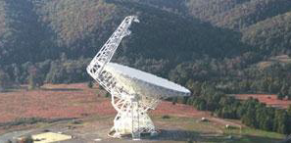
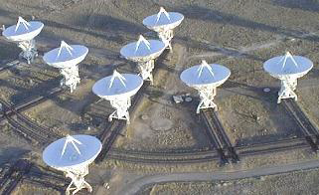
The National Radio Astronomy Observatory sites are located in Green Bank West Virginia, Socorro New Mexico, and
Charlottesville NC.

Slide 46
E1B06 Which of the following additional rules apply if you are installing an amateur station antenna at a site at or near a public use airport?
A. You may have to notify the Federal Aviation Administration and register it with the FCC as required by Part 17 of FCC rules
B. No special rules apply if your antenna structure will be less than 300 feet in height
C. You must file an Environmental Impact Statement with the EPA before construction begins
D. You must obtain a construction permit from the airport zoning authority

Slide 47
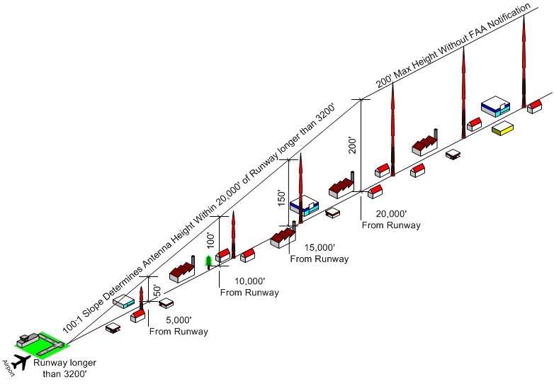
Amateur Radio Towers
Near a Public Airport
Distances from runway and height permitted. 200 feet maximum is the only info needed.

Slide 48
E1B06 Which of the following additional rules apply if you are installing an amateur station antenna at a site at or near a public use airport?
A. You may have to notify the Federal Aviation Administration and register it with the FCC as required by Part 17 of FCC rules
B. No special rules apply if your antenna structure will be less than 300 feet in height
C. You must file an Environmental Impact Statement with the EPA before construction begins
D. You must obtain a construction permit from the airport zoning authority

Slide 49
E1B07 What is the highest modulation index permitted at the highest modulation frequency for angle modulation below 29.0 Mhz?
A. 0.5
B. 1.0
C. 2.0
D. 3.0

Slide 50
E1B07 What is the highest modulation index permitted at the highest modulation frequency for angle modulation below 29.0 Mhz?
A. 0.5
B. 1.0
C. 2.0
D. 3.0

Slide 51
E1B08 What limitations may the FCC place on an amateur station if its signal causes interference to domestic broadcast reception, assuming that the receivers involved are of good engineering design?
A. The amateur station must cease operation
B. The amateur station must cease operation on all frequencies below 30 MHz
C. The amateur station must cease operation on all frequencies above 30 MHz
D. The amateur station must avoid transmitting during certain hours on frequencies that cause the interference

Slide 52
E1B08 What limitations may the FCC place on an amateur station if its signal causes interference to domestic broadcast reception, assuming that the receivers involved are of good engineering design?
A. The amateur station must cease operation
B. The amateur station must cease operation on all frequencies below 30 MHz
C. The amateur station must cease operation on all frequencies above 30 MHz
D. The amateur station must avoid transmitting during certain hours on frequencies that cause the interference

Slide 53
E1B09 Which amateur stations may be operated under RACES rules?
A. Only those club stations licensed to Amateur Extra class operators
B. Any FCC-licensed amateur station except a Technician class
C. Any FCC-licensed amateur station certified by the responsible civil defense organization for the area served
D. Any FCC-licensed amateur station participating in the Military Afuxiliary Radio System (MARS)

Slide 54
E1B09 Which amateur stations may be operated under RACES rules?
A. Only those club stations licensed to Amateur Extra class operators
B. Any FCC-licensed amateur station except a Technician class
C. Any FCC-licensed amateur station certified by the responsible civil defense organization for the area served
D. Any FCC-licensed amateur station participating in the Military Afuxiliary Radio System (MARS)

Slide 55
E1B10 What frequencies are authorized to an amateur station operating under RACES rules?
A. All amateur service frequencies authorized to the control operator
B. Specific segments in the amateur service MF, HF, VHF and UHF bands
C. Specific local government channels
D. Military Auxiliary Radio System (MARS) channels

Slide 56
E1B10 What frequencies are authorized to an amateur station operating under RACES rules?
A. All amateur service frequencies authorized to the control operator
B. Specific segments in the amateur service MF, HF, VHF and UHF bands
C. Specific local government channels
D. Military Auxiliary Radio System (MARS) channels

Slide 57
E1B11 What is the permitted mean power of any spurious emission relative to the mean power of the fundamental emission from a station transmitter or external RF amplifier installed after January 1, 2003 and transmitting on a frequency below 30 MHZ?
A. At least 43 dB below
B. At least 53 dB below
C. At least 63 dB below
D. At least 73 dB below

Slide 58
E1B11 What is the permitted mean power of any spurious emission relative to the mean power of the fundamental emission from a station transmitter or external RF amplifier installed after January 1, 2003 and transmitting on a frequency below 30 MHZ?
A. At least 43 dB below
B. At least 53 dB below
C. At least 63 dB below
D. At least 73 dB below

Slide 59
E1C Station Control
Definitions and restrictions pertaining to local, automatic and remote control operation; control operator responsibilities for remote and automatically controlled stations; IARP and CEPT licenses; third party communications over automatically controlled stations

Slide 60
E1C01 What is a remotely controlled station?
A. A station operated away from its regular home location
B. A station controlled by someone other than the licensee
C. A station operating under automatic control
D. A station controlled indirectly through a control link

Slide 61
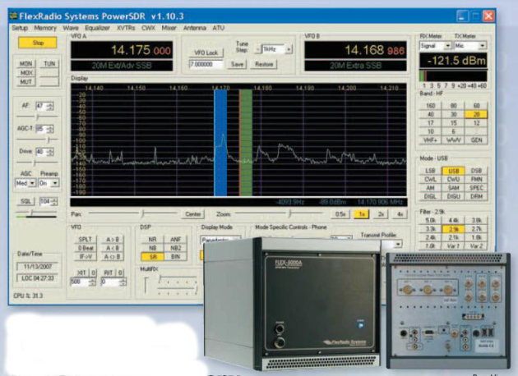
E1C01 What is a remotely controlled station?
A. A station operated away from its regular home location
B. A station controlled by someone other than the licensee
C. A station operating under automatic control
D. A station controlled indirectly through a control link

Slide 62
E1C02 What is meant by automatic control of a station?
A. The use of devices and procedures for control so that the control operator does not have to be present at a control point
B. A station operating with its output power controlled automatically
C. Remotely controlling a station’s antenna pattern through a directional control link
D. The use of a control link between a control point and a locally controlled station

Slide 63
E1C02 What is meant by automatic control of a station?
A. The use of devices and procedures for control so that the control operator does not have to be present at a control point
B. A station operating with its output power controlled automatically
C. Remotely controlling a station’s antenna pattern through a directional control link
D. The use of a control link between a control point and a locally controlled station

Slide 64
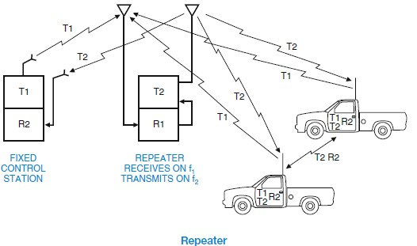
Repeater Operation

Slide 65
E1C03 How do the control operator responsibilities of a station under automatic control differ from one under local control?
A. Under local control there is no control operator
B. Under automatic control the control operator is not required to be present at the control point
C. Under automatic control there is no control operator
D. Under local control a control operator is not required to be present at a control point

Slide 66
E1C03 How do the control operator responsibilities of a station under automatic control differ from one under local control?
A. Under local control there is no control operator
B. Under automatic control the control operator is not required to be present at the control point
C. Under automatic control there is no control operator
D. Under local control a control operator is not required to be present at a control point

Slide 67
E1C04 What is meant by IARP?
A. An international amateur radio permit that allows U.S. amateurs to operate in certain countries of the Americas
B. The internal amateur radio practices policy of the FCC
C. An indication of increased antenna reflected power
D. A forecast of intermittent aurora radio propagation

Slide 68
E1C04 What is meant by IARP?
A. An international amateur radio permit that allows U.S. amateurs to operate in certain countries of the Americas
B. The internal amateur radio practices policy of the FCC
C. An indication of increased antenna reflected power
D. A forecast of intermittent aurora radio propagation

Slide 69
E1C05 When may an automatically controlled station originate third party communications?
A. Never
B. Only when transmitting RTTY or data emissions
C. When agreed upon by the sending or receiving station
D. When approved by the National Telecommunication and Information Administration

Slide 70
E1C05 When may an automatically controlled station originate third party communications?
A. Never
B. Only when transmitting RTTY or data emissions
C. When agreed upon by the sending or receiving station
D. When approved by the National Telecommunication and Information Administration

Slide 71
E1C06 Which of the following statements concerning remotely controlled amateur stations is true?
A. Only Extra Class operators may be the control operator of a remote station
B. A control operator need not be present at the control point
C. A control operator must be present at the control point
D. Repeater and auxiliary stations may not be remotely controlled

Slide 72
E1C06 Which of the following statements concerning remotely controlled amateur stations is true?
A. Only Extra Class operators may be the control operator of a remote station
B. A control operator need not be present at the control point
C. A control operator must be present at the control point
D. Repeater and auxiliary stations may not be remotely controlled

Slide 73
E1C07 What is meant by local control?
A. Controlling a station through a local auxiliary link
B. Automatically manipulating local station controls
C. Direct manipulation of the transmitter by a control operator
D. Controlling a repeater using a portable handheld transceiver

Slide 74
E1C07 What is meant by local control?
A. Controlling a station through a local auxiliary link
B. Automatically manipulating local station controls
C. Direct manipulation of the transmitter by a control operator
D. Controlling a repeater using a portable handheld transceiver

Slide 75
E1C08 What is the maximum permissible duration of a remotely controlled station’s transmissions if its control link malfunctions?
A. 30 seconds
B. 3 minutes
C. 5 minutes
D. 10 minutes

Slide 76
E1C08 What is the maximum permissible duration of a remotely controlled station’s transmissions if its control link malfunctions?
A. 30 seconds
B. 3 minutes
C. 5 minutes
D. 10 minutes

Slide 77
E1C09 Which of these ranges of frequencies is available for an automatically controlled repeater operating below 30 MHz?
A. 18.110 MHz- 18.168 MHz
B. 24.940 MHz- 24.990 MHz
C. 10.100 MHz- 10.150 MHz
D. 29.500 MHz- 29.700 MHz

Slide 78
E1C09 Which of these ranges of frequencies is available for an automatically controlled repeater operating below 30 MHz?
A. 18.110 MHz- 18.168 MHz
B. 24.940 MHz- 24.990 MHz
C. 10.100 MHz- 10.150 MHz
D. 29.500 MHz- 29.700 MHz

Slide 79
E1C10 What types of amateur stations may automatically retransmit the radio signals of other amateur stations?
A. Only beacon, repeater or space stations
B. Only auxiliary, repeater or space stations
C. Only earth stations, repeater stations or model craft
D. Only auxiliary, beacon or space stations

Slide 80
E1C10 What types of amateur stations may automatically retransmit the radio signals of other amateur stations?
A. Only beacon, repeater or space stations
B. Only auxiliary, repeater or space stations
C. Only earth stations, repeater stations or model craft
D. Only auxiliary, beacon or space stations

Slide 81
E1C11 Which of the following operating arrangements allows an FCC-licensed U.S. citizen to operate in many European countries, and alien amateurs from many European countries to operate in the U.S.?
A. CEPT agreement
B. IARP agreement
C. ITU reciprocal license
D. All of these choices are correct

Slide 82
E1C11 Which of the following operating arrangements allows an FCC-licensed U.S. citizen to operate in many European countries, and alien amateurs from many European countries to operate in the U.S.?
A. CEPT agreement
B. IARP agreement
C. ITU reciprocal license
D. All of these choices are correct

Slide 83

US Amateurs May Handle Third-Party Traffic With:
V2 | Antigua/Barbuda
LO-LW | Argentina
VK | Australia
V3 | Belize
CP | Bolivia
E7 | Bosnia-Herzegovina
PP-PY | Brazil
VE, VO, VY | Canada
CA-CE | Chile
HJ-HK | Colombia
D6 | Comoros (Federal Islamic Republic of)
TI, TE | Costa Rica
CM, CO | Cuba
HI | Dominican Republic
J7 | Dominica
HC-HD | Ecuador
YS | El Salvador
C5 | Gambia, The
9G | Ghana
J3 | Grenada
TG | Guatemala
8R | Guyana
HH | Haiti
HQ-HR | Honduras
4X, 4Z | Israel
6Y | Jamaica
JY | Jordan
EL | Liberia
V7 | Marshall Islands
XA-XI | Mexico
V6 | Micronesia, Federated States of
YN | Nicaragua
HO-HP | Panama
ZP | Paraguay
OA-OC | Peru
DU-DZ | Philippines
VR6 | Pitcairn Island*
V4 | St. Kitts/Nevis
J6 | St. Lucia
J8 | St. Vincent and the Grenadines
9L | Sierra Leone
ZR-ZU | South Africa
3DA | Swaziland
9Y-9Z | Trinidad/Tobago
TA-TC | Turkey
GB | United Kingdom
CV-CX | Uruguay
YV-YY | Venezuela
4U1ITU | ITU - Geneva
4U1VIC | VIC - Vienna
http://www.arrl.org/third-party-operating-agreements

Slide 84
E1C12 What types of communications may be transmitted to amateur stations in foreign countries?
A. Business-related messages for non-profit organizations
B. Messages intended for connection to users of the maritime satellite service
C. Communications incidental to the purpose of the amateur service and remarks of a personal nature
D. All of these choices are correct

Slide 85
E1C12 What types of communications may be transmitted to amateur stations in foreign countries?
A. Business-related messages for non-profit organizations
B. Messages intended for connection to users of the maritime satellite service
C. Communications incidental to the purpose of the amateur service and remarks of a personal nature
D. All of these choices are correct

Slide 86
E1C13 Which of the following is required in order to operate in accordance with CEPT rules in foreign countries where permitted?
A. You must identify in the official language of the country in which you are operating
B. The U.S. embassy must approve of your operation
C. You must bring a copy of FCC Public Notice DA 11-221
D. You must append "/CEPT" to your call sign

Slide 87
E1C13 Which of the following is required in order to operate in accordance with CEPT rules in foreign countries where permitted?
A. You must identify in the official language of the country in which you are operating
B. The U.S. embassy must approve of your operation
C. You must bring a copy of FCC Public Notice DA 11-221
D. You must append "/CEPT" to your call sign

Slide 88
E1D Amateur Satellite
definitions and purpose; license requirements for space stations; available frequencies and bands; telecommand and telemetry operations; restrictions, and special provisions; notification requirements

Slide 89
E1D01 What is the definition of the term telemetry?
A. One-way transmission of measurements at a distance from the measuring instrument
B. Two-way radiotelephone transmissions in excess of 1000 feet
C. Two-way single channel transmissions of data
D. One-way transmission that initiates, modifies, or terminates the functions of a device at a distance

Slide 90
E1D01 What is the definition of the term telemetry?
A. One-way transmission of measurements at a distance from the measuring instrument
B. Two-way radiotelephone transmissions in excess of 1000 feet
C. Two-way single channel transmissions of data
D. One-way transmission that initiates, modifies, or terminates the functions of a device at a distance

Slide 91
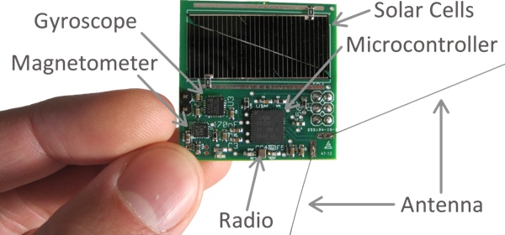
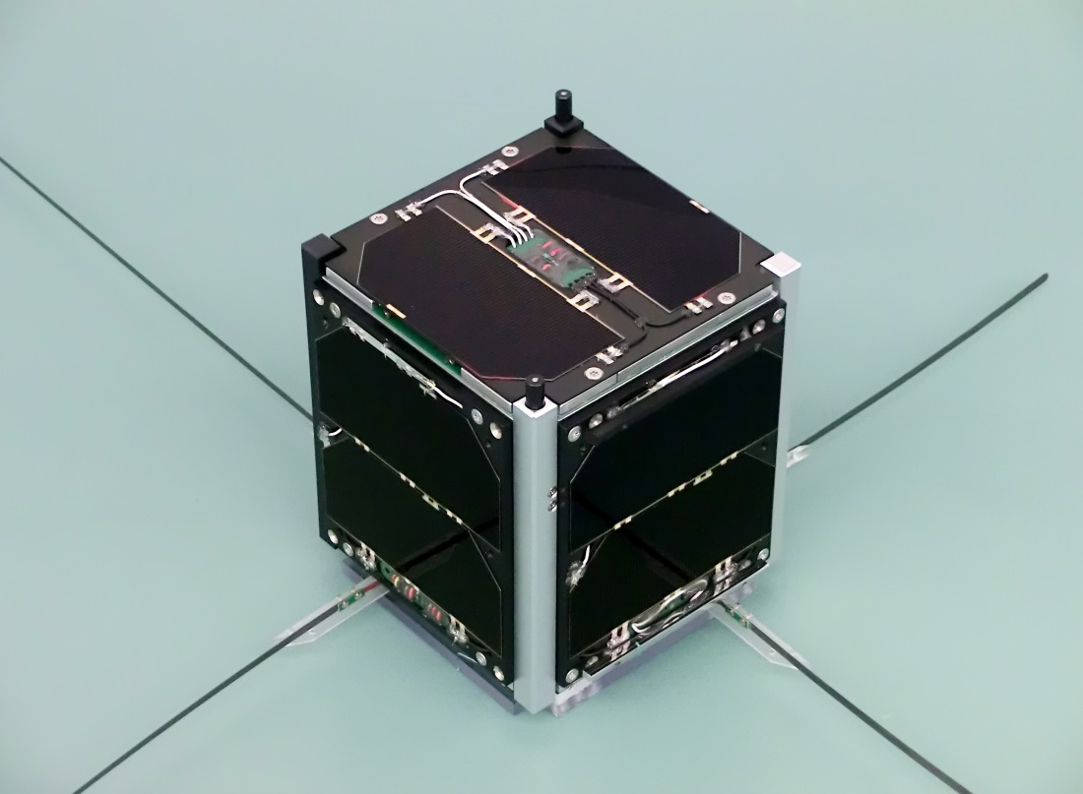
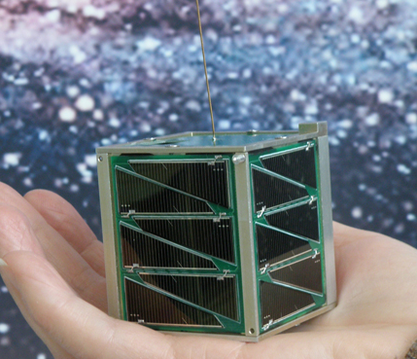
Ham Satellite's

Slide 92
E1D02 What is the amateur satellite service?
A. A radio navigation service using satellites for the purpose of self training, intercommunication and technical studies carried out by amateurs
B. A spacecraft launching service for amateur-built satellites
C. A radio communications service using amateur radio stations on satellites
D. A radio communications service using stations on Earth satellites for public service broadcast

Slide 93
E1D02 What is the amateur satellite service?
A. A radio navigation service using satellites for the purpose of self training, intercommunication and technical studies carried out by amateurs
B. A spacecraft launching service for amateur-built satellites
C. A radio communications service using amateur radio stations on satellites
D. A radio communications service using stations on Earth satellites for public service broadcast

Slide 94
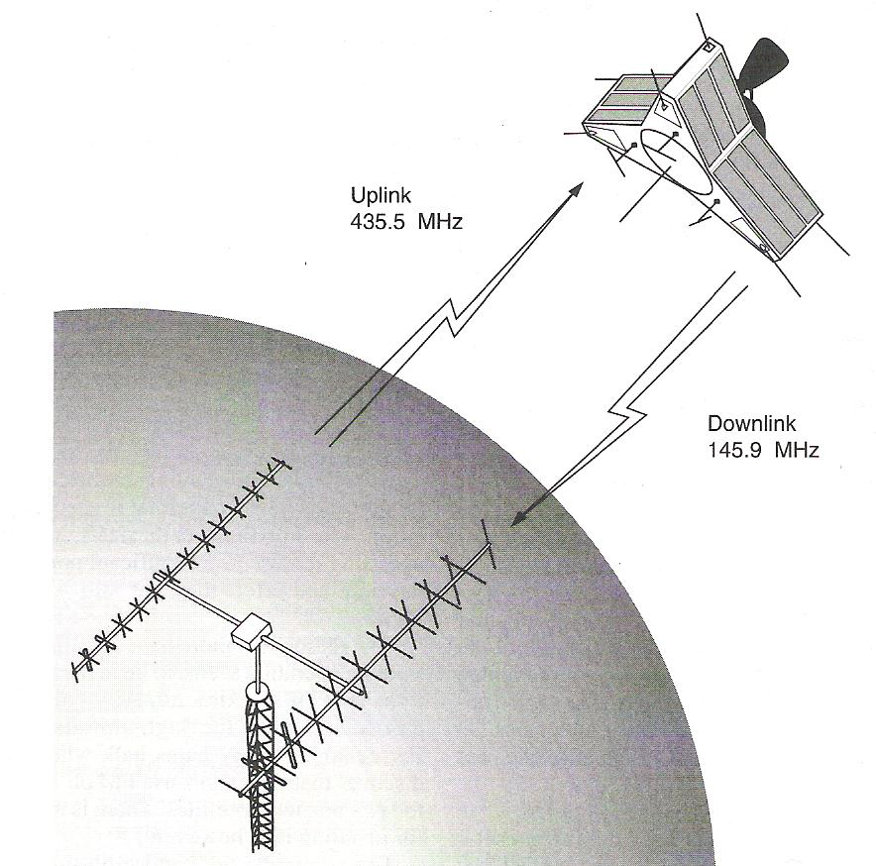

Slide 95
E1D03 What is a telecommand station in the amateur satellite service?
A. An amateur station located on the Earth’s surface for communication with other Earth stations by means of Earth satellites
B. An amateur station that transmits communications to initiate, modify or terminate functions of a space station
C. An amateur station located more than 50 km above the Earth’s surface
D. An amateur station that transmits telemetry consisting of measurements of upper atmosphere

Slide 96
E1D03 What is a telecommand station in the amateur satellite service?
A. An amateur station located on the Earth’s surface for communication with other Earth stations by means of Earth satellites
B. An amateur station that transmits communications to initiate, modify or terminate functions of a space station
C. An amateur station located more than 50 km above the Earth’s surface
D. An amateur station that transmits telemetry consisting of measurements of upper atmosphere

Slide 97
E1D04 What is an Earth station in the amateur satellite service?
A. An amateur station within 50 km of the Earth's surface intended for communications with amateur stations by means of objects in space
B. An amateur station that is not able to communicate using amateur satellites
C. An amateur station that transmits telemetry consisting of measurement of upper atmosphere
D. Any amateur station on the surface of the Earth

Slide 98
E1D04 What is an Earth station in the amateur satellite service?
A. An amateur station within 50 km of the Earth's surface intended for communications with amateur stations by means of objects in space
B. An amateur station that is not able to communicate using amateur satellites
C. An amateur station that transmits telemetry consisting of measurement of upper atmosphere
D. Any amateur station on the surface of the Earth

Slide 99
E1D05 What class of licensee is authorized to be the control operator of a space station?
A. All except Technician Class
B. Only General, Advanced or Amateur Extra Class
C. Any class with appropriate operator privileges
D. Only Amateur Extra Class

Slide 100
E1D05 What class of licensee is authorized to be the control operator of a space station?
A. All except Technician Class
B. Only General, Advanced or Amateur Extra Class
C. Any class with appropriate operator privileges
D. Only Amateur Extra Class

Slide 101
E1D06 Which of the following is a requirement of a space station?
A. The space station must be capable of terminating transmissions by telecommand when directed by the FCC
B. The space station must cease all transmissions after 5 years
C. The space station must be capable of changing its orbit whenever such a change is ordered by NASA
D. All of these choices are correct

Slide 102
E1D06 Which of the following is a requirement of a space station?
A. The space station must be capable of terminating transmissions by telecommand when directed by the FCC
B. The space station must cease all transmissions after 5 years
C. The space station must be capable of changing its orbit whenever such a change is ordered by NASA
D. All of these choices are correct

Slide 103
E1D07 Which amateur service HF bands have frequencies authorized for space stations?
A. Only 40 m, 20 m, 17 m, 15 m, 12 m and 10 m
B. Only 40 m, 20 m, 17 m, 15 m and 10 m bands
C. 40 m, 30 m, 20 m, 15 m, 12 m and 10 m bands
D. All HF bands

Slide 104
E1D07 Which amateur service HF bands have frequencies authorized for space stations?
A. Only 40 m, 20 m, 17 m, 15 m, 12 m and 10 m
B. Only 40 m, 20 m, 17 m, 15 m and 10 m bands
C. 40 m, 30 m, 20 m, 15 m, 12 m and 10 m bands
D. All HF bands

Slide 105
E1D08 Which VHF amateur service bands have frequencies available for space stations?
A. 6 meters and 2 meters
B. 6 meters, 2 meters, and 1.25 meters
C. 2 meters and 1.25 meters
D. 2 meters

Slide 106
E1D08 Which VHF amateur service bands have frequencies available for space stations?
A. 6 meters and 2 meters
B. 6 meters, 2 meters, and 1.25 meters
C. 2 meters and 1.25 meters
D. 2 meters

Slide 107
E1D09 Which UHF amateur service bands have frequencies available for a space station?
A. 70 cm
B. 70 cm, 13 cm
C. 70 cm and 33 cm
D. 33 cm and 13 cm

Slide 108
E1D09 Which UHF amateur service bands have frequencies available for a space station?
A. 70 cm
B. 70 cm, 13 cm
C. 70 cm and 33 cm
D. 33 cm and 13 cm

Slide 109
E1D10 Which amateur stations are eligible to be telecommand stations?
A. Any amateur station designated by NASA
B. Any amateur station so designated by the space station licensee, subject to the privileges of the class of operator license held by the control operator
C. Any amateur station so designated by the ITU
D. All of these choices are correct

Slide 110
E1D10 Which amateur stations are eligible to be telecommand stations?
A. Any amateur station designated by NASA
B. Any amateur station so designated by the space station licensee, subject to the privileges of the class of operator license held by the control operator
C. Any amateur station so designated by the ITU
D. All of these choices are correct

Slide 111
E1D11 Which amateur stations are eligible to operate as Earth stations?
A. Any amateur station whose licensee has filed a pre-space notification with the FCC’s International Bureau
B. Only those of General, Advanced or Amateur Extra Class operators
C. Only those of Amateur Extra Class operators
D. Any amateur station, subject to the privileges of the class of operator license held by the control operator

Slide 112
E1D11 Which amateur stations are eligible to operate as Earth stations?
A. Any amateur station whose licensee has filed a pre-space notification with the FCC’s International Bureau
B. Only those of General, Advanced or Amateur Extra Class operators
C. Only those of Amateur Extra Class operators
D. Any amateur station, subject to the privileges of the class of operator license held by the control operator

Slide 113
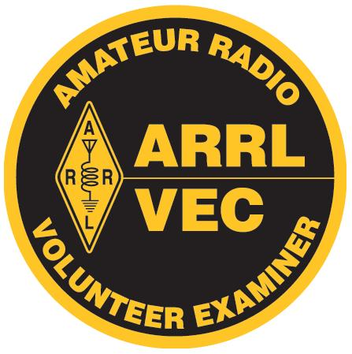

E1E Volunteer examiner program:
definitions; qualifications; preparation and administration of exams; accreditation; question pools; documentation requirements

Slide 114
E1E01 What is the minimum number of qualified VEs required to administer an Element 4 amateur operator license examination?
A. 5
B. 2
C. 4
D. 3

Slide 115

E1E01 What is the minimum number of qualified VEs required to administer an Element 4 amateur operator license examination?
A. 5
B. 2
C. 4
D. 3

Slide 116
E1E02 Where are the questions for all written U.S. amateur license examinations listed?
A. In FCC Part 97
B. In a question pool maintained by the FCC
C. In a question pool maintained by all the VECs
D. In the appropriate FCC Report and Order

Slide 117
E1E02 Where are the questions for all written U.S. amateur license examinations listed?
A. In FCC Part 97
B. In a question pool maintained by the FCC
C. In a question pool maintained by all the VECs
D. In the appropriate FCC Report and Order

Slide 118
E1E03 What is a Volunteer Examiner Coordinator?
A. A person who has volunteered to administer amateur operator license examinations
B. A person who has volunteered to prepare amateur operator license examinations
C. An organization that has entered into an agreement with the FCC to coordinate amateur operator license examinations
D. The person who has entered into an agreement with the FCC to be the VE session manager

Slide 119
E1E03 What is a Volunteer Examiner Coordinator?
A. A person who has volunteered to administer amateur operator license examinations
B. A person who has volunteered to prepare amateur operator license examinations
C. An organization that has entered into an agreement with the FCC to coordinate amateur operator license examinations
D. The person who has entered into an agreement with the FCC to be the VE session manager

Slide 120
E1E04 Which of the following best describes the Volunteer Examiner accreditation process?
A. Each General, Advanced and Amateur Extra Class operator is automatically accredited as a VE when the license is granted
B. The amateur operator applying must pass a VE examination administered by the FCC Enforcement Bureau
C. The prospective VE obtains accreditation from the FCC
D. The procedure by which a VEC confirms that the VE applicant meets FCC requirements to serve as an examiner

Slide 121
E1E03 What is a Volunteer Examiner Coordinator?
A. Each General, Advanced and Amateur Extra Class operator is automatically accredited as a VE when the license is granted
B. The amateur operator applying must pass a VE examination administered by the FCC Enforcement Bureau
C. The prospective VE obtains accreditation from the FCC
D. The procedure by which a VEC confirms that the VE applicant meets FCC requirements to serve as an examiner

Slide 122
E1E05 What is the minimum passing score on amateur operator license examinations?
A. Minimum passing score of 70%
B. Minimum passing score of 74%
C. Minimum passing score of 80%
D. Minimum passing score of 77%

Slide 123
E1E05 What is the minimum passing score on amateur operator license examinations?
A. Minimum passing score of 70%
B. Minimum passing score of 74%
C. Minimum passing score of 80%
D. Minimum passing score of 77%

Slide 124
E1E06 Who is responsible for the proper conduct and necessary supervision during an amateur operator license examination session?
A. The VEC coordinating the session
B. The FCC
C. Each administering VE
D. The VE session manager

Slide 125
E1E06 Who is responsible for the proper conduct and necessary supervision during an amateur operator license examination session?
A. The VEC coordinating the session
B. The FCC
C. Each administering VE
D. The VE session manager

Slide 126
E1E07 What should a VE do if a candidate fails to comply with the examiner’s instructions during an amateur operator license examination?
A. Warn the candidate that continued failure to comply will result in termination of the examination
B. Immediately terminate the candidate’s examination
C. Allow the candidate to complete the examination, but invalidate the results
D. Immediately terminate everyone’s examination and close the session

Slide 127
E1E07 What should a VE do if a candidate fails to comply with the examiner’s instructions during an amateur operator license examination?
A. Warn the candidate that continued failure to comply will result in termination of the examination
B. Immediately terminate the candidate’s examination
C. Allow the candidate to complete the examination, but invalidate the results
D. Immediately terminate everyone’s examination and close the session

Slide 128
E1E08 To which of the following examinees may a VE not administer an examination?
A. Employees of the VE
B. Friends of the VE
C. Relatives of the VE as listed in the FCC rules
D. All of these choices are correct

Slide 129
E1E08 To which of the following examinees may a VE not administer an examination?
A. Employees of the VE
B. Friends of the VE
C. Relatives of the VE as listed in the FCC rules
D. All of these choices are correct

Slide 130
E1E09 What may be the penalty for a VE who fraudulently administers or certifies an examination?
A. Revocation of the VE’s amateur station license grant and the suspension of the VE’s amateur operator license grant
B. A fine of up to $1000 per occurrence
C. A sentence of up to one year in prison
D. All of these choices are correct

Slide 131
E1E09 What may be the penalty for a VE who fraudulently administers or certifies an examination?
A. Revocation of the VE’s amateur station license grant and the suspension of the VE’s amateur operator license grant
B. A fine of up to $1000 per occurrence
C. A sentence of up to one year in prison
D. All of these choices are correct

Slide 132
E1E10 What must the administering VEs do after the administration of a successful examination for an amateur operator license?
A. They must collect and send the documents to the NCVEC for grading
B. They must collect and submit the documents to the coordinating VEC for grading
C. They must submit the application document to the coordinating VEC according to the coordinating VEC instructions
D. They must collect and send the documents to the FCC according to instructions

Slide 133
E1E10 What must the administering VEs do after the administration of a successful examination for an amateur operator license?
A. They must collect and send the documents to the NCVEC for grading
B. They must collect and submit the documents to the coordinating VEC for grading
C. They must submit the application document to the coordinating VEC according to the coordinating VEC instructions
D. They must collect and send the documents to the FCC according to instructions

Slide 134
E1E11 What must the VE team do if an examinee scores a passing grade on all examination elements needed for an upgrade or new license?
A. Photocopy all examination documents and forward them to the FCC for processing
B. Three VEs must certify that the examinee is qualified for the license grant and that they have complied with the administering VE requirements
C. Issue the examinee the new or upgrade license
D. All these choices are correct

Slide 135
E1E11 What must the VE team do if an examinee scores a passing grade on all examination elements needed for an upgrade or new license?
A. Photocopy all examination documents and forward them to the FCC for processing
B. Three VEs must certify that the examinee is qualified for the license grant and that they have complied with the administering VE requirements
C. Issue the examinee the new or upgrade license
D. All these choices are correct

Slide 136
E1E12 What must the VE team do with the application form if the examinee does not pass the exam?
A. Return the application document to the examinee
B. Maintain the application form with the VEC’s records
C. Send the application form to the FCC and inform the FCC of the grade
D. Destroy the application form

Slide 137
E1E12 What must the VE team do with the application form if the examinee does not pass the exam?
A. Return the application document to the examinee
B. Maintain the application form with the VEC’s records
C. Send the application form to the FCC and inform the FCC of the grade
D. Destroy the application form

Slide 138
E1E13 Which of these choices is an acceptable method for monitoring the applicants if a VEC opts to conduct an exam session remotely?
A. Record the exam session on video tape for later review by the
VE team
B. Use a real-time video link and the Internet to connect the exam session to the observing VEs
C. The exam proctor observes the applicants and reports any violations
D. Have each applicant sign an affidavit stating that all session rules were followed

Slide 139
E1E13 Which of these choices is an acceptable method for monitoring the applicants if a VEC opts to conduct an exam session remotely?
A. Record the exam session on video tape for later review by the
VE team
B. Use a real-time video link and the Internet to connect the exam session to the observing VEs
C. The exam proctor observes the applicants and reports any violations
D. Have each applicant sign an affidavit stating that all session rules were followed

Slide 140
E1E14 For which types of out-of-pocket expenses do the Part 97 rules state that VEs and VECs may be reimbursed?
A. Preparing, processing, administering and coordinating an examination for an amateur radio license
B. Teaching an amateur operator license examination preparation course
C. No expenses are authorized for reimbursement
D. Providing amateur operator license examination preparation training materials

Slide 141
E1E14 For which types of out-of-pocket expenses do the Part 97 rules state that VEs and VECs may be reimbursed?
A. Preparing, processing, administering and coordinating an examination for an amateur radio license
B. Teaching an amateur operator license examination preparation course
C. No expenses are authorized for reimbursement
D. Providing amateur operator license examination preparation training materials

Slide 142
E1F Miscellaneous rules
external RF power amplifiers; business communications; compensated communications; spread spectrum; auxiliary stations; reciprocal operating privileges; special temporary authority

Slide 143
E1F01 On what frequencies are spread spectrum transmissions permitted?
A. Only on amateur frequencies above 50 MHz
B. Only on amateur frequencies above 222 MHz
C. Only on amateur frequencies above 420 MHz
D. Only on amateur frequencies above 144 MHz

Slide 144
E1F01 On what frequencies are spread spectrum transmissions permitted?
A. Only on amateur frequencies above 50 MHz
B. Only on amateur frequencies above 222 MHz
C. Only on amateur frequencies above 420 MHz
D. Only on amateur frequencies above 144 MHz

Slide 145
E1F02 What privileges are authorized in the U.S. to persons holding an amateur service license granted by the Government of Canada?
A. None, they must obtain a U.S. license
B. All privileges of the Extra Class license
C. The operating terms and conditions of the Canadian amateur service license, not to exceed U.S. Extra Class privileges
D. Full privileges, up to and including those of the Extra Class License, on the 80, 40, 20, 15, and 10 meter bands

Slide 146
E1F02 What privileges are authorized in the U.S. to persons holding an amateur service license granted by the Government of Canada?
A. None, they must obtain a U.S. license
B. All privileges of the Extra Class license
C. The operating terms and conditions of the Canadian amateur service license, not to exceed U.S. Extra Class privileges
D. Full privileges, up to and including those of the Extra Class License, on the 80, 40, 20, 15, and 10 meter bands

Slide 147
US Amateurs May Handle Third-Party Traffic With:
V2 | Antigua/Barbuda
LO-LW | Argentina
VK | Australia
V3 | Belize
CP | Bolivia
E7 | Bosnia-Herzegovina
PP-PY | Brazil
VE, VO, VY | Canada
CA-CE | Chile
HJ-HK | Colombia
D6 | Comoros (Federal Islamic Republic of)
TI, TE | Costa Rica
CM, CO | Cuba
HI | Dominican Republic
J7 | Dominica
HC-HD | Ecuador
YS | El Salvador
C5 | Gambia, The
9G | Ghana
J3 | Grenada
TG | Guatemala
8R | Guyana
HH | Haiti
HQ-HR | Honduras
4X, 4Z | Israel
6Y | Jamaica
JY | Jordan
EL | Liberia
V7 | Marshall Islands
XA-XI | Mexico
V6 | Micronesia, Federated States of
YN | Nicaragua
HO-HP | Panama
ZP | Paraguay
OA-OC | Peru
DU-DZ | Philippines
VR6 | Pitcairn Island*
V4 | St. Kitts/Nevis
J6 | St. Lucia
J8 | St. Vincent and the Grenadines
9L | Sierra Leone
ZR-ZU | South Africa
3DA | Swaziland
9Y-9Z | Trinidad/Tobago
TA-TC | Turkey
GB | United Kingdom
CV-CX | Uruguay
YV-YY | Venezuela
4U1ITU | ITU - Geneva
4U1VIC | VIC - Vienna
http://www.arrl.org/third-party-operating-agreements

Slide 148
E1F03 Under what circumstances may a dealer sell an external RF power amplifier capable of operation below 144 MHz if it has not been granted FCC certification?
A. It was purchased in used condition from an amateur operator and is sold to another amateur operator for use at that operator's station
B. The equipment dealer assembled it from a kit
C. It was imported from a manufacturer in a country that does not require certification of RF power amplifiers
D. It was imported from a manufacturer in another country and was certificated by that country’s government

Slide 149
E1F03 Under what circumstances may a dealer sell an external RF power amplifier capable of operation below 144 MHz if it has not been granted FCC certification?
A. It was purchased in used condition from an amateur operator and is sold to another amateur operator for use at that operator's station
B. The equipment dealer assembled it from a kit
C. It was imported from a manufacturer in a country that does not require certification of RF power amplifiers
D. It was imported from a manufacturer in another country and was certificated by that country’s government

Slide 150
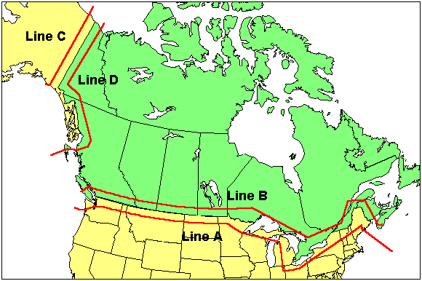
FCC Line A

Slide 151
E1F04 Which of the following geographic descriptions approximately describes "Line A"?
A. A line roughly parallel to and south of the U.S.-Canadian border
B. A line roughly parallel to and west of the U.S. Atlantic coastline
C. A line roughly parallel to and north of the U.S.-Mexican border and Gulf coastline
D. A line roughly parallel to and east of the U.S. Pacific coastline

Slide 152
E1F04 Which of the following geographic descriptions approximately describes "Line A"?
A. A line roughly parallel to and south of the U.S.-Canadian border
B. A line roughly parallel to and west of the U.S. Atlantic coastline
C. A line roughly parallel to and north of the U.S.-Mexican border and Gulf coastline
D. A line roughly parallel to and east of the U.S. Pacific coastline

Slide 153
E1F05 Amateur stations may not transmit in which of the following frequency segments if they are located in the contiguous 48 states and north of Line A?
A. 440 MHz - 450 MHz
B. 53 MHz - 54 MHz
C. 222 MHz - 223 MHz
D. 420 MHz- 430 MHz

Slide 154
E1F05 Amateur stations may not transmit in which of the following frequency segments if they are located in the contiguous 48 states and north of Line A?
A. 440 MHz - 450 MHz
B. 53 MHz - 54 MHz
C. 222 MHz - 223 MHz
D. 420 MHz - 430 MHz

Slide 155
E1F06 Under what circumstances might the FCC issue a Special Temporary Authority (STA) to an amateur station?
A. To provide for experimental amateur communications
B. To allow regular operation on Land Mobile channels
C. To provide additional spectrum for personal use
D. To provide temporary operation while awaiting normal licensing

Slide 156
E1F06 Under what circumstances might the FCC issue a Special Temporary Authority (STA) to an amateur station?
A. To provide for experimental amateur communications
B. To allow regular operation on Land Mobile channels
C. To provide additional spectrum for personal use
D. To provide temporary operation while awaiting normal licensing

Slide 157
E1F07 When may an amateur station send a message to a business?
A. When the total money involved does not exceed $25
B. When the control operator is employed by the FCC or another government agency
C. When transmitting international third-party communications
D. When neither the amateur nor his or her employer has a pecuniary interest in the communications

Slide 158
E1F07 When may an amateur station send a message to a business?
A. When the total money involved does not exceed $25
B. When the control operator is employed by the FCC or another government agency
C. When transmitting international third-party communications
D. When neither the amateur nor his or her employer has a pecuniary interest in the communications

Slide 159
E1F08 Which of the following types of amateur station communications are prohibited?
A. Communications transmitted for hire or material compensation, except as otherwise provided in the rules
B. Communications that have a political content, except as allowed by the Fairness Doctrine
C. Communications that have a religious content
D. Communications in a language other than English

Slide 160
E1F08 Which of the following types of amateur station communications are prohibited?
A. Communications transmitted for hire or material compensation, except as otherwise provided in the rules
B. Communications that have a political content, except as allowed by the Fairness Doctrine
C. Communications that have a religious content
D. Communications in a language other than English

Slide 161
E1F09 Which of the following conditions apply when transmitting spread spectrum emission?
A. A station transmitting SS emission must not cause harmful interference to other stations employing other authorized emissions
B. The transmitting station must be in an area regulated by the FCC or in a country that permits SS emissions
C. The transmission must not be used to obscure the meaning of any communication
D. All of these choices are correct

Slide 162
E1F09 Which of the following conditions apply when transmitting spread spectrum emission?
A. A station transmitting SS emission must not cause harmful interference to other stations employing other authorized emissions
B. The transmitting station must be in an area regulated by the FCC or in a country that permits SS emissions
C. The transmission must not be used to obscure the meaning of any communication
D. All of these choices are correct

Slide 163
E1F10 What is the maximum permitted transmitter peak envelope power for an amateur station transmitting spread spectrum communications?
A. 1 W
B. 1.5 W
C. 10 W
D. 1.5 kW

Slide 164
E1F10 What is the maximum permitted transmitter peak envelope power for an amateur station transmitting spread spectrum communications?
A. 1 W
B. 1.5 W
C. 10 W
D. 1.5 kW

Slide 165
E1F11 Which of the following best describes one of the standards that must be met by an external RF power amplifier if it is to qualify for a grant of FCC certification?
A. It must produce full legal output when driven by not more than 5 watts of mean RF input power
B. It must be capable of external RF switching between its input and output networks
C. It must exhibit a gain of 0 dB or less over its full output range
D. It must satisfy the FCC's spurious emission standards when operated at the lesser of 1500 watts or its full output power

Slide 166
E1F11 Which of the following best describes one of the standards that must be met by an external RF power amplifier if it is to qualify for a grant of FCC certification?
A. It must produce full legal output when driven by not more than 5 watts of mean RF input power
B. It must be capable of external RF switching between its input and output networks
C. It must exhibit a gain of 0 dB or less over its full output range
D. It must satisfy the FCC's spurious emission standards when operated at the lesser of 1500 watts or its full output power

Slide 167
E1F12 Who may be the control operator of an auxiliary station?
A. Any licensed amateur operator
B. Only Technician, General, Advanced or Amateur Extra Class operators
C. Only General, Advanced or Amateur Extra Class operators
D. Only Amateur Extra Class operators

Slide 168
E1F12 Who may be the control operator of an auxiliary station?
A. Any licensed amateur operator
B. Only Technician, General, Advanced or Amateur Extra Class operators
C. Only General, Advanced or Amateur Extra Class operators
D. Only Amateur Extra Class operators

Slide 169
End of
SUBELEMENT E1
COMMISSION’S RULES

