Slide 1
SUBELEMENT E2
OPERATING PROCEDURES
[5 Exam Questions - 5 Groups]
Notes:
Extra Question Pool 2016. The Western Washington Ham Training Team makes these slides available to teach Amateur Technician Radio Licensing Classes. Daniel Stevens KL7WM, Training Coordinator, Howard Swartz, W7HS, Slide master, Dustin Lomax, KF7FK, Leading Instructor, LW Abel, K7LWA, Enthusiasm Leader.

Slide 2
E2A Amateur radio in space: amateur satellites; orbital mechanics; frequencies and modes; satellite hardware; satellite operations; experimental telemetry applications
E2B Television practices: fast scan television standards and techniques; slow scan television standards and techniques
E2C Operating methods: contest and DX operating; spread-spectrum transmissions; selecting an operating frequency
E2D Operating methods: VHF and UHF digital modes; APRS
E2E Operating methods: operating HF digital modes; error correction

Slide 3
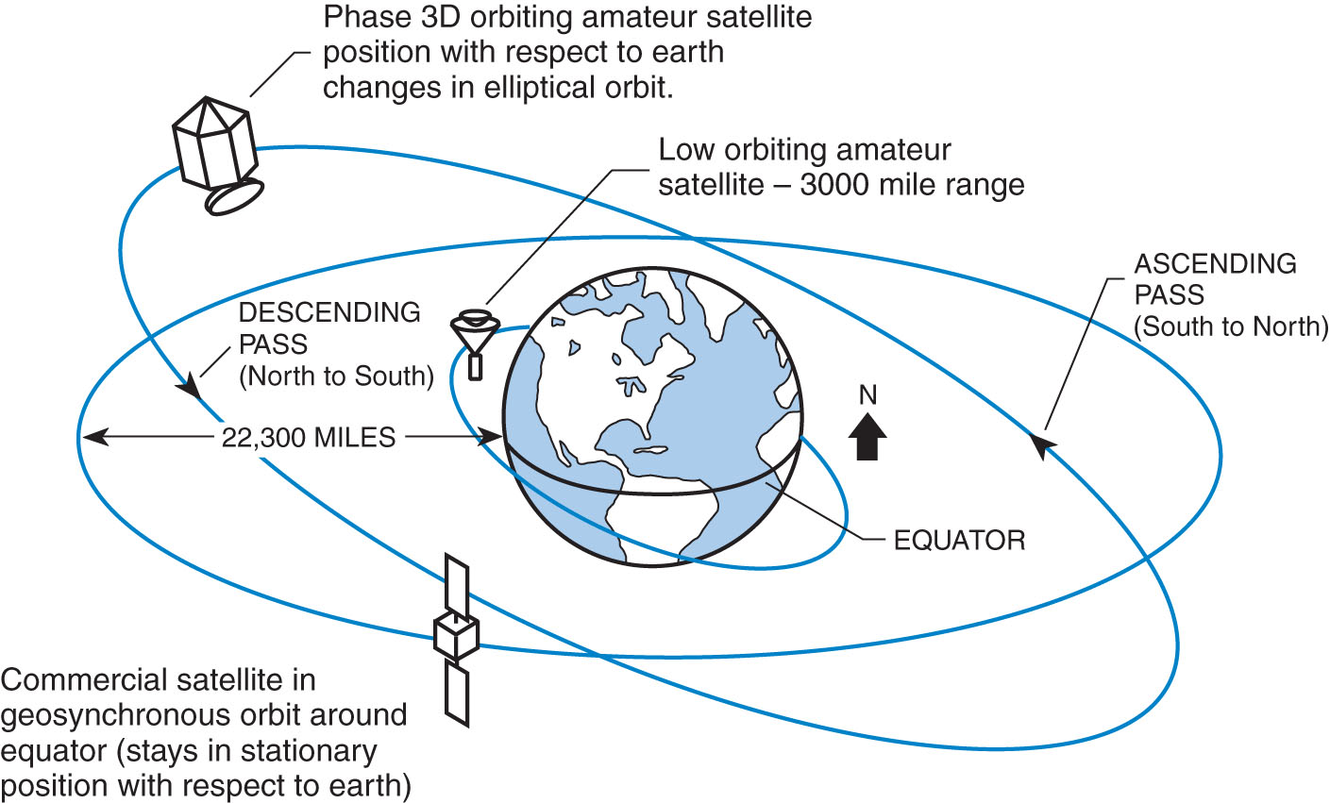
Satellite Orbit

Slide 4
E2A01 What is the direction of an ascending pass for an amateur satellite?
A. From west to east
B. From east to west
C. From south to north
D. From north to south

Slide 5
E2A01 What is the direction of an ascending pass for an amateur satellite?
A. From west to east
B. From east to west
C. From south to north
D. From north to south

Slide 6
E2A02 What is the direction of a descending pass for an amateur satellite?
A. From north to south
B. From west to east
C. From east to west
D. From south to north

Slide 7
E2A02 What is the direction of a descending pass for an amateur satellite?
A. From north to south
B. From west to east
C. From east to west
D. From south to north

Slide 8
E2A03 What is the orbital period of an Earth satellite?
A. The point of maximum height of a satellite's orbit
B. The point of minimum height of a satellite's orbit
C. The time it takes for a satellite to complete one revolution around the Earth
D. The time it takes for a satellite to travel from perigee to apogee

Slide 9
E2A03 What is the orbital period of an Earth satellite?
A. The point of maximum height of a satellite's orbit
B. The point of minimum height of a satellite's orbit
C. The time it takes for a satellite to complete one revolution around the Earth
D. The time it takes for a satellite to travel from perigee to apogee

Slide 10
Satellite Mode Chart
Freq. Bands Frequency Range Modes
High Frequency 21 – 30 MHz Mode H
VHF 144 – 146 MHz Mode V
UHF 435 – 438 MHz Mode U
L band 1.26-1.27 GHz Mode L
S band 2.4-2.45 GHz Mode S
C band 5.8 GHz Mode C
X band 10.4 GHz Mode X
K band 24 GHz Mode K

Slide 11
E2A04 What is meant by the term mode as applied to an amateur radio satellite?
A. The type of signals that can be relayed through the satellite
B. The satellite's uplink and downlink frequency bands
C. The satellite's orientation with respect to the Earth
D. Whether the satellite is in a polar or equatorial orbit

Slide 12
E2A04 What is meant by the term mode as applied to an amateur radio satellite?
A. The type of signals that can be relayed through the satellite
B. The satellite's uplink and downlink frequency bands
C. The satellite's orientation with respect to the Earth
D. Whether the satellite is in a polar or equatorial orbit

Slide 13
E2A05 What do the letters in a satellite's mode designator specify?
A. Power limits for uplink and downlink transmissions
B. The location of the ground control station
C. The polarization of uplink and downlink signals
D. The uplink and downlink frequency ranges

Slide 14
E2A05 What do the letters in a satellite's mode designator specify?
A. Power limits for uplink and downlink transmissions
B. The location of the ground control station
C. The polarization of uplink and downlink signals
D. The uplink and downlink frequency ranges
The following table summarizes the mode designators:
Mode | Satellite Receiving | Satellite Trans
V/H | VHF | HF
U/V | UHF | VHF
V/U | VHF | UHF
L/U | L-Band | UHF

Slide 15
E2A06 On what band would a satellite receive signals if it were operating in mode U/V?
A. 435 MHz-438 MHz
B. 144 MHz-146 MHz
C. 50.0 MHz-50.2 MHz
D. 29.5 MHz - 29.7 MHz

Slide 16
E2A06 On what band would a satellite receive signals if it were operating in mode U/V?
A. 435 MHz-438 MHz
B. 144 MHz-146 MHz
C. 50.0 MHz-50.2 MHz
D. 29.5 MHz - 29.7 MHz
Mode | Satellite Receiving | Satellite Trans
V/H | VHF | HF
U/V | UHF | VHF
V/U | VHF | UHF
L/U | L-Band | UHF

Slide 17
E2A07 Which of the following types of signals can be relayed through a linear transponder?
A. FM and CW
B. SSB and SSTV
C. PSK and Packet
D. All of these choices are correct

Slide 18
E2A07 Which of the following types of signals can be relayed through a linear transponder?
A. FM and CW
B. SSB and SSTV
C. PSK and Packet
D. All of these choices are correct

Slide 19
E2A08 Why should effective radiated power to a satellite which uses a linear transponder be limited?
A. To prevent creating errors in the satellite telemetry
B. To avoid reducing the downlink power to all other users
C. To prevent the satellite from emitting out-of-band signals
D. To avoid interfering with terrestrial QSOs

Slide 20
E2A08 Why should effective radiated power to a satellite which uses a linear transponder be limited?
A. To prevent creating errors in the satellite telemetry
B. To avoid reducing the downlink power to all other users
C. To prevent the satellite from emitting out-of-band signals
D. To avoid interfering with terrestrial QSOs

Slide 21
E2A09 What do the terms L band and S band specify with regard to satellite communications?
A. The 23 centimeter and 13 centimeter bands
B. The 2 meter and 70 centimeter bands
C. FM and Digital Store-and-Forward systems
D. Which sideband to use

Slide 22
E2A09 What do the terms L band and S band specify with regard to satellite communications?
A. The 23 centimeter and 13 centimeter bands
B. The 2 meter and 70 centimeter bands
C. FM and Digital Store-and-Forward systems
D. Which sideband to use

Slide 23
E2A10 Why may the received signal from an amateur satellite exhibit a rapidly repeating fading effect?
A. Because the satellite is spinning
B. Because of ionospheric absorption
C. Because of the satellite's low orbital altitude
D. Because of the Doppler Effect

Slide 24
E2A10 Why may the received signal from an amateur satellite exhibit a rapidly repeating fading effect?
A. Because the satellite is spinning
B. Because of ionospheric absorption
C. Because of the satellite's low orbital altitude
D. Because of the Doppler Effect

Slide 25
E2A11 What type of antenna can be used to minimize the effects of spin modulation and Faraday rotation?
A. A linearly polarized antenna
B. A circularly polarized antenna
C. An isotropic antenna
D. A log-periodic dipole array

Slide 26
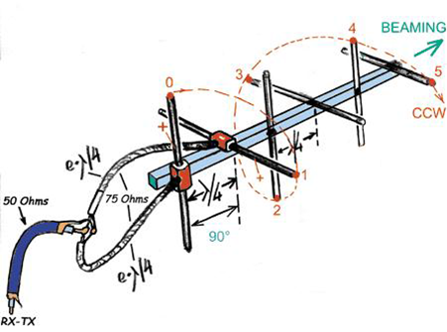
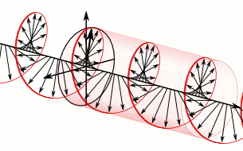
E2A11 What type of antenna can be used to minimize the effects of spin modulation and Faraday rotation?
A. A linearly polarized antenna
B. A circularly polarized antenna
C. An isotropic antenna
D. A log-periodic dipole array

Slide 27
E2A12 What is one way to predict the location of a satellite at a given time?
A. By means of the Doppler data for the specified satellite
B. By subtracting the mean anomaly from the orbital inclination
C. By adding the mean anomaly to the orbital inclination
D. By calculations using the Keplerian elements for the specified satellite

Slide 28
E2A12 What is one way to predict the location of a satellite at a given time?
A. By means of the Doppler data for the specified satellite
B. By subtracting the mean anomaly from the orbital inclination
C. By adding the mean anomaly to the orbital inclination
D. By calculations using the Keplerian elements for the specified satellite

Slide 29
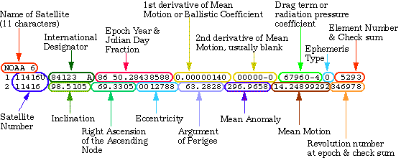
Example Keplerian Data from monthly ARRL report
Satellite AO-07
1 07530U 74089B 12030.76241720 -.00000027 +00000-0 +10000-3 0 02940
2 07530 101.3983 033.3460 0011821 193.4266 166.6489 12.53587393702707
Satellite AO-16
1 20439U 90005D 12030.88295038 +.00000148 +00000-0 +70839-4 0 04002
2 20439 098.4139 338.2452 0010117 206.4703 153.5962 14.32012962150202
Satellite AO-27
1 22825U 93061C 12030.93151253 +.00000113 +00000-0 +61456-4 0 00344
2 22825 098.5601 336.0086 0008243 332.3578 027.7165 14.29425966956729

Slide 30
E2A13 What type of satellite appears to stay in one position in the sky?
A. HEO
B. Geostationary
C. Geomagnetic
D. LEO

Slide 31
E2A13 What type of satellite appears to stay in one position in the sky?
A. HEO
B. Geostationary
C. Geomagnetic
D. LEO

Slide 32
E2A14 What technology is used to track, in real time, balloons carrying amateur radio transmitters?
A. Radar
B. Bandwidth compressed LORAN
C. APRS
D. Doppler shift of beacon signals

Slide 33
E2A14 What technology is used to track, in real time, balloons carrying amateur radio transmitters?
A. Radar
B. Bandwidth compressed LORAN
C. APRS
D. Doppler shift of beacon signals

Slide 34
E2B Television practices
fast scan television standards and techniques; slow scan television standards and techniques

Slide 35
E2B01 How many times per second is a new frame transmitted in a fast-scan (NTSC) television system?
A. 30
B. 60
C. 90
D. 120

Slide 36
E2B01 How many times per second is a new frame transmitted in a fast-scan (NTSC) television system?
A. 30
B. 60
C. 90
D. 120

Slide 37
E2B02 How many horizontal lines make up a fast-scan (NTSC) television frame?
A. 30
B. 60
C. 525
D. 1080

Slide 38
E2B02 How many horizontal lines make up a fast-scan (NTSC) television frame?
A. 30
B. 60
C. 525
D. 1080

Slide 39
E2B03 How is an interlaced scanning pattern generated in a fast-scan (NTSC) television system?
A. By scanning two fields simultaneously
B. By scanning each field from bottom to top
C. By scanning lines from left to right in one field and right to left in the next
D. By scanning odd numbered lines in one field and even numbered lines in the next

Slide 40
E2B03 How is an interlaced scanning pattern generated in a fast-scan (NTSC) television system?
A. By scanning two fields simultaneously
B. By scanning each field from bottom to top
C. By scanning lines from left to right in one field and right to left in the next
D. By scanning odd numbered lines in one field and even numbered lines in the next

Slide 41
E2B04 What is blanking in a video signal?
A. Synchronization of the horizontal and vertical sync pulses
B. Turning off the scanning beam while it is traveling from right to left or from bottom to top
C. Turning off the scanning beam at the conclusion of a transmission
D. Transmitting a black and white test pattern

Slide 42
E2B04 What is blanking in a video signal?
A. Synchronization of the horizontal and vertical sync pulses
B. Turning off the scanning beam while it is traveling from right to left or from bottom to top
C. Turning off the scanning beam at the conclusion of a transmission
D. Transmitting a black and white test pattern

Slide 43
E2B05 Which of the following is an advantage of using vestigial sideband for standard fast- scan TV transmissions?
A. The vestigial sideband carries the audio information
B. The vestigial sideband contains chroma information
C. Vestigial sideband reduces bandwidth while allowing for simple video detector circuitry
D. Vestigial sideband provides high frequency emphasis to sharpen the picture

Slide 44
E2B05 Which of the following is an advantage of using vestigial sideband for standard fast- scan TV transmissions?
A. The vestigial sideband carries the audio information
B. The vestigial sideband contains chroma information
C. Vestigial sideband reduces bandwidth while allowing for simple video detector circuitry
D. Vestigial sideband provides high frequency emphasis to sharpen the picture

Slide 45
E2B06 What is vestigial sideband modulation?
A. Amplitude modulation in which one complete sideband and a portion of the other are transmitted
B. A type of modulation in which one sideband is inverted
C. Narrow-band FM modulation achieved by filtering one sideband from the audio before frequency modulating the carrier
D. Spread spectrum modulation achieved by applying FM modulation following single sideband amplitude modulation

Slide 46
E2B06 What is vestigial sideband modulation?
A. Amplitude modulation in which one complete sideband and a portion of the other are transmitted
B. A type of modulation in which one sideband is inverted
C. Narrow-band FM tmodulation achieved by filtering one sideband from the audio before frequency modulating the carrier
D. Spread spectrum modulation achieved by applying FM modulation following single sideband amplitude modulation

Slide 47
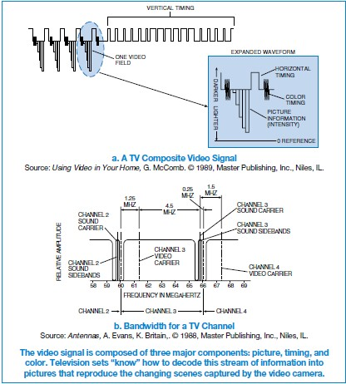
Vestigal Sideband Modulation

Slide 48
E2B07 What is the name of the signal component that carries color information in NTSC video?
A. Luminance
B. Chroma
C. Hue
D. Spectral Intensity

Slide 49
E2B07 What is the name of the signal component that carries color information in NTSC video?
A. Luminance
B. Chroma
C. Hue
D. Spectral Intensity

Slide 50
E2B08 Which of the following is a common method of transmitting accompanying audio with amateur fast-scan television?
A. Frequency-modulated sub-carrier
B. A separate VHF or UHF audio link
C. Frequency modulation of the video carrier
D. All of these choices are correct

Slide 51
E2B08 Which of the following is a common method of transmitting accompanying audio with amateur fast-scan television?
A. Frequency-modulated sub-carrier
B. A separate VHF or UHF audio link
C. Frequency modulation of the video carrier
D. All of these choices are correct

Slide 52
E2B09 What hardware, other than a receiver with SSB capability and a suitable computer, is needed to decode SSTV using Digital Radio Mondiale (DRM)?
A. A special IF converter
B. A special front end limiter
C. A special notch filter to remove synchronization pulses
D. No other hardware is needed

Slide 53
E2B09 What hardware, other than a receiver with SSB capability and a suitable computer, is needed to decode SSTV using Digital Radio Mondiale (DRM)?
A. A special IF converter
B. A special front end limiter
C. A special notch filter to remove synchronization pulses
D. No other hardware is needed

Slide 54
E2B10 Which of the following is an acceptable bandwidth for Digital Radio Mondiale (DRM) based voice or SSTV digital transmissions made on the HF amateur bands?
A. 3 KHz
B. 10 KHz
C. 15 KHz
D. 20 KHz

Slide 55
E2B10 Which of the following is an acceptable bandwidth for Digital Radio Mondiale (DRM) based voice or SSTV digital transmissions made on the HF amateur bands?
A. 3 KHz
B. 10 KHz
C. 15 KHz
D. 20 KHz

Slide 56
E2B11 What is the function of the Vertical Interval Signaling (VIS) code sent as part of an SSTV transmission?
A. To lock the color burst oscillator in color SSTV images
B. To identify the SSTV mode being used
C. To provide vertical synchronization
D. To identify the call sign of the station transmitting

Slide 57
E2B11 What is the function of the Vertical Interval Signaling (VIS) code sent as part of an SSTV transmission?
A. To lock the color burst oscillator in color SSTV images
B. To identify the SSTV mode being used
C. To provide vertical synchronization
D. To identify the call sign of the station transmitting

Slide 58
E2B12 How are analog SSTV images typically transmitted on the HF bands?
A. Video is converted to equivalent Baudot representation
B. Video is converted to equivalent ASCII representation
C. Varying tone frequencies representing the video are transmitted using PSK
D. Varying tone frequencies representing the video are transmitted using single sideband

Slide 59
E2B12 How are analog SSTV images typically transmitted on the HF bands?
A. Video is converted to equivalent Baudot representation
B. Video is converted to equivalent ASCII representation
C. Varying tone frequencies representing the video are transmitted using PSK
D. Varying tone frequencies representing the video are transmitted using single sideband

Slide 60
E2B13 How many lines are commonly used in each frame of an amateur slow-scan color television picture?
A. 30 or 60
B. 60 or 100
C. 128 or 256
D. 180 or 360

Slide 61
E2B13 How many lines are commonly used in each frame of an amateur slow-scan color television picture?
A. 30 or 60
B. 60 or 100
C. 128 or 256
D. 180 or 360

Slide 62
E2B14 What aspect of an amateur slow-scan television signal encodes the brightness of the picture?
A. Tone frequency
B. Tone amplitude
C. Sync amplitude
D. Sync frequency

Slide 63
E2B14 What aspect of an amateur slow-scan television signal encodes the brightness of the picture?
A. Tone frequency
B. Tone amplitude
C. Sync amplitude
D. Sync frequency

Slide 64
E2B15 What signals SSTV receiving equipment to begin a new picture line?
A. Specific tone frequencies
B. Elapsed time
C. Specific tone amplitudes
D. A two-tone signal

Slide 65
E2B15 What signals SSTV receiving equipment to begin a new picture line?
A. Specific tone frequencies
B. Elapsed time
C. Specific tone amplitudes
D. A two-tone signal

Slide 66
E2B16 Which is a video standard used by North American Fast Scan ATV stations?
A. PAL
B. DRM
C. Scottie
D. NTSC

Slide 67
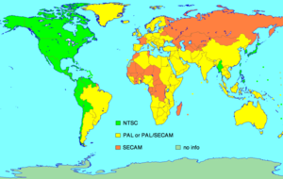
National Television Systems Committee
(NTSC)
Television Standards
  NTSC – Canada, US, Japan, South Korea
  PAL
  SECAM

Slide 68
E2B16 Which is a video standard used by North American Fast Scan ATV stations?
A. PAL
B. DRM
C. Scottie
D. NTSC

Slide 69
E2B17 What is the approximate bandwidth of a slow-scan TV signal?
A. 600 Hz
B. 3 kHz
C. 2 MHz
D. 6 MHz

Slide 70
E2B17 What is the approximate bandwidth of a slow-scan TV signal?
A. 600 Hz
B. 3 kHz
C. 2 MHz
D. 6 MHz

Slide 71
E2B18 On which of the following frequencies is one likely to find FM ATV transmissions?
A. 14.230 MHz
B. 29.6 MHz
C. 52.525 MHz
D. 1255 MHz

Slide 72
E2B18 On which of the following frequencies is one likely to find FM ATV transmissions?
A. 14.230 MHz
B. 29.6 MHz
C. 52.525 MHz
D. 1255 MHz

Slide 73
E2B19 What special operating frequency restrictions are imposed on slow scan TV transmissions?
A. None; they are allowed on all amateur frequencies
B. They are restricted to 7.245 MHz, 14.245 MHz, 21.345, MHz, and 28.945 MHz
C. They are restricted to phone band segments and their bandwidth can be no greater than that of a voice signal of the same modulation type
D. They are not permitted above 54 MHz

Slide 74
E2B19 What special operating frequency restrictions are imposed on slow scan TV transmissions?
A. None; they are allowed on all amateur frequencies
B. They are restricted to 7.245 MHz, 14.245 MHz, 21.345, MHz, and 28.945 MHz
C. They are restricted to phone band segments and their bandwidth can be no greater than that of a voice signal of the same modulation type
D. They are not permitted above 54 MHz

Slide 75
E2C Operating methods
contest and DX operating; remote transmissions; Cabrillo format; QSLing; RF network connected systems

Slide 76
E2C01 Which of the following is true about contest operating?
A. Operators are permitted to make contacts even if they do not submit a log
B. Interference to other amateurs is unavoidable and therefore acceptable
C. It is mandatory to transmit the call sign of the station being worked as part of every transmission to that station
D. Every contest requires a signal report in the exchange

Slide 77
E2C01 Which of the following is true about contest operating?
A. Operators are permitted to make contacts even if they do not submit a log
B. Interference to other amateurs is unavoidable and therefore acceptable
C. It is mandatory to transmit the call sign of the station being worked as part of every transmission to that station
D. Every contest requires a signal report in the exchange

Slide 78
E2C02 Which of the following best describes the term self-spotting in regards to HF contest operating?
A. The generally prohibited practice of posting one’s own call sign and frequency on a spotting network
B. The acceptable practice of manually posting the call signs of stations on a spotting network
C. A manual technique for rapidly zero beating or tuning to a station’s frequency before calling that station
D. An automatic method for rapidly zero beating or tuning to a station’s frequency before calling that station

Slide 79
E2C02 Which of the following best describes the term self-spotting in regards to HF contest operating?
A. The generally prohibited practice of posting one’s own call sign and frequency on a spotting network
B. The acceptable practice of manually posting the call signs of stations on a spotting network
C. A manual technique for rapidly zero beating or tuning to a station’s frequency before calling that station
D. An automatic method for rapidly zero beating or tuning to a station’s frequency before calling that station

Slide 80
E2C03 From which of the following bands is amateur radio contesting generally excluded?
A. 30 m
B. 6 m
C. 2 m
D. 33 cm

Slide 81
E2C03 From which of the following bands is amateur radio contesting generally excluded?
A. 30 m
B. 6 m
C. 2 m
D. 33 cm

Slide 82
E2C04 What type of transmission is most often used for a ham radio mesh network?
A. Spread spectrum in the 2.4 GHz band
B. Multiple Frequency Shift Keying in the 10 GHz band
C. Store and forward on the 440 MHz band
D. Frequency division multiplex in the 24 GHz band

Slide 83
E2C04 What type of transmission is most often used for a ham radio mesh network?
A. Spread spectrum in the 2.4 GHz band
B. Multiple Frequency Shift Keying in the 10 GHz band
C. Store and forward on the 440 MHz band
D. Frequency division multiplex in the 24 GHz band

Slide 84
E2C05 What is the function of a DX QSL Manager?
A. To allocate frequencies for DXpeditions
B. To handle the receiving and sending of confirmation cards for a DX station
C. To run a net to allow many stations to contact a rare DX station
D. To relay calls to and from a DX station

Slide 85
E2C05 What is the function of a DX QSL Manager?
A. To allocate frequencies for DXpeditions
B. To handle the receiving and sending of confirmation cards for a DX station
C. To run a net to allow many stations to contact a rare DX station
D. To relay calls to and from a DX station

Slide 86
E2C06 During a VHF/UHF contest, in which band segment would you expect to find the highest level of activity?
A. At the top of each band, usually in a segment reserved for contests
B. In the middle of each band, usually on the national calling frequency
C. In the weak signal segment of the band, with most of the activity near the calling frequency
D. In the middle of the band, usually 25 kHz above the national calling frequency

Slide 87
E2C06 During a VHF/UHF contest, in which band segment would you expect to find the highest level of activity?
A. At the top of each band, usually in a segment reserved for contests
B. In the middle of each band, usually on the national calling frequency
C. In the weak signal segment of the band, with most of the activity near the calling frequency
D. In the middle of the band, usually 25 kHz above the national calling frequency

Slide 88
CW and weak signal:
144.000 to 144.100
222.000 to 223.400
432.000 to 432.125
902.000 to 902.400
National calling frequencies:
144.200 SSB and 146.52 FM
222.100 SSB and 223.500 FM
432.100 SSB and 446.000 FM
902.100 SSB and 1296.100 SSB

Slide 89
E2C07 What is the Cabrillo format?
A. A standard for submission of electronic contest logs
B. A method of exchanging information during a contest QSO
C. The most common set of contest rules
D. The rules of order for meetings between contest sponsors

Slide 90
E2C07 What is the Cabrillo format?
A. A standard for submission of electronic contest logs
B. A method of exchanging information during a contest QSO
C. The most common set of contest rules
D. The rules of order for meetings between contest sponsors

Slide 91
E2C08 Which of the following contacts may be confirmed through the U.S. QSL bureau system?
A. Special event contacts between stations in the U.S.
B. Contacts between a U.S. station and a non-U.S. station
C. Repeater contacts between U.S. club members
D. Contacts using tactical call signs

Slide 92
E2C08 Which of the following contacts may be confirmed through the U.S. QSL bureau system?
A. Special event contacts between stations in the U.S.
B. Contacts between a U.S. station and a non-U.S. station
C. Repeater contacts between U.S. club members
D. Contacts using tactical call signs

Slide 93
E2C09 What type of equipment is commonly used to implement a ham radio mesh network?
A. A 2 meter VHF transceiver with a 1200 baud modem
B. An optical cable connection between the USB ports of 2 separate computers
C. A standard wireless router running custom software
D. A 440 MHz transceiver with a 9600 baud modem

Slide 94
E2C09 What type of equipment is commonly used to implement a ham radio mesh network?
A. A 2 meter VHF transceiver with a 1200 baud modem
B. An optical cable connection between the USB ports of 2 separate computers
C. A standard wireless router running custom software
D. A 440 MHz transceiver with a 9600 baud modem

Slide 95
E2C10 Why might a DX station state that they are listening on another frequency?
A. Because the DX station may be transmitting on a frequency that is prohibited to some responding stations
B. To separate the calling stations from the DX station
C. To improve operating efficiency by reducing interference
D. All of these choices are correct

Slide 96
E2C10 Why might a DX station state that they are listening on another frequency?
A. Because the DX station may be transmitting on a frequency that is prohibited to some responding stations
B. To separate the calling stations from the DX station
C. To improve operating efficiency by reducing interference
D. All of these choices are correct

Slide 97
E2C11 How should you generally identify
A. Send your full call sign once or twice
B. Send only the last two letters of your call sign until you make contact
C. Send your full call sign and grid square
D. Send the call sign of the DX station three times, the words “this is” then your call sign three times

Slide 98
E2C11 How should you generally identify
A. Send your full call sign once or twice
B. Send only the last two letters of your call sign until you make contact
C. Send your full call sign and grid square
D. Send the call sign of the DX station three times, the words “this is” then your call sign three times

Slide 99
E2C12 What might help to restore contact when DX signals become too weak to copy across an entire HF band a few hours after sunset?
A. Switch to a higher frequency HF band
B. Switch to a lower frequency HF band
C. Wait 90 minutes or so for the signal degradation to pass
D. Wait 24 hours before attempting another communication on the band

Slide 100
E2C12 What might help to restore contact when DX signals become too weak to copy across an entire HF band a few hours after sunset?
A. Switch to a higher frequency HF band
B. Switch to a lower frequency HF band
C. Wait 90 minutes or so for the signal degradation to pass
D. Wait 24 hours before attempting another communication on the band

Slide 101
E2C13 What indicator is required to be used by U.S.-licensed operators when operating a station via remote control where the transmitter is located in the U.S.?
A. / followed by the USPS two letter abbreviation for the state in which the remote station is located
B. /R# where # is the district of the remote station
C. The ARRL section of the remote station
D. No additional indicator is required

Slide 102
E2C13 What indicator is required to be used by U.S.-licensed operators when operating a station via remote control where the transmitter is located in the U.S.?
A. / followed by the USPS two letter abbreviation for the state in which the remote station is located
B. /R# where # is the district of the remote station
C. The ARRL section of the remote station
D. No additional indicator is required

Slide 103
E2D Operating methods
VHF and UHF digital modes and procedures; APRS; EME procdures, meteor scatter procedures

Slide 104
E2D01 Which of the following digital modes is especially designed for use for meteor scatter signals?
A. WSPR
B. FSK441
C. Hellschreiber
D. APRS

Slide 105
E2D01 Which of the following digital modes is especially designed for use for meteor scatter signals?
A. WSPR
B. FSK441
C. Hellschreiber
D. APRS

Slide 106
E2D02 Which of the following is a good technique for making meteor scatter contacts?
A. 15 second timed transmission sequences with stations alternating based on location
B. Use of high speed CW or digital modes
C. Short transmission with rapidly repeated call signs and signal reports
D. All of these choices are correct

Slide 107
E2D02 Which of the following is a good technique for making meteor scatter contacts?
A. 15 second timed transmission sequences with stations alternating based on location
B. Use of high speed CW or digital modes
C. Short transmission with rapidly repeated call signs and signal reports
D. All of these choices are correct
When attempting an EME contact on 432 MHz two-and-one-half minute time sequences are used, where one station
transmits for a full 2.5 minutes and then receives for the following 2.5 minutes.

Slide 108
E2D03 Which of the following digital modes is especially useful for EME communications?
A. FSK441
B. PACTOR III
C. Olivia
D. JT65

Slide 109
E2D03 Which of the following digital modes is especially useful for EME communications?
A. FSK441
B. PACTOR III
C. Olivia
D. JT65

Slide 110
E2D04 What is the purpose of digital store-and-forward functions on an Amateur Radio satellite?
A. To upload operational software for the transponder
B. To delay download of telemetry between satellites
C. To store digital messages in the satellite for later download by other stations
D. To relay messages between satellites

Slide 111
E2D04 What is the purpose of digital store-and-forward functions on an Amateur Radio satellite?
A. To upload operational software for the transponder
B. To delay download of telemetry between satellites
C. To store digital messages in the satellite for later download by other stations
D. To relay messages between satellites

Slide 112
E2D05 Which of the following techniques is normally used by low Earth orbiting digital satellites to relay messages around the world?
A. Digipeating
B. Store-and-forward
C. Multi-satellite relaying
D. Node hopping

Slide 113
E2D05 Which of the following techniques is normally used by low Earth orbiting digital satellites to relay messages around the world?
A. Digipeating
B. Store-and-forward
C. Multi-satellite relaying
D. Node hopping

Slide 114
E2D06 Which of the following describes a method of establishing EME contacts?
A. Time synchronous transmissions alternately from each station
B. Storing and forwarding digital messages
C. Judging optimum transmission times by monitoring beacons reflected from the Moon
D. High speed CW identification to avoid fading

Slide 115
E2D06 Which of the following describes a method of establishing EME contacts?
A. Time synchronous transmissions alternately from each station
B. Storing and forwarding digital messages
C. Judging optimum transmission times by monitoring beacons reflected from the Moon
D. High speed CW identification to avoid fading

Slide 116
E2D07 What digital protocol is used by APRS?
A. PACTOR
B. 802.11
C. AX.25
D. AMTOR

Slide 117
E2D07 What digital protocol is used by APRS?
A. PACTOR
B. 802.11
C. AX.25
D. AMTOR

Slide 118
E2D08 What type of packet frame is used to transmit APRS beacon data?
A. Unnumbered Information
B. Disconnect
C. Acknowledgement
D. Connect

Slide 119
E2D08 What type of packet frame is used to transmit APRS beacon data?
A. Unnumbered Information
B. Disconnect
C. Acknowledgement
D. Connect

Slide 120
E2D09 Which of these digital modes has the fastest data throughput under clear communication conditions?
A. AMTOR
B. 170 Hz shift, 45 baud RTTY
C. PSK31
D. 300 baud packet

Slide 121
E2D09 Which of these digital modes has the fastest data throughput under clear communication conditions?
A. AMTOR
B. 170 Hz shift, 45 baud RTTY
C. PSK31
D. 300 baud packet

Slide 122
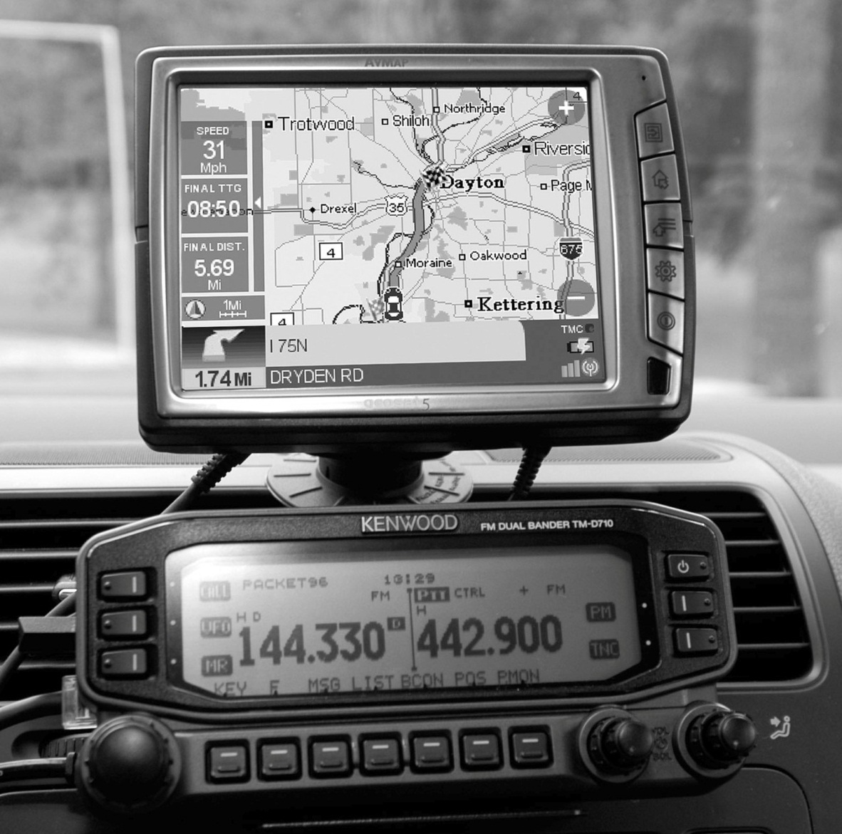
APRS Mobile Setup
Kenwood dual bander plugged into the Avmap G5 GPS position plotter

Slide 123
E2D10 How can an APRS station be used to help support a public service communications activity?
A. An APRS station with an emergency medical technician can automatically transmit medical data to the nearest hospital
B. APRS stations with General Personnel Scanners can automatically relay the participant numbers and time as they pass the check points
C. An APRS station with a GPS unit can automatically transmit information to show a mobile station's position during the event
D. All of these choices are correct

Slide 124
E2D10 How can an APRS station be used to help support a public service communications activity?
A. An APRS station with an emergency medical technician can automatically transmit medical data to the nearest hospital
B. APRS stations with General Personnel Scanners can automatically relay the participant numbers and time as they pass the check points
C. An APRS station with a GPS unit can automatically transmit information to show a mobile station's position during the event
D. All of these choices are correct

Slide 125
E2D11 Which of the following data are used by the APRS network communicate your location?
A. Polar coordinates
B. Time and frequency
C. Radio direction finding spectrum analysis
D. Latitude and longitude

Slide 126
E2D11 Which of the following data are used by the APRS network communicate your location?
A. Polar coordinates
B. Time and frequency
C. Radio direction finding LOPs
D. Latitude and longitude

Slide 127
E2D12 How does JT65 improve EME communications?
It can decode signals many dB below the noise floor using FEC
It controls the receiver to track Doppler shift
It supplies signals to guide the antenna to track the Moon
All of these choices are correct

Slide 128
E2D12 How does JT65 improve EME communications?
It can decode signals many dB below the noise floor using FEC
It controls the receiver to track Doppler shift
It supplies signals to guide the antenna to track the Moon
All of these choices are correct

Slide 129
E2D13 What type of modulation is used for JT65 contacts?
A. Multi-tone AFSK
B. PSK
C. RTTY
D. IEEE 802.11

Slide 130
E2D13 What type of modulation is used for JT65 contacts?
A. Multi-tone AFSK
B. PSK
C. RTTY
D. IEEE 802.11

Slide 131
E2D14 What is one advantage of using JT65 coding?
A. Uses only a 65 Hz bandwidth
B. The ability to decode signals which have a very low signal to noise ratio
C. Easily copied by ear if necessary
D. Permits fast-scan TV transmissions over narrow bandwidth

Slide 132
E2D14 What is one advantage of using JT65 coding?
A. Uses only a 65 Hz bandwidth
B. The ability to decode signals which have a very low signal to noise ratio
C. Easily copied by ear if necessary
D. Permits fast-scan TV transmissions over narrow bandwidth

Slide 133
E2E Operating methods
operating HF digital modes

Slide 134
E2E01 Which type of modulation is common for data emissions below 30 MHz?
A. DTMF tones modulating an FM signal
B. FSK
C. Pulse modulation
D. Spread spectrum

Slide 135
E2E01 Which type of modulation is common for data emissions below 30 MHz?
A. DTMF tones modulating an FM signal
B. FSK
C. Pulse modulation
D. Spread spectrum

Slide 136
E2E02 What do the letters FEC mean as they relate to digital operation?
A. Forward Error Correction
B. First Error Correction
C. Fatal Error Correction
D. Final Error Correction

Slide 137
E2E02 What do the letters FEC mean as they relate to digital operation?
A. Forward Error Correction
B. First Error Correction
C. Fatal Error Correction
D. Final Error Correction

Slide 138
E2E03 How is the timing of JT65 contacts organized?
A. By exchanging ACK/NAK packets
B. Stations take turns on alternate days
C. Alternating transmissions at 1 minute intervals
D. It depends on the lunar phase

Slide 139
E2E03 How is the timing of JT65 contacts organized?
A. By exchanging ACK/NAK packets
B. Stations take turns on alternate days
C. Alternating transmissions at 1 minute intervals
D. It depends on the lunar phase

Slide 140
E2E04 What is indicated when one of the ellipses in an FSAK crossed-ellipse display suddenly disappears?
A. Selective fading has occurred
B. One of the signal filters is saturated
C. The receiver has drifted 5 kHz from the desired receive frequency
D. The mark and space signal have been inverted

Slide 141
E2E04 What is indicated when one of the ellipses in an FSAK crossed-ellipse display suddenly disappears?
A. Selective fading has occurred
B. One of the signal filters is saturated
C. The receiver has drifted 5 kHz from the desired receive frequency
D. The mark and space signal have been inverted

Slide 142
E2E05 Which type of digital mode does not support keyboard-to-keyboard operation?
A. Winlink
B. RTTY
C. PSK31
D. MFSK

Slide 143
E2E05 Which type of digital mode does not support keyboard-to-keyboard operation?
A. Winlink
B. RTTY
C. PSK31
D. MFSK

Slide 144
E2E06 What is the most common data rate used for HF packet?
A. 48 baud
B. 110 baud
C. 300 baud
D. 1200 baud

Slide 145
E2E06 What is the most common data rate used for HF packet?
A. 48 baud
B. 110 baud
C. 300 baud
D. 1200 baud

Slide 146
E2E07 What is the typical bandwidth of a properly modulated MFSK16 signal?
A. 31 Hz
B. 316 Hz
C. 550 Hz
D. 2.16 kHz

Slide 147
E2E07 What is the typical bandwidth of a properly modulated MFSK16 signal?
A. 31 Hz
B. 316 Hz
C. 550 Hz
D. 2.16 kHz

Slide 148
E2E08 Which of the following HF digital modes can be used to transfer binary files?
A. Hellschreiber
B. PACTOR
C. RTTY
D. AMTOR

Slide 149
E2E08 Which of the following HF digital modes can be used to transfer binary files?
A. Hellschreiber
B. PACTOR
C. RTTY
D. AMTOR

Slide 150
E2E09 Which of the following HF digital modes uses variable-length coding for bandwidth efficiency?
A. RTTY
B. PACTOR
C. MT63
D. PSK31

Slide 151
E2E09 Which of the following HF digital modes uses variable-length coding for bandwidth efficiency?
A. RTTY
B. PACTOR
C. MT63
D. PSK31

Slide 152
E2E10 Which of these digital modes has the narrowest bandwidth?
A. MFSK16
B. 170 Hz shift, 45 baud RTTY
C. PSK31
D. 300-baud packet

Slide 153
E2E10 Which of these digital modes has the narrowest bandwidth?
A. MFSK16
B. 170 Hz shift, 45 baud RTTY
C. PSK31
D. 300-baud packet

Slide 154
E2E11 What is the difference between direct FSK and audio FSK?
A. Direct FSK applies the data signal to the transmitter VFO
B. Audio FSK has a superior frequency response
C. Direct FSK uses a DC-coupled data connection
D. Audio FSK can be performed anywhere in the transmit chain

Slide 155
E2E11 What is the difference between direct FSK and audio FSK?
A. Direct FSK applies the data signal to the transmitter VFO
B. Audio FSK has a superior frequency response
C. Direct FSK uses a DC-coupled data connection
D. Audio FSK can be performed anywhere in the transmit chain

Slide 156
E2E12 Which type of control is used by stations using the Automatic Link Enable (ALE) protocol?
A. Local
B. Remote
C. Automatic
D. ALE can use any type of control

Slide 157
E2E12 Which type of control is used by stations using the Automatic Link Enable (ALE) protocol?
A. Local
B. Remote
C. Automatic
D. ALE can use any type of control

Slide 158
E2E13 Which of the following is a possible reason that attempts to initiate contact with a digital station on a clear frequency are unsuccessful?
A. Your transmit frequency is incorrect
B. The protocol version you are using is not the supported by the digital station
C. Another station you are unable to hear is using the frequency
D. All of these choices are correct

Slide 159
E2E13 Which of the following is a possible reason that attempts to initiate contact with a digital station on a clear frequency are unsuccessful?
A. Your transmit frequency is incorrect
B. The protocol version you are using is not the supported by the digital station
C. Another station you are unable to hear is using the frequency
D. All of these choices are correct

Slide 160
End of
SUBELEMENT E2
OPERATING PROCEDURES

