Slide 1
SUBELEMENT E3
RADIO WAVE PROPAGATION
[3 Exam Questions - 3 Groups]
Notes:
Extra Question Pool 2016. The Western Washington Ham Training Team makes these slides available to teach Amateur Technician Radio Licensing Classes. Daniel Stevens KL7WM, Training Coordinator, Howard Swartz, W7HS, Slide master, Dustin Lomax, KF7FK, Leading Instructor, LW Abel, K7LWA, Enthusiasm Leader.

Slide 2
E3A Electronmagnetic waves;:Earth-Moon-Earth communications; meteor scatter; microwave troprospheric and scatter propagation; aurora propgation
E3B Propagation and technique, trans-equatorial; long path; gray-line; multi-path propagation
E3C Propagation and technique, Aurora propagation; selective fading; radio-path horizon; take-off angle over flat or sloping terrain; effects of ground on propagation; less common propagation modes

Slide 3
E3A01 What is the approximate maximum separation measured along the surface of the Earth between two stations communicating by Moon bounce?
A. 500 miles, if the Moon is at perigee
B. 2000 miles, if the Moon is at apogee
C. 5000 miles, if the Moon is at perigee
D. 12,000 miles, if the Moon is visible by both stations

Slide 4
E3A01 What is the approximate maximum separation measured along the surface of the Earth between two stations communicating by Moon bounce?
A. 500 miles, if the Moon is at perigee
B. 2000 miles, if the Moon is at apogee
C. 5000 miles, if the Moon is at perigee
D. 12,000 miles, if the Moon is visible by both stations

Slide 5
E3A02 What characterizes libration fading of an EME signal?
A. A slow change in the pitch of the CW signal
B. A fluttery irregular fading
C. A gradual loss of signal as the Sun rises
D. The returning echo is several Hertz lower in frequency than the transmitted signal

Slide 6
E3A02 What characterizes libration fading of an EME signal?
A. A slow change in the pitch of the CW signal
B. A fluttery irregular fading
C. A gradual loss of signal as the Sun rises
D. The returning echo is several Hertz lower in frequency than the transmitted signal

Slide 7
E3A03 When scheduling EME contacts, which of these conditions will generally result in the least path loss?
A. When the Moon is at perigee
B. When the Moon is full
C. When the Moon is at apogee
D. When the MUF is above 30 MHz

Slide 8
E3A03 When scheduling EME contacts, which of these conditions will generally result in the least path loss?
A. When the Moon is at perigee
B. When the Moon is full
C. When the Moon is at apogee
D. When the MUF is above 30 MHz

Slide 9
E3A04 What do Hepburn maps predict?
A. Sporadic E propagation
B. Locations of auroral reflecting zones
C. Likelihood of rain-scatter along cold or warm fronts
D. Probability of tropospheric propagation

Slide 10
E3A04 What do Hepburn maps predict?
A. Sporadic E propagation
B. Locations of auroral reflecting zones
C. Likelihood of rain-scatter along cold or warm fronts
D. Probability of tropospheric propagation

Slide 11
E3A05 Tropospheric propagation of microwave signals often occurs along what weather related structure?
A. Gray-line
B. Lightning discharges
C. Warm and cold fronts
D. Sprites and jets

Slide 12
E3A05 Tropospheric propagation of microwave signals often occurs along what weather related structure?
A. Gray-line
B. Lightning discharges
C. Warm and cold fronts
D. Sprites and jets

Slide 13
E3A06 Which of the following is required for microwave propagation via rain scatter?
A. Rain droplets must be electrically charged
B. Rain droplets must be within the E layer
C. The rain must be within radio range of both stations
D. All of these choices are correct

Slide 14
E3A06 Which of the following is required for microwave propagation via rain scatter?
A. Rain droplets must be electrically charged
B. Rain droplets must be within the E layer
C. The rain must be within radio range of both stations
D. All of these choices are correct

Slide 15
E3A07 Atmospheric ducts capable of propagating microwave signals often form over what geographic feature?
A. Mountain ranges
B. Forests
C. Bodies of water
D. Urban areas

Slide 16
E3A07 Atmospheric ducts capable of propagating microwave signals often form over what geographic feature?
A. Mountain ranges
B. Forests
C. Bodies of water
D. Urban areas

Slide 17
E3A08 When a meteor strikes the Earth's atmosphere, a cylindrical region of free electrons is formed at what layer of the ionosphere?
A. The E layer
B. The F1 layer
C. The F2 layer
D. The D layer

Slide 18
E3A08 When a meteor strikes the Earth's atmosphere, a cylindrical region of free electrons is formed at what layer of the ionosphere?
A. The E layer
B. The F1 layer
C. The F2 layer
D. The D layer

Slide 19
E3A09 Which of the following frequency range is most suited for meteor scatter communications?
A. 1.8 MHz - 1.9 MHz
B. 10 MHz - 14 MHz
C. 28 MHz - 148 MHz
D. 220 MHz - 450 MHz

Slide 20
E3A09 Which of the following frequency range is most suited for meteor scatter communications?
A. 1.8 MHz- 1.9 MHz
B. 10 MHz - 14 MHz
C. 28 MHz - 148 MHz
D. 220 MHz - 450 MHz

Slide 21
E3A10 Which type of atmospheric structure can create a path for microwave propagation?
A. The jet stream
B. Temperature inversion
C. Wind shear
D. Dust devil

Slide 22
E3A10 Which type of atmospheric structure can create a path for microwave propagation?
A. The jet stream
B. Temperature inversion
C. Wind shear
D. Dust devil

Slide 23
E3A11 What is a typical range for tropospheric propagation of microwave signals?
A. 10 miles to 50 miles
B. 100 miles to 300 miles
C. 1200 miles
D. 2500 miles

Slide 24
E3A11 What is a typical range for tropospheric propagation of microwave signals?
A. 10 miles to 50 miles
B. 100 miles to 300 miles
C. 1200 miles
D. 2500 miles

Slide 25
E3A12 What is the cause of auroral activity?
A. The interaction in the F2 layer between the solar wind and the Van Allen belt
B. A low sunspot level combined with tropospheric ducting
C. The interaction in the E layer of charged particles from the Sun with the Earth’s magnetic field
D. Meteor showers concentrated in the extreme northern and southern latitudes

Slide 26
E3A12 What is the cause of auroral activity?
A. The interaction in the F2 layer between the solar wind and the Van Allen belt
B. A low sunspot level combined with tropospheric ducting
C. The interaction in the E layer of charged particles from the Sun with the Earth’s magnetic field
D. Meteor showers concentrated in the extreme northern and southern latitudes

Slide 27
E3A13 Which emission mode is best for aurora propagation?
A. CW
B. SSB
C. FM
D. RTTY

Slide 28
E3A13 Which emission mode is best for aurora propagation?
A. CW
B. SSB
C. FM
D. RTTY

Slide 29
E3A14 From the contiguous 48 states, in which approximate direction should an antenna be pointed to take maximum advantage of aurora propagation?
A. South
B. North
C. East
D. West

Slide 30
E3A14 From the contiguous 48 states, in which approximate direction should an antenna be pointed to take maximum advantage of aurora propagation?
A. South
B. North
C. East
D. West

Slide 31
E3A15 What is an electromagnetic wave?
A. A wave of alternating current, in the core of an electromagnet
B. A wave consisting of two electric fields at parallel right angles to each other
C. A wave consisting of an electric field and a magnetic field oscillating at right angles to each other
D. A wave consisting of two magnetic fields at right angles to each other

Slide 32
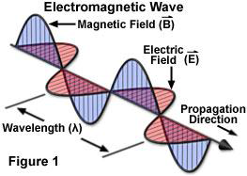
E3A15 What is an electromagnetic wave?
A. A wave of alternating current, in the core of an electromagnet
B. A wave consisting of two electric fields at parallel right angles to each other
C. A wave consisting of an electric field and a magnetic field oscillating at right angles to each other
D. A wave consisting of two magnetic fields at right angles to each other

Slide 33
E3A16 Which of the following best describes electromagnetic waves traveling in free space?
A. Electric and magnetic fields become aligned as they travel
B. The energy propagates through a medium with a high refractive index
C. The waves are reflected by the ionosphere and return to their source
D. Changing electric and magnetic fields propagate the energy

Slide 34
E3A16 Which of the following best describes electromagnetic waves traveling in free space?
A. Electric and magnetic fields become aligned as they travel
B. The energy propagates through a medium with a high refractive index
C. The waves are reflected by the ionosphere and return to their source
D. Changing electric and magnetic fields propagate the energy

Slide 35
E3A17 What is meant by circularly polarized electromagnetic waves?
A. Waves with an electric field bent into a circular shape
B. Waves with a rotating electric field
C. Waves that circle the Earth
D. Waves produced by a loop antenna

Slide 36
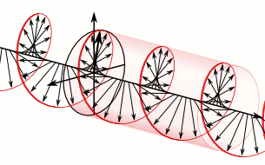
E3A17 What is meant by circularly polarized electromagnetic waves?
A. Waves with an electric field bent into a circular shape
B. Waves with a rotating electric field
C. Waves that circle the Earth
D. Waves produced by a loop antenna

Slide 37
E3B Propagation and technique
Transequatorial propagation; long path; gray-line; multi-path; ordinary and extraordinary waves; chordal hop, sporadic E mechanisms

Slide 38
E3B01 What is transequatorial propagation?
A. Propagation between two mid-latitude points at approximately the same distance north and south of the magnetic equator
B. Propagation between any two points located on the magnetic equator
C. Propagation between two continents by way of ducts along the magnetic equator
D. Propagation between two stations at the same latitude

Slide 39
E3B01 What is transequatorial propagation?
A. Propagation between two mid-latitude points at approximately the same distance north and south of the magnetic equator
B. Propagation between any two points located on the magnetic equator
C. Propagation between two continents by way of ducts along the magnetic equator
D. Propagation between two stations at the same latitude

Slide 40
E3B02 What is the approximate maximum range for signals using transequatorial propagation?
A. 1000 miles
B. 2500 miles
C. 5000 miles
D. 7500 miles

Slide 41
E3B02 What is the approximate maximum range for signals using transequatorial propagation?
A. 1000 miles
B. 2500 miles
C. 5000 miles
D. 7500 miles

Slide 42
E3B03 What is the best time of day for transequatorial propagation?
A. Morning
B. Noon
C. Afternoon or early evening
D. Late at night

Slide 43
E3B03 What is the best time of day for transequatorial propagation?
A. Morning
B. Noon
C. Afternoon or early evening
D. Late at night

Slide 44
E3B04 What is meant by the terms extraordinary and ordinary waves?
A. Extraordinary waves describe rare long skip propagation compared to ordinary waves which travel shorter distances
B. Independent waves created in the ionosphere that are elliptically polarized
C. Long path and short path waves
D. Refracted rays and reflected waves

Slide 45
E3B04 What is meant by the terms extraordinary and ordinary waves?
A. Extraordinary waves describe rare long skip propagation compared to ordinary waves which travel shorter distances
B. Independent waves created in the ionosphere that are elliptically polarized
C. Long path and short path waves
D. Refracted rays and reflected waves

Slide 46
E3B05 Which amateur bands typically support long-path propagation?
A. 160 metersto 40 meters
B. 30 meters to 10 meters
C. 160 meters to 10 meters
D. 6 meters to 2 meters

Slide 47
E3B05 Which amateur bands typically support long-path propagation?
A. 160 meters to 40 meters
B. 30 meters to 10 meters
C. 160 to 10 meters
D. 6 meters to 2 meters

Slide 48
E3B06 Which of the following amateur bands most frequently provides long-path propagation?
A. 80 meters
B. 20 meters
C. 10 meters
D. 6 meters

Slide 49
E3B06 Which of the following amateur bands most frequently provides long-path propagation?
A. 80 meters
B. 20 meters
C. 10 meters
D. 6 meters

Slide 50
E3B07 Which of the following could account for hearing an echo on the received signal of a distant station?
A. High D layer absorption
B. Meteor scatter
C. Transmit frequency is higher than the MUF
D. Receipt of a signal by more than one path

Slide 51
E3B07 Which of the following could account for hearing an echo on the received signal of a distant station?
A. High D layer absorption
B. Meteor scatter
C. Transmit frequency is higher than the MUF
D. Receipt of a signal by more than one path

Slide 52
E3B08 What type of HF propagation is probably occurring if radio signals travel along the terminator between daylight and darkness?
A. Transequatorial
B. Sporadic-E
C. Long-path
D. Gray-line

Slide 53
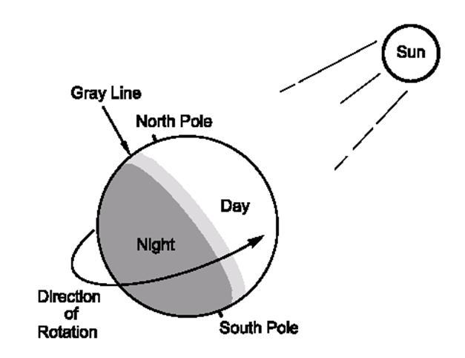
E3B08 What type of HF propagation is probably occurring if radio signals travel along the terminator between daylight and darkness?
A. Transequatorial
B. Sporadic-E
C. Long-path
D. Gray-line

Slide 54
E3B09 At what time of year is Sporadic E propagation most likely to occur?
A. Around the solstices, especially the summer solstice
B. Around the solstices, especially the winter solstice
C. Around the equinoxes, especially the spring equinox
D. Around the equinoxes, especially the fall equinox

Slide 55
E3B09 At what time of year is Sporadic E propagation most likely to occur?
A. Around the solstices, especially the summer solstice
B. Around the solstices, especially the winter solstice
C. Around the equinoxes, especially the spring equinox
D. Around the equinoxes, especially the fall equinox

Slide 56
E3B10 What is the cause of gray-line propagation?
A. At midday, the Sun super heats directly the ionosphere causing increased refraction of radio waves
B. At twilight and sunrise, D-layer absorption is low while E-layer and F-layer propagation remains high
C. In darkness, solar absorption drops greatly while atmospheric ionization remains steady
D. At mid afternoon, the Sun heats the ionosphere decreasing radio wave refraction and the MUF

Slide 57
E3B10 What is the cause of gray-line propagation?
A. At midday, the Sun super heats directly the ionosphere causing increased refraction of radio waves
B. At twilight and sunrise, D-layer absorption is low while E-layer and F-layer propagation remains high
C. In darkness, solar absorption drops greatly while atmospheric ionization remains steady
D. At mid afternoon, the Sun heats the ionosphere decreasing radio wave refraction and the MUF

Slide 58
E3B11 At what time of day is Sporadic-E propagation most likely to occur?
A. Around sunset
B. Around sunrise
C. Early evening
D. Any time

Slide 59
E3B11 At what time of day is Sporadic-E propagation most likely to occur?
A. Around sunset
B. Around sunrise
C. Early evening
D. Any time

Slide 60
E3B12 What is the primary characteristic of chordal hop propagation?
A. Propagation away from the great circle bearing between stations
B. Successive ionospheric reflections without an intermediate reflection from the ground
C. Propagation across the geomagnetic equator
D. Signals reflected back toward the transmitting station

Slide 61
E3B12 What is the primary characteristic of chordal hop propagation?
A. Propagation away from the great circle bearing between stations
B. Successive ionospheric reflections without an intermediate reflection from the ground
C. Propagation across the geomagnetic equator
D. Signals reflected back toward the transmitting station

Slide 62
E3B13 Why is chordal hop propagation desirable?
A. The signal experiences less loss along the path compared to normal skip propagation
B. The MUF for chordal hop propagation is much lower than for normal skip propagation
C. Atmospheric noise is lower in the direction of chordal hop propagation
D. Signals travel faster along ionospheric chords

Slide 63
E3B13 Why is chordal hop propagation desirable?
A. The signal experiences less loss along the path compared to normal skip propagation
B. The MUF for chordal hop propagation is much lower than for normal skip propagation
C. Atmospheric noise is lower in the direction of chordal hop propagation
D. Signals travel faster along ionospheric chords

Slide 64
E3B14 What happens to linearly polarized radio waves that split into ordinary and extraordinary waves in the ionosphere?
A. They are bent toward the magnetic poles
B. Their polarization is randomly modified
C. They become elliptically polarized
D. They become phase-locked
~~

Slide 65
E3B14 What happens to linearly polarized radio waves that split into ordinary and extraordinary waves in the ionosphere?
A. They are bent toward the magnetic poles
B. Their polarization is randomly modified
C. They become elliptically polarized
D. They become phase-locked
~~

Slide 66
E3C Propagation
Radio-path horizon; less common propagation modes; propagation prediction techniques and modeling; space weather parameters and amateur radio

Slide 67
E3C01 What does the term ray tracing describe in regard to radio communications?
A. The process in which an electronic display presents a pattern
B. Modeling a radio wave's path through the ionosphere
C. Determining the radiation pattern from an array of antennas
D. Evaluating high voltage sources for X-Rays

Slide 68
E3C01 What does the term ray tracing describe in regard to radio communications?
A. The process in which an electronic display presents a pattern
B. Modeling a radio wave's path through the ionosphere
C. Determining the radiation pattern from an array of antennas
D. Evaluating high voltage sources for X-Rays

Slide 69
E3C02 What is indicated by a rising A or K index?
A. Increasing disruption of the geomagnetic field
B. Decreasing disruption of the geomagnetic field
C. Higher levels of solar UV radiation
D. An increase in the critical frequency

Slide 70
E3C02 What is indicated by a rising A or K index?
A. Increasing disruption of the geomagnetic field
B. Decreasing disruption of the geomagnetic field
C. Higher levels of solar UV radiation
D. An increase in the critical frequency

Slide 71
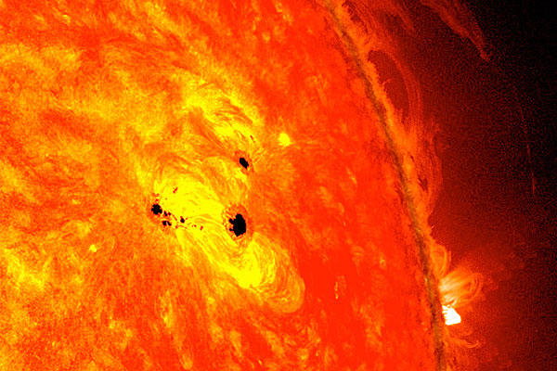
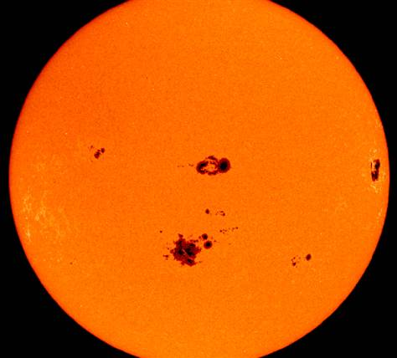
Solar Flare / Sun Spots

Slide 72
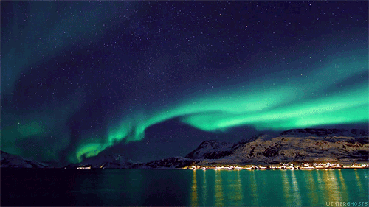
Aurora Borealis

Slide 73
E3C03 Which of the following signal paths is most likely to experience high levels of absorption when the A index or K index is elevated?
A. Transequatorial propagation
B. Polar paths
C. Sporadic-E
D. NVIS

Slide 74
E3C03 Which of the following signal paths is most likely to experience high levels of absorption when the A index or K index is elevated?
A. Transequatorial propagation
B. Polar paths
C. Sporadic-E
D. NVIS

Slide 75
E3C04 What does the value of Bz (B sub Z) represent?
A. Geomagnetic field stability
B. Critical frequency for vertical transmissions
C. Direction and strength of the interplanetary magnetic field
D. Duration of long-delayed echoes

Slide 76
E3C04 What does the value of Bz (B sub Z) represent?
A. Geomagnetic field stability
B. Critical frequency for vertical transmissions
C. Direction and strength of the interplanetary magnetic field
D. Duration of long-delayed echoes

Slide 77
E3C05 What orientation of Bz (B sub z) increases the likelihood that incoming particles from the Sun will cause disturbed conditions?
A. Southward
B. Northward
C. Eastward
D. Westward

Slide 78
E3C05 What orientation of Bz (B sub z) increases the likelihood that incoming particles from the Sun will cause disturbed conditions?
A. Southward
B. Northward
C. Eastward
D. Westward

Slide 79
E3C06 By how much does the VHF/UHF radio horizon distance exceed the geometric horizon?
A. By approximately 15 percent of the distance
B. By approximately twice he distance
C. By approximately 50 percent of the distance
D. By approximately four times the distance

Slide 80
E3C06 By how much does the VHF/UHF radio horizon distance exceed the geometric horizon?
A. By approximately 15 percent of the distance
B. By approximately twice the distance
C. By approximately 50 percent of the distance
D. By approximately four times the distance

Slide 81
E3C07 Which of the following descriptors indicates the greatest solar flare intensity?
A. Class A
B. Class B
C. Class M
D. Class X

Slide 82
E3C07 Which of the following descriptors indicates the greatest solar flare intensity?
A. Class A
B. Class B
C. Class M
D. Class X

Slide 83
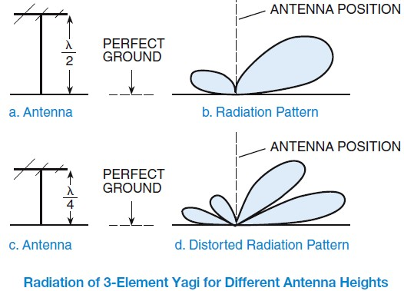
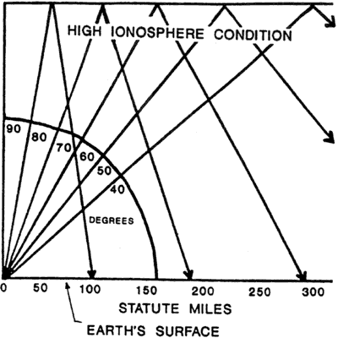
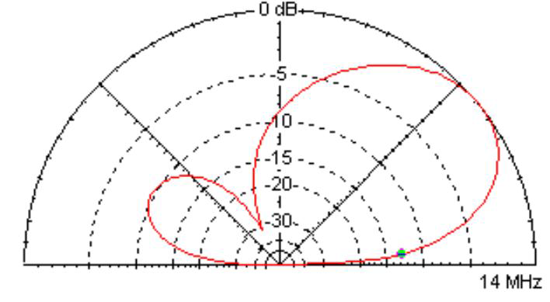
Radiowave take off pattern

Slide 84
E3C08 What does the space weather term G5 mean?
A. An extreme geomagnetic storm
B. Very low solar activity
C. Moderate solar wind
D. Waning sunspot numbers

Slide 85
E3C08 What does the space weather term G5 mean?
A. An extreme geomagnetic storm
B. Very low solar activity
C. Moderate solar wind
D. Waning sunspot numbers

Slide 86
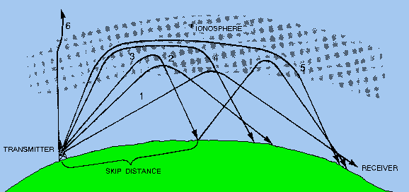
Pedersen Ray
Paths 4 and 5 shown above are Pedersen rays or high-angle rays. These rays are not refracted sufficiently to return directly
to the earth but don't have a high enough angle to penetrate (like ray 6). They get trapped in the ionosphere often exiting
where there is a big gradient in electron density (at dusk and dawn). The plots below are the result of both high and low
angle rays being present at the same time. An effect that we are normally unaware of!
Given this model, we might reasonably expect to see four components on an oblique path as it fades out: o and x wave from
the low angle path and o and x waves from the high angle path. Each with different Doppler shifts.

Slide 87
E3C09 How does the intensity of an X3 flare compare to that of an X2 flare?
A. 10 percent greater
B. 50 percent greater
C. Twice as great
D. Four times as great

Slide 88
E3C09 How does the intensity of an X3 flare compare to that of an X2 flare?
A. 10 percent greater
B. 50 percent greater
C. Twice as great
D. Four times as great

Slide 89
E3C10 What does the 304A solar parameter measure?
A. The ratio of X-Ray flux to radio flux, correlated to sunspot number
B. UV emissions at 304 angstroms, correlated to solar flux index
C. The solar wind velocity at 304 degrees from the solar equator, correlated to solar activity
D. The solar emission at 304 GHz, correlated to X-Ray flare levels

Slide 90
E3C10 What does the 304A solar parameter measure?
A. The ratio of X-Ray flux to radio flux, correlated to sunspot number
B. UV emissions at 304 angstroms, correlated to solar flux index
C. The solar wind velocity at 304 degrees from the solar equator, correlated to solar activity
D. The solar emission at 304 GHz, correlated to X-Ray flare levels

Slide 91
E3C11 What does VOACAP software model?
A. AC voltage and impedance
B. VHF radio propagation
C. HF propagation
D. AC current and impedance

Slide 92
E3C11 What does VOACAP software model?
A. AC voltage and impedance
B. VHF radio propagation
C. HF propagation
D. AC current and impedance

Slide 93
E3C12 How does the maximum distance of ground-wave propagation change when the signal frequency is increased?
A. It stays the same
B. It increases
C. It decreases
D. It peaks at roughly 14 MHz

Slide 94
E3C12 How does the maximum distance of ground-wave propagation change when the signal frequency is increased?
A. It stays the same
B. It increases
C. It decreases
D. It peaks at roughly 14 MHz

Slide 95
E3C13 What type of polarization is best for ground-wave propagation?
A. Vertical
B. Horizontal
C. Circular
D. Elliptical

Slide 96
E3C13 What type of polarization is best for ground-wave propagation?
A. Vertical
B. Horizontal
C. Circular
D. Elliptical

Slide 97
E3C14 Why does the radio-path horizon distance exceed the geometric horizon?
A. E-region skip
B. D-region skip
C. Downward bending due to aurora refraction
D. Downward bending due to density variations in the atmosphere

Slide 98
E3C14 Why does the radio-path horizon distance exceed the geometric horizon?
A. E-region skip
B. D-region skip
C. Downward bending due to aurora refraction
D. Downward bending due to density variations in the atmosphere

Slide 99
E3C15 What might a sudden rise in radio background noise indicate?
A. A meteor ping
B. A solar flare has occurred
C. Increased transequatorial propagation likely
D. Long-path propagation is occurring

Slide 100
E3C15 What might a sudden rise in radio background noise indicate?
A. A meteor ping
B. A solar flare has occurred
C. Increased transequatorial propagation likely
D. Long-path propagation is occurring

Slide 101
End of
SUBELEMENT E3
WAVE PROPAGATION

