Slide 1
SUBELEMENT E4
AMATEUR PRACTICES
[5 Exam Questions - 5 Groups]
Notes:
Extra Question Pool 2016. The Western Washington Ham Training Team makes these slides available to teach Amateur Technician Radio Licensing Classes. Daniel Stevens KL7WM, Training Coordinator, Howard Swartz, W7HS, Slide master, Dustin Lomax, KF7FK, Leading Instructor, LW Abel, K7LWA, Enthusiasm Leader.

Slide 2
E4A Test equipment: analog and digital instruments; spectrum and network analyzers, antenna analyzers; oscilloscopes; RF measurements; computer aidedmeasurements
E4B Measurement technique and limitations: instrument accuracy and performance limitations; probes; techniques to minimize errors; measurement of "Q"; instrument calibration; S parameters; vector network analyers
E4C Receiver performance characteristics, phase noise, noise floor, image rejection, MDS, signal-to-noise-ratio; selectivity; effercts of SDR receiver non-linearity
E4D Receiver performance characteristics, blocking dynamic range, intermodulation and cross-modulation interference; 3rd order intercept; desensitization; preselector
E4E Noise suppression: system noise; electrical appliance noise; line noise; locating noise sources; DSP noise reduction; noise blankers; grounding for signals

Slide 3
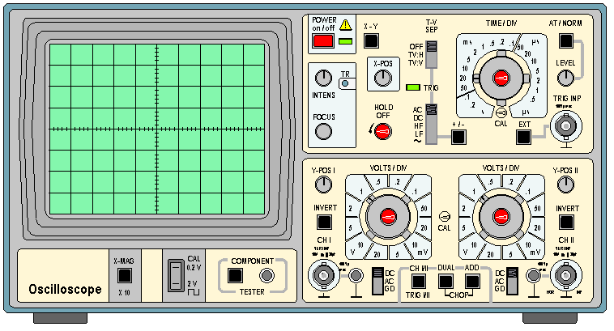
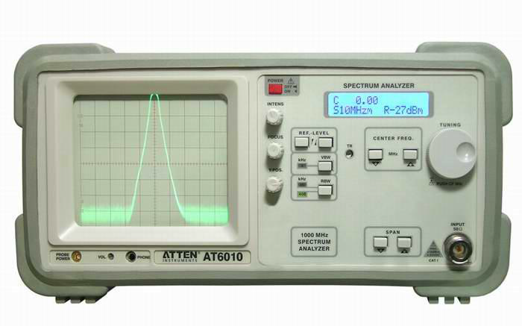
Oscilloscope
The Scoop on Scopes
Spectrum Analyzer

Slide 4
E4A01 Which of the following parameter determines the bandwidth of a digital or computer-based oscilloscope?
A. Input capacitance
B. Input impedance
C. Sampling rate
D. Sample resolution

Slide 5
E4A01 Which of the following parameter determines the bandwidth of a digital or computer-based oscilloscope?
A. Input capacitance
B. Input impedance
C. Sampling rate
D. Sample resolution

Slide 6
E4A02 Which of the following parameters would a spectrum analyzer display on the vertical and horizontal axes?
A. RF amplitude and time
B. RF amplitude and frequency
C. SWR and frequency
D. SWR and time

Slide 7
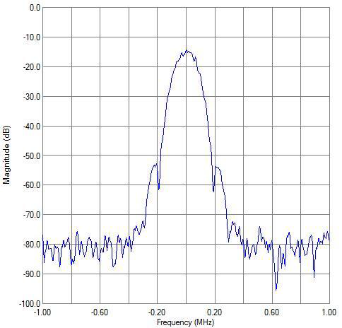
E4A02 Which of the following parameters would a spectrum analyzer display on the vertical and horizontal axes?
A. RF amplitude and time
B. RF amplitude and frequency
C. SWR and frequency
D. SWR and time

Slide 8
E4A03 Which of the following test instrument is used to display spurious signals and/or intermodulation distortion products in an SSB transmitter?
A. A wattmeter
B. A spectrum analyzer
C. A logic analyzer
D. A time-domain reflectometer

Slide 9
E4A03 Which of the following test instrument is used to display spurious signals and/or intermodulation distortion products in an SSB transmitter?
A. A wattmeter
B. A spectrum analyzer
C. A logic analyzer
D. A time-domain reflectometer

Slide 10
E4A04 What determines the upper frequency limit for a computer soundcard-based oscilloscope program?
A. Analog-to-digital conversion speed of the soundcard
B. Amount of memory on the soundcard
C. Q of the interface of the interface circuit
D. All of these choices are correct

Slide 11
E4A04 What determines the upper frequency limit for a computer soundcard-based oscilloscope program?
A. Analog-to-digital conversion speed of the soundcard
B. Amount of memory on the soundcard
C. Q of the interface of the interface circuit
D. All of these choices are correct

Slide 12
E4A05 What might be an advantage of a digital vs an analog oscilloscope?
A. Automatic amplitude and frequency numerical readout
B. Storage of traces for future reference
C. Manipulation of time base after trace capture
D. All of these choices are correct

Slide 13
E4A05 What might be an advantage of a digital vs an analog oscilloscope?
A. Automatic amplitude and frequency numerical readout
B. Storage of traces for future reference
C. Manipulation of time base after trace capture
D. All of these choices are correct

Slide 14
E4A06 What is the effect of aliasing in a digital or computer-based oscilloscope?
A. False signals are displayed
A. False signals are displayed
B. All signals will have a DC offset
C. Calibration of the vertical scale is no longer valid
D. False triggering occurs

Slide 15
E4A06 What is the effect of aliasing in a digital or computer-based oscilloscope?
A. False signals are displayed
A. False signals are displayed
B. All signals will have a DC offset
C. Calibration of the vertical scale is no longer valid
D. False triggering occurs

Slide 16
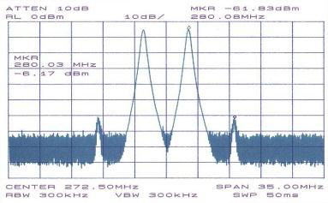
If two separate (non-harmonically related) audio tones are applied to the the microphone input of a SSB transmitter we
would expect to see only two signals in the RF output (Carrier ± tone 1 and the carrier ±tone2). In the illustration below
you can see that there two smaller signals about 55dB bellow the two RF signals. These are intermodulation distortion
products.

Slide 17
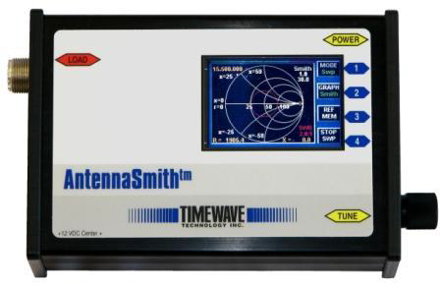
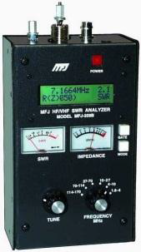
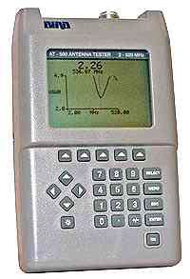
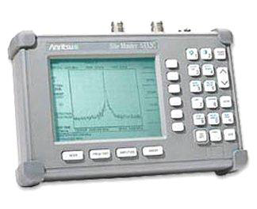
These are some common antenna analyzers. The one the far left is made by MFJ and is the most commonly used by amateur radio operator.

Slide 18
E4A07 Which of the following is an advantage of using an antenna analyzer compared to an SWR bridge to measure antenna SWR?
A. Antenna analyzers automatically tune your antenna for resonance
B. Antenna analyzers do not need an external RF source
C. Antenna analyzers display a time-varying representation of the modulation envelope
D. All of these choices are correct

Slide 19
E4A07 Which of the following is an advantage of using an antenna analyzer compared to an SWR bridge to measure antenna SWR?
A. Antenna analyzers automatically tune your antenna for resonance
B. Antenna analyzers do not need an external RF source
C. Antenna analyzers display a time-varying representation of the modulation envelope
D. All of these choices are correct

Slide 20
E4A08 Which of the following instrument would be best for measuring the SWR of a beam antenna?
A. A spectrum analyzer
B. A Q meter
C. An ohmmeter
D. An antenna analyzer

Slide 21
E4A08 Which of the following instrument would be best for measuring the SWR of a beam antenna?
A. A spectrum analyzer
B. A Q meter
C. An ohmmeter
D. An antenna analyzer

Slide 22
E4A09 When using a computer’s soundcard input to digitize signals, what is the highest frequency signal that can be digitized without aliasing?
A. The same as the sample rate
B. One-half the sample rate
C. One-tenth the sample rate
D. It depends on how the data is stored internally

Slide 23
E4A09 When using a computer’s soundcard input to digitize signals, what is the highest frequency signal that can be digitized without aliasing?
A. The same as the sample rate
B. One-half the sample rate
C. One-tenth the sample rate
D. It depends on how the data is stored internally

Slide 24
E4A10 Which of the following displays multiple digital signal states simultaneously?
A. Network analyzer
B. Bit error rate tester
C. Modulation monitor
D. Logic analyzer

Slide 25
E4A10 Which of the following displays multiple digital signal states simultaneously?
A. Network analyzer
B. Bit error rate tester
C. Modulation monitor
D. Logic analyzer

Slide 26
E4A11 Which of the following is good practice when using an oscilloscope probe?
A. Keep the signal ground connection of the probe as short as possible
B. Never use a high impedance probe to measure a low impedance circuit
C. Never use a DC-coupled probe to measure an AC circuit
D. All of these choices are correct

Slide 27
E4A11 Which of the following is good practice when using an oscilloscope probe?
A. Keep the signal ground connection of the probe as short as possible
B. Never use a high impedance probe to measure a low impedance circuit
C. Never use a DC-coupled probe to measure an AC circuit
D. All of these choices are correct

Slide 28
E4A12 Which of the following procedures is an important precaution to follow when connecting a spectrum analyzer to a transmitter output?
A. Use high quality double shielded coaxial cables to reduce signal losses
B. Attenuate the transmitter output going to the spectrum analyzer
C. Match the antenna to the load
D. All of these choices are correct

Slide 29
E4A12 Which of the following procedures is an important precaution to follow when connecting a spectrum analyzer to a transmitter output?
A. Use high quality double shielded coaxial cables to reduce signal losses
B. Attenuate the transmitter output going to the spectrum analyzer
C. Match the antenna to the load
D. All of these choices are correct
Transmitter
Power Attenuator
Spectrum Analyser

Slide 30
E4A13 How is the compensation of an oscilloscope probe typically adjusted?
A. A square wave is displayed and the probe is adjusted until the horizontal portions of the displayed wave are as nearly flat as possible
B. A high frequency sine wave is displayed and the probe is adjusted for maximum amplitude
C. A frequency standard is displayed and the probe is adjusted until the deflection time is accurate
D. A DC voltage standard is displayed and the probe is adjusted until the displayed voltage is accurate

Slide 31
E4A13 How is the compensation of an oscilloscope probe typically adjusted?
A. A square wave is displayed and the probe is adjusted until the horizontal portions of the displayed wave are as nearly flat as possible
B. A high frequency sine wave is displayed and the probe is adjusted for maximum amplitude
C. A frequency standard is displayed and the probe is adjusted until the deflection time is accurate
D. A DC voltage standard is displayed and the probe is adjusted until the displayed voltage is accurate

Slide 32
E4A14 What is the purpose of the prescaler function on a frequency counter?
A. It amplifies low level signals for more accurate counting
B. It multiplies a higher frequency signal so a low-frequency counter can display the operating frequency
C. It prevents oscillation in a low-frequency counter circuit
D. It divides a higher frequency signal so a low-frequency counter can display the input frequency

Slide 33
E4A14 What is the purpose of the prescaler function on a frequency counter?
A. It amplifies low level signals for more accurate counting
B. It multiplies a higher frequency signal so a low-frequency counter can display the operating frequency
C. It prevents oscillation in a low-frequency counter circuit
D. It divides a higher frequency signal so a low-frequency counter can display the input frequency

Slide 34
E4A15 What is an advantage of a period-measuring frequency counter over a direct-count type?
A. It can run on battery power for remote measurements
B. It does not require an expensive high-precision time base
C. It provides improved resolution of low-frequency signals within a comparable time period
D. It can directly measure the modulation index of an FM transmitter

Slide 35
E4A15 What is an advantage of a period-measuring frequency counter over a direct-count type?
A. It can run on battery power for remote measurements
B. It does not require an expensive high-precision time base
C. It provides improved resolution of low-frequency signals within a comparable time period
D. It can directly measure the modulation index of an FM transmitter

Slide 36
E4B Measurement technique
And limitations; instrument accuracy and performance limitations; probes; techniques to minimize errors; measurement of “Q”; instrument calibration; S parameters; vectornetwork analyzers

Slide 37
E4B01 Which of the following factors most affects the accuracy of a frequency counter?
A. Input attenuator accuracy
B. Time base accuracy
C. Decade divider accuracy
D. Temperature coefficient of the logic

Slide 38
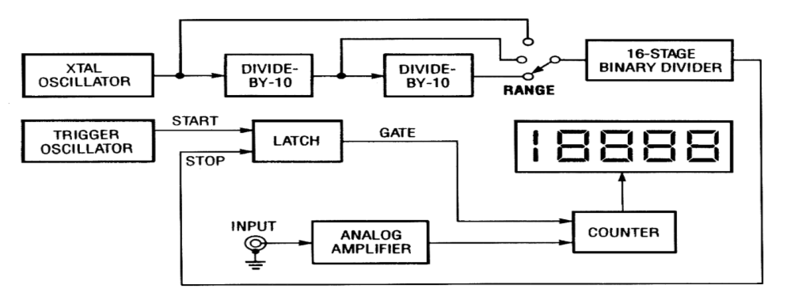
E4B01 Which of the following factors most affects the accuracy of a frequency counter?
A. Input attenuator accuracy
B. Time base accuracy
C. Decade divider accuracy
D. Temperature coefficient of the logic

Slide 39
E4B02 What is an advantage of using a bridge circuit to measure impedance?
A. It provides an excellent match under all conditions
B. It is relatively immune to drift in the signal generator source
C. It is very precise in obtaining a signal null
D. It can display results directly in Smith chart format

Slide 40
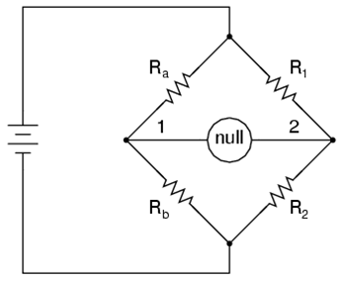
E4B02 What is an advantage of using a bridge circuit to measure impedance?
A. It provides an excellent match under all conditions
B. It is relatively immune to drift in the signal generator source
C. It is very precise in obtaining a signal null
D. It can display results directly in Smith chart format

Slide 41
E4B03 If a frequency counter with a specified accuracy of +/- 1.0 ppm reads 146,520,000 Hz, what is the most the actual frequency being measured could differ from the reading?
A. 165.2 Hz
B. 14.652 kHz
C. 146.52 Hz
D. 1.4652 MHz

Slide 42
E4B03 If a frequency counter with a specified accuracy of +/- 1.0 ppm reads 146,520,000 Hz, what is the most the actual frequency being measured could differ from the reading?
A. 165.2 Hz
B. 14.652 kHz
C. 146.52 Hz
D. 1.4652 MHz
146.520.000 * 1 = 146.52
1,000,000

Slide 43
E4B04 If a frequency counter with a specified accuracy of +/- 0.1 ppm reads 146,520,000 Hz, what is the most the actual frequency being measured could differ from the reading?
A. 14.652 Hz
B. 0.1 MHz
C. 1.4652 Hz
D. 1.4652 kHz

Slide 44
E4B04 If a frequency counter with a specified accuracy of +/- 0.1 ppm reads 146,520,000 Hz, what is the most the actual frequency being measured could differ from the reading?
A. 14.652 Hz
B. 0.1 MHz
C. 1.4652 Hz
D. 1.4652 kHz
146.520.000 * 0.1 = 14 . 652
1,000,000

Slide 45
E4B05 If a frequency counter with a specified accuracy of +/- 10 ppm reads 146,520,000 Hz, what is the most the actual frequency being measured could differ from the reading?
A. 146.52 Hz
B. 10 Hz
C. 146.52 kHz
D. 1465.20 Hz

Slide 46
E4B05 If a frequency counter with a specified accuracy of +/- 10 ppm reads 146,520,000 Hz, what is the most the actual frequency being measured could differ from the reading?
A. 146.52 Hz
B. 10 Hz
C. 146.52 kHz
D. 1465.20 Hz

Slide 47
E4B05 If a frequency counter with a specified accuracy of +/- 10 ppm reads 146,520,000 Hz, what is the most the actual frequency being measured could differ from the reading?
A. 146.52 Hz
B. 10 Hz
C. 146.52 kHz
D. 1465.20 Hz
146.520.000 * 10 = 1,465.2
1,000,000

Slide 48
E4B06 How much power is being absorbed by the load when a directional power meter connected between a transmitter and a terminating load reads 100 watts forward power and 25 watts reflected power?
A. 100 watts
B. 125 watts
C. 25 watts
D. 75 watts

Slide 49
E4B06 How much power is being absorbed by the load when a directional power meter connected between a transmitter and a terminating load reads 100 watts forward power and 25 watts reflected power?
A. 100 watts
B. 125 watts
C. 25 watts
D. 75 watts
100 watts
-25 watts
75 watts

Slide 50
E4B07 What do the subscripts of S parameters represent?
A. The port or ports at which measurements are made
B. The relative time between measurements
C. Relative quality of the data
D. Frequency order of the measurements

Slide 51
E4B07 What do the subscripts of S parameters represent?
A. The port or ports at which measurements are made
B. The relative time between measurements
C. Relative quality of the data
D. Frequency order of the measurements

Slide 52
E4B08 Which of the following is a characteristic of a good DC voltmeter?
A. High reluctance input
B. Low reluctance input
C. High impedance input
D. Low impedance input

Slide 53
E4B08 Which of the following is a characteristic of a good DC voltmeter?
A. High reluctance input
B. Low reluctance input
C. High impedance input
D. Low impedance input

Slide 54
E4B09 What is indicated if the current reading on an RF ammeter placed in series with the antenna feed line of a transmitter increases as the transmitter is tuned to resonance?
A. There is possibly a short to ground in the feed line
B. The transmitter is not properly neutralized
C. There is an impedance mismatch between the antenna and feed line
D. There is more power going into the antenna

Slide 55
E4B09 What is indicated if the current reading on an RF ammeter placed in series with the antenna feed line of a transmitter increases as the transmitter is tuned to resonance?
A. There is possibly a short to ground in the feed line
B. The transmitter is not properly neutralized
C. There is an impedance mismatch between the antenna and feed line
D. There is more power going into the antenna

Slide 56
E4B10 Which of the following describes a method to measure intermodulation distortion in an SSB transmitter?
A. Modulate the transmitter with two non-harmonically related radio frequencies and observe the RF output with a spectrum analyzer
B. Modulate the transmitter with two non-harmonically related audio frequencies and observe the RF output with a spectrum analyzer
C. Modulate the transmitter with two harmonically related audio frequencies and observe the RF output with a peak reading wattmeter
D. Modulate the transmitter with two harmonically related audio frequencies and observe the RF output with a logic analyzer

Slide 57
E4B10 Which of the following describes a method to measure intermodulation distortion in an SSB transmitter?
A. Modulate the transmitter with two non-harmonically related radio frequencies and observe the RF output with a spectrum analyzer
B. Modulate the transmitter with two non-harmonically related audio frequencies and observe the RF output with a spectrum analyzer
C. Modulate the transmitter with two harmonically related audio frequencies and observe the RF output with a peak reading wattmeter
D. Modulate the transmitter with two harmonically related audio frequencies and observe the RF output with a logic analyzer

Slide 58
E4B11 How should an antenna analyzer be connected when measuring antenna resonance and feed point impedance?
A. Loosely couple the analyzer near the antenna base
B. Connect the analyzer via a high-impedance transformer to the antenna
C. Loosely couple the antenna and a dummy load to the analyzer
D. Connect the antenna feed line directly to the analyzer's connector

Slide 59
E4B11 How should an antenna analyzer be connected when measuring antenna resonance and feed point impedance?
A. Loosely couple the analyzer near the antenna base
B. Loosely couple the analyzer via a high-impedance transformer to the antenna
C. Connect the antenna and a dummy load to the analyzer
D. Connect the antenna feed line directly to the analyzer's connector
Never connect an antenna analyzer to a transmitter or measure an antenna
in close proximity to an active transmitting
antenna. This could destroy the antenna analyzer.

Slide 60
E4B12 What is the significance of voltmeter sensitivity expressed in ohms per volt?
A. The full scale reading of the voltmeter multiplied by its ohms per volt rating will indicate the input impedance of the voltmeter
B. When used as a galvanometer, the reading in volts multiplied by the ohms per volt rating will determine the power drawn by the device under test
C. When used as an ohmmeter, the reading in ohms divided by the ohms per volt rating will determine the voltage applied to the circuit
D. When used as an ammeter, the full scale reading in amps divided by ohms per volt rating will determine the size of shunt needed

Slide 61
E4B12 What is the significance of voltmeter sensitivity expressed in ohms per volt?
A. The full scale reading of the voltmeter multiplied by its ohms per volt rating will indicate the input impedance of the voltmeter
B. When used as a galvanometer, the reading in volts multiplied by the ohms per volt rating will determine the power drawn by the device under test
C. When used as an ohmmeter, the reading in ohms divided by the ohms per volt rating will determine the voltage applied to the circuit
D. When used as an ammeter, the full scale reading in amps divided by ohms per volt rating will determine the size of shunt needed

Slide 62
S Parameters
The ease with which Scattering Parameters can be measured makes them especially well suited for describing transistors and other active devices.
Measuring most other parameters calls for the input and output of the device to be successively opened and short circuited. This can be hard to do, especially at RF frequencies where lead inductance and capacitance make short and open circuits difficult to obtain.
At higher frequencies these measurements typically require tuning stubs, separately adjusted at each measurement frequency,

Slide 63
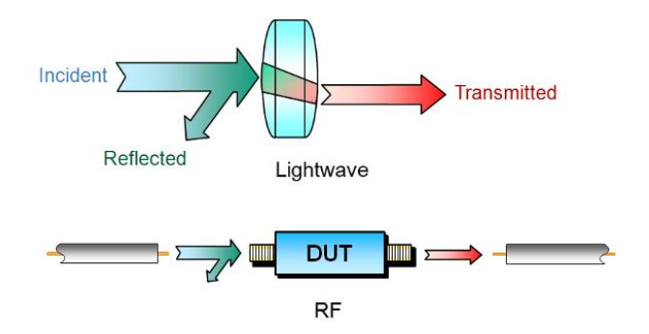
S Parameters
S-parameters, on the other hand, are usually measured with the device imbedded between a 50 Ω load and source, and there is very little chance for oscillations to occur.

Slide 64
S Parameters
Another important advantage of s-parameters stems from the fact that traveling waves, unlike terminal voltages and currents, do not vary in magnitude at points along a lossless transmission line.
This means that scattering parameters can be measured on a device located at some distance from the measurement transducers, provided that the measuring device and the transducers are connected by low-loss transmission lines

Slide 65
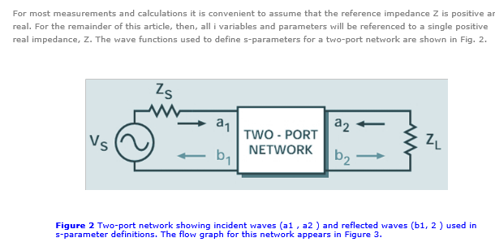
S Parameters

Slide 66
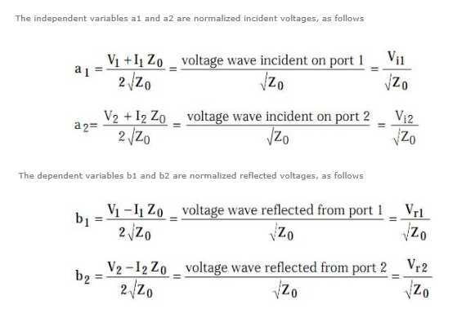
S Parameters

Slide 67
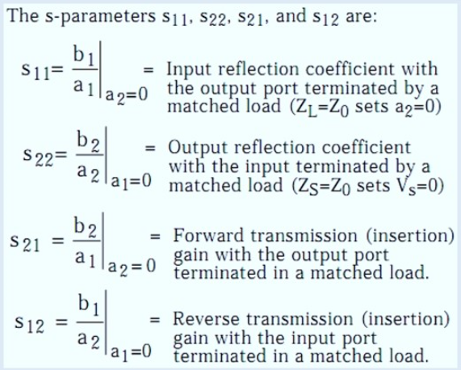
S PARAMETERS
The previous four equations show that s-parameters are simply related to power gain and mismatch loss, quantities which are often of more interest than the corresponding voltage functions:

Slide 68
E4B13 Which S parameter is equivalent to forward gain?
A. S11
B. S12
C. S21
D. S22

Slide 69
E4B13 Which S parameter is equivalent to forward gain?
A. S11
B. S12
C. S21
D. S22

Slide 70
E4B14 What happens if a dip meter is too tightly coupled to a tuned circuit being checked?
A. Harmonics are generated
B. A less accurate reading results
C. Cross modulation occurs
D. Intermodulation distortion occurs

Slide 71
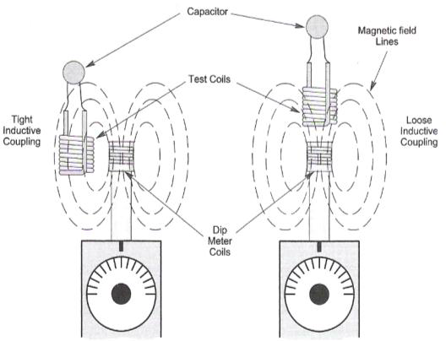
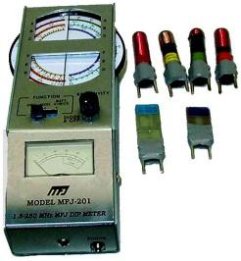
E4B14 What happens if a dip meter is too tightly coupled to a tuned circuit being checked?
A. Harmonics are generated
B. A less accurate reading results
C. Cross modulation occurs
D. Intermodulation distortion occurs

Slide 72
E4B15 Which of the following can be used as a relative measurement of the Q for a series-tuned circuit?
A. The inductance to capacitance ratio
B. The frequency shift
C. The bandwidth of the circuit's frequency response
D. The resonant frequency of the circuit

Slide 73
E4B15 Which of the following can be used as a relative measurement of the Q for a series-tuned circuit?
A. The inductance to capacitance ratio
B. The frequency shift
C. The bandwidth of the circuit's frequency response
D. The resonant frequency of the circuit

Slide 74
E4B16 Which S parameter represents return loss or SWR?
A. S11
B. S12
C. S21
D. S22

Slide 75
E4B16 Which S parameter represents return loss or SWR?
A. S11
B. S12
C. S21
D. S22

Slide 76
E4B17 What three test loads are used to calibrate a standard RF vector network analyzer?
A. 50 ohms, 75 ohms, and 90 ohms
B. Short circuit, open circuit, and 50 ohms
C. Short circuit, open circuit, and resonant circuit
D. 50 ohms through 1/8 wavelength, 1/4 wavelength, and 1/2 wavelength of coaxial cable

Slide 77
E4B17 What three test loads are used to calibrate a standard RF vector network analyzer?
A. 50 ohms, 75 ohms, and 90 ohms
B. Short circuit, open circuit, and 50 ohms
C. Short circuit, open circuit, and resonant circuit
D. 50 ohms through 1/8 wavelength, 1/4 wavelength, and 1/2 wavelength of coaxial cable

Slide 78
E4C Receiver performance characteristics
phase noise, noise floor, image rejection, MDS, signal-to-noise-ratio, selectivity; effects of SDR receiver non-linearity

Slide 79
E4C01 What is an effect of excessive phase noise in the local oscillator section of a receiver?
A. It limits the receiver’s ability to receive strong signals
B. It reduces receiver sensitivity
C. It decreases receiver third-order intermodulation distortion dynamic range
D. It can cause strong signals on nearby frequencies to interfere with reception of weak signals

Slide 80
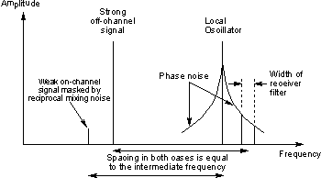
E4C01 What is an effect of excessive phase noise in the local oscillator section of a receiver?
A. It limits the receiver’s ability to receive strong signals
B. It reduces receiver sensitivity
C. It decreases receiver third-order intermodulation distortion dynamic range
D. It can cause strong signals on nearby frequencies to interfere with reception of weak signals

Slide 81
E4C02 Which of the following portions of a receiver can be effective in eliminating image signal interference?
A. A front-end filter or pre-selector
B. A narrow IF filter
C. A notch filter
D. A properly adjusted product detector

Slide 82
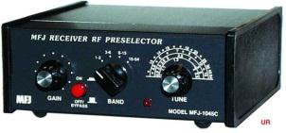
E4C02 Which of the following portions of a receiver can be effective in eliminating image signal interference?
A. A front-end filter or pre-selector
B. A narrow IF filter
C. A notch filter
D. A properly adjusted product detector

Slide 83
E4C03 What is the term for the blocking of one FM phone signal by another, stronger FM phone signal?
A. Desensitization
B. Cross-modulation interference
C. Capture effect
D. Frequency discrimination

Slide 84
E4C03 What is the term for the blocking of one FM phone signal by another, stronger FM phone signal?
A. Desensitization
B. Cross-modulation interference
C. Capture effect
D. Frequency discrimination

Slide 85
E4C04 How is the noise figure of a receiver defined?
A. The ratio of atmospheric noise to phase noise
B. The ratio of the noise bandwidth in Hertz to the theoretical bandwidth of a resistive network
C. The ratio of thermal noise to atmospheric noise
D. The ratio in dB of the noise generated by the receiver to the theoretical minimum noise

Slide 86
E4C04 How is the noise figure of a receiver defined?
A. The ratio of atmospheric noise to phase noise
B. The ratio of the noise bandwidth in Hertz to the theoretical bandwidth of a resistive network
C. The ratio of thermal noise to atmospheric noise
D. The ratio in dB of the noise generated by the receiver to the theoretical minimum noise
The noise figure is a way of describing the amount of noise generated in a receiver, amp, transmission line, antenna system, or other component. The noise figure of a component or system is defined as the signal-to-noise ratio at the input divided by the signal-to-noise ratio at the output, with the input noise equal to the noise available from a matched resistance at a temperature of T0=290 Kelvin.

Slide 87
E4C05 What does a value of -174 dBm/Hz represent with regard to the noise floor of a receiver?
A. The minimum detectable signal as a function of receive frequency
B. The theoretical noise at the input of a perfect receiver at room temperature
C. The noise figure of a 1 Hz bandwidth receiver
D. The galactic noise contribution to minimum detectable signal

Slide 88
E4C05 What does a value of -174 dBm/Hz represent with regard to the noise floor of a receiver?
A. The minimum detectable signal as a function of receive frequency
B. The theoretical noise at the input of a perfect receiver at room temperature
C. The noise figure of a 1 Hz bandwidth receiver
D. The galactic noise contribution to minimum detectable signal
This noise floor will be higher as the receiver bandwidth is increased. A receiver with a 10 KHz bandwidth will have 10,000 times more noise or an additional 40dB of noise bringing the noise floor up to – 174dBm + 40 dB or -134 dBm.

Slide 89
E4C06 A CW receiver with the AGC off has an equivalent input noise power density of -174 dBm/Hz. What would be the level of an unmodulated carrier input to this receiver that would yield an audio output SNR of 0 dB in a 400 Hz noise bandwidth?
A. -174 dBm
B. -164 dBm
C. -155 dBm
D. -148 dBm

Slide 90
E4C06 A CW receiver with the AGC off has an equivalent input noise power density of -174 dBm/Hz. What would be the level of an unmodulated carrier input to this receiver that would yield an audio output SNR of 0 dB in a 400 Hz noise bandwidth?
A. -174 dBm
B. -164 dBm
C. -155 dBm
D. -148 dBm

Slide 91
THEORITICAL NOISE FLOOR
This noise floor will be higher as the receiver bandwidth is increased.
A receiver with a 400 KHz bandwidth will have 400 times more noise or
an additional 26 dB o noise bringing the noise floor up to – 174dBm + 26 dB or -148 dBm.
dB= 10 * log (bw-2/bw-1) or
dB= 10 * log (400/1) = 10 (2.602) or dB=26
Therefore the new noise floor will be -174 +26 or -148dBm

Slide 92
E4C07 What does the MDS of a receiver represent?
A. The meter display sensitivity
B. The minimum discernible signal
C. The multiplex distortion stability
D. The maximum detectable spectrum

Slide 93
E4C07 What does the MDS of a receiver represent?
A. The meter display sensitivity
B. The minimum discernible signal
C. The multiplex distortion stability
D. The maximum detectable spectrum

Slide 94
E4C08 An SDR receiver is overloaded when input signals exceed what level?
A. One-half the maximum sample rate
B. One-half the maximum sampling buffer size
C. The maximum count value of the analog-to-digital converter
D. The reference voltage of the analog-to-digital converter

Slide 95
E4C08 An SDR receiver is overloaded when input signals exceed what level?
A. One-half the maximum sample rate
B. One-half the maximum sampling buffer size
C. The maximum count value of the analog-to-digital converter
D. The reference voltage of the analog-to-digital converter

Slide 96
E4C09 Which of the following choices is a good reason for selecting a high frequency for the design of the IF in a conventional HF or VHF communications receiver?
A. Fewer components in the receiver
B. Reduced drift
C. Easier for front-end circuitry to eliminate image responses
D. Improved receiver noise figure

Slide 97
E4C09 Which of the following choices is a good reason for selecting a high frequency for the design of the IF in a conventional HF or VHF communications receiver?
A. Fewer components in the receiver
B. Reduced drift
C. Easier for front-end circuitry to eliminate image responses
D. Improved receiver noise figure

Slide 98
E4C10 Which of the following is a desirable amount of selectivity for an amateur RTTY HF receiver?
A. 100 Hz
B. 300 Hz
C. 6000 Hz
D. 2400 Hz

Slide 99
E4C10 Which of the following is a desirable amount of selectivity for an amateur RTTY HF receiver?
A. 100 Hz
B. 300 Hz
C. 6000 Hz
D. 2400 Hz

Slide 100
E4C11 Which of the following is a desirable amount of selectivity for an amateur SSB phone receiver?
A. 1 kHz
B. 2.4 kHz
C. 4.2 kHz
D. 4.8 kHz

Slide 101
E4C11 Which of the following is a desirable amount of selectivity for an amateur SSB phone receiver?
A. 1 kHz
B. 2.4 kHz
C. 4.2 kHz
D. 4.8 kHz

Slide 102
E4C12 What is an undesirable effect of using too wide a filter bandwidth in the IF section of a receiver?
A. Output-offset overshoot
B. Filter ringing
C. Thermal-noise distortion
D. Undesired signals may be heard

Slide 103
E4C12 What is an undesirable effect of using too wide a filter bandwidth in the IF section of a receiver?
A. Output-offset overshoot
B. Filter ringing
C. Thermal-noise distortion
D. Undesired signals may be heard

Slide 104
E4C13 How does a narrow-band roofing filter affect receiver performance?
A. It improves sensitivity by reducing front end noise
B. It improves intelligibility by using low Q circuitry to reduce ringing
C. It improves dynamic range by attenuating strong signals near the receive frequency
D. All of these choices are correct

Slide 105
E4C13 How does a narrow-band roofing filter affect receiver performance?
A. It improves sensitivity by reducing front end noise
B. It improves intelligibility by using low Q circuitry to reduce ringing
C. It improves dynamic range by attenuating strong signals near the receive frequency
D. All of these choices are correct

Slide 106
E4C14 What transmit frequency might generate an image response signal in a receiver tuned to 14.300 MHz and which uses a 455 kHz IF frequency?
A. 13.845 MHz
B. 14.755 MHz
C. 14.445 MHz
D. 15.210 MHz

Slide 107
E4C14 What transmit frequency might generate an image response signal in a receiver tuned to 14.300 MHz and which uses a 455 kHz IF frequency?
14,300 14,300
- 455 + 455
13,845 VFO 14,755 2nd harmonic
- 455 + 455
13,390 15,210 3rd harmonic
A. 13.845 MHz
B. 14.755 MHz
C. 14.445 MHz
D. 15.210 MHz

Slide 108
IMAGE IF SIGNAL
1 When a local oscillator signal is mixed with an incoming signal in generates the sum and the difference of the two signals.
If we assume High side mix (the LO is higher than the tuned frequency then the LO will be the tuned frequency + 455KHz.
A signal 455 KHz above the LO would also generate a 455 KHz IF spurious or image signal.
So taking the receive frequency of 14.300 MHz and 2 times the IF frequency of 0.455 MHz (14.300 – (2x.455) we get 15.210 MHz.

Slide 109
E4C15 What is usually the primary source of noise that is heard from an HF receiver with an antenna connected?
A. Detector noise
B. Induction motor noise
C. Receiver front-end noise
D. Atmospheric noise

Slide 110
E4C15 What is usually the primary source of noise that is heard from an HF receiver with an antenna connected?
A. Detector noise
B. Induction motor noise
C. Receiver front-end noise
D. Atmospheric noise

Slide 111
E4C16 Which of the following is caused by missing codes in an SDR receiver’s analog-to-digital converter?
A. Distortion
B. Overload
C. Loss of sensitivity
D. Excess output level

Slide 112
E4C16 Which of the following is caused by missing codes in an SDR receiver’s analog-to-digital converter?
A. Distortion
B. Overload
C. Loss of sensitivity
D. Excess output level

Slide 113
E4C17 Which of the following has the largest effect on an SDR receiver’s linearity?
A. CPU register width in bits
B. Anti-aliasing input filter bandwidth
C. RAM speed used for data storage
D. Analog-to-digital converter sample width in bits

Slide 114
E4C17 Which of the following has the largest effect on an SDR receiver’s linearity?
A. CPU register width in bits
B. Anti-aliasing input filter bandwidth
C. RAM speed used for data storage
D. Analog-to-digital converter sample width in bits

Slide 115
E4D Receiver performance characteristics
blocking dynamic range; intermodulation and cross-modulation interference; 3rd order intercept; desensitization; preselector

Slide 116
E4D01 What is meant by the blocking dynamic range of a receiver?
A. The difference in dB between the noise floor and the level of an incoming signal which will cause 1 dB of gain compression
B. The minimum difference in dB between the levels of two FM signals which will cause one signal to block the other
C. The difference in dB between the noise floor and the third order intercept point
D. The minimum difference in dB between two signals which produce third order intermodulation products greater than the noise floor

Slide 117
E4D01 What is meant by the blocking dynamic range of a receiver?
A. The difference in dB between the noise floor and the level of an incoming signal which will cause 1 dB of gain compression
B. The minimum difference in dB between the levels of two FM signals which will cause one signal to block the other
C. The difference in dB between the noise floor and the third order intercept point
D. The minimum difference in dB between two signals which produce third order intermodulation products greater than the noise floor

Slide 118
E4D02 Which of the following describes two problems caused by poor dynamic range in a communications receiver?
A. Cross-modulation of the desired signal and desensitization from strong adjacent signals
B. Oscillator instability requiring frequent retuning and loss of ability to recover the opposite sideband
C. Cross-modulation of the desired signal and insufficient audio power to operate the speaker
D. Oscillator instability and severe audio distortion of all but the strongest received signals

Slide 119
E4D02 Which of the following describes two problems caused by poor dynamic range in a communications receiver?
A. Cross-modulation of the desired signal and desensitization from strong adjacent signals
B. Oscillator instability requiring frequent retuning and loss of ability to recover the opposite sideband
C. Cross-modulation of the desired signal and insufficient audio power to operate the speaker
D. Oscillator instability and severe audio distortion of all but the strongest received signals

Slide 120
E4D03 How can intermodulation interference between two repeaters occur?
A. When the repeaters are in close proximity and the signals cause feedback in the final amplifier of one or both transmitters
B. When the repeaters are in close proximity and the signals mix in the final amplifier of one or both transmitters
C. When the signals from the transmitters are reflected out of phase from airplanes passing overhead
D. When the signals from the transmitters are reflected in phase from airplanes passing overhead

Slide 121
E4D03 How can intermodulation interference between two repeaters occur?
A. When the repeaters are in close proximity and the signals cause feedback in the final amplifier of one or both transmitters
B. When the repeaters are in close proximity and the signals mix in the final amplifier of one or both transmitters
C. When the signals from the transmitters are reflected out of phase from airplanes passing overhead
D. When the signals from the transmitters are reflected in phase from airplanes passing overhead

Slide 122
E4D04 Which of the following may reduce or eliminate intermodulation interference in a repeater caused by another transmitter operating in close proximity?
A. A band-pass filter in the feed line between the transmitter and receiver
B. A properly terminated circulator at the output of the transmitter
C. A Class C final amplifier
D. A Class D final amplifier

Slide 123
E4D04 Which of the following may reduce or eliminate intermodulation interference in a repeater caused by another transmitter operating in close proximity?
A. A band-pass filter in the feed line between the transmitter and receiver
B. A properly terminated circulator at the output of the transmitter
C. A Class C final amplifier
D. A Class D final amplifier

Slide 124
E4D05 What transmitter frequencies would cause an intermodulation-product signal in a receiver tuned to 146.70 MHz when a nearby station transmits on 146.52 MHz?
A. 146.34 MHz and 146.61 MHz
B. 146.88 MHz and 146.34 MHz
C. 146.10 MHz and 147.30 MHz
D. 173.35 MHz and 139.40 MHz

Slide 125
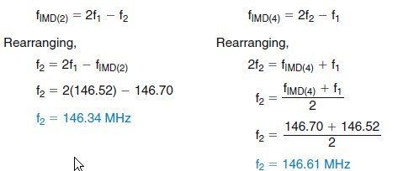
E4D05 What transmitter frequencies would cause an intermodulation-product signal in a receiver tuned to 146.70 MHz when a nearby station transmits on 146.52 MHz?
A. 146.34 MHz and 146.61 MHz
B. 146.88 MHz and 146.34 MHz
C. 146.10 MHz and 147.30 MHz
D. 173.35 MHz and 139.40 MHz

Slide 126
E4D06 What is the term for unwanted signals generated by the mixing of two or more signals?
A. Amplifier desensitization
B. Neutralization
C. Adjacent channel interference
D. Intermodulation interference

Slide 127
E4D06 What is the term for unwanted signals generated by the mixing of two or more signals?
A. Amplifier desensitization
B. Neutralization
C. Adjacent channel interference
D. Intermodulation interference

Slide 128
E4D07 Which of the following describes the most significant effect of an off-frequency signal when it is causing cross-modulation interference to a desired signal?
A. A large increase in background noise
B. A reduction in apparent signal strength
C. The desired signal can no longer be heard
D. The off-frequency unwanted signal is heard in addition to the desired signal

Slide 129
E4D07 Which of the following describes the most significant effect of an off-frequency signal when it is causing cross-modulation interference to a desired signal?
A. A large increase in background noise
B. A reduction in apparent signal strength
C. The desired signal can no longer be heard
D. The off-frequency unwanted signal is heard in addition to the desired signal

Slide 130
E4D08 What causes intermodulation in an electronic circuit?
A. Too little gain
B. Lack of neutralization
C. Nonlinear circuits or devices
D. Positive feedback

Slide 131
E4D08 What causes intermodulation in an electronic circuit?
A. Too little gain
B. Lack of neutralization
C. Nonlinear circuits or devices
D. Positive feedback

Slide 132
E4D09 What is the purpose of the preselector in a communications receiver?
A. To store often-used frequencies
B. To provide a range of AGC time constants
C. To increase rejection of unwanted signals
D. To allow selection of the optimum RF amplifier device

Slide 133
E4D09 What is the purpose of the preselector in a communications receiver?
A. To store often-used frequencies
B. To provide a range of AGC time constants
C. To increase rejection of unwanted signals
D. To allow selection of the optimum RF amplifier device

Slide 134
E4D10 What does a third-order intercept level of 40 dBm mean with respect to receiver performance?
A. Signals less than 40 dBm will not generate audible third-order intermodulation products
B. The receiver can tolerate signals up to 40 dB above the noise floor without producing third-order intermodulation products
C. A pair of 40 dBm signals will theoretically generate a third-order intermodulation product with the same level as the input signals
D. A pair of 1 mW input signals will produce a third-order intermodulation product which is 40 dB stronger than the input signal

Slide 135
E4D10 What does a third-order intercept level of 40 dBm mean with respect to receiver performance?
A. Signals less than 40 dBm will not generate audible third-order intermodulation products
B. The receiver can tolerate signals up to 40 dB above the noise floor without producing third-order intermodulation products
C. A pair of 40 dBm signals will theoretically generate a third-order intermodulation product with the same level as the input signals
D. A pair of 1 mW input signals will produce a third-order intermodulation product which is 40 dB stronger than the input signal

Slide 136
E4D11 Why are third-order intermodulation products created within a receiver of particular interest compared to other products?
A. The third-order product of two signals which are in the band of interest is also likely to be within the band
B. The third-order intercept is much higher than other orders
C. Third-order products are an indication of poor image rejection
D. Third-order intermodulation produces three products for every input signal within the band of interest

Slide 137
E4D11 Why are third-order intermodulation products created within a receiver of particular interest compared to other products?
A. The third-order product of two signals which are in the band of interest is also likely to be within the band
B. The third-order intercept is much higher than other orders
C. Third-order products are an indication of poor image rejection
D. Third-order intermodulation produces three products for every input signal within the band of interest

Slide 138
E4D12 What is the term for the reduction in receiver sensitivity caused by a strong signal near the received frequency?
A. Desensitization
B. Quieting
C. Cross-modulation interference
D. Squelch gain rollback

Slide 139
E4D12 What is the term for the reduction in receiver sensitivity caused by a strong signal near the received frequency?
A. Desensitization
B. Quieting
C. Cross-modulation interference
D. Squelch gain rollback

Slide 140
E4D13 Which of the following can cause receiver desensitization?
A. Audio gain adjusted too low
B. Strong adjacent channel signals
C. Audio bias adjusted too high
D. Squelch gain misadjusted

Slide 141
E4D13 Which of the following can cause receiver desensitization?
A. Audio gain adjusted too low
B. Strong adjacent channel signals
C. Audio bias adjusted too high
D. Squelch gain misadjusted

Slide 142
E4D14 Which of the following is a way to reduce the likelihood of receiver desensitization?
A. Decrease the RF bandwidth of the receiver
B. Raise the receiver IF frequency
C. Increase the receiver front end gain
D. Switch from fast AGC to slow AGC

Slide 143
E4D14 Which of the following is a way to reduce the likelihood of receiver desensitization?
A. Decrease the RF bandwidth of the receiver
B. Raise the receiver IF frequency
C. Increase the receiver front end gain
D. Switch from fast AGC to slow AGC

Slide 144
E4E Noise suppression
system noise; electrical appliance noise; line noise; locating noise sources; DSP noise reduction; noise blankers; grounding for signals

Slide 145
E4E01 Which of the following types of receiver noise can often be reduced by use of a receiver noise blanker?
A. Ignition noise
B. Broadband white noise
C. Heterodyne interference
D. All of these choices are correct

Slide 146
E4E01 Which of the following types of receiver noise can often be reduced by use of a receiver noise blanker?
A. Ignition noise
B. Broadband white noise
C. Heterodyne interference
D. All of these choices are correct

Slide 147
E4E02 Which of the following types of receiver noise can often be reduced with a DSP noise filter?
A. Broadband white noise
B. Ignition noise
C. Power line noise
D. All of these choices are correct

Slide 148
E4E02 Which of the following types of receiver noise can often be reduced with a DSP noise filter?
A. Broadband white noise
B. Ignition noise
C. Power line noise
D. All of these choices are correct

Slide 149
E4E03 Which of the following signals might a receiver noise blanker be able to remove from desired signals?
A. Signals which are constant at all IF levels
B. Signals which appear across a wide bandwidth
C. Signals which appear at one IF but not another
D. Signals which have a sharply peaked frequency distribution

Slide 150
E4E03 Which of the following signals might a receiver noise blanker be able to remove from desired signals?
A. Signals which are constant at all IF levels
B. Signals which appear across a wide bandwidth
C. Signals which appear at one IF but not another
D. Signals which have a sharply peaked frequency distribution

Slide 151
E4E04 How can conducted and radiated noise caused by an automobile alternator be suppressed?
A. By installing filter capacitors in series with the DC power lead and a blocking capacitor in the field lead
B. By installing a noise suppression resistor and a blocking capacitor in both leads
C. By installing a high-pass filter in series with the radio's power lead and a low-pass filter in parallel with the field lead
D. By connecting the radio's power leads directly to the battery and by installing coaxial capacitors in line with the alternator leads

Slide 152
E4E04 How can conducted and radiated noise caused by an automobile alternator be suppressed?
A. By installing filter capacitors in series with the DC power lead and a blocking capacitor in the field lead
B. By installing a noise suppression resistor and a blocking capacitor in both leads
C. By installing a high-pass filter in series with the radio's power lead and a low-pass filter in parallel with the field lead
D. By connecting the radio's power leads directly to the battery and by installing coaxial capacitors in line with the alternator leads

Slide 153
E4E05 How can noise from an electric motor be suppressed?
A. By installing a high pass filter in series with the motor’s power leads
B. By installing a brute-force AC-line filter in series with the motor leads
C. By installing a bypass capacitor in series with the motor leads
D. By using a ground-fault current interrupter in the circuit used to power the motor

Slide 154
E4E05 How can noise from an electric motor be suppressed?
A. By installing a high pass filter in series with the motor’s power leads
B. By installing a brute-force AC-line filter in series with the motor leads
C. By installing a bypass capacitor in series with the motor leads
D. By using a ground-fault current interrupter in the circuit used to power the motor

Slide 155
E4E06 What is a major cause of atmospheric static?
A. Solar radio frequency emissions
B. Thunderstorms
C. Geomagnetic storms
D. Meteor showers

Slide 156
E4E06 What is a major cause of atmospheric static?
A. Solar radio frequency emissions
B. Thunderstorms
C. Geomagnetic storms
D. Meteor showers

Slide 157
E4E07 How can you determine if line noise interference is being generated within your home?
A. By checking the power line voltage with a time domain reflectometer
B. By observing the AC power line waveform with an oscilloscope
C. By turning off the AC power line main circuit breaker and listening on a battery operated radio
D. By observing the AC power line voltage with a spectrum analyzer

Slide 158
E4E07 How can you determine if line noise interference is being generated within your home?
A. By checking the power line voltage with a time domain reflectometer
B. By observing the AC power line waveform with an oscilloscope
C. By turning off the AC power line main circuit breaker and listening on a battery operated radio
D. By observing the AC power line voltage with a spectrum analyzer

Slide 159
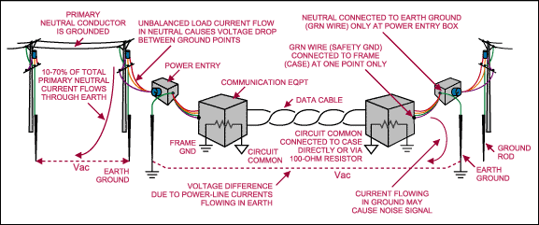
The principal aim of any data-transmission system is to
send data from one location to another,
whether within a single box or enclosure, between boxes within an enclosure, between enclosures within a building or defined area, or between buildings.
Figure 1 illustrates an RS-485 signaling situation in which the buildings are supplied from different power
circuits.

Slide 160
E4E08 What type of signal is picked up by electrical wiring near a radio antenna?
A. A common-mode signal at the frequency of the radio transmitter
B. An electrical-sparking signal
C. A differential-mode signal at the AC power line frequency
D. Harmonics of the AC power line frequency

Slide 161
E4E08 What type of signal is picked up by electrical wiring near a radio antenna?
A. A common-mode signal at the frequency of the radio transmitter
B. An electrical-sparking signal
C. A differential-mode signal at the AC power line frequency
D. Harmonics of the AC power line frequency

Slide 162
E4E09 What undesirable effect can occur when using an IF noise blanker?
A. Received audio in the speech range might have an echo effect
B. The audio frequency bandwidth of the received signal might be compressed
C. Nearby signals may appear to be excessively wide even if they meet emission standards
D. FM signals can no longer be demodulated

Slide 163
E4E09 What undesirable effect can occur when using an IF noise blanker?
A. Received audio in the speech range might have an echo effect
B. The audio frequency bandwidth of the received signal might be compressed
C. Nearby signals may appear to be excessively wide even if they meet emission standards
D. FM signals can no longer be demodulated

Slide 164
E4E10 What is a common characteristic of interference caused by a touch controlled electrical device?
A. The interfering signal sounds like AC hum on an AM receiver or a carrier modulated by 60 Hz hum on a SSB or CW receiver
B. The interfering signal may drift slowly across the HF spectrum
C. The interfering signal can be several kHz in width and usually repeats at regular intervals across a HF band
D. All of these choices are correct

Slide 165
E4E10 What is a common characteristic of interference caused by a touch controlled electrical device?
A. The interfering signal sounds like AC hum on an AM receiver or a carrier modulated by 60 Hz hum on a SSB or CW receiver
B. The interfering signal may drift slowly across the HF spectrum
C. The interfering signal can be several kHz in width and usually repeats at regular intervals across a HF band
D. All of these choices are correct

Slide 166
E4E11 Which is the most likely cause if you are hearing combinations of local AM broadcast signals within one or more of the MF or HF ham bands?
A. The broadcast station is transmitting an over-modulated signal
B. Nearby corroded metal joints are mixing and re-radiating the broadcast signals
C. You are receiving sky wave signals from a distant station
D. Your station receiver IF amplifier stage is defective

Slide 167
E4E11 Which is the most likely cause if you are hearing combinations of local AM broadcast signals within one or more of the MF or HF ham bands?
A. The broadcast station is transmitting an over-modulated signal
B. Nearby corroded metal joints are mixing and re-radiating the broadcast signals
C. You are receiving sky wave signals from a distant station
D. Your station receiver IF amplifier stage is defective

Slide 168
E4E12 What is one disadvantage of using some types of automatic DSP notch-filters when attempting to copy CW signals?
A. A DSP filter can remove the desired signal at the same time as it removes interfering signals
B. Any nearby signal passing through the DSP system will overwhelm the desired signal
C. Received CW signals will appear to be modulated at the DSP clock frequency
D. Ringing in the DSP filter will completely remove the spaces between the CW characters

Slide 169
E4E12 What is one disadvantage of using some types of automatic DSP notch-filters when attempting to copy CW signals?
A. A DSP filter can remove the desired signal at the same time as it removes interfering signals
B. Any nearby signal passing through the DSP system will overwhelm the desired signal
C. Received CW signals will appear to be modulated at the DSP clock frequency
D. Ringing in the DSP filter will completely remove the spaces between the CW characters

Slide 170
E4E13 What might be the cause of a loud roaring or buzzing AC line interference that comes and goes at intervals?
A. Arcing contacts in a thermostatically controlled device
B. A defective doorbell or doorbell transformer inside a nearby residence
C. A malfunctioning illuminated advertising display
D. All of these choices are correct

Slide 171
E4E13 What might be the cause of a loud roaring or buzzing AC line interference that comes and goes at intervals?
A. Arcing contacts in a thermostatically controlled device
B. A defective doorbell or doorbell transformer inside a nearby residence
C. A malfunctioning illuminated advertising display
D. All of these choices are correct

Slide 172
E4E14 What is one type of electrical interference that might be caused by the operation of a nearby personal computer?
A. A loud AC hum in the audio output of your station receiver
B. A clicking noise at intervals of a few seconds
C. The appearance of unstable modulated or unmodulated signals at specific frequencies
D. A whining type noise that continually pulses off and on

Slide 173
E4E14 What is one type of electrical interference that might be caused by the operation of a nearby personal computer?
A. A loud AC hum in the audio output of your station receiver
B. A clicking noise at intervals of a few seconds
C. The appearance of unstable modulated or unmodulated signals at specific frequencies
D. A whining type noise that continually pulses off and on

Slide 174
E4E15 Which of the following can cause shielded cables to radiate or receive interference?
A. Low inductance ground connections at both ends of the shield
B. Common mode currents on the shield and conductors
C. Use of braided shielding material
D. Tying all ground connections to a common point resulting in differential mode currents in the shield

Slide 175
E4E15 Which of the following can cause shielded cables to radiate or receive interference?
A. Low inductance ground connections at both ends of the shield
B. Common mode currents on the shield and conductors
C. Use of braided shielding material
D. Tying all ground connections to a common point resulting in differential mode currents in the shield

Slide 176
E4E16 What current flows equally on all conductors of an unshielded multi-conductor cable?
A. Differential-mode current
B. Common-mode current
C. Reactive current only
D. Return current

Slide 177
E4E16 What current flows equally on all conductors of an unshielded multi-conductor cable?
A. Differential-mode current
B. Common-mode current
C. Reactive current only
D. Return current

Slide 178
End of
SUBELEMENT E4
AMATEUR PRACTICES

