Slide 1
SUBELEMENT E6
CIRCUIT COMPONENTS
[6 Exam Questions - 6 Groups]
Notes:
Extra Question Pool 2016. The Western Washington Ham Training Team makes these slides available to teach Amateur Technician Radio Licensing Classes. Daniel Stevens KL7WM, Training Coordinator, Howard Swartz, W7HS, Slide master, Dustin Lomax, KF7FK, Leading Instructor, LW Abel, K7LWA, Enthusiasm Leader.

Slide 2
E6A Semiconductor materials and devices: semiconductor materials germanium, silicon, P-type, N-type; transistor types: NPN, PNP, junction, field-effect transistors: enhancement mode; depletion mode; MOS; CMOS; N-channel; P-channel
E6B Semiconductor diodes
E6C Integrated circuits: TTL digital integrated circuits; CMOS digital integrated circuits; gates
E6D Optical devices and toroids: cathode-ray tube devices; charge-coupled devices (CCDs); liquid crystal displays (LCDs); toroids: permeability, core material, selecting, winding
E6E Piezoelectric crystals and MMICs: quartz crystals; crystal oscillators and filters; monolithic amplifiers
E6F Optical components and power systems: photoconductive principles and effects, photovoltaic systems, optical couplers, optical sensors, and optoisolators

Slide 3
E6A Semiconductor materials and devices
semiconductor materials; germanium, silicon, P-type, N-type; transistor types: NPN, PNP, junction, field-effect transistors: enhancement mode; depletion mode; MOS; CMOS; N-channel; P-channel

Slide 4
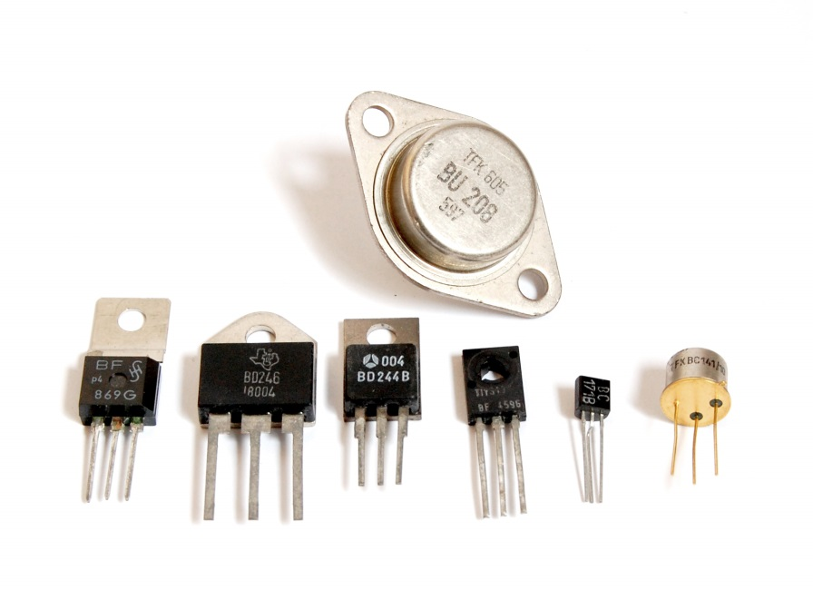
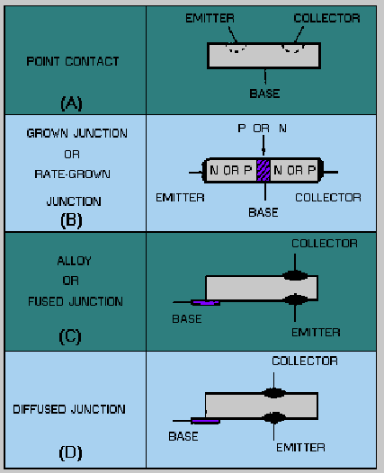
Transistor Construction

Slide 5
E6A01 In what application is gallium arsenide used as a semiconductor material in preference to germanium or silicon?
A. In high-current rectifier circuits
B. In high-power audio circuits
C. In microwave circuits
D. In very low frequency RF circuits

Slide 6
E6A01 In what application is gallium arsenide used as a semiconductor material in preference to germanium or silicon?
A. In high-current rectifier circuits
B. In high-power audio circuits
C. In microwave circuits
D. In very low frequency RF circuits

Slide 7
E6A02 Which of the following semiconductor materials contains excess free electrons?
A. N-type
B. P-type
C. Bipolar
D. Insulated gate

Slide 8
E6A02 Which of the following semiconductor materials contains excess free electrons?
A. N-type
B. P-type
C. Bipolar
D. Insulated gate

Slide 9
E6A03 Why does a PN-junction diode not conduct current when reverse biased?
A. Only P-type semiconductor material can conduct current
B. Only N-type semiconductor material can conduct current
C. Holes in P-type material and electrons in the N-type material are separated by the applied voltage, widening the depletion region
D. Excess holes in P-type material combine with the electrons in N-type material, converting the entire diode into an insulator

Slide 10
E6A03 Why does a PN-junction diode not conduct current when reverse biased?
A. Only P-type semiconductor material can conduct current
B. Only N-type semiconductor material can conduct current
C. Holes in P-type material and electrons in the N-type material are separated by the applied voltage, widening the depletion region
D. Excess holes in P-type material combine with the electrons in N-type material, converting the entire diode into an insulator

Slide 11
E6A04 What is the name given to an impurity atom that adds holes to a semiconductor crystal structure?
A. Insulator impurity
B. N-type impurity
C. Acceptor impurity
D. Donor impurity

Slide 12
E6A04 What is the name given to an impurity atom that adds holes to a semiconductor crystal structure?
A. Insulator impurity
B. N-type impurity
C. Acceptor impurity
D. Donor impurity

Slide 13
E6A05 What is the alpha of a bipolar junction transistor?
A. The change of collector current with respect to base current
B. The change of base current with respect to collector current
C. The change of collector current with respect to emitter current
D. The change of collector current with respect to gate current

Slide 14
E6A05 What is the alpha of a bipolar junction transistor?
A. The change of collector current with respect to base current
B. The change of base current with respect to collector current
C. The change of collector current with respect to emitter current
D. The change of collector current with respect to gate current

Slide 15
E6A06 What is the beta of a bipolar junction transistor?
A. The frequency at which the current gain is reduced to 1
B. The change in collector current with respect to base current
C. The breakdown voltage of the base to collector junction
D. The switching speed of the transistor

Slide 16
E6A06 What is the beta of a bipolar junction transistor?
A. The frequency at which the current gain is reduced to 1
B. The change in collector current with respect to base current
C. The breakdown voltage of the base to collector junction
D. The switching speed of the transistor

Slide 17
E6A07 Which of the following indicates that a silicon NPN junction transistor is biased on?
A. Base-to-emitter resistance of approximately 6 to 7 ohms
B. Base-to-emitter resistance of approximately 0.6 to 0.7 ohms
C. Base-to-emitter voltage of approximately 6 to 7 volts
D. Base-to-emitter voltage of approximately 0.6 to 0.7 volts

Slide 18
E6A07 Which of the following indicates that a silicon NPN junction transistor is biased on?
A. Base-to-emitter resistance of approximately 6 to 7 ohms
B. Base-to-emitter resistance of approximately 0.6 to 0.7 ohms
C. Base-to-emitter voltage of approximately 6 to 7 volts
D. Base-to-emitter voltage of approximately 0.6 to 0.7 volts

Slide 19
E6A08 What term indicates the frequency at which the grounded-base current gain of a transistor has decreased to 0.7 of the gain obtainable at 1 kHz?
A. Corner frequency
B. Alpha rejection frequency
C. Beta cutoff frequency
D. Alpha cutoff frequency

Slide 20
E6A08 What term indicates the frequency at which the grounded-base current gain of a transistor has decreased to 0.7 of the gain obtainable at 1 kHz?
A. Corner frequency
B. Alpha rejection frequency
C. Beta cutoff frequency
D. Alpha cutoff frequency

Slide 21
E6A09 What is a depletion-mode FET?
A. An FET that exhibits a current flow between source and drain when no gate voltage is applied
B. An FET that has no current flow between source and drain when no gate voltage is applied
C. Any FET without a channel
D. Any FET for which holes are the majority carriers

Slide 22
E6A09 What is a depletion-mode FET?
A. An FET that exhibits a current flow between source and drain when no gate voltage is applied
B. An FET that has no current flow between source and drain when no gate voltage is applied
C. Any FET without a channel
D. Any FET for which holes are the majority carriers

Slide 23
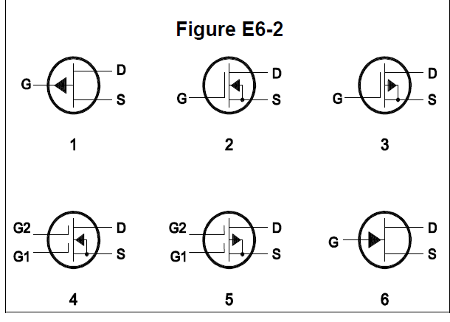
E6A10 In Figure E6-2, what is the schematic symbol for an N-channel dual-gate MOSFET?
A. 2
B. 4
C. 5
D. 6

Slide 24
E6A10 In Figure E6-2, what is the schematic symbol for an N-channel dual-gate MOSFET?
A. 2
B. 4
C. 5
D. 6

Slide 25
E6A11 In Figure E6-2, what is the schematic symbol for a P-channel junction FET?
A. 1
B. 2
C. 3
D. 6

Slide 26
E6A11 In Figure E6-2, what is the schematic symbol for a P-channel junction FET?
A. 1
B. 2
C. 3
D. 6

Slide 27
E6A12 Why do many MOSFET devices have internally connected Zener diodes on the gates?
A. To provide a voltage reference for the correct amount of reverse-bias gate voltage
B. To protect the substrate from excessive voltages
C. To keep the gate voltage within specifications and prevent the device from overheating
D. To reduce the chance of the gate insulation being punctured by static discharges or excessive voltages

Slide 28
E6A12 Why do many MOSFET devices have internally connected Zener diodes on the gates?
A. To provide a voltage reference for the correct amount of reverse-bias gate voltage
B. To protect the substrate from excessive voltages
C. To keep the gate voltage within specifications and prevent the device from overheating
D. To reduce the chance of the gate insulation being punctured by static discharges or excessive voltages

Slide 29
E6A13 What do the initials CMOS stand for?
A. Common Mode Oscillating System
B. Complementary Mica-Oxide Silicon
C. Complementary Metal-Oxide Semiconductor
D. Common Mode Organic Silicon

Slide 30
E6A13 What do the initials CMOS stand for?
A. Common Mode Oscillating System
B. Complementary Mica-Oxide Silicon
C. Complementary Metal-Oxide Semiconductor
D. Common Mode Organic Silicon

Slide 31
E6A14 How does DC input impedance at the gate of a field-effect transistor compare with the DC input impedance of a bipolar transistor?
A. They are both low impedance
B. An FET has low input impedance; a bipolar transistor has high input impedance
C. An FET has high input impedance; a bipolar transistor has low input impedance
D. They are both high impedance

Slide 32
E6A14 How does DC input impedance at the gate of a field-effect transistor compare with the DC input impedance of a bipolar transistor?
A. They are both low impedance
B. An FET has low input impedance; a bipolar transistor has high input impedance
C. An FET has high input impedance; a bipolar transistor has low input impedance
D. They are both high impedance

Slide 33
E6A15 Which semiconductor material contains excess holes in the outer shell of electrons?
A. N-type
B. P-type
C. Superconductor-type
D. Bipolar-type

Slide 34
E6A15 Which semiconductor material contains excess holes in the outer shell of electrons?
A. N-type
B. P-type
C. Superconductor-type
D. Bipolar-type

Slide 35
E6A16 What are the majority charge carriers in N-type semiconductor material?
A. Holes
B. Free electrons
C. Free protons
D. Free neutrons

Slide 36
E6A16 What are the majority charge carriers in N-type semiconductor material?
A. Holes
B. Free electrons
C. Free protons
D. Free neutrons

Slide 37
E6A17 What are the names of the three terminals of a field-effect transistor?
A. Gate 1, gate 2, drain
B. Emitter, base, collector
C. Emitter, base 1, base 2
D. Gate, drain, source

Slide 38
E6A17 What are the names of the three terminals of a field-effect transistor?
A. Gate 1, gate 2, drain
B. Emitter, base, collector
C. Emitter, base 1, base 2
D. Gate, drain, source

Slide 39
E6B Diodes

Slide 40
E6B01 What is the most useful characteristic of a Zener diode?
A. A constant current drop under conditions of varying voltage
B. A constant voltage drop under conditions of varying current
C. A negative resistance region
D. An internal capacitance that varies with the applied voltage

Slide 41
E6B01 What is the most useful characteristic of a Zener diode?
A. A constant current drop under conditions of varying voltage
B. A constant voltage drop under conditions of varying current
C. A negative resistance region
D. An internal capacitance that varies with the applied voltage

Slide 42
E6B02 What is an important characteristic of a Schottky diode as compared to an ordinary silicon diode when used as a power supply rectifier?
A. Much higher reverse voltage breakdown
B. Controlled reverse avalanche voltage
C. Enhanced carrier retention time
D. Less forward voltage drop

Slide 43
E6B02 What is an important characteristic of a Schottky diode as compared to an ordinary silicon diode when used as a power supply rectifier?
A. Much higher reverse voltage breakdown
B. Controlled reverse avalanche voltage
C. Enhanced carrier retention time
D. Less forward voltage drop

Slide 44
E6B03 What special type of diode is capable of both amplification and oscillation?
A. Point contact
B. Zener
C. Tunnel
D. Junction

Slide 45
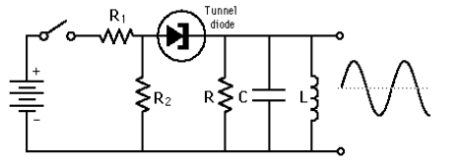
E6B03 What special type of diode is capable of both amplification and oscillation?
A. Point contact
B. Zener
C. Tunnel
D. Junction

Slide 46
E6B04 What type of semiconductor device is designed for use as a voltage-controlled capacitor?
A. Varactor diode
B. Tunnel diode
C. Silicon-controlled rectifier
D. Zener diode

Slide 47
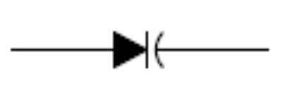
E6B04 What type of semiconductor device is designed for use as a voltage-controlled capacitor?
A. Varactor diode
B. Tunnel diode
C. Silicon-controlled rectifier
D. Zener diode

Slide 48
E6B05 What characteristic of a PIN diode makes it useful as an RF switch or attenuator?
A. Extremely high reverse breakdown voltage
B. Ability to dissipate large amounts of power
C. Reverse bias controls its forward voltage drop
D. A large region of intrinsic material

Slide 49
E6B05 What characteristic of a PIN diode makes it useful as an RF switch or attenuator?
A. Extremely high reverse breakdown voltage
B. Ability to dissipate large amounts of power
C. Reverse bias controls its forward voltage drop
D. A large region of intrinsic material

Slide 50
E6B06 Which of the following is a common use of a hot-carrier diode?
A. As balanced mixers in FM generation
B. As a variable capacitance in an automatic frequency control circuit
C. As a constant voltage reference in a power supply
D. As a VHF / UHF mixer or detector

Slide 51
E6B06 Which of the following is a common use of a hot-carrier diode?
A. As balanced mixers in FM generation
B. As a variable capacitance in an automatic frequency control circuit
C. As a constant voltage reference in a power supply
D. As a VHF / UHF mixer or detector

Slide 52
E6B07 What is the failure mechanism when a junction diode fails due to excessive current?
A. Excessive inverse voltage
B. Excessive junction temperature
C. Insufficient forward voltage
D. Charge carrier depletion

Slide 53
E6B07 What is the failure mechanism when a junction diode fails due to excessive current?
A. Excessive inverse voltage
B. Excessive junction temperature
C. Insufficient forward voltage
D. Charge carrier depletion

Slide 54
E6B08 Which of the following describes a type of semiconductor diode?
A. Metal-semiconductor junction
B. Electrolytic rectifier
C. CMOS-field effect
D. Thermionic emission diode

Slide 55
E6B08 Which of the following describes a type of semiconductor diode?
A. Metal-semiconductor junction
B. Electrolytic rectifier
C. CMOS-field effect
D. Thermionic emission diode

Slide 56
E6B09 What is a common use for point contact diodes?
A. As a constant current source
B. As a constant voltage source
C. As an RF detector
D. As a high voltage rectifier

Slide 57
E6B09 What is a common use for point contact diodes?
A. As a constant current source
B. As a constant voltage source
C. As an RF detector
D. As a high voltage rectifier

Slide 58
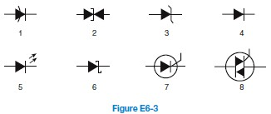
E6B10 In Figure E6-3, what is the schematic symbol for a light-emitting diode?
A. 1
B. 5
C. 6
D. 7

Slide 59
E6B10 In Figure E6-3, what is the schematic symbol for a light-emitting diode?
A. 1
B. 5
C. 6
D. 7

Slide 60
E6B11 What is used to control the attenuation of RF signals by a PIN diode?
A. Forward DC bias current
B. A sub-harmonic pump signal
C. Reverse voltage larger than the RF signal
D. Capacitance of an RF coupling capacitor

Slide 61
E6B11 What is used to control the attenuation of RF signals by a PIN diode?
A. Forward DC bias current
B. A sub-harmonic pump signal
C. Reverse voltage larger than the RF signal
D. Capacitance of an RF coupling capacitor

Slide 62
E6B12 What is one common use for PIN diodes?
A. As a constant current source
B. As a constant voltage source
C. As an RF switch
D. As a high voltage rectifier

Slide 63
E6B12 What is one common use for PIN diodes?
A. As a constant current source
B. As a constant voltage source
C. As an RF switch
D. As a high voltage rectifier

Slide 64
E6B13 What type of bias is required for an LED to emit light?
A. Reverse bias
B. Forward bias
C. Zero bias
D. Inductive bias

Slide 65
E6B13 What type of bias is required for an LED to emit light?
A. Reverse bias
B. Forward bias
C. Zero bias
D. Inductive bias

Slide 66
E6C Digital ICs:
Families of digital ICs; gates; Programmable Logic Devices (PLDs)

Slide 67
E6C01 What is the function of hysteresis in a comparator?
A. To prevent input noise from causing unstable output signals
B. To allow the comparator to be used with AC input signal
C. To cause the output to change states continually
D. To increase the sensitivity

Slide 68
E6C01 What is the function of hysteresis in a comparator?
A. To prevent input noise from causing unstable output signals
B. To allow the comparator to be used with AC input signal
C. To cause the output to change states continually
D. To increase the sensitivity

Slide 69
E6C02 What happens when the level of a comparator’s input signal crosses the threshold?
A. The IC input can be damaged
B. The comparator changes its output state
C. The comparator enters latch-up
D. The feedback loop becomes unstable

Slide 70
E6C02 What happens when the level of a comparator’s input signal crosses the threshold?
A. The IC input can be damaged
B. The comparator changes its output state
C. The comparator enters latch-up
D. The feedback loop becomes unstable

Slide 71
E6C03 What is tri-state logic?
A. Logic devices with 0, 1, and high impedance output states
B. Logic devices that utilize ternary math
C. Low power logic devices designed to operate at 3 volts
D. Proprietary logic devices manufactured by Tri-State Devices

Slide 72
E6C03 What is tri-state logic?
A. Logic devices with 0, 1, and high impedance output states
B. Logic devices that utilize ternary math
C. Low power logic devices designed to operate at 3 volts
D. Proprietary logic devices manufactured by Tri-State Devices

Slide 73
E6C04 What is the primary advantage of tri-state logic?
A. Low power consumption
B. Ability to connect many device outputs to a common bus
C. High speed operation
D. More efficient arithmetic operations

Slide 74
E6C04 What is the primary advantage of tri-state logic?
A. Low power consumption
B. Ability to connect many device outputs to a common bus
C. High speed operation
D. More efficient arithmetic operations

Slide 75
E6C05 What is an advantage of CMOS logic devices over TTL devices?
A. Differential output capability
B. Lower distortion
C. Immune to damage from static discharge
D. Lower power consumption

Slide 76
E6C05 What is an advantage of CMOS logic devices over TTL devices?
A. Differential output capability
B. Lower distortion
C. Immune to damage from static discharge
D. Lower power consumption

Slide 77
E6C06 Why do CMOS digital integrated circuits have high immunity to noise on the input signal or power supply?
A. Larger bypass capacitors are used in CMOS circuit design
B. The input switching threshold is about two times the power supply voltage
C. The input switching threshold is about one-half the power supply voltage
D. Input signals are stronger

Slide 78
E6C06 Why do CMOS digital integrated circuits have high immunity to noise on the input signal or power supply?
A. Larger bypass capacitors are used in CMOS circuit design
B. The input switching threshold is about two times the power supply voltage
C. The input switching threshold is about one-half the power supply voltage
D. Input signals are stronger

Slide 79
E6C07 What best describes a pull-up or pull-down resistor?
A. A resistor in a keying circuit used to reduce key clicks
B. A resistor connected to the positive or negative supply line used to establish a voltage when an input or output is an open circuit
C. A resistor that insures that an oscillator frequency does not drive lower over time
D. A resistor connected to an op-amp output that only functions when the logic output is false

Slide 80
E6C07 What best describes a pull-up or pull-down resistor?
A. A resistor in a keying circuit used to reduce key clicks
B. A resistor connected to the positive or negative supply line used to establish a voltage when an input or output is an open circuit
C. A resistor that insures that an oscillator frequency does not drive lower over time
D. A resistor connected to an op-amp output that only functions when the logic output is false

Slide 81
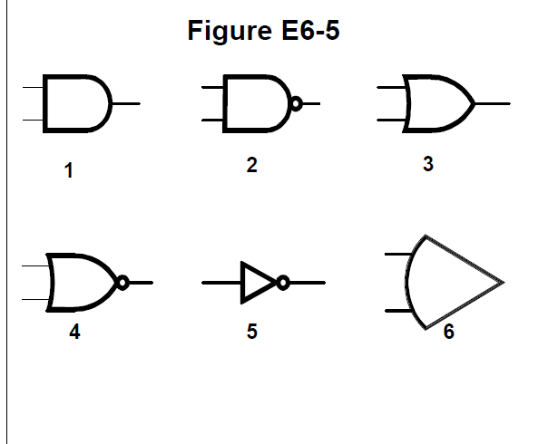
E6C08 In Figure E6-5, what is the schematic symbol for a NAND gate?
A. 1
B. 2
C. 3
D. 4

Slide 82
E6C08 In Figure E6-5, what is the schematic symbol for a NAND gate?
A. 1
B. 2
C. 3
D. 4

Slide 83
E6C09 What is a Programmable Logic Device (PLD)?
A. A device to control industrial equipment
B. A programmable collection of logic gates and circuits in a single integrated circuit
C. Programmable equipment used for testing digital logic integrated circuits
D. An algorithm for simulating logic functions during circuit design

Slide 84
E6C09 What is a Programmable Logic Device (PLD)?
A. A device to control industrial equipment
B. A programmable collection of logic gates and circuits in a single integrated circuit
C. Programmable equipment used for testing digital logic integrated circuits
D. An algorithm for simulating logic functions during circuit design

Slide 85
E6C10 In Figure E6-5, what is the schematic symbol for a NOR gate?
A. 1
B. 2
C. 3
D. 4

Slide 86
E6C10 In Figure E6-5, what is the schematic symbol for a NOR gate?
A. 1
B. 2
C. 3
D. 4

Slide 87
E6C11 In Figure E6-5, what is the schematic symbol for the NOT operation (inverter)?
A. 2
B. 4
C. 5
D. 6

Slide 88
E6C11 In Figure E6-5, what is the schematic symbol for the NOT operation (inverter)?
A. 2
B. 4
C. 5
D. 6

Slide 89
E6C12 What is BiCMOS logic?
A. A logic device with two CMOS circuits per package
B. A FET logic family based on bimetallic semiconductors
C. A logic family based on bismuth CMOS devices
D. An integrated circuit logic family using both bipolar and CMOS transistors

Slide 90
E6C12 What is BiCMOS logic?
A. A logic device with two CMOS circuits per package
B. A FET logic family based on bimetallic semiconductors
C. A logic family based on bismuth CMOS devices
D. An integrated circuit logic family using both bipolar and CMOS transistors

Slide 91
E6C13 Which of the following is an advantage of BiCMOS logic?
A. Its simplicity results in much less expensive devices than standard CMOS
B. It is totally immune to electrostatic damage
C. It has the high input impedance of CMOS and the low output impedance of bipolar transistors
D. All of these choices are correct

Slide 92
E6C13 Which of the following is an advantage of BiCMOS logic?
A. Its simplicity results in much less expensive devices than standard CMOS
B. It is totally immune to electrostatic damage
C. It has the high input impedance of CMOS and the low output impedance of bipolar transistors
D. All of these choices are correct

Slide 93
E6C14 What is the primary advantage of using a Programmable Gate Array (PGA) in a logic circuit?
A. Many similar gates are less expensive than a mixture of gate types
B. Complex logic functions can be created in a single integrated circuit
C. A PGA contains its own internal power supply
D. All of these choices are correct
~~

Slide 94
E6C14 What is the primary advantage of using a Programmable Gate Array (PGA) in a logic circuit?
A. Many similar gates are less expensive than a mixture of gate types
B. Complex logic functions can be created in a single integrated circuit
C. A PGA contains its own internal power supply
D. All of these choices are correct
~~

Slide 95
E6D Toroidal and Solenoidal Inductors:
permeability, core material, selecting, winding; transformers; Piezoelectric devices

Slide 96
E6D01 How many turns will be required to produce a 5-microhenry inductor using a powdered-iron toroidal core that has an inductance index (A L) value of 40 microhenrys/100 turns?
A. 35 turns
B. 13 turns
C. 79 turns
D. 141 turns

Slide 97
E6D01 How many turns will be required to produce a 5-microhenry inductor using a powdered-iron toroidal core that has an inductance index (A L) value of 40 microhenrys/100 turns?
A. 35 turns
B. 13 turns
C. 79 turns
D. 141 turns
N turns = 100 x (√ (L / AL)) or
N turns = 100 x (√ (5 / 40)) or 35.35 turns

Slide 98
E6D02 What is the equivalent circuit of a quartz crystal?
A. Motional capacitance, motional inductance, and loss resistance in series, all in parallel with a shunt capacitor representing electrode and stray capacitance
B. Motional capacitance, motional inductance, loss resistance, and a capacitor representing electrode and stray capacitance all in parallel
C. Motional capacitance, motional inductance, loss resistance, and a capacitor representing electrode and stray capacitance all in series
D. Motional inductance and loss resistance in series, paralleled with motional capacitance and a capacitor representing electrode and stray capacitance

Slide 99
E6D02 What is the equivalent circuit of a quartz crystal?
A. Motional capacitance, motional inductance ,and loss resistance in series, all in parallel with a shunt capacitor representing electrode and stray capacitance
B. Motional capacitance, motional inductance, loss resistance, and a capacitor representing electrode and stray capacitance all in parallel
C. Motional capacitance, motional inductance, loss resistance, and a capacitor representing electrode and stray capacitance all in series
D. Motional inductance and loss resistance in series, paralleled with motional capacitance and a capacitor representing electrode and stray capacitance

Slide 100
E6D03 Which of the following is an aspect of the piezoelectric effect?
A. Mechanical deformation of material by the application of a voltage
B. Mechanical deformation of material by the application of a magnetic field
C. Generation of electrical energy in the presence of light
D. Increased conductivity in the presence of light

Slide 101
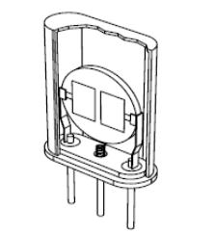
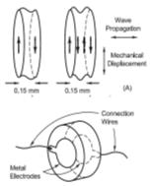
E6D03 Which of the following is an aspect of the piezoelectric effect?
A. Mechanical deformation of material by the application of a voltage
B. Mechanical deformation of material by the application of a magnetic field
C. Generation of electrical energy in the presence of light
D. Increased conductivity in the presence of light

Slide 102
E6D04 Which materials are commonly used as a slug core in a variable inductor?
A. Polystyrene and polyethylene
B. Ferrite and brass
C. Teflon and Delrin
D. Cobalt and aluminum

Slide 103
E6D04 Which materials are commonly used as a slug core in a variable inductor?
A. Polystyrene and polyethylene
B. Ferrite and brass
C. Teflon and Delrin
D. Cobalt and aluminum

Slide 104
E6D05 What is one reason for using ferrite cores rather than powdered-iron in an inductor?
A. Ferrite toroids generally have lower initial permeability
B. Ferrite toroids generally have better temperature stability
C. Ferrite toroids generally require fewer turns to produce a given inductance value
D. Ferrite toroids are easier to use with surface mount technology

Slide 105
E6D05 What is one reason for using ferrite cores rather than powdered-iron in an inductor?
A. Ferrite toroids generally have lower initial permeability
B. Ferrite toroids generally have better temperature stability
C. Ferrite toroids generally require fewer turns to produce a given inductance value
D. Ferrite toroids are easier to use with surface mount technology

Slide 106
E6D06 What core material property determines the inductance of a toroidal inductor?
A. Thermal impedance
B. Resistance
C. Reactivity
D. Permeability

Slide 107
E6D06 What core material property determines the inductance of a toroidal inductor?
A. Thermal impedance
B. Resistance
C. Reactivity
D. Permeability

Slide 108
E6D07 What is the usable frequency range of inductors that use toroidal cores, assuming a correct selection of core material for the frequency being used?
A. From a few kHz to no more than 30 MHz
B. From less than 20 Hz to approximately 300 MHz
C. From approximately 10 Hz to no more than 3000 kHz
D. From about 100 kHz to at least 1000 GHz

Slide 109
E6D07 What is the usable frequency range of inductors that use toroidal cores, assuming a correct selection of core material for the frequency being used?
A. From a few kHz to no more than 30 MHz
B. From less than 20 Hz to approximately 300 MHz
C. From approximately 10 Hz to no more than 3000 kHz
D. From about 100 kHz to at least 1000 GHz

Slide 110
E6D08 What is one reason for using powdered-iron cores rather than ferrite cores in an inductor?
A. Powdered-iron cores generally have greater initial permeability
B. Powdered-iron ores generally maintain their characteristics at higher currents
C. Powdered-iron cores generally require fewer turns to produce a given inductance
D. Powdered-iron cores use smaller diameter wire for the same inductance

Slide 111
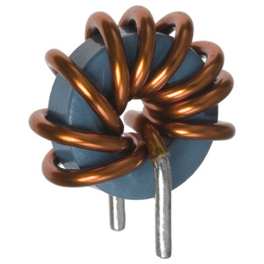
E6D08 What is one reason for using powdered-iron cores rather than ferrite cores in an inductor?
A. Powdered-iron cores generally have greater initial permeability
B. Powdered-iron ores generally maintain their characteristics at higher currents
C. Powdered-iron cores generally require fewer turns to produce a given inductance
D. Powdered-iron cores use smaller diameter wire for the same inductance

Slide 112
E6D09 What devices are commonly used as VHF and UHF parasitic suppressors at the input and output terminals a transistor HF amplifier?
A. Electrolytic capacitors
B. Butterworth filters
C. Ferrite beads
D. Steel-core toroids

Slide 113
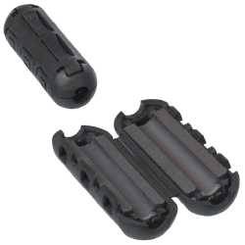
E6D09 What devices are commonly used as VHF and UHF parasitic suppressors at the input and output terminals a transistor HF amplifier?
A. Electrolytic capacitors
B. Butterworth filters
C. Ferrite beads
D. Steel-core toroids

Slide 114
E6D10 What is a primary advantage of using a toroidal core instead of a solenoidal core in an inductor?
A. Toroidal cores confine most of the magnetic field within the core material
B. Toroidal cores make it easier to couple the magnetic energy into other components
C. Toroidal cores exhibit greater hysteresis
D. Toroidal cores have lower Q characteristics

Slide 115
E6D10 What is a primary advantage of using a toroidal core instead of a solenoidal core in an inductor?
A. Toroidal cores confine most of the magnetic field within the core material
B. Toroidal cores make it easier to couple the magnetic energy into other components
C. Toroidal cores exhibit greater hysteresis
D. Toroidal cores have lower Q characteristics

Slide 116
E6D11 How many turns will be required to produce a 1-mH inductor using a core that has an inductance index (A L) value of 523 millihenrys/1000 turns?
A. 2 turns
B. 4 turns
C. 43 turns
D. 229 turns

Slide 117
E6D11 How many turns will be required to produce a 1-mH inductor using a core that has an inductance index (A L) value of 523 millihenrys/1000 turns?
A. 2 turns
B. 4 turns
C. 43 turns
D. 229 turns
N turns = 1000 x (√ (L / AL)) or
N turns = 1000 x (√ (1 / 523)) or 43.7 turns

Slide 118
E6D12 What is the definition of saturation in a ferrite core inductor?
A. The inductor windings are over coupled
B. The inductor’s voltage rating is exceeded causing a flashover
C. The ability of the inductor’s core to store magnetic energy has been exceeded
D. Adjacent inductors become over-coupled

Slide 119
E6D12 What is the definition of saturation in a ferrite core inductor?
A. The inductor windings are over coupled
B. The inductor’s voltage rating is exceeded causing a flashover
C. The ability of the inductor’s core to store magnetic energy has been exceeded
D. Adjacent inductors become over-coupled

Slide 120
E6D13 What is the primary cause of inductor self-resonance?
A. Inter-turn capacitance
B. The skin effect
C. Inductive kickback
D. Non-linear core hysteresis

Slide 121
E6D13 What is the primary cause of inductor self-resonance?
A. Inter-turn capacitance
B. The skin effect
C. Inductive kickback
D. Non-linear core hysteresis

Slide 122
E6D14 Which type of slug material decreases inductance when inserted into a coil?
A. Ceramic
B. Brass
C. Ferrite
D. Powdered-iron

Slide 123
E6D14 Which type of slug material decreases inductance when inserted into a coil?
A. Ceramic
B. Brass
C. Ferrite
D. Powdered-iron

Slide 124
E6D15 What is current in the primary winding of a transformer called if no load is attached to the secondary?
A. Magnetizing current
B. Direct current
C. Excitation current
D. Stabilizing current

Slide 125
E6D15 What is current in the primary winding of a transformer called if no load is attached to the secondary?
A. Magnetizing current
B. Direct current
C. Excitation current
D. Stabilizing current

Slide 126
E6D16 What is the common name for a capacitor connected across a transformer secondary that is used to absorb transient voltage spikes?
A. Clipper capacitor
B. Trimmer capacitor
C. Feedback capacitor
D. Snubber capacitor

Slide 127
E6D16 What is the common name for a capacitor connected across a transformer secondary that is used to absorb transient voltage spikes?
A. Clipper capacitor
B. Trimmer capacitor
C. Feedback capacitor
D. Snubber capacitor

Slide 128
E6D17 Why should core saturation of a conventional impedance matching transformer be avoided?
A. Harmonics and distortion could result
B. Magnetic flux would increase with frequency
C. RF susceptance would increase
D. Temporary changes of the core permeability could result

Slide 129
E6D17 Why should core saturation of a conventional impedance matching transformer be avoided?
A. Harmonics and distortion could result
B. Magnetic flux would increase with frequency
C. RF susceptance would increase
D. Temporary changes of the core permeability could result

Slide 130
E6E Analog ICs
: MMICs, CCDs, Device packages

Slide 131
E6E01 Which of the following is true of a charge-coupled device (CCD)?
A. Its phase shift changes rapidly with frequency
B. It is a CMOS analog-to-digital converter
C. It samples an analog signal and passes it in stages from the input to the output
D. It is used in a battery charger circuit

Slide 132
E6E01 Which of the following is true of a charge-coupled device (CCD)?
A. Its phase shift changes rapidly with frequency
B. It is a CMOS analog-to-digital converter
C. It samples an analog signal and passes it in stages from the input to the output
D. It is used in a battery charger circuit

Slide 133
E6E02 Which of the following device packages is a through-hole type?
A DIP
B. PLCC
C Ball grid array
D SOT

Slide 134
E6E02 Which of the following device packages is a through-hole type?
A DIP
B. PLCC
C Ball grid array
D SOT

Slide 135
E6E03 Which of the following materials is likely to provide the highest frequency of operation when used in MMICs?
A. Silicon
B. Silicon nitride
C. Silicon dioxide
D. Gallium nitride

Slide 136
E6E03 Which of the following materials is likely to provide the highest frequency of operation when used in MMICs?
A. Silicon
B. Silicon nitride
C. Silicon dioxide
D. Gallium nitride

Slide 137
E6E04 Which is the most common input and output impedance of circuits that use MMICs?
A. 50 ohms
B. 300 ohms
C. 450 ohms
D. 10 ohms

Slide 138
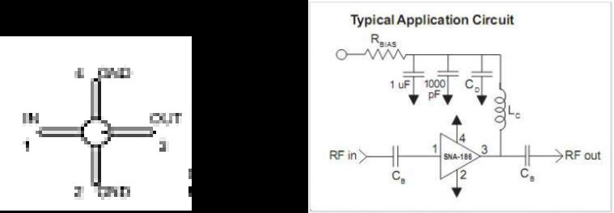
E6E04 Which is the most common input and output impedance of circuits that use MMICs?
A. 50 ohms
B. 300 ohms
C. 450 ohms
D. 10 ohms

Slide 139
E6E05 Which of the following noise figure values is typical of a low-noise UHF preamplifier?
A. 2 dB
B. -10 dB
C. 44 dBm
D. -20 dBm

Slide 140
E6E05 Which of the following noise figure values is typical of a low-noise UHF preamplifier?
A. 2 dB
B. -10 dB
C. 44 dBm
D. -20 dBm

Slide 141
E6E06 What characteristics of the MMIC make it a popular choice for VHF through microwave circuits?
A. The ability to retrieve information from a single signal even in the presence of other strong signals.
B. Plate current that is controlled by a control grid
C. Nearly infinite gain, very high input impedance, and very low output impedance
D. Controlled gain, low noise figure, and constant input and output impedance over the specified frequency range

Slide 142
E6E06 What characteristics of the MMIC make it a popular choice for VHF through microwave circuits?
A. The ability to retrieve information from a single signal even in the presence of other strong signals.
B. Plate current that is controlled by a control grid
C. Nearly infinite gain, very high input impedance, and very low output impedance
D. Controlled gain, low noise figure, and constant input and output impedance over the specified frequency range

Slide 143
E6E07 Which of the following is typically used to construct a MMIC-based microwave amplifier?
A. Ground-plane construction
B. Microstrip construction
C. Point-to-point construction
D. Wave-soldering construction

Slide 144
E6E07 Which of the following is typically used to construct a MMIC-based microwave amplifier?
A. Ground-plane construction
B. Microstrip construction
C. Point-to-point construction
D. Wave-soldering construction

Slide 145
E6E08 How is voltage from a power supply normally furnished to the most common type of monolithic microwave integrated circuit (MMIC)?
A. Through a resistor and/or RF choke connected to the amplifier output lead
B. MMICs require no operating bias
C. Through a capacitor and RF choke connected to the amplifier input lead
D. Directly to the bias voltage (VCC IN) lead

Slide 146
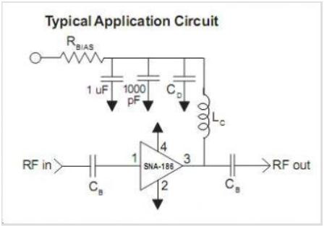
E6E08 How is voltage from a power supply normally furnished to the most common type of monolithic microwave integrated circuit (MMIC)?
A. Through a resistor and/or RF choke connected to the amplifier output lead
B. MMICs require no operating bias
C. Through a capacitor and RF choke connected to the amplifier input lead
D. Directly to the biasvvoltage (VCC IN) lead

Slide 147
E6E09 Which of the following component package types would be most suitable for use at frequencies above the HF range?
A. TO-220
B. Axial lead
C. Radial lead
D. Surface mount

Slide 148
E6E09 Which of the following component package types would be most suitable for use at frequencies above the HF range?
A. TO-220
B. Axial lead
C. Radial lead
D. Surface mount

Slide 149
E6E10 What is the packaging technique in which leadless components are soldered directly to circuit boards?
A. Direct soldering
B. Virtual lead mounting
C. Stripped lead
D. Surface mount

Slide 150
E6E10 What is the packaging technique in which leadless components are soldered directly to circuit boards?
A. Direct soldering
B. Virtual lead mounting
C. Stripped lead
D. Surface mount

Slide 151
E6E11 What is a characteristic of DIP packaging used for integrated circuits?
A. Package mounts in a direct inverted position
B. Low leakage doubly insulated package
C. Two chips in each package (Dual In Package)
D. A total of two rows of connecting pins placed on opposite sides of the package (Dual In-line Package)

Slide 152
E6E11 What is a characteristic of DIP packaging used for integrated circuits?
A. Package mounts in a direct inverted position
B. Low leakage doubly insulated package
C. Two chips in each package (Dual In Package)
D. A total of two rows of connecting pins placed on opposite sides of the package (Dual In-line Package)

Slide 153
E6E12 Why are high-power RF amplifier ICs and transistors sometimes mounted in ceramic packages?
A. High-voltage insulating ability
B. Better dissipation of heat
C. Enhanced sensitivity to light
D. To provide a low-pass frequency response

Slide 154
E6E12 Why are high-power RF amplifier ICs and transistors sometimes mounted in ceramic packages?
A. High-voltage insulating ability
B. Better dissipation of heat
C. Enhanced sensitivity to light
D. To provide a low-pass frequency response

Slide 155
E6F Optical components
photoconductive principles and effects, photovoltaic systems, optical couplers, optical sensors, and optoisolators; LCDs

Slide 156
E6F01 What is photoconductivity?
A. The conversion of photon energy to electromotive energy
B. The increased conductivity of an illuminated semiconductor
C. The conversion of electromotive energy to photon energy
D. The decreased conductivity of an illuminated semiconductor

Slide 157
E6F01 What is photoconductivity?
A. The conversion of photon energy to electromotive energy
B. The increased conductivity of an illuminated semiconductor
C. The conversion of electromotive energy to photon energy
D. The decreased conductivity of an illuminated semiconductor

Slide 158
E6F02 What happens to the conductivity of a photoconductive material when light shines on it?
A. It increases
B. It decreases
C. It stays the same
D. It becomes unstable

Slide 159
E6F02 What happens to the conductivity of a photoconductive material when light shines on it?
A. It increases
B. It decreases
C. It stays the same
D. It becomes unstable

Slide 160
E6F03 What is the most common configuration of an optoisolator or optocoupler?
A. A lens and a photomultiplier
B. A frequency modulated helium-neon laser
C. An amplitude modulated helium-neon laser
D. An LED and a phototransistor

Slide 161
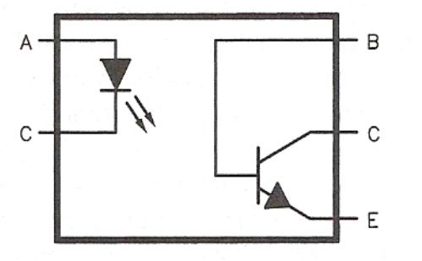
E6F03 What is the most common configuration of an optoisolator or optocoupler?
A. A lens and a photomultiplier
B. A frequency modulated helium-neon laser
C. An amplitude modulated helium-neon laser
D. An LED and a phototransistor

Slide 162
E6F04 What is the photovoltaic effect?
A. The conversion of voltage to current when exposed to light
B. The conversion of light to electrical energy
C. The conversion of electrical energy to mechanical energy
D. The tendency of a battery to discharge when used outside

Slide 163
E6F04 What is the photovoltaic effect?
A. The conversion of voltage to current when exposed to light
B. The conversion of light to electrical energy
C. The conversion of electrical energy to mechanical energy
D. The tendency of a battery to discharge when used outside

Slide 164
E6F05 Which describes an optical shaft encoder?
A. A device which detects rotation of a control by interrupting a light source with a patterned wheel
B. A device which measures the strength of a beam of light using analog to digital conversion
C. A digital encryption device often used to encrypt spacecraft control signals
D. A device for generating RTTY signals by means of a rotating light source.

Slide 165
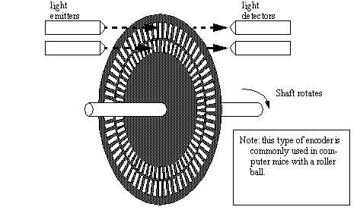
Optical shaft encoder

Slide 166
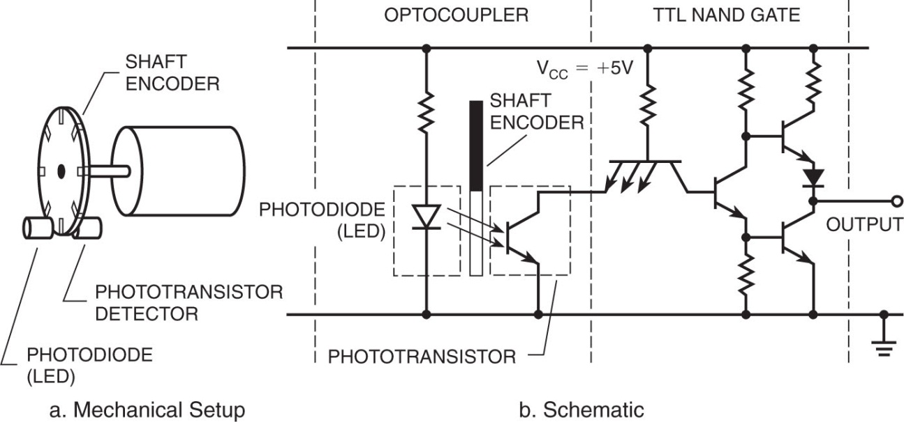
Optical shaft encoder

Slide 167
E6F05 Which describes an optical shaft encoder?
A. A device which detects rotation of a control by interrupting a light source with a patterned wheel
B. A device which measures the strength of a beam of light using analog to digital conversion
C. A digital encryption device often used to encrypt spacecraft control signals
D. A device for generating RTTY signals by means of a rotating light source.

Slide 168
E6F06 Which of these materials is affected the most by photoconductivity?
A. A crystalline semiconductor
B. An ordinary metal
C. A heavy metal
D. A liquid semiconductor

Slide 169
E6F06 Which of these materials is affected the most by photoconductivity?
A. A crystalline semiconductor
B. An ordinary metal
C. A heavy metal
D. A liquid semiconductor

Slide 170
E6F07 What is a solid state relay?
A. A relay using transistors to drive the relay coil
B. A device that uses semiconductors to implement the functions of an electromechanical relay
C. A mechanical relay that latches in the on or off state each time it is pulsed
D. A passive delay line

Slide 171
E6F07 What is a solid state relay?
A. A relay using transistors to drive the relay coil
B. A device that uses semiconductors to implement the functions of an electromechanical relay
C. A mechanical relay that latches in the on or off state each time it is pulsed
D. A passive delay line

Slide 172
E6F08 Why are optoisolators often used in conjunction with solid state circuits when switching 120VAC?
A. Optoisolators provide a low impedance link between a control circuit and a power circuit
B. Optoisolators provide impedance matching between the control circuit and power circuit
C. Optoisolators provide a very high degree of electrical isolation between a control circuit and the circuit being switched
D. Optoisolators eliminate the effects of reflected light in the control circuit

Slide 173
E6F08 Why are optoisolators often used in conjunction with solid state circuits when switching 120VAC?
A. Optoisolators provide a low impedance link between a control circuit and a power circuit
B. Optoisolators provide impedance matching between the control circuit and power circuit
C. Optoisolators provide a very high degree of electrical isolation between a control circuit and the circuit being switched
D. Optoisolators eliminate the effects of reflected light in the control circuit

Slide 174
E6F09 What is the efficiency of a photovoltaic cell?
A. The output RF power divided by the input DC power
B. The effective payback period
C. The open-circuit voltage divided by the short-circuit current under full illumination
D. The relative fraction of light that is converted to current

Slide 175
E6F09 What is the efficiency of a photovoltaic cell?
A. The output RF power divided by the input DC power
B. The effective payback period
C. The open-circuit voltage divided by the short-circuit current under full illumination
D. The relative fraction of light that is converted to current

Slide 176
E6F10 What is the most common type of photovoltaic cell used for electrical power generation?
A. Selenium
B. Silicon
C. Cadmium Sulfide
D. Copper oxide

Slide 177
E6F10 What is the most common type of photovoltaic cell used for electrical power generation?
A. Selenium
B. Silicon
C. Cadmium Sulfide
D. Copper oxide

Slide 178
E6F11 What is the approximate open-circuit voltage produced by a fully-illuminated silicon photovoltaic cell?
A. 0.1 V
B. 0.5 V
C. 1.5 V
D. 12 V

Slide 179
E6F11 What is the approximate open-circuit voltage produced by a fully-illuminated silicon photovoltaic cell?
A. 0.1 V
B. 0.5 V
C. 1.5 V
D. 12 V

Slide 180
E6F12 What absorbs the energy from light falling on a photovoltaic cell?
A. Protons
B. Photons
C. Electrons
D. Holes

Slide 181
E6F12 What absorbs the energy from light falling on a photovoltaic cell?
A. Protons
B. Photons
C. Electrons
D. Holes

Slide 182
E6F13 What is a liquid crystal display (LCD)?
A. A modern replacement for a quartz crystal oscillator which displays its fundamental frequency
B. A display utilizing a crystalline liquid and polarizing filters which becomes opaque when voltage is applied
C. A frequency-determining unit for a transmitter or receiver
D. A display that uses a glowing liquid to remain brightly lit in dim light

Slide 183
E6F13 What is a liquid crystal display (LCD)?
A. A modern replacement for a quartz crystal oscillator which displays its fundamental frequency
B. A display utilizing a crystalline liquid and polarizing filters which becomes opaque when voltage is applied
C. A frequency-determining unit for a transmitter or receiver
D. A display that uses a glowing liquid to remain brightly lit in dim light

Slide 184
E6F14 Which of the following is true of LCD displays?
A. They are hard to view in high ambient light conditions
B. They may be hard view through polarized lenses
C. They only display alphanumeric symbols
D. All of these choices are correct

Slide 185
E6F14 Which of the following is true of LCD displays?
A. They are hard to view in high ambient light conditions
B. They may be hard view through polarized lenses
C. They only display alphanumeric symbols
D. All of these choices are correct

Slide 186
End of
SUBELEMENT E6
CIRCUIT COMPONENTS

