Slide 1
SUBELEMENT E7
PRACTICAL CIRCUITS
[8 Exam Questions - 8 Groups]
Notes:
Extra Question Pool 2016. The Western Washington Ham Training Team makes these slides available to teach Amateur Technician Radio Licensing Classes. Daniel Stevens KL7WM, Training Coordinator, Howard Swartz, W7HS, Slide master, Dustin Lomax, KF7FK, Leading Instructor, LW Abel, K7LWA, Enthusiasm Leader.

Slide 2
E7A Digital circuits: digital circuit principles and logic circuits: classes of logic elements; positive and negative logic; frequency dividers; truth tables
E7B Amplifiers: Class of operation; vacuum tube and solid-state circuits; distortion and intermodulation; spurious and parasitic suppression; microwave amplifiers
E7C Filters and matching networks: filters and impedance matching networks: types of networks; types of filters; filter applications; filter characteristics; impedance matching; DSP filtering
E7D Power supplies and voltage regulators
E7E Modulation and demodulation: reactance, phase and balanced modulators; detectors; mixer stages; DSP modulation and demodulation; software defined radio systems
E7F Frequency markers and counters: frequency divider circuits; frequency marker generators; frequency counters
E7G Active filters and op-amps: active audio filters; characteristics; basic circuit design; operational amplifiers
E7H Oscillators and signal sources: types of oscillators; synthesizers and phase-locked loops; direct digital synthesizers

Slide 3
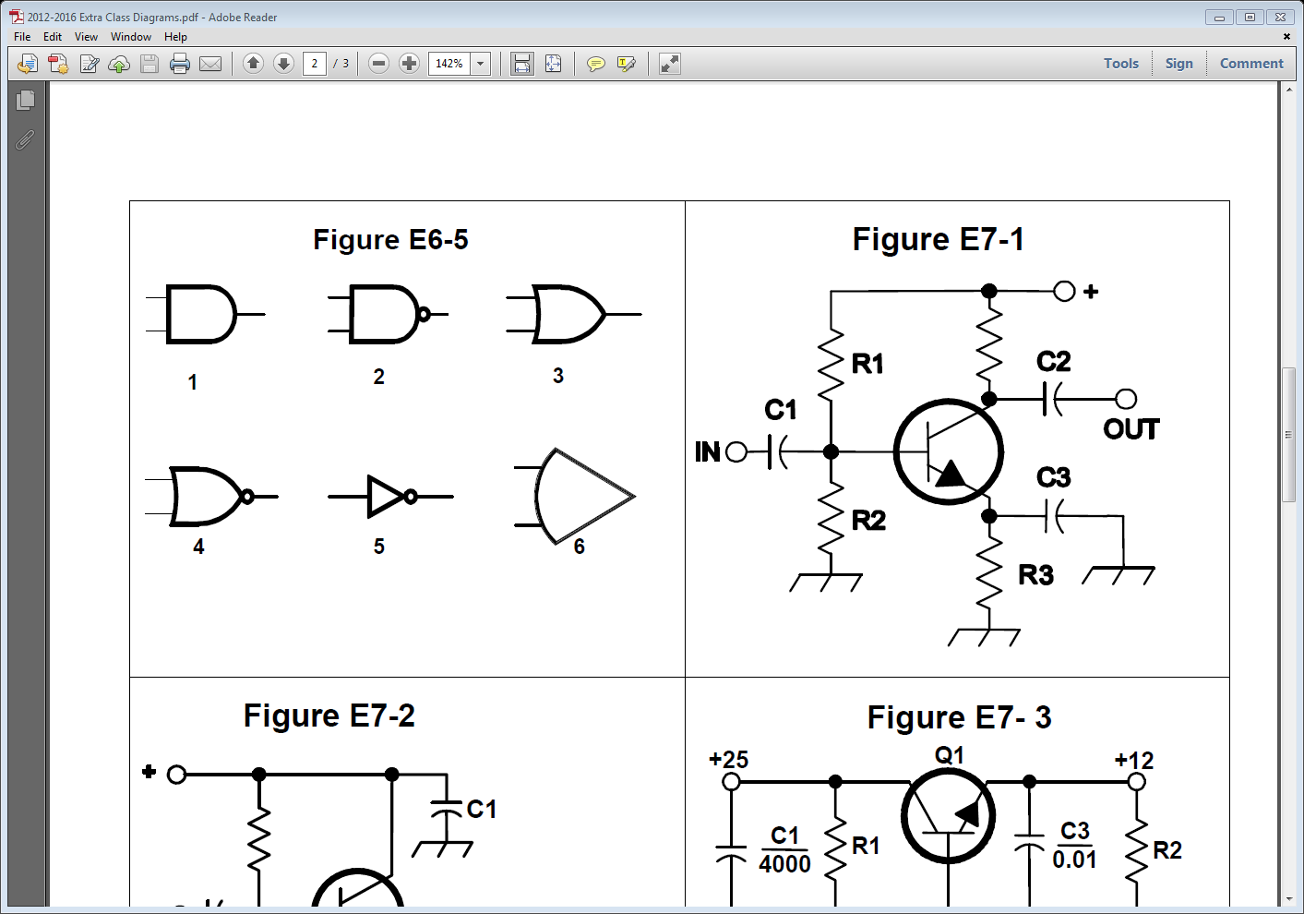
Logic Symbols
Symbol 6 is an Operational Amp. (OP)

Slide 4
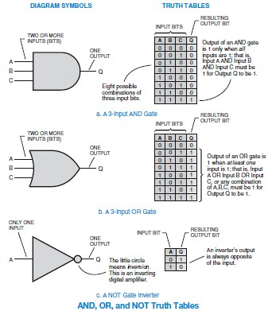
Truth Table

Slide 5
E7A01 Which is a bi-stable circuit?
A. An "AND" gate
B. An "OR" gate
C. A flip-flop
D. A clock

Slide 6
E7A01 Which is a bi-stable circuit?
A. An "AND" gate
B. An "OR" gate
C. A flip-flop
D. A clock

Slide 7
E7A02 What is the function of a decade counter digital IC?
A. It produces one output pulse for every ten input pulses
B. It decodes a decimal number for display on a seven segment LED display
C. It produces ten output pulses for every input pulse
D. It adds two decimal numbers together

Slide 8
E7A02 What is the function of a decade counter digital IC?
A. It produces one output pulse for every ten input pulses
B. It decodes a decimal number for display on a seven segment LED display
C. It produces ten output pulses for every input pulse
D. It adds two decimal numbers together

Slide 9
E7A03 Which of the following can divide the frequency of a pulse train by 2?
A. An XOR gate
B. A flip-flop
C. An OR gate
D. A multiplexer

Slide 10
E7A03 Which of the following can divide the frequency of a pulse train by 2?
A. An XOR gate
B. A flip-flop
C. An OR gate
D. A multiplexer

Slide 11
E7A04 How many flip-flops are required to divide a signal frequency by 4?
A. 1
B. 2
C. 4
D. 8

Slide 12
E7A04 How many flip-flops are required to divide a signal frequency by 4?
A. 1
B. 2
C. 4
D. 8

Slide 13
E7A05 Which of the following is a circuit that continuously alternates between two states without an external clock?
A. Monostable multivibrator
B. J-K flip-flop
C. T flip-flop
D. Astable multivibrator

Slide 14
E7A05 Which of the following is a circuit that continuously alternates between two states without an external clock?
A. Monostable multivibrator
B. J-K flip-flop
C. T flip-flop
D. Astable multivibrator

Slide 15
E7A06 What is a characteristic of a monostable multivibrator?
A. It switches momentarily to the opposite binary state and then returns, to its original state after a set time
B. It produces a continuous square wave oscillating between 1 and 0
C. It stores one bit of data in either a 0 or 1 state
D. It maintains a constant output voltage, regardless of variations in the input voltage

Slide 16
E7A06 What is a characteristic of a monostable multivibrator?
A. It switches momentarily to the opposite binary state and then returns, to its original state after a set time,
B. It produces a continuous square wave oscillating between 1 and 0
C. It stores one bit of data in either a 0 or 1 state
D. It maintains a constant output voltage, regardless of variations in the input voltage

Slide 17
E7A07 What logical operation does a NAND gate perform?
A. It produces logic "0" at its output only when all inputs are logic "0"
B. It produces logic "1" at its output only when all inputs are logic "1"
C. It produces logic "0" at its output if some but not all inputs are logic "1"
D. It produces logic "0" at its output only when all inputs are logic "1"

Slide 18
E7A07 What logical operation does a NAND gate perform?
A. It produces logic "0" at its output only when all inputs are logic "0"
B. It produces logic "1" at its output only when all inputs are logic "1"
C. It produces logic "0" at its output if some but not all inputs are logic "1"
D. It produces logic "0" at its output only when all inputs are logic "1"

Slide 19
E7A08 What logical operation does an OR gate perform?
A. It produces logic "1" at its output if any or all inputs are logic "1"
B. It produces logic "0" at its output if all inputs are logic "1"
C. It only produces logic "0" at its output when all inputs are logic "1"
D. It produces logic "1" at its output if all inputs are logic "0"

Slide 20
E7A08 What logical operation does an OR gate perform?
A. It produces logic "1" at its output if any or all inputs are logic "1"
B. It produces logic "0" at its output if all inputs are logic "1"
C. It only produces logic "0" at its output when all inputs are logic "1"
D. It produces logic "1" at its output if all inputs are logic "0"

Slide 21
E7A09 What logical operation is performed by an exclusive NOR gate?
A. It produces logic "0" at its output only if all inputs are logic "0"
B. It produces logic "1" at its output only if all inputs are logic "1"
C. It produces logic "0" at its output if any single input is logic "1"
D. It produces logic "1" at its output if any single input is logic "1"

Slide 22
E7A09 What logical operation is performed by an exclusive NOR gate?
A. It produces logic "0" at its output only if all inputs are logic "0"
B. It produces logic "1" at its output only if all inputs are logic "1"
C. It produces logic "0" at its output if any single input is logic "1"
D. It produces logic "1" at its output if any single input is logic "1"

Slide 23
Truth Table

Slide 24
E7A10 What is a truth table?
A. A table of logic symbols that indicate the high logic states of an op-amp
B. A diagram showing logic states when the digital device output is true
C. A list of inputs and corresponding outputs for a digital device
D. A table of logic symbols that indicate the logic states of an op-amp

Slide 25
E7A10 What is a truth table?
A. A table of logic symbols that indicate the high logic states of an op-amp
B. A diagram showing logic states when the digital device output is true
C. A list of inputs and corresponding outputs for a digital device
D. A table of logic symbols that indicate the logic states of an op-amp

Slide 26
E7A11 What type of logic defines "1" as a high voltage?
A. Reverse Logic
B. Assertive Logic
C. Negative logic
D. Positive Logic

Slide 27
E7A11 What type of logic defines "1" as a high voltage?
A. Reverse Logic
B. Assertive Logic
C. Negative logic
D. Positive Logic

Slide 28
E7A12 What type of logic defines "0" as a high voltage?
A. Reverse Logic
B. Assertive Logic
C. Negative logic
D. Positive Logic

Slide 29
E7A12 What type of logic defines "0" as a high voltage?
A. Reverse Logic
B. Assertive Logic
C. Negative logic
D. Positive Logic

Slide 30
E7B Amplifiers
Class of operation; vacuum tube and solid-state circuits; distortion and intermodulation; spurious and parasitic suppression; microwave amplifiers; switching type amplifiers

Slide 31
E7B01 For what portion of a signal cycle does a Class AB amplifier operate?
A. More than 180 degrees but less than 360 degrees
B. Exactly 180 degrees
C. The entire cycle
D. Less than 180 degrees

Slide 32
E7B01 For what portion of a signal cycle does a Class AB amplifier operate?
A. More than 180 degrees but less than 360 degrees
B. Exactly 180 degrees
C. The entire cycle
D. Less than 180 degrees

Slide 33
E7B02 What is a Class D amplifier?
A. A type of amplifier that uses switching technology to achieve high efficiency
B. A low power amplifier that uses a differential amplifier for improved linearity
C. An amplifier that uses drift-mode FETs for high efficiency
D. A frequency doubling amplifier

Slide 34
E7B02 What is a Class D amplifier?
A. A type of amplifier that uses switching technology to achieve high efficiency
B. A low power amplifier that uses a differential amplifier for improved linearity
C. An amplifier that uses drift-mode FETs for high efficiency
D. A frequency doubling amplifier

Slide 35
E7B03 Which of the following components form the output of a class D amplifier circuit?
A. A low-pass filter to remove switching signal components
B. A high-pass filter to compensate for low gain at low frequencies
C. A matched load resistor to prevent damage by switching transients
D. A temperature-compensating load resistor to improve linearity

Slide 36
E7B03 Which of the following components form the output of a class D amplifier circuit?
A. A low-pass filter to remove switching signal components
B. A high-pass filter to compensate for low gain at low frequencies
C. A matched load resistor to prevent damage by switching transients
D. A temperature-compensating load resistor to improve linearity

Slide 37
E7B04 Where on the load line of a Class A common emitter amplifier would bias normally be set?
A. Approximately half-way between saturation and cutoff
B. Where the load line intersects the voltage axis
C. At a point where the bias resistor equals the load resistor
D. At a point where the load line intersects the zero bias current curve

Slide 38
E7B04 Where on the load line of a Class A common emitter amplifier would bias normally be set?
A. Approximately half-way between saturation and cutoff
B. Where the load line intersects the voltage axis
C. At a point where the bias resistor equals the load resistor
D. At a point where the load line intersects the zero bias current curve

Slide 39
E7B05 What can be done to prevent unwanted oscillations in an RF power amplifier?
A. Tune the stage for maximum SWR
B. Tune both the input and output for maximum power
C. Install parasitic suppressors and/or neutralize the stage
D. Use a phase inverter in the output filter

Slide 40
E7B05 What can be done to prevent unwanted oscillations in an RF power amplifier?
A. Tune the stage for maximum SWR
B. Tune both the input and output for maximum power
C. Install parasitic suppressors and/or neutralize the stage
D. Use a phase inverter in the output filter

Slide 41
E7B06 Which of the following amplifier types reduces or eliminates even-order harmonics?
A. Push-push
B. Push-pull
C. Class C
D. Class AB

Slide 42
E7B06 Which of the following amplifier types reduces or eliminates even-order harmonics?
A. Push-push
B. Push-pull
C. Class C
D. Class AB

Slide 43
E7B07 Which of the following is a likely result when a Class C amplifier is used to amplify a single-sideband phone signal?
A. Reduced intermodulation products
B. Increased overall intelligibility
C. Signal inversion
D. Signal distortion and excessive bandwidth

Slide 44
E7B07 Which of the following is a likely result when a Class C amplifier is used to amplify a single-sideband phone signal?
A. Reduced intermodulation products
B. Increased overall intelligibility
C. Signal inversion
D. Signal distortion and excessive bandwidth

Slide 45
E7B08 How can an RF power amplifier be neutralized?
A. By increasing the driving power
B. By reducing the driving power
C. By feeding a 180-degree out-of-phase portion of the output back to the input
D. By feeding an in-phase component of the output back to the input

Slide 46
E7B08 How can an RF power amplifier be neutralized?
A. By increasing the driving power
B. By reducing the driving power
C. By feeding a 180-degree out-of-phase portion of the output back to the input
D. By feeding an in-phase component of the output back to the input

Slide 47
E7B09 Which of the following describes how the loading and tuning capacitors are to be adjusted when tuning a vacuum tube RF power amplifier that employs a Pi-network output circuit?
A. The loading capacitor is set to maximum capacitance and the tuning capacitor is adjusted for minimum allowable plate current
B. The tuning capacitor is set to maximum capacitance and the loading capacitor is adjusted for minimum plate permissible current
C. The loading capacitor is adjusted to minimum plate current while alternately adjusting the tuning capacitor for maximum allowable plate current
D. The tuning capacitor is adjusted for minimum plate current, and the loading capacitor is adjusted for maximum permissible plate current

Slide 48
E7B09 Which of the following describes how the loading and tuning capacitors are to be adjusted when tuning a vacuum tube RF power amplifier that employs a Pi-network output circuit?
A. The loading capacitor is set to maximum capacitance and the tuning capacitor is adjusted for minimum allowable plate current
B. The tuning capacitor is set to maximum capacitance and the loading capacitor is adjusted for minimum plate permissible current
C. The loading capacitor is adjusted to minimum plate current while alternately adjusting the tuning capacitor for maximum allowable plate current
D. The tuning capacitor is adjusted for minimum plate current, and the loading capacitor is adjusted for maximum permissible plate current

Slide 49
E7B10 In Figure E7-1, what is the purpose of R1 and R2?
A. Load resistors
B. Fixed bias
C. Self bias
D. Feedback

Slide 50
E7B10 In Figure E7-1, what is the purpose of R1 and R2?
A. Load resistors
B. Fixed bias
C. Self bias
D. Feedback

Slide 51
E7B11 In Figure E7-1, what is the purpose of R3?
A. Fixed bias
B. Emitter bypass
C. Output load resistor
D. Self bias

Slide 52
E7B11 In Figure E7-1, what is the purpose of R3?
A. Fixed bias
B. Emitter bypass
C. Output load resistor
D. Self bias

Slide 53
E7B12 What type of amplifier circuit is shown in Figure E7-1?
A. Common base
B. Common collector
C. Common emitter
D. Emitter follower

Slide 54
E7B12 What type of amplifier circuit is shown in Figure E7-1?
A. Common base
B. Common collector
C. Common emitter
D. Emitter follower

Slide 55
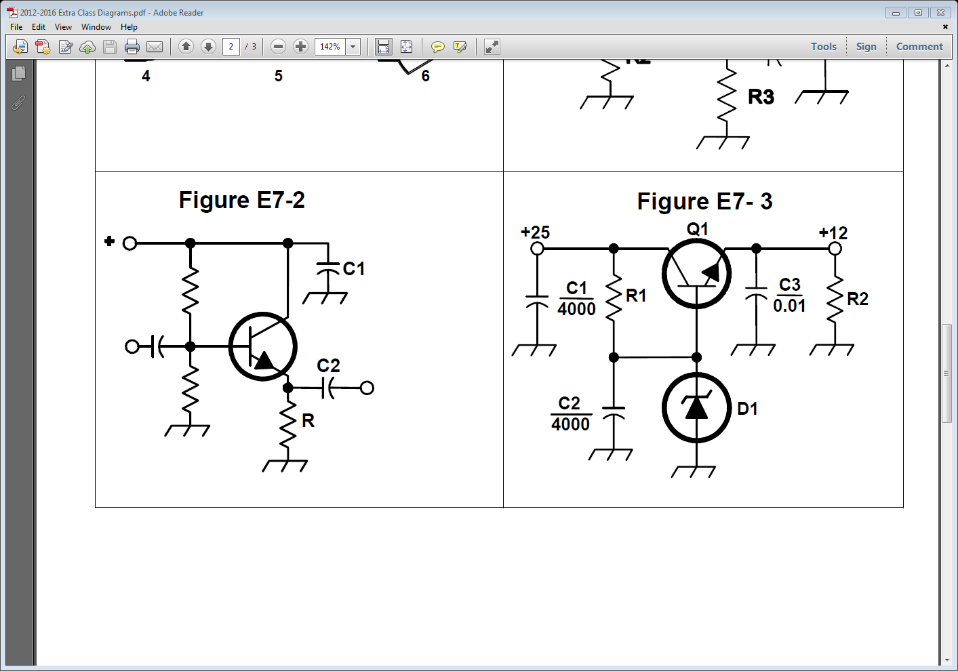
E7B13 In Figure E7-2, what is the purpose of R?
A. Emitter load
B. Fixed bias
C. Collector load
D. Voltage regulation

Slide 56
E7B13 In Figure E7-2, what is the purpose of R?
A. Emitter load
B. Fixed bias
C. Collector load
D. Voltage regulation

Slide 57
E7B14 Why are switching amplifiers more efficient than linear amplifiers?
A. Switching amplifiers operate at higher voltages
B. The power transistor is at saturation or cut off most of the time, resulting in low power dissipation
C. Linear amplifiers have high gain resulting in higher harmonic content
D. Switching amplifiers use push-pull circuits

Slide 58
E7B14 Why are switching amplifiers more efficient than linear amplifiers?
A. Switching amplifiers operate at higher voltages
B. The power transistor is at saturation or cut off most of the time, resulting in low power dissipation
C. Linear amplifiers have high gain resulting in higher harmonic content
D. Switching amplifiers use push-pull circuits

Slide 59
E7B15 What is one way to prevent thermal runaway in a bipolar transistor amplifier?
A. Neutralization
B. Select transistors with high beta
C. Use a resistor in series with the emitter
D. All of these choices are correct

Slide 60
E7B15 What is one way to prevent thermal runaway in a bipolar transistor amplifier?
A. Neutralization
B. Select transistors with high beta
C. Use a resistor in series with the emitter
D. All of these choices are correct

Slide 61
E7B16 What is the effect of intermodulation products in a linear power amplifier?
A. Transmission of spurious signals
B. Creation of parasitic oscillations
C. Low efficiency
D. All of these choices are correct

Slide 62
E7B16 What is the effect of intermodulation products in a linear power amplifier?
A. Transmission of spurious signals
B. Creation of parasitic oscillations
C. Low efficiency
D. All of these choices are correct

Slide 63
E7B17 Why are odd-order rather than even-order intermodulation distortion products of concern in linear power amplifiers?
A. Because they are relatively close in frequency to the desired signal
B. Because they are relatively far in frequency from the desired signal
C. Because they invert the sidebands causing distortion
D. Because they maintain the sidebands, thus causing multiple duplicate signals

Slide 64
E7B17 Why are odd-order rather than even-order intermodulation distortion products of concern in linear power amplifiers?
A. Because they are relatively close in frequency to the desired signal
B. Because they are relatively far in frequency from the desired signal
C. Because they invert the sidebands causing distortion
D. Because they maintain the sidebands, thus causing multiple duplicate signals

Slide 65
E7B18 What is a characteristic of a grounded-grid amplifier?
A. High power gain
B. High filament voltage
C. Low input impedance
D. Low bandwidth

Slide 66
E7B18 What is a characteristic of a grounded-grid amplifier?
A. High power gain
B. High filament voltage
C. Low input impedance
D. Low bandwidth

Slide 67
E7C Filters and matching networks
types of networks; types of filters; filter applications; filter characteristics; impedance matching; DSP filtering

Slide 68
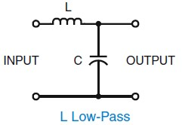
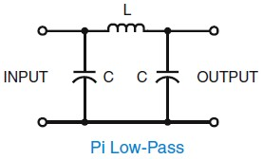
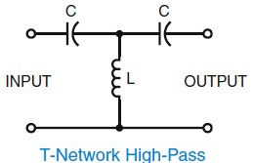
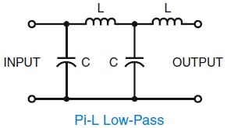
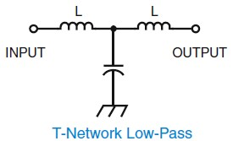
Matching networks

Slide 69
E7C01 How are the capacitors and inductors of a low-pass filter Pi-network arranged between the network's input and output?
A. Two inductors are in series between the input and output, and a capacitor is connected between the two inductors and ground
B. Two capacitors are in series between the input and output, and an inductor is connected between the two capacitors and ground
C. An inductor is connected between the input and ground, another inductor is connected between the output and ground, and a capacitor is connected between the input and output
D. A capacitor is connected between the input and ground, another capacitor is connected between the output and ground, and an inductor is connected between input and output

Slide 70
E7C01 How are the capacitors and inductors of a low-pass filter Pi-network arranged between the network's input and output?
A. Two inductors are in series between the input and output, and a capacitor is connected between the two inductors and ground
B. Two capacitors are in series between the input and output, and an inductor is connected between the two capacitors and ground
C. An inductor is connected between the input and ground, another inductor is connected between the output and ground, and a capacitor is connected between the input and output
D. A capacitor is connected between the input and ground, another capacitor is connected between the output and ground, and an inductor is connected between input and output

Slide 71
E7C02 Which of the following is a property of a T-network with series capacitors and a parallel shunt inductor?
A. It is a low-pass filter
B. It is a band-pass filter
C. It is a high-pass filter
D. It is a notch filter

Slide 72
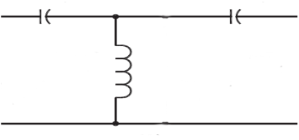
E7C02 Which of the following is a property of a T-network with series capacitors and a parallel shunt inductor?
A. It is a low-pass filter
B. It is a band-pass filter
C. It is a high-pass filter
D. It is a notch filter

Slide 73
E7C03 What advantage does a Pi-L-network have over a regular Pi-network for impedance matching between the final amplifier of a vacuum-tube transmitter and an antenna?
A. Greater harmonic suppression
B. Higher efficiency
C. Lower losses
D. Greater transformation range

Slide 74
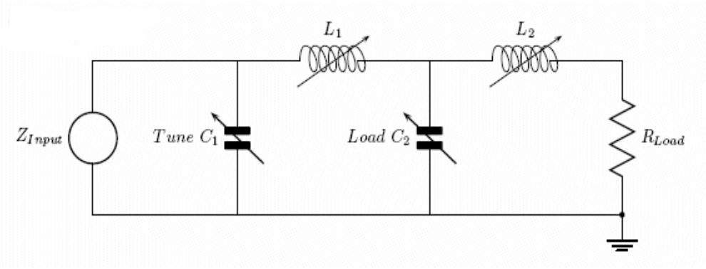
E7C03 What advantage does a Pi-L-network have over a regular Pi-network for impedance matching between the final amplifier of a vacuum-tube transmitter and an antenna?
A. Greater harmonic suppression
B. Higher efficiency
C. Lower losses
D. Greater transformation range

Slide 75
E7C04 How does an impedance-matching circuit transform a complex impedance to a resistive impedance?
A. It introduces negative resistance to cancel the resistive part of impedance
B. It introduces transconductance to cancel the reactive part of impedance
C. It cancels the reactive part of the impedance and changes the resistive part to a desired value
D. Network resistances are substituted for load resistances and reactances are matched to the resistances

Slide 76
E7C04 How does an impedance-matching circuit transform a complex impedance to a resistive impedance?
A. It introduces negative resistance to cancel the resistive part of impedance
B. It introduces transconductance to cancel the reactive part of impedance
C. It cancels the reactive part of the impedance and changes the resistive part to a desired value
D. Network resistances are substituted for load resistances and reactances are matched to the resistances

Slide 77
E7C05 Which filter type is described as having ripple in the passband and a sharp cutoff?
A. A Butterworth filter
B. An active LC filter
C. A passive op-amp filter
D. A Chebyshev filter

Slide 78
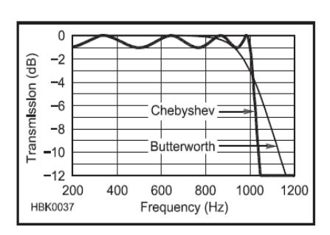
E7C05 Which filter type is described as having ripple in the passband and a sharp cutoff?
A. A Butterworth filter
B. An active LC filter
C. A passive op-amp filter
D. A Chebyshev filter

Slide 79
E7C06 What are the distinguishing features of an elliptical filter?
A. Gradual passband rolloff with minimal stop band ripple
B. Extremely flat response over its pass band with gradually rounded stop band corners
C. Extremely sharp cutoff with one or more notches in the stop band
D. Gradual passband rolloff with extreme stop band ripple

Slide 80
E7C06 What are the distinguishing features of an elliptical filter?
A. Gradual passband rolloff with minimal stop band ripple
B. Extremely flat response over its pass band with gradually rounded stop band corners
C. Extremely sharp cutoff with one or more notches in the stop band
D. Gradual passband rolloff with extreme stop band ripple

Slide 81
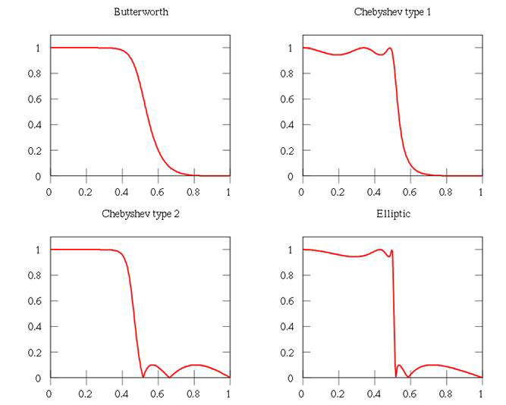
Filter Types

Slide 82
E7C07 What kind of filter would you use to attenuate an interfering carrier signal while receiving an SSB transmission?
A. A band-pass filter
B. A notch filter
C. A Pi-network filter
D. An all-pass filter

Slide 83
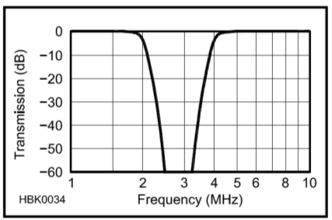
E7C07 What kind of filter would you use to attenuate an interfering carrier signal while receiving an SSB transmission?
A. A band-pass filter
B. A notch filter
C. A Pi-network filter
D. An all-pass filter

Slide 84
E7C08 Which of the following factors has the greatest effect in helping determine the bandwidth and response shape of a crystal ladder filter?
A. The relative frequencies of the individual crystals
B. The DC voltage applied to the quartz crystal
C. The gain of the RF stage preceding the filter
D. The amplitude of the signals passing through the filter

Slide 85
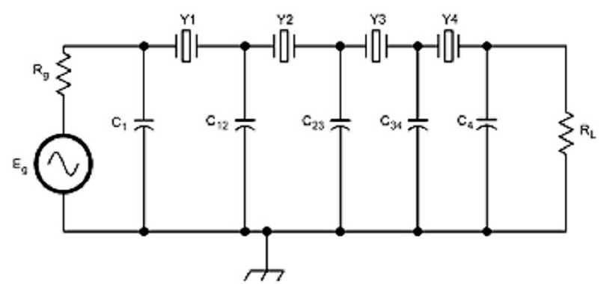
E7C08 Which of the following factors has the greatest effect in helping determine the bandwidth and response shape of a crystal ladder filter?
A. The relative frequencies of the individual crystals
B. The DC voltage applied to the quartz crystal
C. The gain of the RF stage preceding the filter
D. The amplitude of the signals passing through the filter

Slide 86
E7C09 What is a Jones filter as used as part of an HF receiver IF stage?
A. An automatic notch filter
B. A variable bandwidth crystal lattice filter
C. A special filter that emphasizes image responses
D. A filter that removes impulse noise

Slide 87
E7C09 What is a Jones filter as used as part of an HF receiver IF stage?
A. An automatic notch filter
B. A variable bandwidth crystal lattice filter
C. A special filter that emphasizes image responses
D. A filter that removes impulse noise

Slide 88
E7C10 Which of the following filters would be the best choice for use in a 2 meter repeater duplexer?
A. A crystal filter
B. A cavity filter
C. A DSP filter
D. An L-C filter

Slide 89
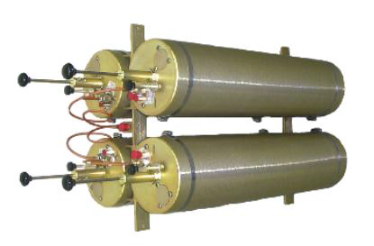
E7C10 Which of the following filters would be the best choice for use in a 2 meter repeater duplexer?
A. A crystal filter
B. A cavity filter
C. A DSP filter
D. An L-C filter

Slide 90
E7C11 Which of the following is the common name for a filter network which is equivalent to two L-networks connected back-to-back with the two inductors in series and the capacitors in shunt at the input and output?
A. Pi-L
B. Cascode
C. Omega
D. Pi

Slide 91
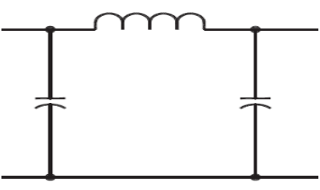
E7C11 Which of the following is the common name for a filter network which is equivalent to two L-networks connected back-to-back with the two inductors in series and the capacitors in shunt at the input and output?
A. Pi-L
B. Cascode
C. Omega
D. Pi

Slide 92
E7C12 Which describes a Pi-L-network used for matching a vacuum tube final amplifier to a 50 ohm unbalanced output?
A. A Phase Inverter Load network
B. A Pi network with an additional series inductor on the output
C. A network with only three discrete parts
D. A matching network in which all components are isolated from ground

Slide 93
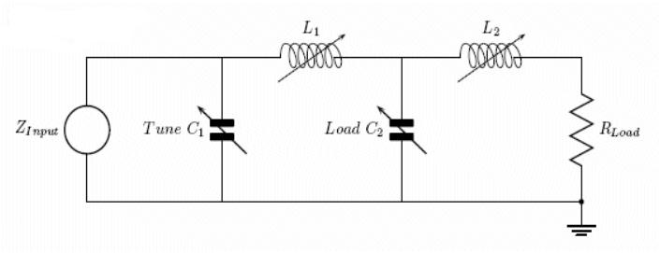
E7C12 Which describes a Pi-L-network used for matching a vacuum tube final amplifier to a 50 ohm unbalanced output?
A. A Phase Inverter Load network
B. A Pi network with an additional series inductor on the output
C. A network with only three discrete parts
D. A matching network in which all components are isolated from ground

Slide 94
E7C13 What is one advantage of a Pi-matching network over an L-matching network consisting of a single inductor and a single capacitor?
A. The Q of Pi-networks can be varied depending on the component values chosen
B. L-networks can not perform impedance transformation
C. Pi-networks have fewer components
D. Pi-networks are designed for balanced input and output

Slide 95
E7C13 What is one advantage of a Pi-matching network over an L-matching network consisting of a single inductor and a single capacitor?
A. The Q of Pi-networks can be varied depending on the component values chosen
B. L-networks can not perform impedance transformation
C. Pi-networks have fewer components
D. Pi-networks are designed for balanced input and output

Slide 96
E7C14 Which mode is most affected by non-linear phase response in a receiver IF filter?
A. Meteor scatter
B. Single-Sideband voice
C. Digital
D. Video

Slide 97
E7C14 Which mode is most affected by non-linear phase response in a receiver IF filter?
A. Meteor scatter
B. Single-Sideband voice
C. Digital
D. Video

Slide 98
E7C15 What is a crystal lattice filter?
A. A power supply filter made with interlaced quartz crystals
B. An audio filter made with four quartz crystals that resonate at 1-kHz intervals
C. A filter with wide bandwidth and shallow skirts made using quartz crystals
D. A filter with narrow bandwidth and steep skirts made using quartz crystals

Slide 99
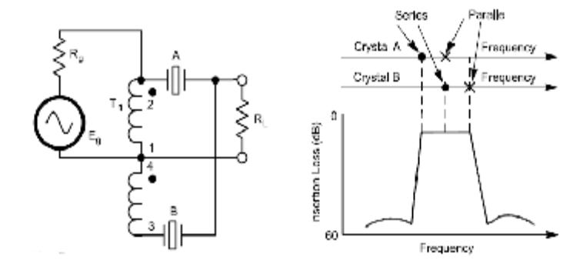
E7C15 What is a crystal lattice filter?
A. A power supply filter made with interlaced quartz crystals
B. An audio filter made with four quartz crystals that resonate at 1-kHz intervals
C. A filter with wide bandwidth and shallow skirts made using quartz crystals
D. A filter with narrow bandwidth and steep skirts made using quartz crystals

Slide 100
E7D Power supplies and voltage regulators: Solar array charge controllers

Slide 101
E7D01 What is one characteristic of a linear electronic voltage regulator?
A. It has a ramp voltage as its output
B. It eliminates the need for a pass transistor
C. The control element duty cycle is proportional to the line or load conditions
D. The conduction of a control element is varied to maintain a constant output voltage

Slide 102
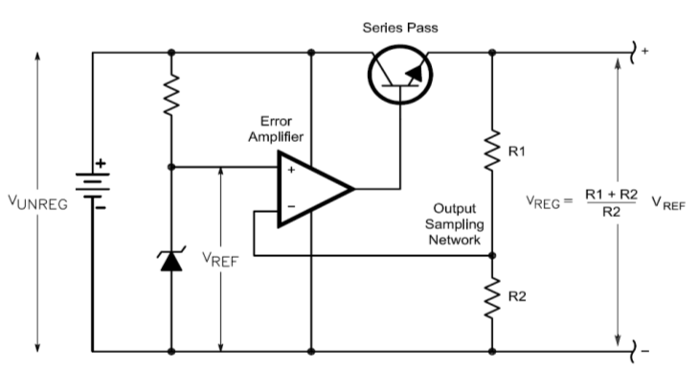
E7D01 What is one characteristic of a linear electronic voltage regulator?
A. It has a ramp voltage as its output
B. It eliminates the need for a pass transistor
C. The control element duty cycle is proportional to the line or load conditions
D. The conduction of a control element is varied to maintain a constant output voltage

Slide 103
E7D02 What is one characteristic of a switching electronic voltage regulator?
A. The resistance of a control element is varied in direct proportion to the line voltage or load current
B. It is generally less efficient than a linear regulator
C. The controlled device’s duty cycle is charged to produce a constant average output voltage
D. It gives a ramp voltage at its output

Slide 104
E7D02 What is one characteristic of a switching electronic voltage regulator?
A. The resistance of a control element is varied in direct proportion to the line voltage or load current
B. It is generally less efficient than a linear regulator
C. The controlled device’s duty cycle is charged to produce a constant average output voltage
D. It gives a ramp voltage at its output

Slide 105
E7D03 What device is typically used as a stable reference voltage in a linear voltage regulator?
A. A Zener diode
B. A tunnel diode
C. An SCR
D. A varactor diode

Slide 106
E7D03 What device is typically used as a stable reference voltage in a linear voltage regulator?
A. A Zener diode
B. A tunnel diode
C. An SCR
D. A varactor diode

Slide 107
E7D04 Which of the following types of linear voltage regulator usually make the most efficient use of the primary power source?
A. A series current source
B. A series regulator
C. A shunt regulator
D. A shunt current source

Slide 108
E7D04 Which of the following types of linear voltage regulator usually make the most efficient use of the primary power source?
A. A series current source
B. A series regulator
C. A shunt regulator
D. A shunt current source

Slide 109
E7D05 Which of the following types of linear voltage regulator places a constant load on the unregulated voltage source?
A. A constant current source
B. A series regulator
C. A shunt current source
D. A shunt regulator

Slide 110
E7D05 Which of the following types of linear voltage regulator places a constant load on the unregulated voltage source?
A. A constant current source
B. A series regulator
C. A shunt current source
D. A shunt regulator

Slide 111
E7D06 What is the purpose of Q1 in the circuit shown in Figure E7-3?
A. It provides negative feedback to improve regulation
B. It provides a constant load for the voltage source
C. It increases the current-handling capability of the regulator
D. It provides D1 with current

Slide 112
E7D06 What is the purpose of Q1 in the circuit shown in Figure E7-3?
A. It provides negative feedback to improve regulation
B. It provides a constant load for the voltage source
C. It increases the current-handling capability of the regulator
D. It provides D1 with current

Slide 113
E7D07 What is the purpose of C2 in the circuit shown in Figure E7-3?
A. It bypasses hum around D1
B. It is a brute force filter for the output
C. To self-resonate at the hum frequency
D. To provide fixed DC bias for Q1

Slide 114
E7D07 What is the purpose of C2 in the circuit shown in Figure E7-3?
A. It bypasses hum around D1
B. It is a brute force filter for the output
C. To self-resonate at the hum frequency
D. To provide fixed DC bias for Q1

Slide 115
E7D08 What type of circuit is shown in Figure E7-3?
A. Switching voltage regulator
B. Grounded emitter amplifier
C. Linear voltage regulator
D. Emitter follower

Slide 116
E7D08 What type of circuit is shown in Figure E7-3?
A. Switching voltage regulator
B. Grounded emitter amplifier
C. Linear voltage regulator
D. Emitter follower

Slide 117
E7D09 What is the main reason to use a charge controller with a solar power system?
A. Prevention of battery undercharge
B. Control of electrolyte levels during battery discharge
C. Prevention of battery damage due to overcharge
D. Matching of day and night charge rates

Slide 118
E7D09 What is the main reason to use a charge controller with a solar power system?
A. Prevention of battery undercharge
B. Control of electrolyte levels during battery discharge
C. Prevention of battery damage due to overcharge
D. Matching of day and night charge rates

Slide 119
E7D10 What is the primary reason that a high-frequency inverter type high-voltage power supply can be both less expensive and lighter in weight than a conventional power supply?
A. The inverter design does not require any output filtering
B. It uses a diode bridge rectifier for increased output
C. The high frequency inverter design uses much smaller transformers and filter components for an equivalent power output
D. It uses a large power-factor compensation capacitor to create "free power” from the unused portion of the AC cycle

Slide 120
E7D10 What is the primary reason that a high-frequency inverter type high-voltage power supply can be both less expensive and lighter in weight than a conventional power supply?
A. The inverter design does not require any output filtering
B. It uses a diode bridge rectifier for increased output
C. The high frequency inverter design uses much smaller transformers and filter components for an equivalent power output
D. It uses a large power-factor compensation capacitor to create "free power” from the unused portion of the AC cycle

Slide 121
E7D11 What circuit element is controlled by a series analog voltage regulator to maintain a constant output voltage?
A. Reference voltage
B. Switching inductance
C. Error amplifier
D. Pass transistor

Slide 122
E7D11 What circuit element is controlled by a series analog voltage regulator to maintain a constant output voltage?
A. Reference voltage
B. Switching inductance
C. Error amplifier
D. Pass transistor

Slide 123
E7D12 What is the drop-out voltage of an analog voltage regulator?
A. Minimum input voltage for rated power dissipation
B. Maximum amount that the output voltage drops when the input voltage is varied over its specified range
C. Minimum input-to-output voltage required to maintain regulation
D. Maximum amount that the output voltage may decrease at rated load

Slide 124
E7D12 What is the drop-out voltage of an analog voltage regulator?
A. Minimum input voltage for rated power dissipation
B. Maximum amount that the output voltage drops when the input voltage is varied over its specified range
C. Minimum input-to-output voltage required to maintain regulation
D. Maximum amount that the output voltage may decrease at rated load

Slide 125
E7D13 What is the equation for calculating power dissipation by a series connected linear voltage regulator?
A. Input voltage multiplied by input current
B. Input voltage divided by output current
C. Voltage difference from input to output multiplied by output current
D. Output voltage multiplied by output current

Slide 126
E7D13 What is the equation for calculating power dissipation by a series connected linear voltage regulator?
A. Input voltage multiplied by input current
B. Input voltage divided by output current
C. Voltage difference from input to output multiplied by output current
D. Output voltage multiplied by output current

Slide 127
E7D14 What is one purpose of a "bleeder" resistor in a conventional unregulated power supply?
A. To cut down on waste heat generated by the power supply
B. To balance the low-voltage filament windings
C. To improve output voltage regulation
D. To boost the amount of output current

Slide 128
E7D14 What is one purpose of a "bleeder" resistor in a conventional unregulated power supply?
A. To cut down on waste heat generated by the power supply
B. To balance the low-voltage filament windings
C. To improve output voltage regulation
D. To boost the amount of output current

Slide 129
E7D15 What is the purpose of a "step-start" circuit in a high voltage power supply?
A. To provide a dual-voltage output for reduced power applications
B. To compensate for variations of the incoming line voltage
C. To allow for remote control of the power supply
D. To allow the filter capacitors to charge gradually

Slide 130
E7D15 What is the purpose of a "step-start" circuit in a high voltage power supply?
A. To provide a dual-voltage output for reduced power applications
B. To compensate for variations of the incoming line voltage
C. To allow for remote control of the power supply
D. To allow the filter capacitors to charge gradually

Slide 131
E7D16 When several electrolytic filter capacitors are connected in series to increase the operating voltage of a power supply filter circuit, why should resistors be connected across each capacitor?
A. To equalize, as much as possible, the voltage drop across each capacitor
B. To provide a safety bleeder to discharge the capacitors when the supply is off
C. To provide a minimum load current to reduce voltage excursions at light loads
D. All of these choices are correct

Slide 132
E7D16 When several electrolytic filter capacitors are connected in series to increase the operating voltage of a power supply filter circuit, why should resistors be connected across each capacitor?
A. To equalize, as much as possible, the voltage drop across each capacitor
B. To provide a safety bleeder to discharge the capacitors when the supply is off
C. To provide a minimum load current to reduce voltage excursions at light loads
D. All of these choices are correct

Slide 133
Halfway Point
15 Min Break ???

Slide 134
E7E Modulation and demodulation
reactance, phase and balanced modulators; detectors; mixer stages

Slide 135
E7E01 Which of the following can be used to generate FM phone emissions?
A. A balanced modulator on the audio amplifier
B. A reactance modulator on the oscillator
C. A reactance modulator on the final amplifier
D. A balanced modulator on the oscillator

Slide 136
E7E01 Which of the following can be used to generate FM phone emissions?
A. A balanced modulator on the audio amplifier
B. A reactance modulator on the oscillator
C. A reactance modulator on the final amplifier
D. A balanced modulator on the oscillator

Slide 137
E7E02 What is the function of a reactance modulator?
A. To produce PM signals by using an electrically variable resistance
B. To produce AM signals by using an electrically variable inductance or capacitance
C. To produce AM signals by using an electrically variable resistance
D. To produce PM signals by using an electrically variable inductance or capacitance

Slide 138
E7E02 What is the function of a reactance modulator?
A. To produce PM signals by using an electrically variable resistance
B. To produce AM signals by using an electrically variable inductance or capacitance
C. To produce AM signals by using an electrically variable resistance
D. To produce PM signals by using an electrically variable inductance or capacitance

Slide 139
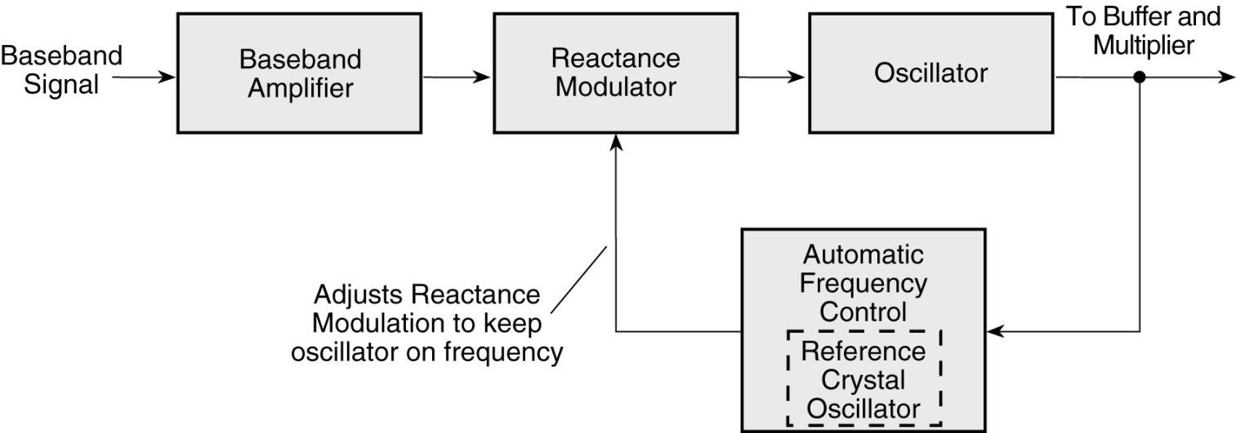
Reactance modulator

Slide 140
E7E03 How does an analog phase modulator function?
A. By varying the tuning of a microphone preamplifier to produce PM signals
B. By varying the tuning of an amplifier tank circuit to produce AM signals
C. By varying the tuning of an amplifier tank circuit to produce PM signals
D. By varying the tuning of a microphone preamplifier to produce AM signals

Slide 141
E7E03 How does an analog phase modulator function?
A. By varying the tuning of a microphone preamplifier to produce PM signals
B. By varying the tuning of an amplifier tank circuit to produce AM signals
C. By varying the tuning of an amplifier tank circuit to produce PM signals
D. By varying the tuning of a microphone preamplifier to produce AM signals

Slide 142
E7E04 What is one way a single-sideband phone signal can be generated?
A. By using a balanced modulator followed by a filter
B. By using a reactance modulator followed by a mixer
C. By using a loop modulator followed by a mixer
D. By driving a product detector with a DSB signal

Slide 143
E7E04 What is one way a single-sideband phone signal can be generated?
A. By using a balanced modulator followed by a filter
B. By using a reactance modulator followed by a mixer
C. By using a loop modulator followed by a mixer
D. By driving a product detector with a DSB signal

Slide 144
E7E05 What circuit is added to an FM transmitter to boost the higher audio frequencies?
A. A de-emphasis network
B. A heterodyne suppressor
C. An audio prescaler
D. A pre-emphasis network

Slide 145
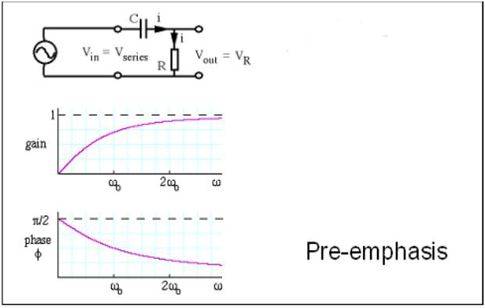
E7E05 What circuit is added to an FM transmitter to boost the higher audio frequencies?
A. A de-emphasis network
B. A heterodyne suppressor
C. An audio prescaler
D. A pre-emphasis network

Slide 146
E7E06 Why is de-emphasis commonly used in FM communications receivers?
A. For compatibility with transmitters using phase modulation
B. To reduce impulse noise reception
C. For higher efficiency
D. To remove third-order distortion products

Slide 147
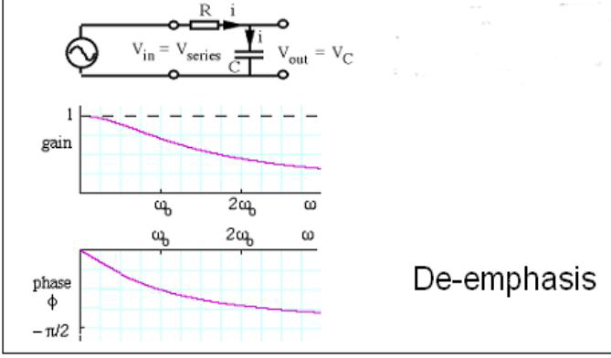
E7E06 Why is de-emphasis commonly used in FM communications receivers?
A. For compatibility with transmitters using phase modulation
B. To reduce impulse noise reception
C. For higher efficiency
D. To remove third-order distortion products

Slide 148
E7E07 What is meant by the term baseband in radio communications?
A. The lowest frequency band that the transmitter or receiver covers
B. The frequency components present in the modulating signal
C. The unmodulated bandwidth of the transmitted signal
D. The basic oscillator frequency in an FM transmitter that is multiplied to increase the deviation and carrier frequency

Slide 149
E7E07 What is meant by the term baseband in radio communications?
A. The lowest frequency band that the transmitter or receiver covers
B. The frequency components present in the modulating signal
C. The unmodulated bandwidth of the transmitted signal
D. The basic oscillator frequency in an FM transmitter that is multiplied to increase the deviation and carrier frequency

Slide 150
E7E08 What are the principal frequencies that appear at the output of a mixer circuit?
A. Two and four times the original frequency
B. The sum, difference and square root of the input frequencies
C. The two input frequencies along with their sum and difference frequencies
D. 1.414 and 0.707 times the input frequency

Slide 151
E7E08 What are the principal frequencies that appear at the output of a mixer circuit?
A. Two and four times the original frequency
B. The sum, difference and square root of the input frequencies
C. The two input frequencies along with their sum and difference frequencies
D. 1.414 and 0.707 times the input frequency

Slide 152
E7E09 What occurs when an excessive amount of signal energy reaches a mixer circuit?
A. Spurious mixer products are generated
B. Mixer blanking occurs
C. Automatic limiting occurs
D. A beat frequency is generated

Slide 153
E7E09 What occurs when an excessive amount of signal energy reaches a mixer circuit?
A. Spurious mixer products are generated
B. Mixer blanking occurs
C. Automatic limiting occurs
D. A beat frequency is generated

Slide 154
E7E10 How does a diode detector function?
A. By rectification and filtering of RF signals
B. By breakdown of the Zener voltage
C. By mixing signals with noise in the transition region of the diode
D. By sensing the change of reactance in the diode with respect to frequency

Slide 155
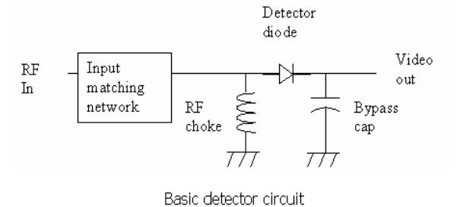
E7E10 How does a diode detector function?
A. By rectification and filtering of RF signals
B. By breakdown of the Zener voltage
C. By mixing signals with noise in the transition region of the diode
D. By sensing the change of reactance in the diode with respect to frequency
Since a diode only conducts for half of the AC signal, it may be used as a rectifier

Slide 156
E7E11 Which type of detector is used for demodulating SSB signals?
A. Discriminator
B. Phase detector
C. Product detector
D. Phase comparator

Slide 157
E7E11 Which type of detector is used for demodulating SSB signals?
A. Discriminator
B. Phase detector
C. Product detector
D. Phase comparator

Slide 158
E7E12 What is a frequency discriminator stage in a FM receiver?
A. An FM generator circuit
B. A circuit for filtering two closely adjacent signals
C. An automatic band-switching circuit
D. A circuit for detecting FM signals

Slide 159
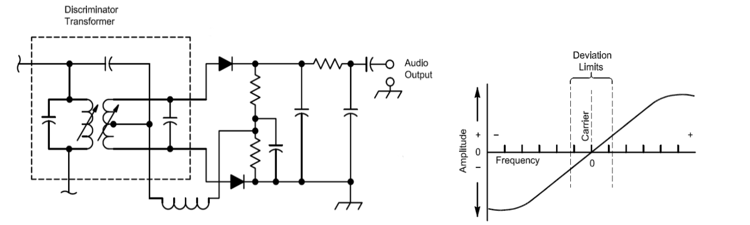
E7E12 What is a frequency discriminator stage in a FM receiver?
A. An FM generator circuit
B. A circuit for filtering two closely adjacent signals
C. An automatic band-switching circuit
D. A circuit for detecting FM signals

Slide 160
E7F DSP filtering and other operations;
Software Defined Radio Fundamentals; DSP modulation and demodulation

Slide 161
E7F01 What is meant by direct digital conversion as applied to software defined radios?
A. Software is converted from source code to object code during operation of the receiver
B. Incoming RF is converted to a control voltage for a voltage controlled oscillator
C. Incoming RF is digitized by an analog-to-digital converter without being mixed with a local oscillator signal
D. A switching mixer is used to generate I and Q signals directly from the RF input

Slide 162
E7F01 What is meant by direct digital conversion as applied to software defined radios?
A. Software is converted from source code to object code during operation of the receiver
B. Incoming RF is converted to a control voltage for a voltage controlled oscillator
C. Incoming RF is digitized by an analog-to-digital converter without being mixed with a local oscillator signal
D. A switching mixer is used to generate I and Q signals directly from the RF input

Slide 163
E7F02 What kind of digital signal processing audio filter is used to remove unwanted noise from a received SSB signal?
A. An adaptive filter
B. A crystal-lattice filter
C. A Hilbert-transform filter
D. A phase-inverting filter

Slide 164
E7F02 What kind of digital signal processing audio filter is used to remove unwanted noise from a received SSB signal?
A. An adaptive filter
B. A crystal-lattice filter
C. A Hilbert-transform filter
D. A phase-inverting filter

Slide 165
E7F03 What type of digital signal processing filter is used to generate an SSB signal?
A. An adaptive filter
B. A notch filter
C. A Hilbert-transform filter
D. An elliptical filter

Slide 166
E7F03 What type of digital signal processing filter is used to generate an SSB signal?
A. An adaptive filter
B. A notch filter
C. A Hilbert-transform filter
D. An elliptical filter
The Hilbert transform is a linear operator in mathematics and in signal processing.

Slide 167
E7F04 What is a common method of generating an SSB signal using digital signal processing?
A. Mixing products are converted to voltages and subtracted by adder circuits
B. A frequency synthesizer removes the unwanted sidebands
C. Emulation of quartz crystal filter characteristics
D. Combine signals with a quadrature phase relationship

Slide 168
E7F04 What is a common method of generating an SSB signal using digital signal processing?
A. Mixing products are converted to voltages and subtracted by adder circuits
B. A frequency synthesizer removes the unwanted sidebands
C. Emulation of quartz crystal filter characteristics
D. Combine signals with a quadrature phase relationship

Slide 169
E7F05 How frequently must an analog signal be sampled by an analog-to-digital converter so that the signal can be accurately reproduced?
A. At half the rate of the highest frequency component of the signal
B. At twice the rate of the highest frequency component of the signal
C. At the same rate as the highest frequency component of the signal
D. At four times the rate of the highest frequency component of the signal

Slide 170
E7F05 How frequently must an analog signal be sampled by an analog-to-digital converter so that the signal can be accurately reproduced?
A. At half the rate of the highest frequency component of the signal
B. At twice the rate of the highest frequency component of the signal
C. At the same rate as the highest frequency component of the signal
D. At four times the rate of the highest frequency component of the signal

Slide 171
E7F06 What is the minimum number of bits required for an analog-to-digital converter to sample a signal with a range of 1 volt at a resolution of 1 millivolt?
A. 4 bits
B. 6 bits
C. 8 bits
D. 10 bits

Slide 172
E7F06 What is the minimum number of bits required for an analog-to-digital converter to sample a signal with a range of 1 volt at a resolution of 1 millivolt?
A. 4 bits
B. 6 bits
C. 8 bits
D. 10 bits

Slide 173
E7F07 What function can a Fast Fourier Transform perform?
A. Converting analog signals to digital form
B. Converting digital signals to analog form
C. Converting digital signals from the time domain to the frequency domain
D. Converting 8-bit data to 16 bit data

Slide 174
E7F07 What function can a Fast Fourier Transform perform?
A. Converting analog signals to digital form
B. Converting digital signals to analog form
C. Converting digital signals from the time domain to the frequency domain
D. Converting 8-bit data to 16 bit data

Slide 175
E7F08 What is the function of decimation with regard to digital filters?
A. Converting data to binary code decimal form
B. Reducing the effective sample rate by removing samples
C. Attenuating the signal
D. Removing unnecessary significant digits

Slide 176
E7F08 What is the function of decimation with regard to digital filters?
A. Converting data to binary code decimal form
B. Reducing the effective sample rate by removing samples
C. Attenuating the signal
D. Removing unnecessary significant digits

Slide 177
E7F09 Why is an anti-aliasing digital filter required in a digital decimator?
A. It removes high-frequency signal components which would otherwise be reproduced as lower frequency components
B. It peaks the response of the decimator, improving bandwidth
C. It removes low frequency signal components to eliminate the need for DC restoration
D. It notches out the sampling frequency to avoid sampling errors

Slide 178
E7F09 Why is an anti-aliasing digital filter required in a digital decimator?
A. It removes high-frequency signal components which would otherwise be reproduced as lower frequency components
B. It peaks the response of the decimator, improving bandwidth
C. It removes low frequency signal components to eliminate the need for DC restoration
D. It notches out the sampling frequency to avoid sampling errors

Slide 179
E7F10 What aspect of receiver analog-to-digital conversion determines the maximum receive bandwidth of a Direct Digital Conversion SDR?
A. Sample rate
B. Sample width in bits
C. Sample clock phase noise
D. Processor latency

Slide 180
E7F10 What aspect of receiver analog-to-digital conversion determines the maximum receive bandwidth of a Direct Digital Conversion SDR?
A. Sample rate
B. Sample width in bits
C. Sample clock phase noise
D. Processor latency

Slide 181
E7F11 What sets the minimum detectable signal level for an SDR in the absence of atmospheric or thermal noise?
A. Sample clock phase noise
B. Reference voltage level and sample width in bits
C. Data storage transfer rate
D. Missing codes and jitter

Slide 182
E7F11 What sets the minimum detectable signal level for an SDR in the absence of atmospheric or thermal noise?
A. Sample clock phase noise
B. Reference voltage level and sample width in bits
C. Data storage transfer rate
D. Missing codes and jitter

Slide 183
E7F12 What digital process is applied to I and Q signals in order to recover the baseband modulation information?
A. Fast Fourier Transform
B. Decimation
C. Signal conditioning
D. Quadrature mixing

Slide 184
E7F12 What digital process is applied to I and Q signals in order to recover the baseband modulation information?
A. Fast Fourier Transform
B. Decimation
C. Signal conditioning
D. Quadrature mixing

Slide 185
E7F13 What is the function of taps in a digital signal processing filter?
A. To reduce excess signal pressure levels
B. Provide access for debugging software
C. Select the point at which baseband signals are generated
D. Provide incremental signal delays for filter algorithms

Slide 186
E7F13 What is the function of taps in a digital signal processing filter?
A. To reduce excess signal pressure levels
B. Provide access for debugging software
C. Select the point at which baseband signals are generated
D. Provide incremental signal delays for filter algorithms

Slide 187
E7F14 Which of the following would allow a digital signal processing filter to create a sharper filter response?
A. Higher data rate
B. More taps
C. Complex phasor representations
D. Double-precision math routines

Slide 188
E7F14 Which of the following would allow a digital signal processing filter to create a sharper filter response?
A. Higher data rate
B. More taps
C. Complex phasor representations
D. Double-precision math routines

Slide 189
E7F15 Which of the following is an advantage of a Finite Impulse Response (FIR) filter vs an Infinite Impulse Response (IIR) digital filter?
A. FIR filters delay all frequency components of the signal by the same amount
B. FIR filters are easier to implement for a given set of passband rolloff requirements
C. FIR filters can respond faster to impulses
D. All of these choices are correct

Slide 190
E7F15 Which of the following is an advantage of a Finite Impulse Response (FIR) filter vs an Infinite Impulse Response (IIR) digital filter?
A. FIR filters delay all frequency components of the signal by the same amount
B. FIR filters are easier to implement for a given set of passband rolloff requirements
C. FIR filters can respond faster to impulses
D. All of these choices are correct

Slide 191
E7F16 How might the sampling rate of an existing digital signal be adjusted by a factor of 3/4?
A. Change the gain by a factor of 3/4
B. Multiply each sample value by a factor of 3/4
C. Add 3 to each input value and subtract 4 from each output value
D. Interpolate by a factor of three, then decimate by a factor of four

Slide 192
E7F16 How might the sampling rate of an existing digital signal be adjusted by a factor of 3/4?
A. Change the gain by a factor of 3/4
B. Multiply each sample value by a factor of 3/4
C. Add 3 to each input value and subtract 4 from each output value
D. Interpolate by a factor of three, then decimate by a factor of four

Slide 193
E7F17 What do the letters I and Q in I/Q Modulation represent?
A. Inactive and Quiescent
B. Instantaneous and Quasi-stable
C. Instantaneous and Quenched
D. In-phase and Quadrature

Slide 194
E7F17 What do the letters I and Q in I/Q Modulation represent?
A. Inactive and Quiescent
B. Instantaneous and Quasi-stable
C. Instantaneous and Quenched
D. In-phase and Quadrature

Slide 195
E7G Active filters and op-amps circuits
active audio filters; characteristics; basic circuit design; operational amplifiers

Slide 196
E7G01 What is the typical output impedance of an integrated circuit op-amp?
A. Very low
B. Very high
C. 100 ohms
D. 1000 ohms

Slide 197
E7G01 What is the typical output impedance of an integrated circuit op-amp?
A. Very low
B. Very high
C. 100 ohms
D. 1000 ohms

Slide 198
E7G02 What is the effect of ringing in a filter?
A. An echo caused by a long time delay
B. A reduction in high frequency response
C. Partial cancellation of the signal over a range of frequencies
D. Undesired oscillations added to the desired signal

Slide 199
E7G02 What is the effect of ringing in a filter?
A. An echo caused by a long time delay
B. A reduction in high frequency response
C. Partial cancellation of the signal over a range of frequencies
D. Undesired oscillations added to the desired signal

Slide 200
E7G03 What is the typical input impedance of an integrated circuit op-amp?
A. 100 ohms
B. 1000 ohms
C. Very low
D. Very high

Slide 201
E7G03 What is the typical input impedance of an integrated circuit op-amp?
A. 100 ohms
B. 1000 ohms
C. Very low
D. Very high

Slide 202
E7G04 What is meant by the term op-amp input offset voltage?
A. The output voltage of the op-amp minus its input voltage
B. The difference between the output voltage of the op-amp and the input voltage required in the immediately following stage
C. The differential input voltage needed to bring the open loop output voltage to zero
D. The potential between the amplifier input terminals of the op-amp in an open-loop condition

Slide 203
E7G04 What is meant by the term op-amp input offset voltage?
A. The output voltage of the op-amp minus its input voltage
B. The difference between the output voltage of the op-amp and the input voltage required in the immediately following stage
C. The differential input voltage needed to bring the open loop output voltage to zero
D. The potential between the amplifier input terminals of the op-amp in an open-loop condition

Slide 204
E7G05 How can unwanted ringing and audio instability be prevented in a multi-section op-amp RC audio filter circuit?
A. Restrict both gain and Q
B. Restrict gain but increase Q
C. Restrict Q but increase gain
D. Increase both gain and Q

Slide 205
E7G05 How can unwanted ringing and audio instability be prevented in a multi-section op-amp RC audio filter circuit?
A. Restrict both gain and Q
B. Restrict gain but increase Q
C. Restrict Q but increase gain
D. Increase both gain and Q

Slide 206
E7G06 Which of the following is the most appropriate use of an op-amp active filter?
A. As a high-pass filter used to block RFI at the input to receivers
B. As a low-pass filter used between a transmitter and a transmission line
C. For smoothing power supply output
D. As an audio filter in a receiver

Slide 207
E7G06 Which of the following is the most appropriate use of an op-amp active filter?
A. As a high-pass filter used to block RFI at the input to receivers
B. As a low-pass filter used between a transmitter and a transmission line
C. For smoothing power supply output
D. As an audio filter in a receiver

Slide 208
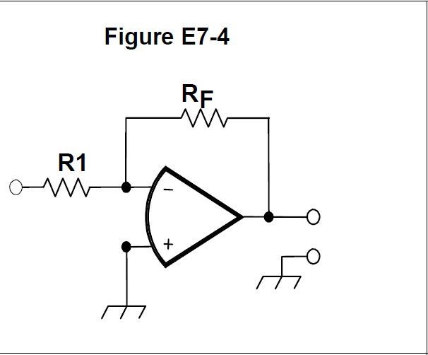
E7G07 What magnitude of voltage gain can be expected from the circuit in Figure E7-4 when R1 is 10 ohms and RF is 470 ohms?
A. 0.21
B. 94
C. 47
D. 24

Slide 209
E7G07 What magnitude of voltage gain can be expected from the circuit in Figure E7-4 when R1 is 10 ohms and RF is 470 ohms?
A. 0.21
B. 94
C. 47
D. 24
Gain = RF / R1 = 470 / 10 = 47

Slide 210
E7G08 How does the gain of an ideal operational amplifier vary with frequency?
A. It increases linearly with increasing frequency
B. It decreases linearly with increasing frequency
C. It decreases logarithmically with increasing frequency
D. It does not vary with frequency

Slide 211
E7G08 How does the gain of an ideal operational amplifier vary with frequency?
A. It increases linearly with increasing frequency
B. It decreases linearly with increasing frequency
C. It decreases logarithmically with increasing frequency
D. It does not vary with frequency

Slide 212
E7G09 What will be the output voltage of the circuit shown in Figure E7-4 if R1 is 1000 ohms, RF is 10,000 ohms, and 0.23 volts DC is applied to the input?
A. 0.23 volts
B. 2.3 volts
C. -0.23 volts
D. -2.3 volts

Slide 213
E7G09 What will be the output voltage of the circuit shown in Figure E7-4 if R1 is 1000 ohms, RF is 10,000 ohms, and 0.23 volts DC is applied to the input?
A. 0.23 volts
B. 2.3 volts
C. -0.23 volts
D. -2.3 volts
Gain = RF / R1 = 10,000 / 1,000 = 10
Gain * Input = - Output = 10 * 0.23 = -2.3 V

Slide 214
E7G10 What absolute voltage gain can be expected from the circuit in Figure E7-4 when R1 is 1800 ohms and RF is 68 kilohms?
A. 1
B. 0.03
C. 38
D. 76

Slide 215
E7G10 What absolute voltage gain can be expected from the circuit in Figure E7-4 when R1 is 1800 ohms and RF is 68 kilohms?
A. 1
B. 0.03
C. 38
D. 76
Gain = RF / R1 = 68,000 / 1,800 = 37.7

Slide 216
E7G11 What absolute voltage gain can be expected from the circuit in Figure E7-4 when R1 is 3300 ohms and RF is 47 kilohms?
A. 28
B. 14
C. 7
D. 0.07

Slide 217
E7G11 What absolute voltage gain can be expected from the circuit in Figure E7-4 when R1 is 3300 ohms and RF is 47 kilohms?
A. 28
B. 14
C. 7
D. 0.07
Gain = RF / R1 = 47,000 / 3300 = 14.24

Slide 218
E7G12 What is an integrated circuit operational amplifier?
A. A high-gain, direct-coupled differential amplifier with very high input impedance and very low output impedance
B. A digital audio amplifier whose characteristics are determined by components external to the amplifier
C. An amplifier used to increase the average output of frequency modulated amateur signals to the legal limit
D. A RF amplifier used in the UHF and microwave regions

Slide 219
E7G12 What is an integrated circuit operational amplifier?
A. A high-gain, direct-coupled differential amplifier with very high input impedance and very low output impedance
B. A digital audio amplifier whose characteristics are determined by components external to the amplifier
C. An amplifier used to increase the average output of frequency modulated amateur signals to the legal limit
D. A RF amplifier used in the UHF and microwave regions

Slide 220
E7H Oscillators and signal sources
types of oscillators; synthesizers and phase-locked loops; direct digital synthesizers; stabilizing thermal drift; microphonics; high accuracy oscillators

Slide 221
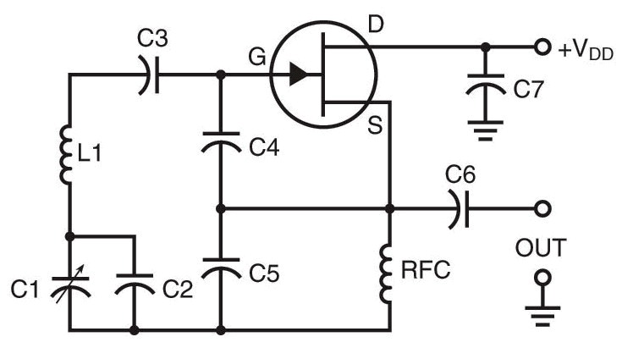
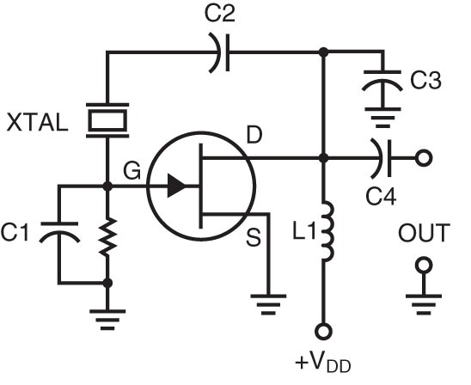
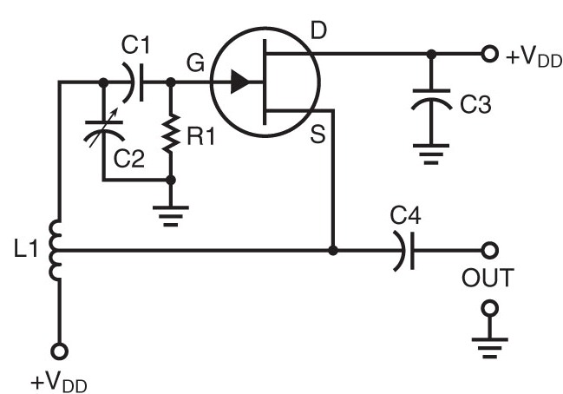
3 styles of Oscillators used in HAM radio
Colpitts
Pierce
Hartley

Slide 222
E7H01 What are three oscillator circuits used in Amateur Radio equipment?
A. Taft, Pierce and negative feedback
B. Pierce, Fenner and Beane
C. Taft, Hartley and Pierce
D. Colpitts, Hartley and Pierce

Slide 223
E7H01 What are three oscillator circuits used in Amateur Radio equipment?
A. Taft, Pierce and negative feedback
B. Pierce, Fenner and Beane
C. Taft, Hartley and Pierce
D. Colpitts, Hartley and Pierce

Slide 224
E7H02 Which describes a microphonic?
A. An IC used for amplifying microphone signals
B. Distortion caused by RF pickup on the microphone cable
C. Changes in oscillator frequency due to mechanical vibration
D. Excess loading of the microphone by an oscillator

Slide 225
E7H02 Which describes a microphonic?
A. An IC used for amplifying microphone signals
B. Distortion caused by RF pickup on the microphone cable
C. Changes in oscillator frequency due to mechanical vibration
D. Excess loading of the microphone by an oscillator

Slide 226
E7H03 How is positive feedback supplied in a Hartley oscillator?
A. Through a tapped coil
B. Through a capacitive divider
C. Through link coupling
D. Through a neutralizing capacitor

Slide 227
E7H03 How is positive feedback supplied in a Hartley oscillator?
A. Through a tapped coil
B. Through a capacitive divider
C. Through link coupling
D. Through a neutralizing capacitor

Slide 228
E7H04 How is positive feedback supplied in a Colpitts oscillator?
A. Through a tapped coil
B. Through link coupling
C. Through a capacitive divider
D. Through a neutralizing capacitor

Slide 229
E7H04 How is positive feedback supplied in a Colpitts oscillator?
A. Through a tapped coil
B. Through link coupling
C. Through a capacitive divider
D. Through a neutralizing capacitor

Slide 230
E7H05 How is positive feedback supplied in a Pierce oscillator?
A. Through a tapped coil
B. Through link coupling
C. Through a neutralizing capacitor
D. Through a quartz crystal

Slide 231
E7H05 How is positive feedback supplied in a Pierce oscillator?
A. Through a tapped coil
B. Through link coupling
C. Through a neutralizing capacitor
D. Through a quartz crystal

Slide 232
E7H06 Which of the following oscillator circuits are commonly used in VFOs?
A. Pierce and Zener
B. Colpitts and Hartley
C. Armstrong and deForest
D. Negative feedback and balanced feedback

Slide 233
E7H06 Which of the following oscillator circuits are commonly used in VFOs?
A. Pierce and Zener
B. Colpitts and Hartley
C. Armstrong and deForest
D. Negative feedback and balanced feedback

Slide 234
E7H07 How can an oscillator’s microphonic responses be reduced?
A. Use of NP0 capacitors
B. Eliminating noise on the oscillator’s power supply
C. Using the oscillator only for CW and digital signals
D. Mechanically isolating the oscillator circuitry from its enclosure

Slide 235
E7H07 How can an oscillator’s microphonic responses be reduced?
A. Use of NP0 capacitors
B. Eliminating noise on the oscillator’s power supply
C. Using the oscillator only for CW and digital signals
D. Mechanically isolating the oscillator circuitry from its enclosure

Slide 236
E7H08 Which of the following components can be used to reduce thermal drift in crystal oscillators?
A. NP0 capacitors
B. Toroidal inductors
C. Wirewound resistors
D. Non-inductive resistors

Slide 237
E7H08 Which of the following components can be used to reduce thermal drift in crystal oscillators?
A. NP0 capacitors
B. Toroidal inductors
C. Wirewound resistors
D. Non-inductive resistors

Slide 238
E7H09 What type of frequency synthesizer circuit uses a phase accumulator, lookup table, digital to analog converter, and a low-pass anti-alias filter?
A. A direct digital synthesizer
B. A hybrid synthesizer
C. A phase locked loop synthesizer
D. A diode-switching matrix synthesizer

Slide 239
E7H09 What type of frequency synthesizer circuit uses a phase accumulator, lookup table, digital to analog converter, and a low-pass anti-alias filter?
A. A direct digital synthesizer
B. A hybrid synthesizer
C. A phase locked loop synthesizer
D. A diode-switching matrix synthesizer

Slide 240
E7H10 What information is contained in the lookup table of a direct digital frequency synthesizer?
A. The phase relationship between a reference oscillator and the output waveform
B. The amplitude values that represent a sine-wave output
C. The phase relationship between a voltage-controlled oscillator and the output waveform
D. The synthesizer frequency limits and frequency values stored in the radio memories

Slide 241
E7H10 What information is contained in the lookup table of a direct digital frequency synthesizer?
A. The phase relationship between a reference oscillator and the output waveform
B. The amplitude values that represent a sine-wave output
C. The phase relationship between a voltage-controlled oscillator and the output waveform
D. The synthesizer frequency limits and frequency values stored in the radio memories

Slide 242
E7H11 What are the major spectral impurity components of direct digital synthesizers?
A. Broadband noise
B. Digital conversion noise
C. Spurious signals at discrete frequencies
D. Nyquist limit noise

Slide 243
E7H11 What are the major spectral impurity components of direct digital synthesizers?
A. Broadband noise
B. Digital conversion noise
C. Spurious signals at discrete frequencies
D. Nyquist limit noise

Slide 244
E7H12 Which of the following must be done to insure that a crystal oscillator provides the frequency specified by the crystal manufacturer?
A. Provide the crystal with a specified parallel inductance
B. Provide the crystal with a specified parallel capacitance
C. Bias the crystal at a specified voltage
D. Bias the crystal at a specified current

Slide 245
E7H12 Which of the following must be done to insure that a crystal oscillator provides the frequency specified by the crystal manufacturer?
A. Provide the crystal with a specified parallel inductance
B. Provide the crystal with a specified parallel capacitance
C. Bias the crystal at a specified voltage
D. Bias the crystal at a specified current

Slide 246
E7H13 Which of the following is a technique for providing highly accurate and stable oscillators needed for microwave transmission and reception?
A. Use a GPS signal reference
B. Use a rubidium stabilized reference oscillator
C. Use a temperature-controlled high Q dielectric resonator
D. All of these choices are correct

Slide 247
E7H13 Which of the following is a technique for providing highly accurate and stable oscillators needed for microwave transmission and reception?
A. Use a GPS signal reference
B. Use a rubidium stabilized reference oscillator
C. Use a temperature-controlled high Q dielectric resonator
D. All of these choices are correct

Slide 248
E7H14 What is a phase-locked loop circuit?
A. An electronic servo loop consisting of a ratio detector, reactance modulator, and voltage-controlled oscillator
B. An electronic circuit also known as a monostable multivibrator
C. An electronic servo loop consisting of a phase detector, a low-pass filter, a voltage-controlled oscillator, and a stable reference oscillator
D. An electronic circuit consisting of a precision push-pull amplifier with a differential input

Slide 249
E7H14 What is a phase-locked loop circuit?
A. An electronic servo loop consisting of a ratio detector, reactance modulator, and voltage-controlled oscillator
B. An electronic circuit also known as a monostable multivibrator
C. An electronic servo loop consisting of a phase detector, a low-pass filter, a voltage-controlled oscillator, and a stable reference oscillator
D. An electronic circuit consisting of a precision push-pull amplifier with a differential input

Slide 250
E7H15 Which of these functions can be performed by a phase-locked loop?
A. Wide-band AF and RF power amplification
B. Comparison of two digital input signals, digital pulse counter
C. Photovoltaic conversion, optical coupling
D. Frequency synthesis, FM demodulation

Slide 251
E7H15 Which of these functions can be performed by a phase-locked loop?
A. Wide-band AF and RF power amplification
B. Comparison of two digital input signals, digital pulse counter
C. Photovoltaic conversion, optical coupling
D. Frequency synthesis, FM demodulation

Slide 252
End of
SUBELEMENT E7
PRACTICAL CIRCUITS

