Slide 1
SUBELEMENT E9
ANTENNAS AND TRANSMISSION LINES
[8 Exam Questions - 8 Groups]
Notes:
Extra Question Pool 2016. The Western Washington Ham Training Team makes these slides available to teach Amateur Technician Radio Licensing Classes. Daniel Stevens KL7WM, Training Coordinator, Howard Swartz, W7HS, Slide master, Dustin Lomax, KF7FK, Leading Instructor, LW Abel, K7LWA, Enthusiasm Leader.

Slide 2
E9A Basic Antenna parameters: radiation resistance, gain, beamwidth, efficiency, beamwidth; effective radiated power, polarization.
E9B Antenna patterns: E and H plane patterns; gain as a function of pattern; antenna design.
E9C Wire and phased array antennas: rhombic antennas; effects of ground reflections; e-off angles; Practical wire antennas: Zepps, OCFD, loops.
E9D Directional antennas: gain; Yagi Antennas; losses; SWR bandwidth; antenna efficiency; shortened and mobile antennas; RF Grounding.
E9E Matching: matching antennas to feed lines; phasing lines; power dividers.
E9F Transmission lines: characteristics of open and shorted feed lines; 1/8 wavelength; 1/4 wavelength; 1/2 wavelength; feed lines: coax versus open-wire; velocity factor; electrical length; coaxial cable dielectrics; velocity factor.
E9G The Smith chart.
E9H Receiving Antennas: radio direction finding antennas; Beverage Antennas; specialized receiving antennas; longwire receiving antennas.

Slide 3
E9A01 What describes an isotropic antenna?
A. A grounded antenna used to measure earth conductivity
B. A horizontally polarized antenna used to compare Yagi antennas
C. A theoretical antenna used as a reference for antenna gain
D. A spacecraft antenna used to direct signals toward the earth

Slide 4
E9A01 What describes an isotropic antenna?
A. A grounded antenna used to measure earth conductivity
B. A horizontally polarized antenna used to compare Yagi antennas
C. A theoretical antenna used as a reference for antenna gain
D. A spacecraft antenna used to direct signals toward the earth

Slide 5
E9A02 What antenna has no gain in any direction?
A. Quarter-wave vertical
B. Yagi
C. Half-wave dipole
D. Isotropic antenna

Slide 6
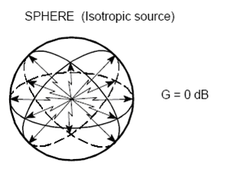
E9A02 What antenna has no gain in any direction?
A. Quarter-wave vertical
B. Yagi
C. Half-wave dipole
D. Isotropic antenna

Slide 7
E9A03 Why would one need to know the feed point impedance of an antenna?
A. To match impedances in order to minimize standing wave ratio on the transmission line
B. To measure the near-field radiation density from a transmitting antenna
C. To calculate the front-to-side ratio of the antenna
D. To calculate the front-to-back ratio of the antenna

Slide 8
E9A03 Why would one need to know the feed point impedance of an antenna?
A. To match impedances in order to minimize standing wave ratio on the transmission line
B. To measure the near-field radiation density from a transmitting antenna
C. To calculate the front-to-side ratio of the antenna
D. To calculate the front-to-back ratio of the antenna

Slide 9
E9A04 Which of the following factors may affect the feed point impedance of an antenna?
A. Transmission-line length
B. Antenna height, conductor length/diameter ratio and location of nearby conductive objects
C. The settings of an antenna tuner at the trnsmitter
D. Sunspot activity and time of day

Slide 10
E9A04 Which of the following factors may affect the feed point impedance of an antenna?
A. Transmission-line length
B. Antenna height, conductor length/diameter ratio and location of nearby conductive objects
C. The settings of an antenna tuner at the trnsmitter
D. Sunspot activity and time of day

Slide 11
E9A05 What is included in the total resistance of an antenna system?
A. Radiation resistance plus space impedance
B. Radiation resistance plus transmission resistance
C. Transmission-line resistance plus radiation resistance
D. Radiation resistance plus ohmic resistance

Slide 12
E9A05 What is included in the total resistance of an antenna system?
A. Radiation resistance plus space impedance
B. Radiation resistance plus transmission resistance
C. Transmission-line resistance plus radiation resistance
D. Radiation resistance plus ohmic resistance

Slide 13
E9A06 How does the beamwidth of an antenna vary as the gain is increased?
A. It increases geometrically
B. It increases arithmetically
C. It is essentially unaffected
D. It decreases

Slide 14
E9A06 How does the beamwidth of an antenna vary as the gain is increased?
A. It increases geometrically
B. It increases arithmetically
C. It is essentially unaffected
D. It decreases

Slide 15
E9A07 What is meant by antenna gain?
A. The ratio of the radiated signal strength of an antenna in the direction of maximum radiation to that of a reference antenna
B. The ratio of the signal in the forward direction to that in the opposite direction
C. The ratio of the amount of power radiated by an antenna compared to the transmitter output power
D. The final amplifier gain minus the transmission line losses

Slide 16
E9A07 What is meant by antenna gain?
A. The ratio of the radiated signal strength of an antenna in the direction of maximum radiation to that of a reference antenna
B. The ratio of the signal in the forward direction to that in the opposite direction
C. The ratio of the amount of power radiated by an antenna compared to the transmitter output power
D. The final amplifier gain minus the transmission line losses

Slide 17
E9A08 What is meant by antenna bandwidth?
A. Antenna length divided by the number of elements
B. The frequency range over which an antenna satisfies a performance requirement
C. The angle between the half-power radiation points
D. The angle formed between two imaginary lines drawn through the element ends

Slide 18
E9A08 What is meant by antenna bandwidth?
A. Antenna length divided by the number of elements
B. The frequency range over which an antenna satisfies a performance requirement
C. The angle between the half-power radiation points
D. The angle formed between two imaginary lines drawn through the element ends

Slide 19
E9A09 How is antenna efficiency calculated?
A. (radiation resistance / transmission resistance) x 100 percent
B. (radiation resistance / total resistance) x 100 percent
C. (total resistance / radiation resistance) x 100 percent
D. (effective radiated power / transmitter output) x 100 percent

Slide 20
E9A09 How is antenna efficiency calculated?
A. (radiation resistance / transmission resistance) x 100 percent
B. (radiation resistance / total resistance) x 100 percent
C. (total resistance / radiation resistance) x 100 percent
D. (effective radiated power / transmitter output) x 100 percent

Slide 21
E9A10 Which of the following choices is a way to improve the efficiency of a ground-mounted quarter-wave vertical antenna?
A. Install a good radial system
B. Isolate the coax shield from ground
C. Shorten the radiating element
D. Reduce the diameter of the radiating element

Slide 22
E9A10 Which of the following choices is a way to improve the efficiency of a ground-mounted quarter-wave vertical antenna?
A. Install a good radial system
B. Isolate the coax shield from ground
C. Shorten the radiating element
D. Reduce the diameter of the radiating element

Slide 23
E9A11 Which of the following factors determines ground losses for a ground-mounted vertical antenna operating in the 3 MHz to 30 MHz range?
A. The standing wave ratio
B. Distance from the transmitter
C. Soil conductivity
D. Take-off angle

Slide 24
E9A11 Which of the following factors determines ground losses for a ground-mounted vertical antenna operating in the 3 MHz to 30 MHz range?
A. The standing wave ratio
B. Distance from the transmitter
C. Soil conductivity
D. Take-off angle

Slide 25
E9A12 How much gain does an antenna have compared to a 1/2-wavelength dipole when it has 6 dB gain over an isotropic antenna?
A. 3.85 dB
B. 6.0 dB
C. 8.15 dB
D. 2.79 dB

Slide 26
E9A12 How much gain does an antenna have compared to a 1/2-wavelength dipole when it has 6 dB gain over an isotropic antenna?
A. 3.85 dB
B. 6.0 dB
C. 8.15 dB
D. 2.79 dB

Slide 27
E9A13 How much gain does an antenna have compared to a 1/2-wavelength dipole when it has 12 dB gain over an isotropic antenna?
A. 6.17 dB
B. 9.85 dB
C. 12.5 dB
D. 14.15 dB

Slide 28
E9A13 How much gain does an antenna have compared to a 1/2-wavelength dipole when it has 12 dB gain over an isotropic antenna?
A. 6.17 dB
B. 9.85 dB
C. 12.5 dB
D. 14.15 dB

Slide 29
E9A14 What is meant by the radiation resistance of an antenna?
A. The combined losses of the antenna elements and feed line
B. The specific impedance of the antenna
C. The value of a resistance that would dissipate the same amount of power as that radiated from an antenna
D. The resistance in the atmosphere that an antenna must overcome to be able to radiate a signal

Slide 30
E9A14 What is meant by the radiation resistance of an antenna?
A. The combined losses of the antenna elements and feed line
B. The specific impedance of the antenna
C. The value of a resistance that would dissipate the same amount of power as that radiated from an antenna
D. The resistance in the atmosphere that an antenna must overcome to be able to radiate a signal

Slide 31
E9A15 What is the effective radiated power relative to a dipole of a repeater station with 150 watts transmitter power output, 2 dB feed line loss, 2.2 dB duplexer loss, and 7 dBd antenna gain?
A. 1977 watts
B. 78.7 watts
C. 420 watts
D. 286 watts

Slide 32
E9A15 What is the effective radiated power relative to a dipole of a repeater station with 150 watts transmitter power output, 2 dB feed line loss, 2.2 dB duplexer loss, and 7 dBd antenna gain?
- 2.0 db feed line loss
- 2.2 db dupexer loss
+ 7.0 db antenna gain
+ 2.8 db net gain
A. 1977 watts
B. 78.7 watts
C. 420 watts
D. 286 watts
ERP = Power + gain(s) – Loss(es)
ERP= 150 watts + (7 dB) – (2 dB + 2.2 dB) or 150 watts + 2.8 dB
Gain/loss ratio = 10^(dB/10)or 10^(2.8/10) or 10^.28 or 1.905
ERP = 150 watts x 1.905(the overall db gain/loss ratio) or 285.8 watts

Slide 33
E9A16 What is the effective radiated power relative to a dipole of a repeater station with 200 watts transmitter power output, 4 dB feed line loss, 3.2 dB duplexer loss, 0.8 dB circulator loss and 10 dBd antenna gain?
A. 317 watts
B. 2000 watts
C. 126 watts
D. 300 watts

Slide 34
E9A16 What is the effective radiated power relative to a dipole of a repeater station with 200 watts transmitter power output, 4 dB feed line loss, 3.2 dB duplexer loss, 0.8 dB circulator loss and 10 dBd antenna gain?
- 4.0 db feed line loss
3.2 db dupexer loss
- 0.8 db circulator loss
+ 10.0 db antenna gain
+ 2.0 db net gain
A. 317 watts
B. 2000 watts
C. 126 watts
D. 300 watts
ERP = Power + gain(s) – Loss(es)
ERP= 150 watts + (10 dB) – (4 dB + 3.2 dB +0.8 dB) or 150 watts + 2 dB
Gain/loss ratio = 10^(dB/10)or 10^(2.0/10) or 10^.20 or 1.584
ERP = 200 watts x 1.584(the overall db gain/loss ratio) or 316.9 watts

Slide 35
E9A17 What is the effective radiated power of a repeater station with 200 watts transmitter power output, 2 dB feed line loss, 2.8 dB duplexer loss, 1.2 dB circulator loss and 7 dBi antenna gain?
A. 159 watts
B. 252 watts
C. 632 watts
D. 63.2 watts

Slide 36
E9A17 What is the effective radiated power of a repeater station with 200 watts transmitter power output, 2 dB feed line loss, 2.8 dB duplexer loss, 1.2 dB circulator loss and 7 dBi antenna gain?
A. 159 watts
B. 252 watts
C. 632 watts
D. 63.2 watts
- 2.0 db feed line loss
2.8 db dupexer loss
- 1.2 db circulator loss
+ 7.0 db antenna gain
+ 1.0 db net gain
ERP = Power + gain(s) – Loss(es)
ERP= 200 watts + (7 dB) – (2 dB + 2.8 dB +1.2 dB) or ERP = 200 watts + 1 dB
Gain/loss ratio = 10^(dB/10) or 10^(1/10) or 10^.1 or 1.258
ERP = 200 watts x 1.258 (the overall db gain/loss ratio) or 251.7 watts

Slide 37
E9A18 What term describes station output, taking into account all gains and losses?
A. Power factor
B. Half-power bandwidth
C. Effective radiated power
D. Apparent power

Slide 38
E9A18 What term describes station output, taking into account all gains and losses?
A. Power factor
B. Half-power bandwidth
C. Effective radiated power
D. Apparent power

Slide 39
E9B Antenna patterns
E and H plane patterns; gain as a function of pattern; antenna design

Slide 40
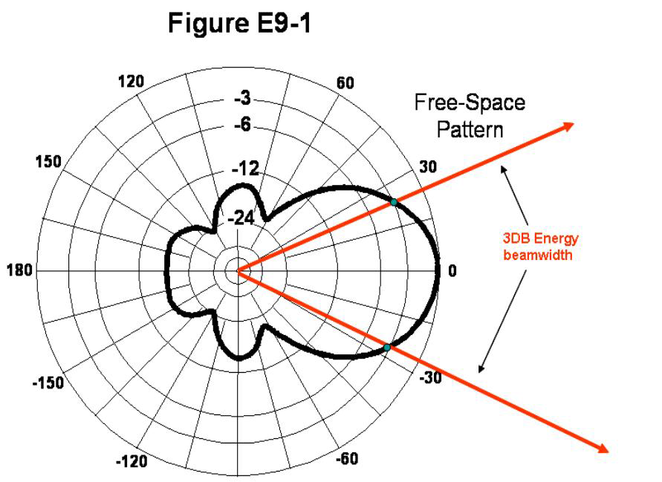
Antenna Radiation Pattern
Front to Side
Ratio
Front to Back 
Ratio

Slide 41
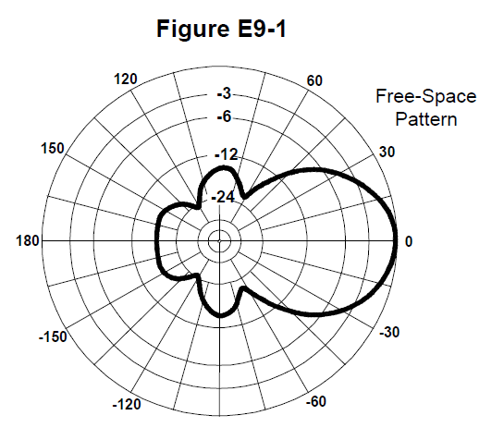
E9B01 In the antenna radiation pattern shown in Figure E9-1, what is the 3 dB beam-width?
A. 75 degrees
B. 50 degrees
C. 25 degrees
D. 30 degrees

Slide 42
E9B01 In the antenna radiation pattern shown in Figure E9-1, what is the 3 dB beam-width?
A. 75 degrees
B. 50 degrees
C. 25 degrees
D. 30 degrees

Slide 43
E9B02 In the antenna radiation pattern shown in Figure E9-1, what is the front-to-back ratio?
A. 36 dB
B. 18 dB
C. 24 dB
D. 14 dB

Slide 44
E9B02 In the antenna radiation pattern shown in Figure E9-1, what is the front-to-back ratio?
A. 36 dB
B. 18 dB
C. 24 dB
D. 14 dB

Slide 45
E9B03 In the antenna radiation pattern shown in Figure E9-1, what is the front-to-side ratio?
A. 12 dB
B. 14 dB
C. 18 dB
D. 24 dB

Slide 46
E9B03 In the antenna radiation pattern shown in Figure E9-1, what is the front-to-side ratio?
A. 12 dB
B. 14 dB
C. 18 dB
D. 24 dB

Slide 47
E9B04 What may occur when a directional antenna is operated at different frequencies within the band for which it was designed?
A. Feed point impedance may become negative
B. The E-field and H-field patterns may reverse
C. Element spacing limits could be exceeded
D. The gain may change depending on frequency

Slide 48
E9B04 What may occur when a directional antenna is operated at different frequencies within the band for which it was designed?
A. Feed point impedance may become negative
B. The E-field and H-field patterns may reverse
C. Element spacing limits could be exceeded
D. The gain may change depending on frequency

Slide 49
E9B05 What usually occurs if a Yagi antenna is designed solely for maximum forward gain?
A. The front-to-back ratio increases
B. The front-to-back ratio decreases
C. The frequency response is widened over the whole frequency band
D. The SWR is reduced

Slide 50
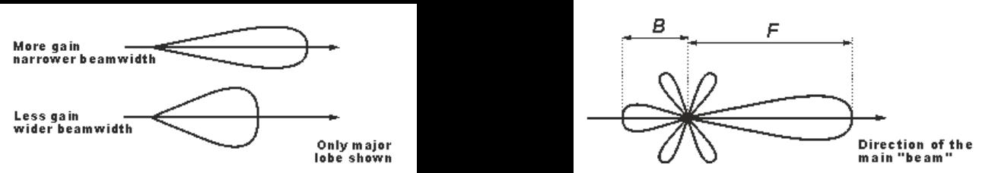
E9B05 What usually occurs if a Yagi antenna is designed solely for maximum forward gain?
A. The front-to-back ratio increases
B. The front-to-back ratio decreases
C. The frequency response is widened over the whole frequency band
D. The SWR is reduced

Slide 51
E9B06 If the boom of a Yagi antenna is lengthened and the elements are properly retuned, what usually occurs?
A. The gain increases
B. The SWR decreases
C. The front-to-back ratio increases
D. The gain bandwidth decreases rapidly

Slide 52
E9B06 If the boom of a Yagi antenna is lengthened and the elements are properly retuned, what usually occurs?
A. The gain increases
B. The SWR decreases
C. The front-to-back ratio increases
D. The gain bandwidth decreases rapidly

Slide 53
E9B07 How does the total amount of radiation emitted by a directional gain antenna compare with the total amount of radiation emitted from an isotropic antenna, assuming each is driven by the same amount of power?
A. The total amount of radiation from the directional antenna is increased by the gain of the antenna
B. The total amount of radiation from the directional antenna is stronger by its front-to-back ratio
C. They are the same
D. The radiation from the isotropic antenna is 2.15 dB stronger than that from the directional antenna

Slide 54
E9B07 How does the total amount of radiation emitted by a directional gain antenna compare with the total amount of radiation emitted from an isotropic antenna, assuming each is driven by the same amount of power?
A. The total amount of radiation from the directional antenna is increased by the gain of the antenna
B. The total amount of radiation from the directional antenna is stronger by its front-to-back ratio
C. They are the same
D. The radiation from the isotropic antenna is 2.15 dB stronger than that from the directional antenna

Slide 55
E9B08 How can the approximate beam-width in a given plane of a directional antenna be determined?

Slide 56
E9B08 How can the approximate beam-width in a given plane of a directional antenna be determined?
A. Note the two points where the signal strength of the antenna is 3 dB less than maximum and compute the angular difference
B. Measure the ratio of the signal strengths of the radiated power lobes from the front and rear of the antenna
C. Draw two imaginary lines through the ends of the elements and measure the angle between the lines
D. Measure the ratio of the signal strengths of the radiated power lobes from the front and side of the antenna

Slide 57
E9B08 How can the approximate beam-width in a given plane of a directional antenna be determined?
A. Note the two points where the signal strength of the antenna is 3 dB less than maximum and compute the angular difference
B. Measure the ratio of the signal strengths of the radiated power lobes from the front and rear of the antenna
C. Draw two imaginary lines through the ends of the elements and measure the angle between the lines
D. Measure the ratio of the signal strengths of the radiated power lobes from the front and side of the antenna

Slide 58
E9B09 What type of computer program technique is commonly used for modeling antennas?
A. Graphical analysis
B. Method of Moments
C. Mutual impedance analysis
D. Calculus differentiation with respect to physical properties

Slide 59
E9B09 What type of computer program technique is commonly used for modeling antennas?
A. Graphical analysis
B. Method of Moments
C. Mutual impedance analysis
D. Calculus differentiation with respect to physical properties

Slide 60
E9B10 What is the principle of a Method of Moments analysis?
A. A wire is modeled as a series of segments, each having a uniform value of current
B. A wire is modeled as a single sine-wave current generator
C. A wire is modeled as a series of points, each having a distinct location in space
D. A wire is modeled as a series of segments, each having a distinct value of voltage across it

Slide 61
E9B10 What is the principle of a Method of Moments analysis?
A. A wire is modeled as a series of segments, each having a uniform value of current
B. A wire is modeled as a single sine-wave current generator
C. A wire is modeled as a series of points, each having a distinct location in space
D. A wire is modeled as a series of segments, each having a distinct value of voltage across it

Slide 62
E9B11 What is a disadvantage of decreasing the number of wire segments in an antenna model below the guideline of 10 segments per half-wavelength?
A. Ground conductivity will not be accurately modeled
B. The resulting design will favor radiation of harmonic energy
C. The computed feed point impedance may be incorrect
D. The antenna will become mechanically unstable

Slide 63
E9B11 What is a disadvantage of decreasing the number of wire segments in an antenna model below the guideline of 10 segments per half-wavelength?
A. Ground conductivity will not be accurately modeled
B. The resulting design will favor radiation of harmonic energy
C. The computed feed point impedance may be incorrect
D. The antenna will become mechanically unstable

Slide 64
E9B12 What is the far field of an antenna?
A. The region of the ionosphere where radiated power is not refracted
B. The region where radiated power dissipates over a specified time period
C. The region where radiated field strengths are obstructed by objects of reflection
D. The region where the shape of the antenna pattern is independent of distance

Slide 65
E9B12 What is the far field of an antenna?
A. The region of the ionosphere where radiated power is not refracted
B. The region where radiated power dissipates over a specified time period
C. The region where radiated field strengths are obstructed by objects of reflection
D. The region where the shape of the antenna pattern is independent of distance

Slide 66
E9B13 What does the abbreviation NEC stand for when applied to antenna modeling programs?
A. Next Element Comparison
B. Numerical Electromagnetic Code
C. National Electrical Code
D. Numeric Electrical Computation

Slide 67
E9B13 What does the abbreviation NEC stand for when applied to antenna modeling programs?
A. Next Element Comparison
B. Numerical Electromagnetic Code
C. National Electrical Code
D. Numeric Electrical Computation

Slide 68
E9B14 What type of information can be obtained by submitting the details of a proposed new antenna to a modeling program?
A. SWR vs frequency charts
B. Polar plots of the far field elevation and azimuth patterns
C. Antenna gain
D. All of these choices are correct

Slide 69
E9B14 What type of information can be obtained by submitting the details of a proposed new antenna to a modeling program?
A. SWR vs frequency charts
B. Polar plots of the far field elevation and azimuth patterns
C. Antenna gain
D. All of these choices are correct

Slide 70
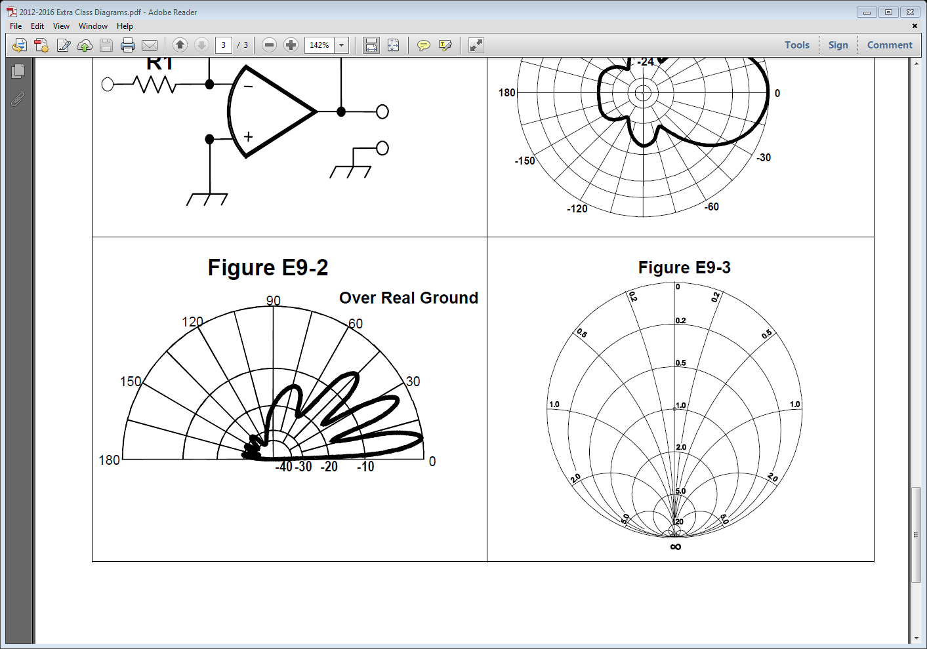
E9B15 What is the front-to-back ratio of the radiation pattern shown in Figure E9-2?
A. 15 dB
B. 28 dB
C. 3 dB
D. 24 dB

Slide 71
E9B15 What is the front-to-back ratio of the radiation pattern shown in Figure E9-2?
A. 15 dB
B. 28 dB
C. 3 dB
D. 24 dB

Slide 72
E9B16 How many elevation lobes appear in the forward direction of the antenna radiation pattern shown in Figure E9-2?
A. 4
B. 3
C. 1
D. 7

Slide 73
E9B16 How many elevation lobes appear in the forward direction of the antenna radiation pattern shown in Figure E9-2?
A. 4
B. 3
C. 1
D. 7

Slide 74
E9C Wire and phased array antennas
rhombic antennas; effects of ground reflections; e-off angles; Practical wire antennas: Zepps, OCFD, loops

Slide 75
E9C01 What is the radiation pattern of two 1/4-wavelength vertical antennas spaced 1/2-wavelength apart and fed 180 degrees out of phase?
A. Cardioid
B. Omni-directional
C. A figure-8 broadside to the axis of the array
D. A figure-8 oriented along the axis of the array

Slide 76
E9C01 What is the radiation pattern of two 1/4-wavelength vertical antennas spaced 1/2-wavelength apart and fed 180 degrees out of phase?
A. Cardioid
B. Omni-directional
C. A figure-8 broadside to the axis of the array
D. A figure-8 oriented along the axis of the array

Slide 77
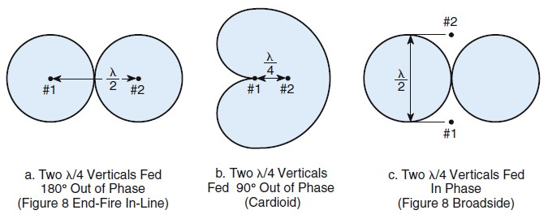
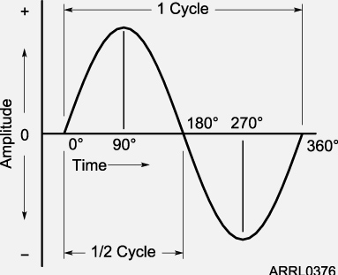
Antenna Radiation Patterns

Slide 78
E9C02 What is the radiation pattern of two 1/4 wavelength vertical antennas spaced 1/4 wavelength apart and fed 90 degrees out of phase?
A. Cardioid
B. A figure-8 end-fire along the axis of the array
C. A figure-8 broadside to the axis of the array
D. Omni-directional

Slide 79
E9C02 What is the radiation pattern of two 1/4 wavelength vertical antennas spaced 1/4 wavelength apart and fed 90 degrees out of phase?
A. Cardioid
B. A figure-8 end-fire along the axis of the array
C. A figure-8 broadside to the axis of the array
D. Omni-directional

Slide 80
E9C03 What is the radiation pattern of two 1/4 wavelength vertical antennas spaced 1/2 wavelength apart and fed in phase?
A. Omni-directional
B. Cardioid
C. A Figure-8 broadside to the axis of the array
D. A Figure-8 end-fire along the axis of the array

Slide 81
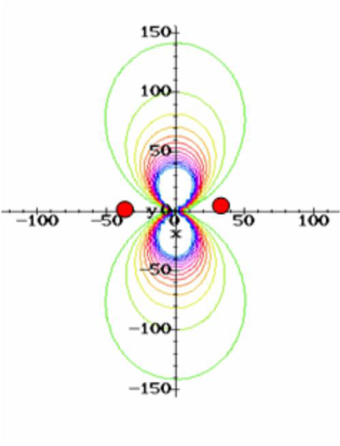
E9C03 What is the radiation pattern of two 1/4 wavelength vertical antennas spaced 1/2 wavelength apart and fed in phase?
A. Omni-directional
B. Cardioid
C. A Figure-8 broadside to the axis of the array
D. A Figure-8 end-fire along the axis of the array

Slide 82
E9C04 What happens to the radiation pattern of an unterminated long wire antenna as the wire length is increased?
A. The lobes become more perpendicular to the wire
B. The lobes align more in the direction of the wire
C. The vertical angle increases
D. The front-to-back ratio decreases

Slide 83
E9C04 What happens to the radiation pattern of an unterminated long wire antenna as the wire length is increased?
A. The lobes become more perpendicular to the wire
B. The lobes align more in the direction of the wire
C. The vertical angle increases
D. The front-to-back ratio decreases

Slide 84
E9C05 What is an OCFD antenna?
A. A dipole feed approximately 1/3 the way from one end with a 4:1 balun to provide multiband operation
B. A remotely tunable dipole antenna using orthogonally controlled frequency diversity
C. An eight band dipole antenna using octophase filters
D. A multiband dipole antenna using one-way circular polarization for frequency diversity

Slide 85
E9C05 What is an OCFD antenna?
A. A dipole feed approximately 1/3 the way from one end with a 4:1 balun to provide multiband operation
B. A remotely tunable dipole antenna using orthogonally controlled frequency diversity
C. An eight band dipole antenna using octophase filters
D. A multiband dipole antenna using one-way circular polarization for frequency diversity

Slide 86
E9C06 What is the effect of a terminating resistor on a rhombic antenna?
A. It reflects the standing waves on the antenna elements back to the transmitter
B. It changes the radiation pattern from bidirectional to unidirectional
C. It changes the radiation pattern from horizontal to vertical polarization
D. It decreases the ground loss

Slide 87
E9C06 What is the effect of a terminating resistor on a rhombic antenna?
A. It reflects the standing waves on the antenna elements back to the transmitter
B. It changes the radiation pattern from bidirectional to unidirectional
C. It changes the radiation pattern from horizontal to vertical polarization
D. It decreases the ground loss

Slide 88
E9C07 What is the approximate feed point impedance at the center of a two-wire folded dipole antenna?
A. 300 ohms
B. 72 ohms
C. 50 ohms
D. 450 ohms

Slide 89
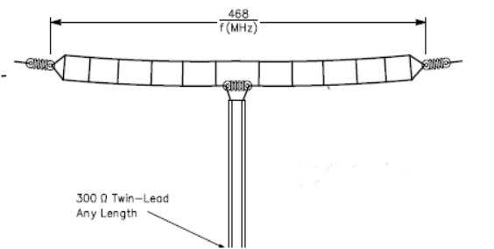
E9C07 What is the approximate feed point impedance at the center of a two-wire folded dipole antenna?
A. 300 ohms
B. 72 ohms
C. 50 ohms
D. 450 ohms

Slide 90
E9C08 What is a folded dipole antenna?
A. A dipole one-quarter wavelength long
B. A type of ground-plane antenna
C. A dipole consisting of one wavelength of wire forming a very thin loop
D. A dipole configured to provide forward gain

Slide 91
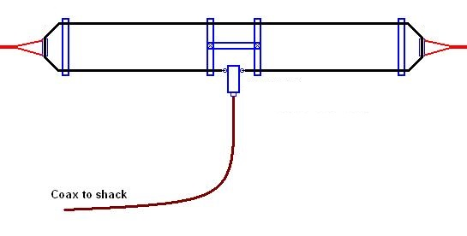
E9C08 What is a folded dipole antenna?
A. A dipole one-quarter wavelength long
B. A type of ground-plane antenna
C. A dipole consisting of one wavelength of wire forming a very thin loop
D. A dipole configured to provide forward gain

Slide 92
E9C09 What is a G5RV antenna?
A. A multi-band dipole antenna fed with coax and a balun through a selected length of open wire transmission line
B. A multi-band trap antenna
C. A phased array antenna consisting of multiple loops
D. A wide band dipole using shorted coaxial cable for the radiating elements and fed with a 4:1 balun

Slide 93
E9C09 What is a G5RV antenna?
A. A multi-band dipole antenna fed with coax and a balun through a selected length of open wire transmission line
B. A multi-band trap antenna
C. A phased array antenna consisting of multiple loops
D. A wide band dipole using shorted coaxial cable for the radiating elements and fed with a 4:1 balun

Slide 94
E9C10 Which of the following describes a Zepp antenna?
A. A dipole constructed from zip cord
B. An end fed dipole antenna
C. An omni-directional antenna commonly used for satellite communications
D. A vertical array capable of quickly changing the direction of maximum radiation by changing phasing lines

Slide 95
E9C10 Which of the following describes a Zepp antenna?
A. A dipole constructed from zip cord
B. An end fed dipole antenna
C. An omni-directional antenna commonly used for satellite communications
D. A vertical array capable of quickly changing the direction of maximum radiation by changing phasing lines

Slide 96
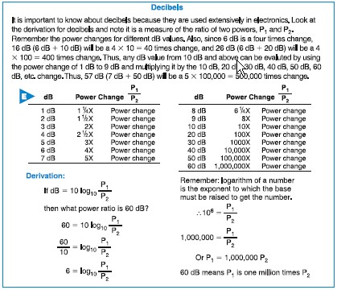
Decibels

Slide 97
E9C11 How is the far-field elevation pattern of a vertically polarized antenna affected by being mounted over seawater versus rocky ground?
A. The low-angle radiation decreases
B. The high-angle radiation increases
C. Both the high-angle and low-angle radiation decrease
D. The low-angle radiation increases

Slide 98
E9C11 How is the far-field elevation pattern of a vertically polarized antenna affected by being mounted over seawater versus rocky ground?
A. The low-angle radiation decreases
B. The high-angle radiation increases
C. Both the high-angle and low-angle radiation decrease
D. The low-angle radiation increases

Slide 99
E9C12 Which of the following describes an extended double Zepp antenna?
A. A wideband vertical antenna constructed from precisely tapered aluminum tubing
B. A portable antenna erected using two push support poles
C. A center fed 1.25 wavelength antenna (two 5/8 wave elements in phase)
D. An end fed folded dipole antenna

Slide 100
E9C12 Which of the following describes an extended double Zepp antenna?
A. A wideband vertical antenna constructed from precisely tapered aluminum tubing
B. A portable antenna erected using two push support poles
C. A center fed 1.25 wavelength antenna (two 5/8 wave elements in phase)
D. An end fed folded dipole antenna

Slide 101
E9C13 What is the main effect of placing a vertical antenna over an imperfect ground?
A. It causes increased SWR
B. It changes the impedance angle of the matching network
C. It reduces low-angle radiation
D. It reduces losses in the radiating portion of the antenna

Slide 102
E9C13 What is the main effect of placing a vertical antenna over an imperfect ground?
A. It causes increased SWR
B. It changes the impedance angle of the matching network
C. It reduces low-angle radiation
D. It reduces losses in the radiating portion of the antenna

Slide 103
E3C14 How does the performance of a horizontally polarized antenna mounted on the side of a hill compare with the same antenna mounted on flat ground?
A. The main lobe takeoff angle increases in the downhill direction
B. The main lobe takeoff angle decreases in the downhill direction
C. The horizontal beam width decreases in the downhill direction
D. The horizontal beam width increases in the uphill direction

Slide 104
E3C14 How does the performance of a horizontally polarized antenna mounted on the side of a hill compare with the same antenna mounted on flat ground?
A. The main lobe takeoff angle increases in the downhill direction
B. The main lobe takeoff angle decreases in the downhill direction
C. The horizontal beam width decreases in the downhill direction
D. The horizontal beam width increases in the uphill direction

Slide 105
E9C15 How does the radiation pattern of a horizontally polarized 3-element beam antenna vary with its height above ground?
A. The main lobe takeoff angle increases with increasing height
B. The main lobe takeoff angle decreases with increasing height
C. The horizontal beam width increases with height
D. The horizontal beam width decreases with height

Slide 106
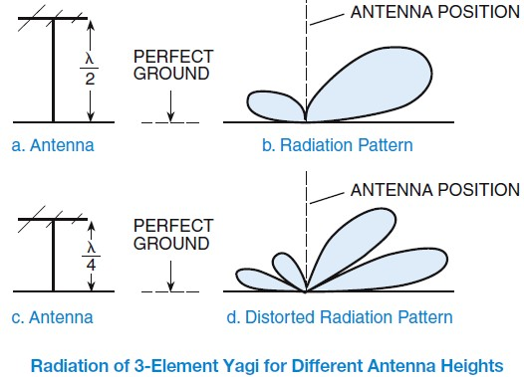
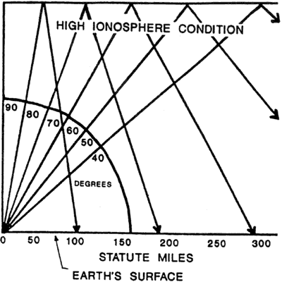
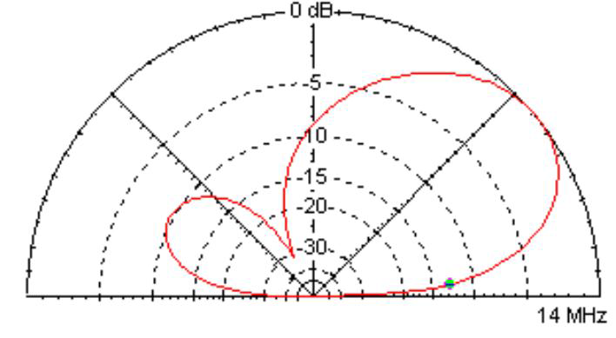
Radiowave take off pattern

Slide 107
E9C15 How does the radiation pattern of a horizontally polarized 3-element beam antenna vary with its height above ground?
A. The main lobe takeoff angle increases with increasing height
B. The main lobe takeoff angle decreases with increasing height
C. The horizontal beam width increases with height
D. The horizontal beam width decreases with height

Slide 108
E9D Directional antennas gain
Yagi Antennas; losses; SWR bandwidth: antenna bandwidth; antenna efficiency; shortened and mobile antennas; RF Grounding

Slide 109
E9D01 How does the gain of an ideal parabolic dish antenna change when the operating frequency is doubled?
A. Gain does not change
B. Gain is multiplied by 0.707
C. Gain increases by 6 dB
D. Gain increases by 3 dB

Slide 110
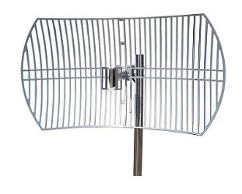
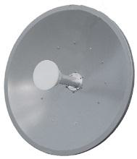
E9D01 How does the gain of an ideal parabolic dish antenna change when the operating frequency is doubled?
A. Gain does not change
B. Gain is multiplied by 0.707
C. Gain increases by 6 dB
D. Gain increases by 3 dB

Slide 111
E9D02 How can linearly polarized Yagi antennas be used to produce circular polarization?
A. Stack two Yagis fed 90 degrees out of phase to form an array with the respective elements in parallel planes
B. Stack two Yagis fed in phase to form an array with the respective elements in parallel planes
C. Arrange two Yagis perpendicular to each other with the driven elements at the same point on the boom fed 90 degrees out of phase
D. Arrange two Yagis collinear to each other with the driven elements fed 180 degrees out of phase

Slide 112
E9D02 How can linearly polarized Yagi antennas be used to produce circular polarization?
A. Stack two Yagis fed 90 degrees out of phase to form an array with the respective elements in parallel planes
B. Stack two Yagis fed in phase to form an array with the respective elements in parallel planes
C. Arrange two Yagis perpendicular to each other with the driven elements at the same point on the boom fed 90 degrees out of phase
D. Arrange two Yagis collinear to each other with the driven elements fed 180 degrees out of phase

Slide 113
E9D03 Where should a high Q loading coil be placed to minimize losses in a shortened vertical antenna?
A. Near the center of the vertical radiator
B. As low as possible on the vertical radiator
C. As close to the transmitter as possible
D. At a voltage node

Slide 114
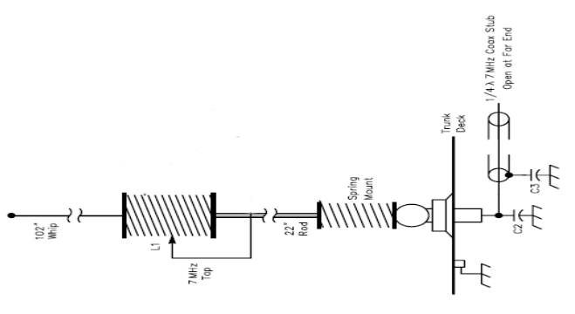
E9D03 Where should a high Q loading coil be placed to minimize losses in a shortened vertical antenna?
A. Near the center of the vertical radiator
B. As low as possible on the vertical radiator
C. As close to the transmitter as possible
D. At a voltage node

Slide 115
E9D04 Why should an HF mobile antenna loading coil have a high ratio of reactance to resistance?
A. To swamp out harmonics
B. To maximize losses
C. To minimize losses
D. To minimize the Q

Slide 116
E9D04 Why should an HF mobile antenna loading coil have a high ratio of reactance to resistance?
A. To swamp out harmonics
B. To maximize losses
C. To minimize losses
D. To minimize the Q

Slide 117
E9D05 What is a disadvantage of using a multiband trapped antenna?
A. It might radiate harmonics
B. It radiates the harmonics and fundamental equally well
C. It is too sharply directional at lower frequencies
D. It must be neutralized

Slide 118
E9D05 What is a disadvantage of using a multiband trapped antenna?
A. It might radiate harmonics
B. It radiates the harmonics and fundamental equally well
C. It is too sharply directional at lower frequencies
D. It must be neutralized

Slide 119
E9D06 What happens to the bandwidth of an antenna as it is shortened through the use of loading coils?
A. It is increased
B. It is decreased
C. No change occurs
D. It becomes flat

Slide 120
E9D06 What happens to the bandwidth of an antenna as it is shortened through the use of loading coils?
A. It is increased
B. It is decreased
C. No change occurs
D. It becomes flat

Slide 121
E9D07 What is an advantage of using top loading in a shortened HF vertical antenna?
A. Lower Q
B. Greater structural strength
C. Higher losses
D. Improved radiation efficiency

Slide 122
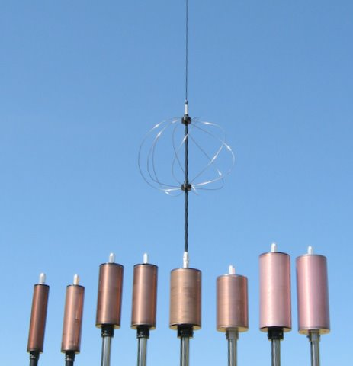
E9D07 What is an advantage of using top loading in a shortened HF vertical antenna?
A. Lower Q
B. Greater structural strength
C. Higher losses
D. Improved radiation efficiency

Slide 123
E9D08 What happens as the Q of an antenna increases?
A. SWR bandwidth increases
B. SWR bandwidth decreases
C. Gain is reduced
D. More common-mode current is present on the feed line

Slide 124
E9D08 What happens as the Q of an antenna increases?
A. SWR bandwidth increases
B. SWR bandwidth decreases
C. Gain is reduced
D. More common-mode current is present on the feed line

Slide 125
E9D09 What is the function of a loading coil used as part of an HF mobile antenna?
A. To increase the SWR bandwidth
B. To lower the losses
C. To lower the Q
D. To cancel capacitive reactance

Slide 126
E9D09 What is the function of a loading coil used as part of an HF mobile antenna?
A. To increase the SWR bandwidth
B. To lower the losses
C. To lower the Q
D. To cancel capacitive reactance

Slide 127
E9D10 What happens to feed point impedance at the base of a fixed length HF mobile antenna as the frequency of operation is lowered?
A. The radiation resistance decreases and the capacitive reactance decreases
B. The radiation resistance decreases and the capacitive reactance increases
C. The radiation resistance increases and the capacitive reactance decreases
D. The radiation resistance increases and the capacitive reactance increases

Slide 128
E9D10 What happens to feed point impedance at the base of a fixed length HF mobile antenna as the frequency of operation is lowered?
A. The radiation resistance decreases and the capacitive reactance decreases
B. The radiation resistance decreases and the capacitive reactance increases
C. The radiation resistance increases and the capacitive reactance decreases
D. The radiation resistance increases and the capacitive reactance increases

Slide 129
E9D11 Which of the following types of conductor would be best for minimizing losses in a station's RF ground system?
A. A resistive wire, such as spark plug wire
B. A wide flat copper strap
C. A cable with six or seven 18 gauge conductors in parallel
D. A single 12 gauge or 10 gauge stainless steel wire

Slide 130
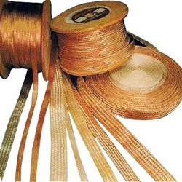
E9D11 Which of the following types of conductor would be best for minimizing losses in a station's RF ground system?
A. A resistive wire, such as spark plug wire
B. A wide flat copper strap
C. A cable with six or seven 18 gauge conductors in parallel
D. A single 12 gauge or 10 gauge stainless steel wire

Slide 131
E9D12 Which of the following would provide the best RF ground for your station?
A. A 50 ohm resistor connected to ground
B. An electrically short connection to a metal water pipe
C. An electrically short connection to 3 or 4 interconnected ground rods driven into the Earth
D. An electrically short connection to 3 or 4 interconnected ground rods via a series RF choke

Slide 132
E9D12 Which of the following would provide the best RF ground for your station?
A. A 50 ohm resistor connected to ground
B. An electrically short connection to a metal water pipe
C. An electrically short connection to 3 or 4 interconnected ground rods driven into the Earth
D. An electrically short connection to 3 or 4 interconnected ground rods via a series RF choke

Slide 133
E9D13 What usually occurs if a Yagi antenna is designed solely for maximum forward gain?
A. The front-to-back ratio increases
B. The front-to-back ratio decreases
C. The frequency response is widened over the whole frequency band
D. The SWR is reduced

Slide 134
E9D13 What usually occurs if a Yagi antenna is designed solely for maximum forward gain?
A. The front-to-back ratio increases
B. The front-to-back ratio decreases
C. The frequency response is widened over the whole frequency band
D. The SWR is reduced

Slide 135
Break Time
Half way thru – any questions???

Slide 136
E9E Matching
matching antennas to feed lines; phasing lines; power dividers

Slide 137
E9E01 What system matches a higher impedance transmission line to a lower impedance antenna by connecting the line to the driven element in two places spaced a fraction of a wavelength each side of element center?
A. The gamma matching system
B. The delta matching system
C. The omega matching system
D. The stub matching system

Slide 138
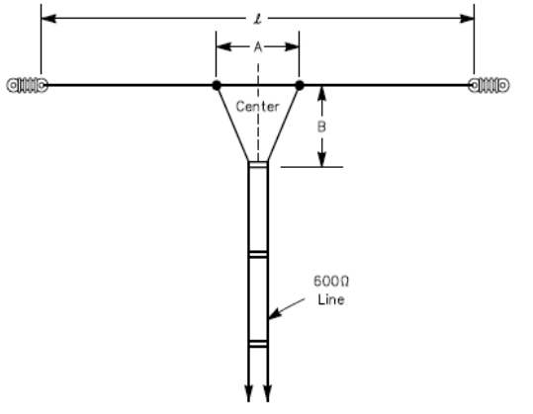
E9E01 What system matches a higher impedance transmission line to a lower impedance antenna by connecting the line to the driven element in two places spaced a fraction of a wavelength each side of element center?
A. The gamma matching system
B. The delta matching system
C. The omega matching system
D. The stub matching system

Slide 139
E9E02 What is the name of an antenna matching system that matches an unbalanced feed line to an antenna by feeding the driven element both at the center of the element and at a fraction of a wavelength to one side of center?
A. The gamma match
B. The delta match
C. The epsilon match
D. The stub match

Slide 140
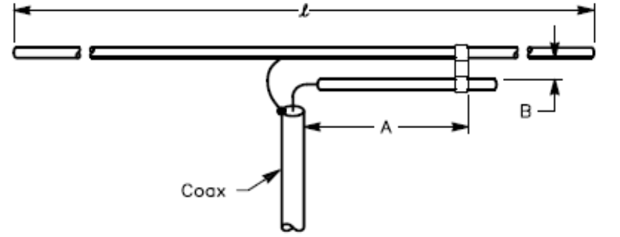
E9E02 What is the name of an antenna matching system that matches an unbalanced feed line to an antenna by feeding the driven element both at the center of the element and at a fraction of a wavelength to one side of center?
A. The gamma match
B. The delta match
C. The epsilon match
D. The stub match

Slide 141
E9E03 What is the name of the matching system that uses a section of transmission line connected in parallel with the feed line at or near the feed point?
A. The gamma match
B. The delta match
C. The omega match
D. The stub match

Slide 142
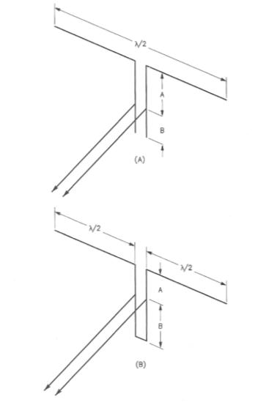
E9E03 What is the name of the matching system that uses a section of transmission line connected in parallel with the feed line at or near the feed point?
A. The gamma match
B. The delta match
C. The omega match
D. The stub match

Slide 143
E9E04 What is the purpose of the series capacitor in a gamma-type antenna matching network?
A. To provide DC isolation between the feed line and the antenna
B. To cancel the inductive reactance of the matching network
C. To provide a rejection notch that prevents the radiation of harmonics
D. To transform the antenna impedance to a higher value

Slide 144
E9E04 What is the purpose of the series capacitor in a gamma-type antenna matching network?
A. To provide DC isolation between the feed line and the antenna
B. To cancel the inductive reactance of the matching network
C. To provide a rejection notch that prevents the radiation of harmonics
D. To transform the antenna impedance to a higher value

Slide 145
E9E05 How must the driven element in a 3-element Yagi be tuned to use a hairpin matching system?
A. The driven element reactance must be capacitive
B. The driven element reactance must be inductive
C. The driven element resonance must be lower than the operating frequency
D. The driven element radiation resistance must be higher than the characteristic impedance of the transmission line

Slide 146
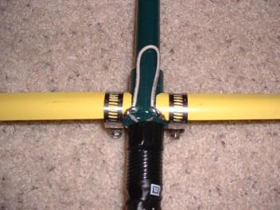
E9E05 How must the driven element in a 3-element Yagi be tuned to use a hairpin matching system?
A. The driven element reactance must be capacitive
B. The driven element reactance must be inductive
C. The driven element resonance must be lower than the operating frequency
D. The driven element radiation resistance must be higher than the characteristic impedance of the transmission line

Slide 147
E9E06 What is the equivalent lumped-constant network for a hairpin matching system of a
3-element Yagi?
A. Pi-network
B. Pi-L-network
C. A shunt inductor
D. A series capacitor

Slide 148
E9E06 What is the equivalent lumped-constant network for a hairpin matching system of a
3-element Yagi?
A. Pi-network
B. Pi-L-network
C. A shunt inductor
D. A series capacitor

Slide 149
E9E07 What term best describes the interactions at the load end of a mismatched transmission line?
A. Characteristic impedance
B. Reflection coefficient
C. Velocity factor
D. Dielectric constant

Slide 150
E9E07 What term best describes the interactions at the load end of a mismatched transmission line?
A. Characteristic impedance
B. Reflection coefficient
C. Velocity factor
D. Dielectric constant

Slide 151
E9E08 Which of the following measurements is characteristic of a mismatched transmission line?
A. An SWR less than 1:1
B. A reflection coefficient greater than 1
C. A dielectric constant greater than 1
D. An SWR greater than 1:1

Slide 152
E9E08 Which of the following measurements is characteristic of a mismatched transmission line?
A. An SWR less than 1:1
B. A reflection coefficient greater than 1
C. A dielectric constant greater than 1
D. An SWR greater than 1:1

Slide 153
E9E09 Which of these matching systems is an effective method of connecting a 50 ohm coaxial cable feed line to a grounded tower so it can be used as a vertical antenna?
A. Double-bazooka match
B. Hairpin match
C. Gamma match
D. All of these choices are correct

Slide 154
E9E09 Which of these matching systems is an effective method of connecting a 50 ohm coaxial cable feed line to a grounded tower so it can be used as a vertical antenna?
A. Double-bazooka match
B. Hairpin match
C. Gamma match
D. All of these choices are correct

Slide 155
E9E10 Which of these choices is an effective way to match an antenna with a 100 ohm feed point impedance to a 50 ohm coaxial cable feed line?
A. Connect a 1/4-wavelength open stub of 300 ohm twin-lead in parallel with the coaxial feed line where it connects to the antenna
B. Insert a 1/2 wavelength piece of 300 ohm twin-lead in series between the antenna terminals and the 50 ohm feed cable
C. Insert a 1/4-wavelength piece of 75 ohm coaxial cable transmission line in series between the antenna terminals and the 50 ohm feed cable
D. Connect 1/2 wavelength shorted stub of 75 ohm cable in parallel with the 50 ohm cable where it attaches to the antenna

Slide 156
E9E10 Which of these choices is an effective way to match an antenna with a 100 ohm feed point impedance to a 50 ohm coaxial cable feed line?
A. Connect a 1/4-wavelength open stub of 300 ohm twin-lead in parallel with the coaxial feed line where it connects to the antenna
B. Insert a 1/2 wavelength piece of 300 ohm twin-lead in series between the antenna terminals and the 50 ohm feed cable
C. Insert a 1/4-wavelength piece of 75 ohm coaxial cable transmission line in series between the antenna terminals and the 50 ohm feed cable
D. Connect 1/2 wavelength shorted stub of 75 ohm cable in parallel with the 50 ohm cable where it attaches to the antenna

Slide 157
E9E11 What is an effective way of matching a feed line to a VHF or UHF antenna when the impedances of both the antenna and feed line are unknown?
A. Use a 50 ohm 1:1 balun between the antenna and feed line
B. Use the universal stub matching technique
C. Connect a series-resonant LC network across the antenna feed terminals
D. Connect a parallel-resonant LC network across the antenna feed terminals

Slide 158
E9E11 What is an effective way of matching a feed line to a VHF or UHF antenna when the impedances of both the antenna and feed line are unknown?
A. Use a 50 ohm 1:1 balun between the antenna and feed line
B. Use the universal stub matching technique
C. Connect a series-resonant LC network across the antenna feed terminals
D. Connect a parallel-resonant LC network across the antenna feed terminals

Slide 159
E9E12 What is the primary purpose of a phasing line when used with an antenna having multiple driven elements?
A. It ensures that each driven element operates in concert with the others to create the desired antenna pattern
B. It prevents reflected power from traveling back down the feed line and causing harmonic radiation from the transmitter
C. It allows single-band antennas to operate on other bands
D. It makes sure the antenna has a low-angle radiation pattern

Slide 160
E9E12 What is the primary purpose of a phasing line when used with an antenna having multiple driven elements?
A. It ensures that each driven element operates in concert with the others to create the desired antenna pattern
B. It prevents reflected power from traveling back down the feed line and causing harmonic radiation from the transmitter
C. It allows single-band antennas to operate on other bands
D. It makes sure the antenna has a low-angle radiation pattern

Slide 161
E9E13 What is a purpose use for a Wilkinson divider?
A. It divides the operating frequency of a transmitter signal so it can be used on a lower frequency band
B. It is used to feed high-impedance antennas from a low-impedance source
C. It is used to divide power equally between two 50 ohm loads while maintaining 50 ohm input impedance
D. It is used to feed low-impedance loads from a high-impedance source

Slide 162
E9E13 What is a purpose use for a Wilkinson divider?
A. It divides the operating frequency of a transmitter signal so it can be used on a lower frequency band
B. It is used to feed high-impedance antennas from a low-impedance source
C. It is used to divide power equally between two 50 ohm loads while maintaining 50 ohm input impedance
D. It is used to feed low-impedance loads from a high-impedance source

Slide 163
E9F Transmission lines
characteristics of open and shorted feed lines; 1/8 wavelength; 1/4 wavelength; 1/2 wavelength; feed lines: coax versus open-wire; velocity factor; electrical length; coaxial cable dielectrics; velocity factor

Slide 164
E9F01 What is the velocity factor of a transmission line?
A. The ratio of the characteristic impedance of the line to the terminating impedance
B. The index of shielding for coaxial cable
C. The velocity of the wave in the transmission line multiplied by the velocity of light in a vacuum
D. The velocity of the wave in the transmission line divided by the velocity of light in a vacuum

Slide 165
E9F01 What is the velocity factor of a transmission line?
A. The ratio of the characteristic impedance of the line to the terminating impedance
B. The index of shielding for coaxial cable
C. The velocity of the wave in the transmission line multiplied by the velocity of light in a vacuum
D. The velocity of the wave in the transmission line divided by the velocity of light in a vacuum

Slide 166
E9F02 Which of the following determines the velocity factor of a transmission line?
A. The termination impedance
B. The line length
C. Dielectric materials used in the line
D. The center conductor resistivity

Slide 167
E9F02 Which of the following determines the velocity factor of a transmission line?
A. The termination impedance
B. The line length
C. Dielectric materials used in the line
D. The center conductor resistivity

Slide 168
E9F03 Why is the physical length of a coaxial cable transmission line shorter than its electrical length?
A. Skin effect is less pronounced in the coaxial cable
B. The characteristic impedance is higher in a parallel feed line
C. The surge impedance is higher in a parallel feed line
D. Electrical signals move more slowly in a coaxial cable than in air

Slide 169
E9F03 Why is the physical length of a coaxial cable transmission line shorter than its electrical length?
A. Skin effect is less pronounced in the coaxial cable
B. The characteristic impedance is higher in a parallel feed line
C. The surge impedance is higher in a parallel feed line
D. Electrical signals move more slowly in a coaxial cable than in air

Slide 170
E9F04 What is the typical velocity factor for a coaxial cable with solid polyethylene dielectric?
A. 2.70
B. 0.66
C. 0.30
D. 0.10

Slide 171
E9F04 What is the typical velocity factor for a coaxial cable with solid polyethylene dielectric?
A. 2.70
B. 0.66
C. 0.30
D. 0.10

Slide 172
E9F05 What is the approximate physical length of a solid polyethylene dielectric coaxial transmission line that is electrically one-quarter wavelength long at 14.1 MHz?
A. 20 meters
B. 2.3 meters
C. 3.5 meters
D. 0.2 meters

Slide 173
E9F05 What is the approximate physical length of a solid polyethylene dielectric coaxial transmission line that is electrically one-quarter wavelength long at 14.1 MHz?
A. 20 meters
B. 2.3 meters
C. 3.5 meters
D. 0.2 meters
Wave length = 300 / 14.1 = 21.2766
Wavelength / 4 = 5.319 meters
5.319 * .66 = 3.51 meters

Slide 174
E9F06 What is the approximate physical length of an air-insulated, parallel conductor transmission line that is electrically one-half wavelength long at 14.10 MHz?
A. 15 meters
B. 20 meters
C. 10 meters
D. 71 meters

Slide 175
E9F06 What is the approximate physical length of an air-insulated, parallel conductor transmission line that is electrically one-half wavelength long at 14.10 MHz?
A. 15 meters
B. 20 meters
C. 10 meters
D. 71 meters
Wave length = 300 / 14.1 = 21.2766
Wavelength / 2 = 10.628 meters
10.628 * .95 = 10.106 meters

Slide 176
E9F07 How does ladder line compare to small-diameter coaxial cable such as RG-58 at 50 MHz?
A. Lower loss
B. Higher SWR
C. Smaller reflection coefficient
D. Lower velocity factor

Slide 177
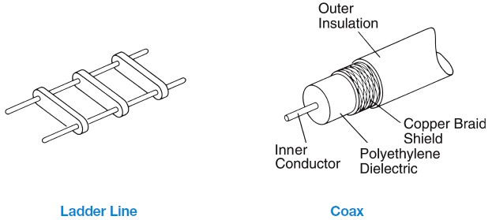
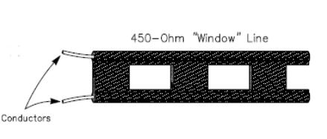
E9F07 How does ladder line compare to small-diameter coaxial cable such as RG-58 at 50 MHz?
A. Lower loss
B. Higher SWR
C. Smaller reflection coefficient
D. Lower velocity factor

Slide 178
E9F08 What is the term for the ratio of the actual speed at which a signal travels through a transmission line to the speed of light in a vacuum?
A. Velocity factor
B. Characteristic impedance
C. Surge impedance
D. Standing wave ratio

Slide 179
E9F08 What is the term for the ratio of the actual speed at which a signal travels through a transmission line to the speed of light in a vacuum?
A. Velocity factor
B. Characteristic impedance
C. Surge impedance
D. Standing wave ratio

Slide 180
E9F09 What is the approximate physical length of a solid polyethylene dielectric coaxial transmission line that is electrically one-quarter wavelength long at 7.2 MHz?
A. 10 meters
B. 6.9 meters
C. 24 meters
D. 50 meters

Slide 181
E9F09 What is the approximate physical length of a solid polyethylene dielectric coaxial transmission line that is electrically one-quarter wavelength long at 7.2 MHz?
A. 10 meters
B. 6.9 meters
C. 24 meters
D. 50 meters
Wave length = 300 / 7.2 = 41.66
Wavelength / 4 = 10.33 meters
10.33 * .66 = 6.875 meters

Slide 182
Transmissions Stub Matching
Impedance of coaxial stubs
Wavelength | Open Stub | Shorted Stub
1/8 | Capacitive | Inductive
1/4 | Low Imp. | High Imp.
1/2 | High Imp. | Low Imp.

Slide 183
E9F10 What impedance does a 1/8 wavelength transmission line present to a generator when the line is shorted at the far end?
A. A capacitive reactance
B. The same as the characteristic impedance of the line
C. An inductive reactance
D. The same as the input impedance to the final generator stage

Slide 184
E9F10 What impedance does a 1/8 wavelength transmission line present to a generator when the line is shorted at the far end?
A. A capacitive reactance
B. The same as the characteristic impedance of the line
C. An inductive reactance
D. The same as the input impedance to the final generator stage

Slide 185
E9F11 What impedance does a 1/8 wavelength transmission line present to a generator when the line is open at the far end?
A. The same as the characteristic impedance of the line
B. An inductive reactance
C. A capacitive reactance
D. The same as the input impedance of the final generator stage

Slide 186
E9F11 What impedance does a 1/8 wavelength transmission line present to a generator when the line is open at the far end?
A. The same as the characteristic impedance of the line
B. An inductive reactance
C. A capacitive reactance
D. The same as the input impedance of the final generator stage

Slide 187
E9F12 What impedance does a 1/4 wavelength transmission line present to a generator when the line is open at the far end?
A. The same as the characteristic impedance of the line
B. The same as the input impedance to the generator
C. Very high impedance
D. Very low impedance

Slide 188
E9F12 What impedance does a 1/4 wavelength transmission line present to a generator when the line is open at the far end?
A. The same as the characteristic impedance of the line
B. The same as the input impedance to the generator
C. Very high impedance
D. Very low impedance

Slide 189
E9F13 What impedance does a 1/4 wavelength transmission line present to a generator when the line is shorted at the far end?
A. Very high impedance
B. Very low impedance
C. The same as the characteristic impedance of the transmission line
D. The same as the generator output impedance

Slide 190
E9F13 What impedance does a 1/4 wavelength transmission line present to a generator when the line is shorted at the far end?
A. Very high impedance
B. Very low impedance
C. The same as the characteristic impedance of the transmission line
D. The same as the generator output impedance

Slide 191
E9F14 What impedance does a 1/2 wavelength transmission line present to a generator when the line is shorted at the far end?
A. Very high impedance
B. Very low impedance
C. The same as the characteristic impedance of the line
D. The same as the output impedance of the generator

Slide 192
E9F14 What impedance does a 1/2 wavelength transmission line present to a generator when the line is shorted at the far end?
A. Very high impedance
B. Very low impedance
C. The same as the characteristic impedance of the line
D. The same as the output impedance of the generator

Slide 193
E9F15 What impedance does a 1/2 wavelength transmission line present to a generator when the line is open at the far end?
A. Very high impedance
B. Very low impedance
C. The same as the characteristic impedance of the line
D. The same as the output impedance of the generator

Slide 194
E9F15 What impedance does a 1/2 wavelength transmission line present to a generator when the line is open at the far end?
A. Very high impedance
B. Very low impedance
C. The same as the characteristic impedance of the line
D. The same as the output impedance of the generator

Slide 195
E9F16 Which of the following is a significant difference between foam dielectric coaxial cable and solid dielectric cable, assuming all other parameters are the same?
A. Foam dielectric has lower safe operating voltage limits
B. Foam dielectric has lower loss per unit of length
C. Foam dielectric has higher velocity factor
D. All of these choices are correct

Slide 196
E9F16 Which of the following is a significant difference between foam dielectric coaxial cable and solid dielectric cable, assuming all other parameters are the same?
A. Foam dielectric has lower safe operating voltage limits
B. Foam dielectric has lower loss per unit of length
C. Foam dielectric has higher velocity factor
D. All of these choices are correct

Slide 197
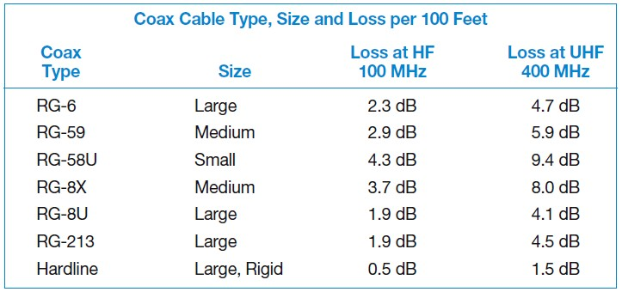
Coax Loss per 100 foot

Slide 198
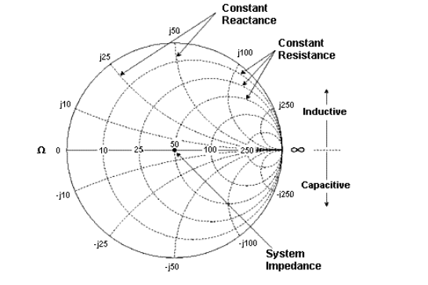
E9G Smith Chart

Slide 199
E9G01 Which of the following can be calculated using a Smith chart?
A. Impedance along transmission lines
B. Radiation resistance
C. Antenna radiation pattern
D. Radio propagation

Slide 200
E9G01 Which of the following can be calculated using a Smith chart?
A. Impedance along transmission lines
B. Radiation resistance
C. Antenna radiation pattern
D. Radio propagation

Slide 201
E9G02 What type of coordinate system is used in a Smith chart?
A. Voltage circles and current arcs
B. Resistance circles and reactance arcs
C. Voltage lines and current chords
D. Resistance lines and reactance chords

Slide 202
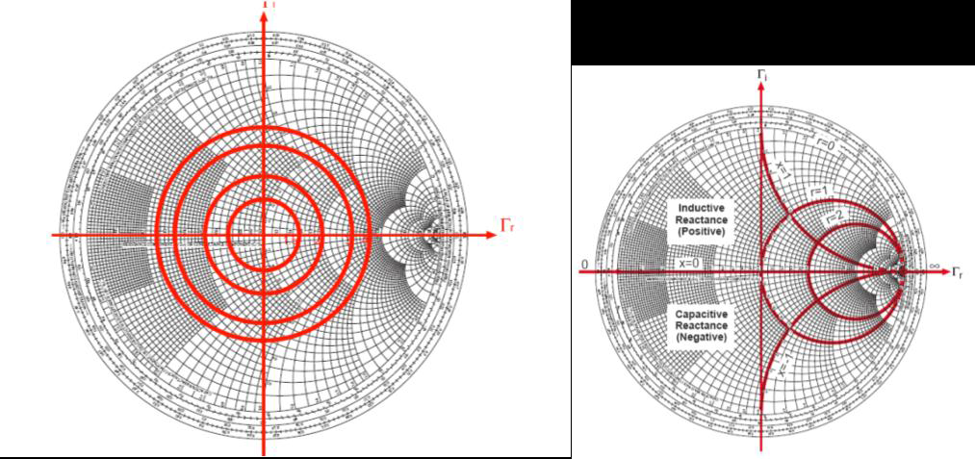
E9G02 What type of coordinate system is used in a Smith chart?
A. Voltage circles and current arcs
B. Resistance circles and reactance arcs
C. Voltage lines and current chords
D. Resistance lines and reactance chords

Slide 203
E9G03 Which of the following is often determined using a Smith chart?
A. Beam headings and radiation patterns
B. Satellite azimuth and elevation bearings
C. Impedance and SWR values in transmission lines
D. Trigonometric functions

Slide 204
E9G03 Which of the following is often determined using a Smith chart?
A. Beam headings and radiation patterns
B. Satellite azimuth and elevation bearings
C. Impedance and SWR values in transmission lines
D. Trigonometric functions

Slide 205
E9G04 What are the two families of circles and arcs that make up a Smith chart?
A. Resistance and voltage
B. Reactance and voltage
C. Resistance and reactance
D. Voltage and impedance

Slide 206
E9G04 What are the two families of circles and arcs that make up a Smith chart?
A. Resistance and voltage
B. Reactance and voltage
C. Resistance and reactance
D. Voltage and impedance

Slide 207
E9G05 What type of chart is shown in Figure E9-3?
A. Smith chart
B. Free space radiation directivity chart
C. Elevation angle radiation pattern chart
D. Azimuth angle radiation pattern chart

Slide 208
E9G05 What type of chart is shown in Figure E9-3?
A. Smith chart
B. Free space radiation directivity chart
C. Elevation angle radiation pattern chart
D. Azimuth angle radiation pattern chart

Slide 209
E9G06 On the Smith chart shown in Figure E9-3, what is the name for the large outer circle on which the reactance arcs terminate?
A. Prime axis
B. Reactance axis
C. Impedance axis
D. Polar axis

Slide 210
E9G06 On the Smith chart shown in Figure E9-3, what is the name for the large outer circle on which the reactance arcs terminate?
A. Prime axis
B. Reactance axis
C. Impedance axis
D. Polar axis

Slide 211
E9G07 On the Smith chart shown in Figure E9-3, what is the only straight line shown?
A. The reactance axis
B. The current axis
C. The voltage axis
D. The resistance axis

Slide 212
E9G07 On the Smith chart shown in Figure E9-3, what is the only straight line shown?
A. The reactance axis
B. The current axis
C. The voltage axis
D. The resistance axis

Slide 213
E9G08 What is the process of normalization with regard to a Smith chart?
A. Reassigning resistance values with regard to the reactance axis
B. Reassigning reactance values with regard to the resistance axis
C. Reassigning impedance values with regard to the prime center
D. Reassigning prime center with regard to the reactance axis

Slide 214
E9G08 What is the process of normalization with regard to a Smith chart?
A. Reassigning resistance values with regard to the reactance axis
B. Reassigning reactance values with regard to the resistance axis
C. Reassigning impedance values with regard to the prime center
D. Reassigning prime center with regard to the reactance axis

Slide 215
E9G09 What third family of circles is often added to a Smith chart during the process of solving problems?
A. Standing wave ratio circles
B. Antenna-length circles
C. Coaxial-length circles
D. Radiation-pattern circles

Slide 216
E9G09 What third family of circles is often added to a Smith chart during the process of solving problems?
A. Standing wave ratio circles
B. Antenna-length circles
C. Coaxial-length circles
D. Radiation-pattern circles

Slide 217
E9G10 What do the arcs on a Smith chart represent?
A. Frequency
B. SWR
C. Points with constant resistance
D. Points with constant reactance

Slide 218
E9G10 What do the arcs on a Smith chart represent?
A. Frequency
B. SWR
C. Points with constant resistance
D. Points with constant reactance

Slide 219
E9G11 How are the wavelength scales on a Smith chart calibrated?
A. In fractions of transmission line electrical frequency
B. In fractions of transmission line electrical wavelength
C. In fractions of antenna electrical wavelength
D. In fractions of antenna electrical frequency

Slide 220
E9G11 How are the wavelength scales on a Smith chart calibrated?
A. In fractions of transmission line electrical frequency
B. In fractions of transmission line electrical wavelength
C. In fractions of antenna electrical wavelength
D. In fractions of antenna electrical frequency

Slide 221
E9H Receiving Antennas:
Radio direction finding antennas; Beverage Antennas; specialized receiving antennas; longwire receiving antennas

Slide 222
E9H01 When constructing a Beverage antenna, which of the following factors should be included in the design to achieve good performance at the desired frequency?
A. Its overall length must not exceed 1/4 wavelength
B. It must be mounted more than 1 wavelength above ground
C. It should be configured as a four-sided loop
D. It should be one or more wavelengths long

Slide 223
E9H01 When constructing a Beverage antenna, which of the following factors should be included in the design to achieve good performance at the desired frequency?
A. Its overall length must not exceed 1/4 wavelength
B. It must be mounted more than 1 wavelength above ground
C. It should be configured as a four-sided loop
D. It should be one or more wavelengths long

Slide 224
E9H02 Which is generally true for low band (160 meter and 80 meter) receiving antennas?
A. Atmospheric noise is so high that gain over a dipole is not important
B. They must be erected at least 1/2 wavelength above the ground to attain good directivity
C. Low loss coax transmission line is essential for good performance
D. All of these choices are correct

Slide 225
E9H02 Which is generally true for low band (160 meter and 80 meter) receiving antennas?
A. Atmospheric noise is so high that gain over a dipole is not important
B. They must be erected at least 1/2 wavelength above the ground to attain good directivity
C. Low loss coax transmission line is essential for good performance
D. All of these choices are correct

Slide 226
E9H04 What is an advantage of using a shielded loop antenna for direction finding?
A. It automatically cancels ignition noise in mobile installations
B. It is electro statically balanced against ground, giving better nulls
C. It eliminates tracking errors caused by strong out-of-band signals
D. It allows stations to communicate without giving away their position

Slide 227
E9H04 What is an advantage of using a shielded loop antenna for direction finding?
A. It automatically cancels ignition noise in mobile installations
B. It is electro statically balanced against ground, giving better nulls
C. It eliminates tracking errors caused by strong out-of-band signals
D. It allows stations to communicate without giving away their position

Slide 228
E9H05 What is the main drawback of a wire-loop antenna for direction finding?
A. It has a bidirectional pattern
B. It is non-rotatable
C. It receives equally well in all directions
D. It is practical for use only on VHF bands

Slide 229
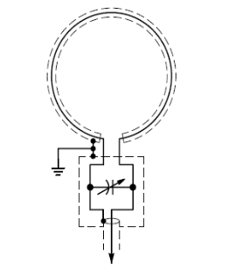
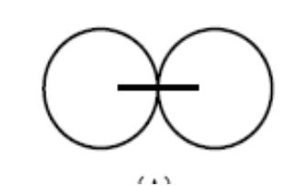
E9H05 What is the main drawback of a wire-loop antenna for direction finding?
A. It has a bidirectional pattern
B. It is non-rotatable
C. It receives equally well in all directions
D. It is practical for use only on VHF bands

Slide 230
E9H06 What is the triangulation method of direction finding?
A. The geometric angles of sky waves from the source are used to determine its position
B. A fixed receiving station plots three headings to the signal source
C. Antenna headings from several different receiving locations are used to locate the signal source
D. A fixed receiving station uses three different antennas to plot the location of the signal source

Slide 231
E9H06 What is the triangulation method of direction finding?
A. The geometric angles of sky waves from the source are used to determine its position
B. A fixed receiving station plots three headings to the signal source
C. Antenna headings from several different receiving locations are used to locate the signal source
D. A fixed receiving station uses three different antennas to plot the location of the signal source

Slide 232
E9H07 Why is it advisable to use an RF attenuator on a receiver being used for direction finding?
It narrows the bandwidth of the received signal to improve signal to noise ratio
It compensates for the effects of an isotropic antenna, thereby improving directivity
It reduces loss of received signals caused by antenna pattern nulls, thereby increasing sensitivity
It prevents receiver overload which could make it difficult to determine peaks or nulls

Slide 233
E9H07 Why is it advisable to use an RF attenuator on a receiver being used for direction finding?
It narrows the bandwidth of the received signal to improve signal to noise ratio
It compensates for the effects of an isotropic antenna, thereby improving directivity
It reduces loss of received signals caused by antenna pattern nulls, thereby increasing sensitivity
It prevents receiver overload which could make it difficult to determine peaks or nulls

Slide 234
E9H08 What is the function of a sense antenna?
A. It modifies the pattern of a DF antenna array to provide a null in one direction
B. It increases the sensitivity of a DF antenna array
C. It allows DF antennas to receive signals at different vertical angles
D. It provides diversity reception that cancels multipath signals

Slide 235
E9H08 What is the function of a sense antenna?
A. It modifies the pattern of a DF antenna array to provide a null in one direction
B. It increases the sensitivity of a DF antenna array
C. It allows DF antennas to receive signals at different vertical angles
D. It provides diversity reception that cancels multipath signals

Slide 236
E9H09 Which of the following describes the construction of a receiving loop antenna?
A. A large circularly-polarized antenna
B. A small coil of wire tightly wound around a toroidal ferrite core
C. One or more turns of wire wound in the shape of a large open coil
D. A vertical antenna coupled to a feed line through an inductive loop of wire

Slide 237
E9H09 Which of the following describes the construction of a receiving loop antenna?
A. A large circularly-polarized antenna
B. A small coil of wire tightly wound around a toroidal ferrite core
C. One or more turns of wire wound in the shape of a large open coil
D. A vertical antenna coupled to a feed line through an inductive loop of wire

Slide 238
E9H10 How can the output voltage of a multiple turn receiving loop antenna be increased?
A. By reducing the permeability of the loop shield
B. By increasing the number of wire turns in the loop and reducing the area of the loop structure
C. By winding adjacent turns in opposing directions
D. By increasing either the number of wire turns in the loop or the area of the loop structure or both

Slide 239
E9H10 How can the output voltage of a multiple turn receiving loop antenna be increased?
A. By reducing the permeability of the loop shield
B. By increasing the number of wire turns in the loop and reducing the area of the loop structure
C. By winding adjacent turns in opposing directions
D. By increasing either the number of wire turns in the loop or the area of the loop structure or both

Slide 240
E9H11 What characteristic of a cardioid pattern antenna is useful for direction finding?
A. A very sharp peak
B. A very sharp single null
C. Broad band response
D. High-radiation angle

Slide 241
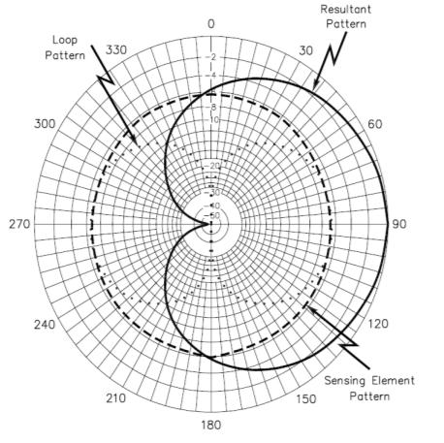
E9H11 What characteristic of a cardioid pattern antenna is useful for direction finding?
A. A very sharp peak
B. A very sharp single null
C. Broad band response
D. High-radiation angle

Slide 242
End of
SUBELEMENT E9
ANTENNAS AND TRANSMISSION LINES

