Slide 1
SUBELEMENT T1 – COMMISSION’S Rules,
Descriptions and definitions for the Amateur Radio Service, operator and station license responsibilities.
[6 Exam Questions - 6 Groups]
Notes:
Subelement T1 COMMISSION’S Rules. Technician Training Slides for 2022 Question Pool Good through June 30, 2026 Assembled by Western Washington Ham Training Team, Daniel Stevens KL7WM.

Slide 2
FCC Rules
T1A - Purpose and permissible use of the Amateur Radio Service; Operator/primary station license grant; Meanings of basic terms used in FCC rules; Interference; RACES rules; Phonetics; Frequency Coordinator
T1B - Frequency allocations; Emission modes; Spectrum sharing; Transmissions near band edges; Contacting the International Space Station; Power output
T1C - Licensing: classes, sequential and vanity call sign systems, places where the Amateur Radio Service is regulated by the FCC, name and address on FCC license database, term, renewal, grace period, maintaining mailing address; International communications
T1D - Authorized and prohibited transmissions: communications with other countries, music, exchange of information with other services, indecent language, compensation for operating, retransmission of other amateur signals, encryption, sale of equipment, unidentified transmissions, one-way transmission
T1E - Control operator: eligibility, designating, privileges, duties, location, required; Control point; Control types: automatic, remote
T1F - Station identification; Repeaters; Third party communications; Club stations; FCC inspection

Slide 3
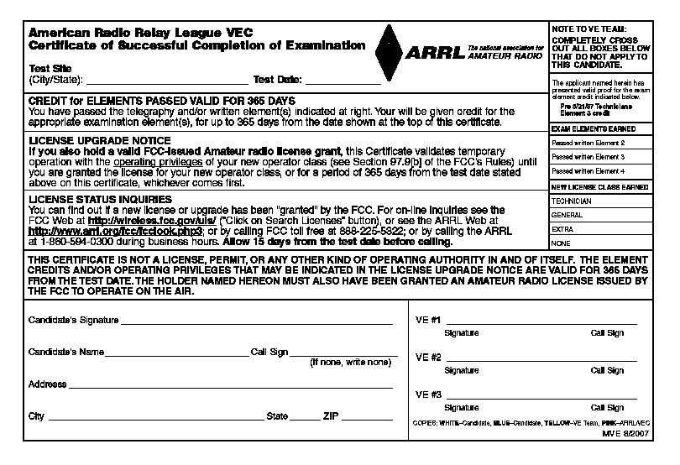
Certificate of Successful Completion (CSCE)

Slide 4
FCC Part 97
  Title 47 governs all Telecommunications in the US
    There are 301 parts (Part 0-332)
  Part 97 applies to Amateur Radio
  Copies available at:
  http://www.arrl.org/FandES/field/regulations/rules-g.html
  http://www.fcc.gov

Slide 5
FCC Universal License System
  Online License Service http://wireless.fcc.gov/uls/
  Tracks all FCC License Applications and Licensees
  When your license shows up here, you’re legal ☺

Slide 6
Definitions
Regulatory Body – FCC rules are defined in Part 97
Amateur Service – A radio communication service, carried out by authorized individuals without pecuniary interest
Amateur Operator – A person granted a license for amateur service
Amateur Station – A station licensed for Amateur Service
Amateur Space Station – An amateur station over 50KM high
Unidentified Communications – Communications from an unidentified source
Interference – Unwanted signals that disrupt other communications

Slide 7
Five Fundamental Purposes of Ham Radio
  1. Recognition and enhancement of the value of the amateur service to the public as a voluntary noncommercial communication service, particularly with respect to providing emergency communications.
  2. Continuation and extension of the amateur’s proven ability to contribute to the advancement of the radio art.
  3. Encouragement and improvement of the amateur service through rules which provide for advancing skills in both the communications and technical phases of the art.
  4. Expansion of the existing reservoir within the amateur radio service of trained operators, technicians, and electronics experts.
  5. Continuation and extension of the amateur’s unique ability to enhance international goodwill.

Slide 8
Section T1A
Amateur Radio Service: purpose and permissible use of the Amateur Radio Service, operator/primary station license grant; Meanings of basic terms used in FCC rules; Interference; RACES rules; Phonetics; Frequency Coordinator

Slide 9
T1A01 - Which of the following is part of the Basis and Purpose of the Amateur Radio Service?
A. Providing personal radio communications for as many citizens as possible
B. Providing communications for international non-profit organizations
C. Advancing skills in the technical and communication phases of the radio art
D. All of these choices are correct

Slide 10
T1A01 - Which of the following is part of the Basis and Purpose of the Amateur Radio Service?
A. Providing personal radio communications for as many citizens as possible
B. Providing communications for international non-profit organizations
C. Advancing skills in the technical and communication phases of the radio art
D. All of these choices are correct

Slide 11
T1A02 - Which agency regulates and enforces the rules for the Amateur Radio Service in the United States?
A. FEMA
B. Homrland Security
C. The FCC
D. All these choices are correct

Slide 12

T1A02 - Which agency regulates and enforces the rules for the Amateur Radio Service in the United States?
A. FEMA
B. Homeland Security
C. The FCC
D. Al;l these choices are correct

Slide 13
T1A03 What do the FCC rules state regarding the use of a phonetic alphabet for station identification in the Amateur Radio Service?
A. It is required when transmitting emergency messages
B. It is encouraged
C. It is required when in contact with foreign stations
D. Al the choices are correct

Slide 14
T1A03 What do the FCC rules state regarding the use of a phonetic alphabet for station identification in the Amateur Radio Service?
A. It is required when transmitting emergency messages
B. It is encouraged
C. It is required when in contact with foreign stations
D. All thre choices are correct

Slide 15
T1A04 How many operator/primary station license grants may be held by any one person?
A. One
B. No more than two
C. One for each band on which the person plans to operate
D. One for each permanent station location from which the person plans to operate

Slide 16
T1A04 How many operator/primary station license grants may be held by any one person?
A. One
B. No more than two
C. One for each band on which the person plans to operate
D. One for each permanent station location from which the person plans to operate

Slide 17
T1A05 What proves that the FCC has issued an operator/primary license grant?
A printed copy of the certificate of successful completion of examination
An email notification from the NCVEC granting the license.
The license appears in the FCC ULS database.
All these choices are correct.

Slide 18
T1A05 What proves that the FCC has issued an operator/primary license grant?
A printed copy of the certificate of successful completion of examination
An email notification from the NCVEC granting the license.
The license appears in the FCC ULS database.
All these choices are correct.

Slide 19
T1A06 What is the FCC Part 97 definition of a beacon?
A. A government transmitter marking the amateur radio band edges
B. A bulletin sent by the FCC to announce a national emergency
C. A continuous transmission of weather information authorized in the amateur bands by the National Weather Service
D .An amateur station transmitting communications for the purposes of observing propagation or related experimental activities

Slide 20
T1A06 What is the FCC Part 97 definition of a beacon?
A. A government transmitter marking the amateur radio band edges
B. A bulletin sent by the FCC to announce a national emergency
C. A continuous transmission of weather information authorized in the amateur bands by the National Weather Service
D .An amateur station transmitting communications for the purposes of observing propagation or related experimental activities

Slide 21
T1A07 What is the FCC Part 97 definition of a space station?
A. Any satellite orbiting the earth
B. A manned satellite orbiting the earth
C. An amateur station located more than 50 km above the Earth's surface
D. An amateur station using amateur radio satellites for relay of signals

Slide 22
T1A07 What is the FCC Part 97 definition of a space station?
A. Any satellite orbiting the earth
B. A manned satellite orbiting the earth
C. An amateur station located more than 50 km above the Earth's surface
D. An amateur station using amateur radio satellites for relay of signals

Slide 23
T1A08 - Which of the following entities recommends transmit/receive channels and other parameters for auxiliary and repeater stations?
A. Frequency Spectrum Manager appointed by the FCC
B. Volunteer Frequency Coordinator recognized by local amateurs
C. FCC Regional Field Office
D. International Telecommunications Union

Slide 24
T1A08 - Which of the following entities recommends transmit/receive channels and other parameters for auxiliary and repeater stations?
A. Frequency Spectrum Manager appointed by the FCC
B. Volunteer Frequency Coordinator recognized by local amateurs
C. FCC Regional Field Office
D. International Telecommunications Union

Slide 25
T1A09 - Who selects a Frequency Coordinator?
A. The FCC Office of Spectrum Management and Coordination Policy
B. The local chapter of the Office of National Council of Independent Frequency Coordinators
C. Amateur operators in a local or regional area whose stations are eligible to be repeater or auxiliary stations
D. FCC Regional Field Office

Slide 26
T1A09 - Who selects a Frequency Coordinator?
A. The FCC Office of Spectrum Management and Coordination Policy
B. The local chapter of the Office of National Council of Independent Frequency Coordinators
C. Amateur operators in a local or regional area whose stations are eligible to be repeater or auxiliary stations
D. FCC Regional Field Office

Slide 27
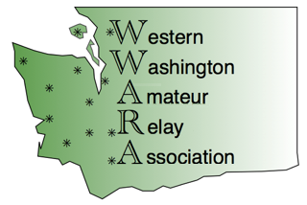
Local Frequency Coordinators help organize repeater activities within a region to minimize interference issues
The Western Washington Amateur Relay Association (WWARA) covers Western Washington and has repeater lists and the local band plan
http://www.WWARA.org
WWARA
PO BOX 31521
SEATTLE WA 98103-1521

Slide 28
T1A10 What is the Radio Amateur Civil Emergency Service (RACES)?
A. A radio service using amateur frequencies for emergency management or civil defense communications
B. A radio service using amateur stations for emergency management or civil defense communications
C. An emergency service using amateur operators certified by a civil defense organization as being enrolled in that organization
D. All of these choices are correct

Slide 29
T1A10 What is the Radio Amateur Civil Emergency Service (RACES)?
A. A radio service using amateur frequencies for emergency management or civil defense communications
B. A radio service using amateur stations for emergency management or civil defense communications
C. An emergency service using amateur operators certified by a civil defense organization as being enrolled in that organization
D. All of these choices are correct

Slide 30
T1A11 - When is willful interference to other amateur radio stations permitted?
A. To stop another amateur station that is breaking the FCC rules.
B. At no time
C. When making short test transmissions
D. At any time. Stations in the Amateur Radio Service are not protected from willful interference

Slide 31
T1A11 - When is willful interference to other amateur radio stations permitted?
A. To stop another amateur station that is breaking the FCC rules.
B. At no time
C. When making short test transmissions
D. At any time. Stations in the Amateur Radio Service are not protected from willful interference

Slide 32
Section T1B
Frequency allocations; ITU; emission modes; restricted sub-bands; spectrum sharing; transmissions near band edges; contacting the International Space Station; power output

Slide 33
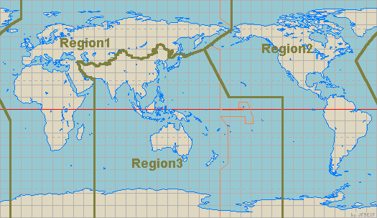
International Telecommunication Union (ITU) Regions

Slide 34
Wavelength vs Frequency
The distance a radio wave travels in one cycle is called wavelength
The number of cycles per second is frequency
The maximum displacement of wave from reference value is amplitude
One Cycle
V+
Amplitude
¼ wave
0V
Time
V-
½ Wave
One Wavelength

Slide 35
Frequency to Wavelength Conversion
To convert from frequency to wavelength in meters:
Wavelength = 300/Freq (MHz)
Frequency and wavelength are inversely proportional – as one increases, the other decreases
Longer (wavelength) – Lower (frequency)

Slide 36
Frequency Calculations
To solve for a value, cover it with your finger and solve the remaining formula
300
300,000,000
Wave length meters
f
m
Frequency
300 is the speed of light 300,000,000 meters per second
F is frequency in MHz
M is Wave Length distance in meters of a full cycle at this frequency
Radio Waves 2014

Slide 37
Frequency Calculations
300 is the Speed of Light in free space
  Radio wave travel at the Speed of Light
  300,000,000 meters per second
  Radio waves moves slower in wire
  Velocity Factor is speed in a material divided by the speed of light i.e. .66
f is frequency in millions (MHz)
  The millions of cycles cancel the millions of meters 146,520,000 = 146.53 MHz
m is Wave length in Meters or the distance of a full cycle
  How far it takes a wave to complete a complete cycle
  The higher the frequency the lower the meter (shorter)
  The lower the frequency the higher the meters (longer)
300
m
f
300 = m x f

Slide 38
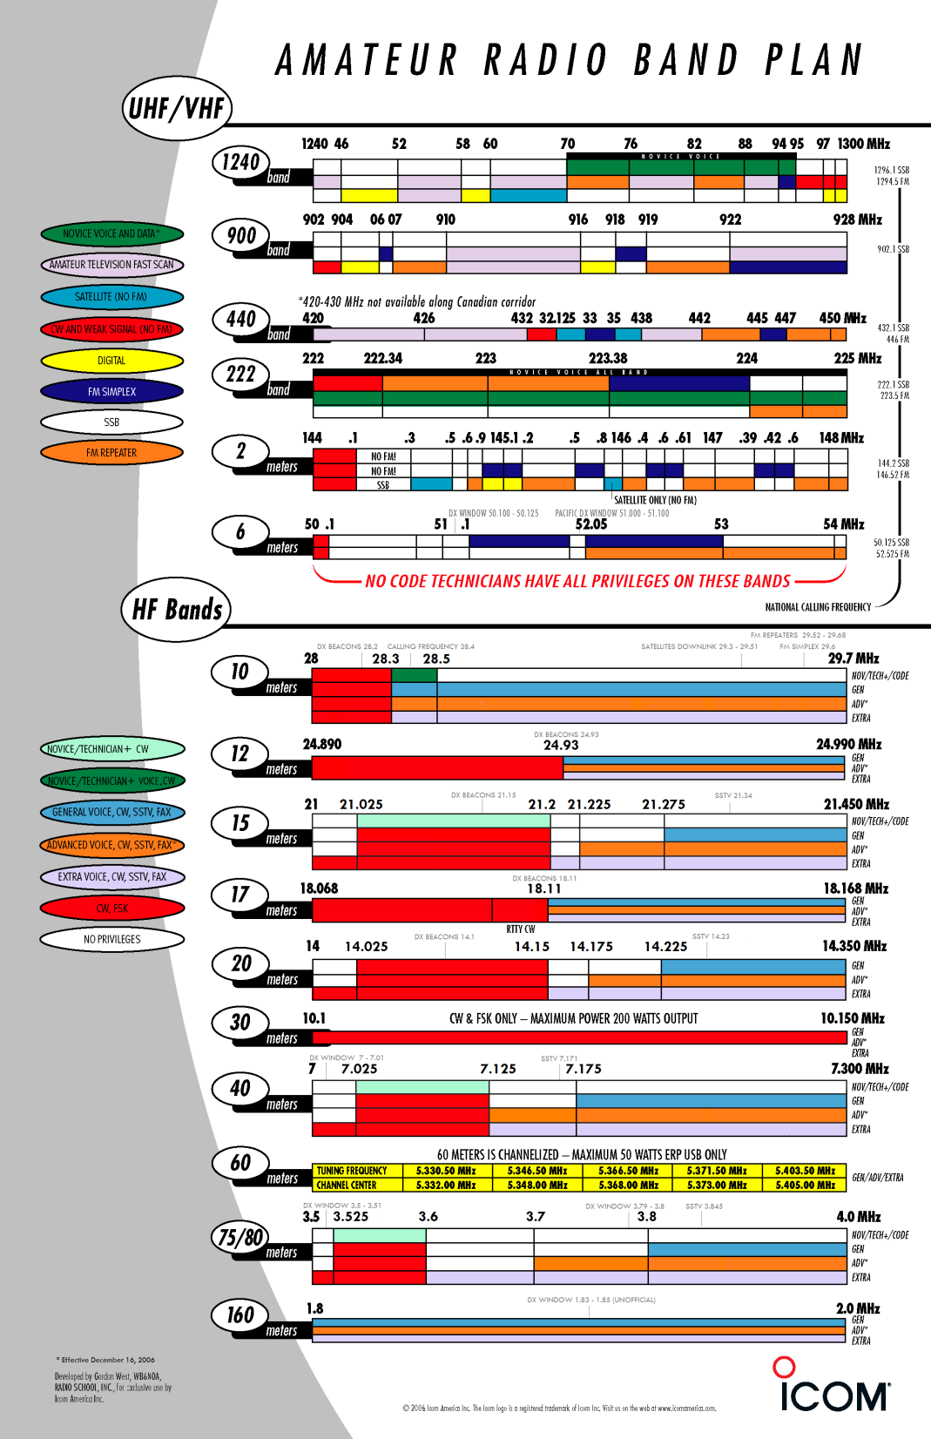

Slide 39
Technician HF Privileges
Notes
This information does not appear in the Technician exam
Technician Licensees may use up to 1500 watts PEP
Technician + HF Licensees may use up to 1500 watts PEP and 200 watts PEP on the HF bands

Slide 40
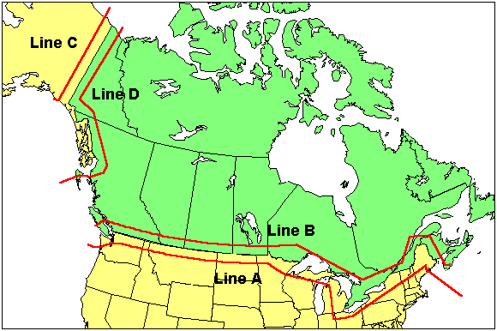
FCC Line A

Slide 41
Metric Units of Measure
LARGER than
1
SMALLER than 1
10⁹ 10⁶ 10³ 10² 10¹ 10⁰ 10⁻¹ 10⁻² 10⁻³ 10⁻⁶ 10⁻⁹ 10⁻¹²
G M k h da d c m µ n p
giga mega kilo hecto deca 0 deci centi milli micro nano pico
Millions
Hundreds
Tens
Thousands
Tenths
Millionths
Hundredths
Thousandths
Gigahertz | 1,000,000,000
Megahertz | 1,000,000
Kilohertz | 1,000
Hertz | 1
Ampere | 1
Milliampere | 0.001
Microampere | 0.000001
Nanoampere | 0.000000001

Slide 42
T1B01 Which of the following frequency ranges are available for phone operation by Technician licensees?
A. 28.050 MHz to 28.150 MHz
B. 28.100 MHz to 28.300 MHz
C. 28.300 MHz to 28.500 MHz
D. 28.500 MHz to 28.600 MHz

Slide 43
T1B01 Which of the following frequency ranges are available for phone operation by Technician licensees?
A. 28.050 MHz to 28.150 MHz
B. 28.100 MHz to 28.300 MHz
C. 28.300 MHz to 28.500 MHz
D. 28.500 MHz to 28.600 MHz

Slide 44
T1B02 Which amateurs may contact the International Space Station (ISS) on VHF?
A. Any amateur holding a General class or higher license..
B. Any amateur holding a Technician or higher-class license
C. Any amateur holding a General class or higher license who has applied for and received approval from NSSA
D. Any amateur holding a Technician class or higher licenser who has applied for and received approval from NSSA

Slide 45
T1B02 Which amateurs may contact the International Space Station (ISS) on VHF?
A. Any amateur holding a General class or higher license..
B. Any amateur holding a Technician or higher-class license
C. Any amateur holding a General class or higher license who has applied for and received approval from NSSA
D. Any amateur holding a Technician class or higher licenser who has applied for and received approval from NSSA

Slide 46
T1B03 - Which frequency is in the 6 meter band?
A. 49.00 MHz
B. 52.525 MHz
C. 28.50 MHz
D. 222.15 MHz

Slide 47
T1B03 - Which frequency is in the 6 meter band?
A. 49.00 MHz
B. 52.525 MHz
C. 28.50 MHz
D. 222.15 MHz
300
6m
f
What are you looking for?
What do you have?
f = 50 MHz
6m Band 50 to 54 MHz

Slide 48
T1B04 - Which amateur band includes 146.52 MHz?
A. 6 meter
B. 20 meter
C. 70 centimeters
D. 2 meter

Slide 49
T1B04 - Which amateur band includes 146.52 MHz?
300
A. 6 meters
B. 20 meters
C. 70 centimeters
D. 2 meters
m
146.52
m = 300 / 146.52
m = 2.0475
2 meter band
What are you looking for?
What do you have?

Slide 50
T1B05 How may amateur use the 219 to 220 MHz segment of the 1.25 meter band?
A. Spread spectrum only
B. Fast-scan television only
C. Emergency traffic only
D. Fixed digital message forwarding systems only
~~

Slide 51
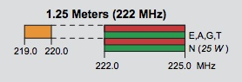
T1B05 How may amateur use the 219 to 220 MHz segment of the 1.25 meter band?
A. Spread spectrum only
B. Fast-scan television only
C. Emergency traffic only
D. Fixed digital message forwarding systems only
~~
219 through 220 is not on many band charts

Slide 52
Technician HF Privileges

Slide 53
T1B06 On which HF bands does a Technician class operator have phone privileges?
A. None
B. 10 meter band only
C. 80 meter, 40 meter, 15 meter and 10 meter bands
D. 30 meter band only

Slide 54
T1B06 On which HF bands does a Technician class operator have phone privileges?
A. None
B. 10 meter band only
C. 80 meter, 40 meter, 15 meter and 10 meter bands
D. 30 meter band only

Slide 55
T1B07 Which of the following VHF/UHF band segments are limited to CW only?
A. 50.0 MHz to 50.1 MHz and 144.0 MHz to 144.1 MHz
B. 219 MHz to 220 MHz and 420.0 MHz to 420.1 MHz
C. 902.0 MHz to 902.1 MHZ
D. All of these choices are correct

Slide 56
T1B07 Which of the following VHF/UHF band segments are limited to CW only?
A. 50.0 MHz to 50.1 MHz and 144.0 MHz to 144.1 MHz
B. 219 MHz to 220 MHz and 420.0 MHz to 420.1 MHz
C. 902.0 MHz to 902.1 MHZ
D. All of these choices are correct

Slide 57
T1B08 How are US amateurs restricted in segmernts of bands where the Amateur Radio Service is secondary?
A. U.S. amateurs may find non-amateur stations in the bands, and must avoid interfering with them
B. U.S. amateurs must give foreign amateur stations priority in those segments
C. International communications are not permitted in those segments
D. Digital transmissions are not permitted in those segments

Slide 58
T1B08 How are US amateurs restricted in segmernts of bands where the Amateur Radio Service is secondary?
A. U.S. amateurs may find non-amateur stations in the bands, and must avoid interfering with them
B. U.S. amateurs must give foreign amateur stations priority in those segments
C. International communications are not permitted in those segments
D. Digital transmissions are not permitted in those segments

Slide 59
T1B09 - Why should you not set your transmit frequency to be exactly at the edge of an amateur band or sub-band?
A. To allow for calibration error in the transmitter frequency display
B. So that modulation sidebands do not extend beyond the band edge
C. To allow for transmitter frequency drift
D. All of these choices are correct

Slide 60
T1B09 - Why should you not set your transmit frequency to be exactly at the edge of an amateur band or sub-band?
A. To allow for calibration error in the transmitter frequency display
B. So that modulation sidebands do not extend beyond the band edge
C. To allow for transmitter frequency drift
D. All of these choices are correct

Slide 61
T1B10 Where may SSB phone be used in amateur bands above 50 MHz?
A. Only in sub-bands allocated to General class or higher licenses
B. Only on repeaters
C. In at least some segment of all these bands
D. On any band if the power is limited to 25 watts.

Slide 62
T1B10 Where may SSB phone be used in amateur bands above 50 MHz?
A. Only in sub-bands allocated to General class or higher licenses
B. Only on repeaters
C. In at least some segment of all these bands
D. On any band if the power is limited to 25 watts.

Slide 63
T1B11 What is the maximum peak envelope power output for Technician class operators in their HF band segments?
A. 200 watts
B. 100 watts
C. 50 watts
D. 10 watts

Slide 64
T1B11 What is the maximum peak envelope power output for Technician class operators in their HF band segments?
A. 200 watts
B. 100 watts
C. 50 watts
D. 10 watts

Slide 65
T1B12 Except for some specific restrictions, what is the maximum peak envelope power output for Technician class operators using frequencies above 30 MHz?
A. 50 watts
B. 100 watts
C. 500 watts
D. 1500 watts

Slide 66
T1B12 Except for some specific restrictions, what is the maximum peak envelope power output for Technician class operators using frequencies above 30 MHz?
A. 50 watts
B. 100 watts
C. 500 watts
D. 1500 watts

Slide 67
Section T1C
Licensing: classes, sequential and vanity call sign systems, places where the Amateur Radio Service is regulated by the FCC, name and address on FCC license database, term, renewal, grace period, maintaining mailing address; International communications

Slide 68
ITU Regions

Slide 69
Callsign Groups
All valid US Callsigns start with
A, K, N or W and contain a digit 0-9
Group A | 1x2, 2x1 W1AW, KU7M
Group B | 2x2 KK7LK
Group C | 1x3 N7WSU
Group D | 2x3 KB7PJM

Slide 70
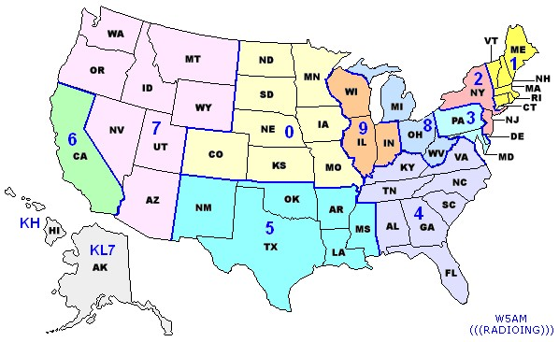
US Call Districts

Slide 71
Other Call Sign Categories
Vanity Call Sign
  Custom call sign chosen by you
  Can be any valid callsign available to your license class
Club Call Sign
  Call sign for your club
  Can be any valid callsign available to the trustee
Special Event Call Sign
  1x1 – N8D
  Valid only for the duration of the event
  Available to any amateur licensee

Slide 72
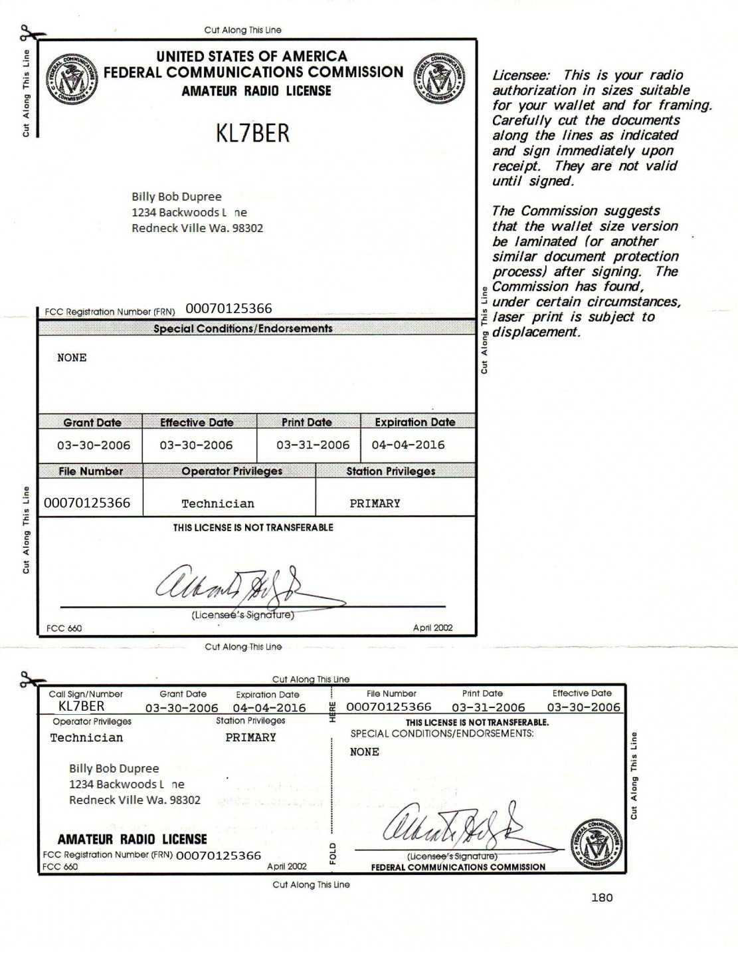
FCC Amateur License

Slide 73
T1C01 For which license classes are new licenses currently available from the FCC?
A. Novice, Technician, General, Advanced
B. Technician, Technician Plus, General, Advanced
C. Novice, Technician Plus, General, Advanced
D. Technician, General, Amateur Extra

Slide 74
T1C01 For which license classes are new licenses currently available from the FCC?
A. Novice, Technician, General, Advanced
B. Technician, Technician Plus, General, Advanced
C. Novice, Technician Plus, General, Advanced
D. Technician, General, Amateur Extra

Slide 75
T1C02 Who may select a desired call sign under the vanity call sign rules?
A. Only a licensed amateur with a General or Amateur Extra class license
B. Only a licensed amateur with an Amateur Extra class license
C. Only a licensed amateur who has been licensed continuously for more than 10 years
D. Any licensed amateur

Slide 76
T1C02 Who may select a desired call sign under the vanity call sign rules?
A. Only a licensed amateur with a General or Amateur Extra class license
B. Only a licensed amateur with an Amateur Extra class license
C. Only a licensed amateur who has been licensed continuously for more than 10 years
D. Any licensed amateur

Slide 77
T1C03 What types of international communications is an FCC-licensed amateur radio station permitted to make?
A. Communications incidental to the purposes of the Amateur Radio Service and remarks of a personal character
B. Communications incidental to conducting business or remarks of a personal nature
C. Only communications incidental to contest exchanges, all other communications are prohibited
D. Any communications that would be permitted by an international broadcast station

Slide 78
T1C03 What types of international communications is an FCC-licensed amateur radio station permitted to make?
A. Communications incidental to the purposes of the Amateur Radio Service and remarks of a personal character
B. Communications incidental to conducting business or remarks of a personal nature
C. Only communications incidental to contest exchanges, all other communications are prohibited
D. Any communications that would be permitted by an international broadcast station

Slide 79
T1C04 – What may happen if the FCC is unable to reach you by email?
Fine and suspension of operator license
Revocation of the station license or suspension of the operator license
Revocation of access to the license record in the FCC system
Nothing, there is no such requirement

Slide 80
T1C04 – What may happen if the FCC is unable to reach you by email?
Fine and suspension of operator license
Revocation of the station license or suspension of the operator license
Revocation of access to the license record in the FCC system
Nothing, there is no such requirement

Slide 81
T1C05 Which of the following is a valid Technician call sign format?
A. KF1XXX
B. KA1X
C. W1XX
D. All of these choices are correct

Slide 82
T1C05 Which of the following is a valid Technician call sign format?
A. KF1XXX
B. KA1X
C. W1XX
D. All of these choices are correct

Slide 83
T1C06 From which of the following locations may an FCC-licensed amateur station transmit?
A. From within any country that belongs to the International Telecommunications Union
B. From within any country that is a member of the United Nations
C. From anywhere within in International Telecommunication Union (ITU) Regions 2 and 3
D. From any vessel or craft located in international waters and documented or registered in the United States

Slide 84
T1C06 From which of the following locations may an FCC-licensed amateur station transmit?
A. From within any country that belongs to the International Telecommunications Union
B. From within any country that is a member of the United Nations
C. From anywhere within in International Telecommunication Union (ITU) Regions 2 and 3
D. From any vessel or craft located in international waters and documented or registered in the United States

Slide 85
T1C07 – Which of the following can result in revocation of the station license or suspension of the operator license?
A. Failure to inform the FCC of any changes in the amateur station following performance of an RF safety. Environmental evaluation
B. Failure to provide and maintain a correct email address with the FCC
C. Failure to obtain FCC type acceptance prior to using a home-built transmitter
D. Failure to have a copy of your license available at your station

Slide 86
T1C07 – Which of the following can result in revocation of the station license or suspension of the operator license?
A. Failure to inform the FCC of any changes in the amateur station following performance of an RF safety. Environmental evaluation
B. Failure to provide and maintain a correct email address with the FCC
C. Failure to obtain FCC type acceptance prior to using a home-built transmitter
D. Failure to have a copy of your license available at your station

Slide 87
T1C08 - What is the normal term for an FCC-issued primary amateur radio license?
A. Five years
B. Life
C. Ten years
D. Twenty years

Slide 88
T1C08 - What is the normal term for an FCC-issued primary amateur radio license?
A. Five years
B. Life
C. Ten years
D. Twenty years

Slide 89
T1C09 - What is the grace period for renewal if an amateur license expires?
A. Two years
B. Three years
C. Five years
D. Ten years

Slide 90
T1C09 - What is the grace period for renewal if an amateur license expires?
A. Two years
B. Three years
C. Five years
D. Ten years

Slide 91
T1C10 - How soon after passing the examination for your first amateur radio license may you transmit on the amateur radio bands?
A. Immediately on receiving your Certificate of Successful Completion of Examination (CSCE)
B. As soon as your operator/ststion license grant appears on the ARRL website
C. As soon as your operator/station license grant appears in the FCC’s license database
D. As soon as you receive your license in the mail from the FCC

Slide 92
T1C10 - How soon after passing the examination for your first amateur radio license may you transmit on the amateur radio bands?
A. Immediately on receiving your Certificate of Successful Completion of Examination (CSCE)
B. As soon as your operator/ststion license grant appears on the ARRL website
C. As soon as your operator/station license grant appears in the FCC’s license database
D. As soon as you receive your license in the mail from the FCC

Slide 93
T1C11 - If your license has expired and is still within the allowable grace period, may you continue to transmit on the amateur radio bands?
A. Yes, for up to to years
B. Yes, as soon as you apply for a renewal
C. Yes, for up to one year
D. No, you must wait until the license has been renewed

Slide 94
T1C11 - If your license has expired and is still within the allowable grace period, may you continue to transmit on the amateur radio bands?
A. Yes, for up to to years
B. Yes, as soon as you apply for a renewal
C. Yes, for up to one year
D. No, you must wait until the license has been renewed

Slide 95
Section T1D
Authorized and prohibited transmission: communications with other countries; music; exchange of information with other services; indecent language; compensation for operating; retransmission of other amateur signals; encription; sale of equipment; unidentified transmissions; one-way transmission

Slide 96
T1D01 - With which countries are FCC-licensed amateur radio stations prohibited from exchanging communications?
A. Any country whose administration has notified the International Telecommunication Union (ITU) that it objects to such communications
B. Any country whose administration has notified the American Radio Relay League (ARRL) that it objects to such communications
C. Any country banned from such communication by the International Amateur Radio Union (IARU)
D. Any country banned from making such communication by the American Radio Relay League (ARRL)

Slide 97
T1D01 - With which countries are FCC-licensed amateur radio stations prohibited from exchanging communications?
A. Any country whose administration has notified the International Telecommunication Union (ITU) that it objects to such communications
B. Any country whose administration has notified the American Radio Relay League (ARRL) that it objects to such communications
C. Any country banned from such communication by the International Amateur Radio Union (IARU)
D. Any country banned from making such communication by the American Radio Relay League (ARRL)

Slide 98
T1D02 Under which of the following circumstances are one-way transmissions by amateur station prohibited?
In all circumstances
Broadcasting
International Morse Code Practice
Telecommand or transmissions of telemetry

Slide 99
T1D02 Under which of the following circumstances are one-way transmissions by amateur station prohibited?
In all circumstances
Broadcasting
International Morse Code Practice
Telecommand or transmissions of telemetry

Slide 100
T1D03 When is it permissible to transmit messages encoded to hide their meaning?
A. Only during contests
B. Only when transmitting cxwetrrain approved digital codes
C. Only when transmitting control commands to space stations or radio control craft
D. Never

Slide 101
T1D03 When is it permissible to transmit messages encoded to hide their meaning?
A. Only during contests
B. Only when transmitting cxwetrrain approved digital codes
C. Only when transmitting control commands to space stations or radio control craft
D. Never

Slide 102
T1D04 Under what conditions is an amateur station authorized to transmit music using a phone emission?
A. When incidental to an authorized retransmission of manned spacecraft communications
B. When the music produces no spurious emissions
C. When transmissions are limited to less than three minutes per hour
D When the music is transmitted above 1280 MHz

Slide 103
T1D04 Under what conditions is an amateur station authorized to transmit music using a phone emission?
A. When incidental to an authorized retransmission of manned spacecraft communications
B. When the music produces no spurious emissions
C. When transmissions are limited to less than three minutes per hour
D When the music is transmitted above 1280 MHz

Slide 104
T1D05 When may amateur radio operators use their stations to notify other amateurs of the availability of equipment for sale or trade?
Never
When the equipment is not the personal property of either the station licensee, or the control; operator, or their close relatives.
When no profit is made on the sale.
When selling amateur equipment and not on a regular basis

Slide 105
T1D05 When may amateur radio operators use their stations to notify other amateurs of the availability of equipment for sale or trade?
Never
When the equipment is not the personal property of either the station licensee, or the control; operator, or their close relatives.
When no profit is made on the sale.
When selling amateur equipment and not on a regular basis

Slide 106
T1D06 - What, if any, are the restrictions concerning transmission of language that may be considered indecent or obscene?
A. The FCC maintains a list of words that are not permitted to be used on amateur frequencies
B. Any such language is prohibited
C. The ITU maintains a list of words that are not permitted to be used on amateur frequencies
D. There is no such prohibition

Slide 107
T1D06 - What, if any, are the restrictions concerning transmission of language that may be considered indecent or obscene?
A. The FCC maintains a list of words that are not permitted to be used on amateur frequencies
B. Any such language is prohibited
C. The ITU maintains a list of words that are not permitted to be used on amateur frequencies
D. There is no such prohibition

Slide 108
Station Control
Control Operator
Licensed amateur responsible for proper station operation
Control Point
The point at which the Control Operator function is performed
Local - Control operator has hands on control point
Remote – Control operator uses a link: phone, Internet, or Skype
Automatic Control - Using a Repeater

Slide 109
T1D07 - What types of amateur stations can automatically retransmit the signals of other amateur stations?
A. Auxiliary, beacon, or Earth stations
B. Earth, repeater, or space stations
C. Beacon, repeater, or space stations
D. Auxiliary, repeater, or space stations

Slide 110
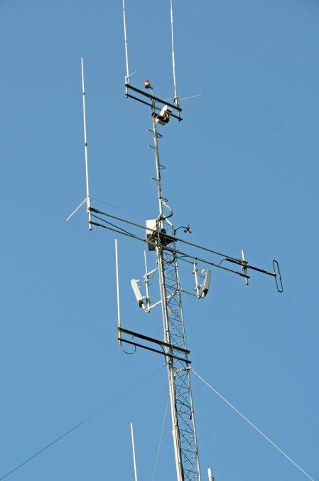
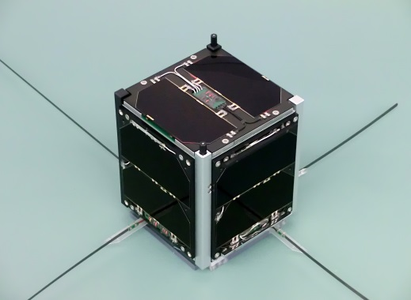
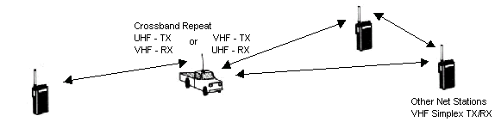
T1D07 - What types of amateur stations can automatically retransmit the signals of other amateur stations?
A. Auxiliary, beacon, or Earth stations
B. Earth, repeater, or space stations
C. Beacon, repeater, or space stations
D Auxiliary, repeater, or space stations

Slide 111
T1D08 In which of the following circumstances may the control operator of an amateur station receive compensation for operating that station?
A. When the communication is related to the sale of amateur equipment by the control operator's employer
B. When the communication is incidental to classroom instruction at an educational institution
C. When the communication is made to obtain emergency information for a local broadcast station
D. All of these choices are correct

Slide 112
T1D08 In which of the following circumstances may the control operator of an amateur station receive compensation for operating that station?
A. When the communication is related to the sale of amateur equipment by the control operator's employer
B. When the communication is incidental to classroom instruction at an educational institution
C. When the communication is made to obtain emergency information for a local broadcast station
D. All of these choices are correct

Slide 113
T1D09 When may amateur stations transmit information in support of broadcasting, program production, or news gathering, assuming no other means is available?
A. When such communications are directly related to the immediate safety of human life or protection of property
B. When broadcasting communications to or from the space shuttle
C. When noncommercial programming is gathered and supplied exclusively to the National Public Radio network
D. Never

Slide 114
T1D09 When may amateur stations transmit information in support of broadcasting, program production, or news gathering, assuming no other means is available?
A. When such communications are directly related to the immediate safety of human life or protection of property
B. When broadcasting communications to or from the space shuttle
C. When noncommercial programming is gathered and supplied exclusively to the National Public Radio network
D. Never

Slide 115
T1D10 How does the FCC define broadcasting for the Amateur Radio Service?
A. Two-way transmissions by amateur stations
B. Any transmission made by the licensed station
C. Transmission of messages directed only to amateur operators
D. Transmissions intended for reception by the general public

Slide 116
T1D10 How does the FCC define broadcasting for the Amateur Radio Service?
A. Two-way transmissions by amateur stations
B. Any transmission made by the licensed station
C. Transmission of messages directed only to amateur operators
D. Transmissions intended for reception by the general public

Slide 117
T1D11 When may an amateur station transmit without identifying on the air?
A. When the transmissions are of a brief nature to make station adjustments
B. When the transmissions are unmodulated
C. When the transmitted power level is below 1 watt
D. When transmitting signals to control model craft

Slide 118
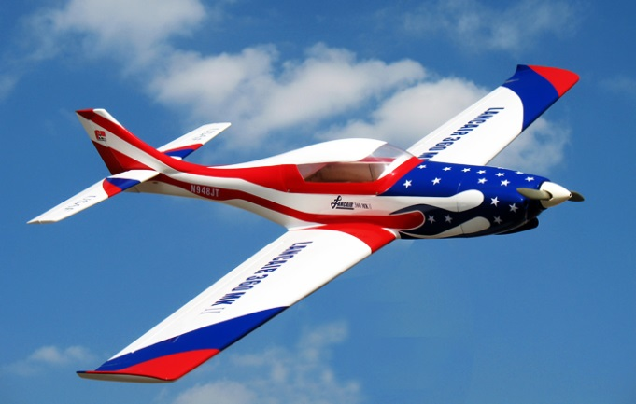
T1D11 When may an amateur station transmit without identifying on the air?
A. When the transmissions are of a brief nature to make station adjustments
B. When the transmissions are unmodulated
C. When the transmitted power level is below 1 watt
D. When transmitting signals to control model craft

Slide 119
Section T1E
Control operator: eligibility, designating, privileges, duties, location, required; Control point; Control types: automatic, remote

Slide 120
T1E01 - When is an amateur station permitted to transmit without a control operator?
A. When using automatic control, such as in the case of a repeater
B. When the station licensee is away and another licensed amateur is using the station
C. When the transmitting station is an auxiliary station
D. Never

Slide 121
T1E01 - When is an amateur station permitted to transmit without a control operator?
A. When using automatic control, such as in the case of a repeater
B. When the station licensee is away and another licensed amateur is using the station
C. When the transmitting station is an auxiliary station
D. Never

Slide 122
T1E02 Who may be the control operator of a station communicating through an amateur satellite or space station?
A. Only an Amateur Extra Class operator
B. A General class or higher licensee who has a satellite operator certification
C. Only an Amateur Extra Class operator who is also an AMSAT member
D. Any amateur whose license privileges allow them to transmit on the satellite uplink frequency

Slide 123
T1E02 Who may be the control operator of a station communicating through an amateur satellite or space station?
A. Only an Amateur Extra Class operator
B. A General class or higher licensee who has a satellite operator certification
C. Only an Amateur Extra Class operator who is also an AMSAT member
D. Any amateur whose license privileges allow them to transmit on the satellite uplink frequency

Slide 124
T1E03 - Who must designate the station control operator?
A. The station licensee
B. The FCC
C. The frequency coordinator
D. Any licensed operator

Slide 125
T1E03 - Who must designate the station control operator?
A. The station licensee
B. The FCC
C. The frequency coordinator
D. Any licensed operator

Slide 126
T1E04 What determines the transmitting privileges of an amateur station?
A. The frequency authorized by the frequency coordinator
B. The frequencies printed on the license grant
C. The highest class of operator license held by anyone on the premises
D. The class of operator license held by the control operator

Slide 127
T1E04 What determines the transmitting privileges of an amateur station?
A. The frequency authorized by the frequency coordinator
B. The frequencies printed on the license grant
C. The highest class of operator license held by anyone on the premises
D. The class of operator license held by the control operator

Slide 128
T1E05 - What is an amateur station’s control point?
A. The location of the station’s transmitting antenna
B. The location of the station transmitting apparatus
C. The location at which the control operator function is performed
D. The mailing address of the station licensee

Slide 129
T1E05 - What is an amateur station’s control point?
A. The location of the station’s transmitting antenna
B. The location of the station transmitting apparatus
C. The location at which the control operator function is performed
D. The mailing address of the station licensee

Slide 130
T1E06 When, under normal circumstances, may a Technician class licensee be the control operator of a station operating in an Amateur Extra class band segment?
A. At no time
B. When designated as the control operator by an Amateur extra Class licensee
C. As part of a multi-operator contest team
D. When using a club station whose trustee holds an Amateur Extra class licensee

Slide 131
T1E06 When, under normal circumstances, may a Technician class licensee be the control operator of a station operating in an Amateur Extra class band segment?
A. At no time
B. When designated as the control operator by an Amateur extra Class licensee
C. As part of a multi-operator contest team
D. When using a club station whose trustee holds an Amateur Extra class licensee

Slide 132
T1E07 - When the control operator is not the station licensee, who is responsible for the proper operation of the station?
A. All licensed amateurs who are present at the operation
B. Only the station licensee
C. Only the control operator
D. The control operator and the station licensee are equally responsible

Slide 133
T1E07 - When the control operator is not the station licensee, who is responsible for the proper operation of the station?
A. All licensed amateurs who are present at the operation
B. Only the station licensee
C. Only the control operator
D. The control operator and the station licensee are equally responsible

Slide 134
T1E08 - Which of the following is an example of automatic control?
A. Repeater operation
B. Controlling the station over the Internet
C. Using a computer or other device to send CW automatically
D. Using a computer or other device to identify automatically

Slide 135
T1E08 - Which of the following is an example of automatic control?
A. Repeater operation
B. Controlling the station over the Internet
C. Using a computer or other device to send CW automatically
D. Using a computer or other device to identify automatically

Slide 136
T1E09 Which of the following are required for remote control operation?
A. The control operator must be at the control point
B. A control operator is required at all times
C. The control operator indirectly manipulates the controls
D. All these choices are correct

Slide 137
T1E09 Which of the following are required for remote control operation?
A. The control operator must be at the control point
B. A control operator is required at all times
C. The control operator indirectly manipulates the controls
D. All these choices are correct

Slide 138
T1E10 - Which of the following is an example of remote control as defined in Part 97?
A. Repeater operation
B. Operating the station over the Internet
C. Controlling a model aircraft, boat or car by amateur radio
D. All of these choices are correct

Slide 139
T1E10 - Which of the following is an example of remote control as defined in Part 97?
A. Repeater operation
B. Operating the station over the Internet
C. Controlling a model aircraft, boat or car by amateur radio
D. All of these choices are correct

Slide 140
T1E11 - Who does the FCC presume to be the control operator of an amateur station, unless documentation to the contrary is in the station records?
A. The station custodian
B. The third party participant
C. The person operating the station equipment
D. The station licensee

Slide 141
T1E11 - Who does the FCC presume to be the control operator of an amateur station, unless documentation to the contrary is in the station records?
A. The station custodian
B. The third party participant
C. The person operating the station equipment
D. The station licensee

Slide 142
Section T1F
Station identification; repeaters; third-party communications; club stations; FCC inspection

Slide 143
T1F01 When must the station and its records be available for FCC inspection?
A. At any time ten days after notification by the FCC of such an inspection
B. At any time upon request by an FCC representative
C. At any time after written notification by the FCC of such inspection
D. Only when presented with a valid warrant by an FCC official or government agent

Slide 144
T1F01 When must the station and its records be available for FCC inspection?
A. At any time ten days after notification by the FCC of such an inspection
B. At any time upon request by an FCC representative
C. At any time after written notification by the FCC of such inspection
D. Only when presented with a valid warrant by an FCC official or government agent

Slide 145
T1F02 How often must you identify with your FCC assigned call sign when using tactical call signs such as “Race Headquarters”?
A. Never, the tactical call is sufficient
B. Once during every hour
C. At the end of each communication and every ten minutes during a communication
D. At the end of every transmission

Slide 146
T1F02 How often must you identify with your FCC assigned call sign when using tactical call signs such as “Race Headquarters”?
A. Never, the tactical call is sufficient
B. Once during every hour
C. At the end of each communication and every ten minutes during a communication
D. At the end of every transmission

Slide 147
T1F03 - When are you required to transmit its assigned call sign?
A. At the beginning of each contact, and every 10 minutes thereafter
B. At least once during each transmission
C. At least every 15 minutes during and at the end of a communication
D. At least every 10 minutes during and at the end of a communication

Slide 148
T1F03 - When are you required to transmit its assigned call sign?
A. At the beginning of each contact, and every 10 minutes thereafter
B. At least once during each transmission
C. At least every 15 minutes during and at the end of a communication
D. At least every 10 minutes during and at the end of a communication

Slide 149
T1F04 - What language may you use for identification when operating in a phone sub-band?
A. Any language recognized by the United Nations
B. Any language recognized by the ITU
C. The English language
D. English, French, or Spanish

Slide 150
T1F04 - What language may you use for identification when operating in a phone sub-band?
A. Any language recognized by the United Nations
B. Any language recognized by the ITU
C. The English language
D. English, French, or Spanish

Slide 151
T1F05 - What method of call sign identification is required for a station transmitting phone signals?
A. Send the call sign followed by the indicator RPT
B. Send the call sign using CW or phone emission
C. Send the call sign followed by the indicator R
D. Send the call sign using only phone emission

Slide 152
T1F05 - What method of call sign identification is required for a station transmitting phone signals?
A. Send the call sign followed by the indicator RPT
B. Send the call sign using CW or phone emission
C. Send the call sign followed by the indicator R
D. Send the call sign using only phone emission

Slide 153
T1F06 - Which of the following self-assigned indicator are acceptable when using a phone transmission?
A. KL7CC stroke W3
B. KL7CC slant W3
C. KL7CC slash W3
D. All of these choices are correct

Slide 154
T1F06 - Which of the following self-assigned indicator are acceptable when using a phone transmission?
A. KL7CC stroke W3
B. KL7CC slant W3
C. KL7CC slash W3
D. All of these choices are correct

Slide 155
T1F07 - Which of the following restrictions apply when a non-licensed person is allowed to speak to a foreign station using a station under the control of a licensed amateur operator?
A. The person must be a U.S. citizen
B. The foreign station must be one with which the U.S. has a third party agreement
C. The licensed control operator must do the station identification
D. All of these choices are correct

Slide 156
T1F07 - Which of the following restrictions apply when a non-licensed person is allowed to speak to a foreign station using a station under the control of a licensed amateur operator?
A. The person must be a U.S. citizen
B. The foreign station must be one with which the U.S. has a third party agreement
C. The licensed control operator must do the station identification
D. All of these choices are correct

Slide 157

US Amateurs May Handle Third-Party Traffic With:
V2 | Antigua/Barbuda
LO-LW | Argentina
VK | Australia
V3 | Belize
CP | Bolivia
E7 | Bosnia-Herzegovina
PP-PY | Brazil
VE, VO, VY | Canada
CA-CE | Chile
HJ-HK | Colombia
D6 | Comoros (Federal Islamic Republic of)
TI, TE | Costa Rica
CM, CO | Cuba
HI | Dominican Republic
J7 | Dominica
HC-HD | Ecuador
YS | El Salvador
C5 | Gambia, The
9G | Ghana
J3 | Grenada
TG | Guatemala
8R | Guyana
HH | Haiti
HQ-HR | Honduras
4X, 4Z | Israel
6Y | Jamaica
JY | Jordan
EL | Liberia
V7 | Marshall Islands
XA-XI | Mexico
V6 | Micronesia, Federated States of
YN | Nicaragua
HO-HP | Panama
ZP | Paraguay
OA-OC | Peru
DU-DZ | Philippines
VR6 | Pitcairn Island*
V4 | St. Kitts/Nevis
J6 | St. Lucia
J8 | St. Vincent and the Grenadines
9L | Sierra Leone
ZR-ZU | South Africa
3DA | Swaziland
9Y-9Z | Trinidad/Tobago
TA-TC | Turkey
GB | United Kingdom
CV-CX | Uruguay
YV-YY | Venezuela
4U1ITU | ITU - Geneva
4U1VIC | VIC - Vienna
http://www.arrl.org/third-party-operating-agreements

Slide 158
T1F08 What is the definition of third party communications?
A. A message from a control operator to another amateur station control operator on behalf of another person
B. Amateur radio communications where three stations are in communications with one another
C. Operation when the transmitting equipment is licensed to a person other than the control operator
D. Temporary authorization for an unlicensed person to transmit on the amateur bands for technical experiments

Slide 159
T1F08 What is the definition of third party communications?
A. A message from a control operator to another amateur station control operator on behalf of another person
B. Amateur radio communications where three stations are in communications with one another
C. Operation when the transmitting equipment is licensed to a person other than the control operator
D. Temporary authorization for an unlicensed person to transmit on the amateur bands for technical experiments

Slide 160
T1F09 - What type of amateur station simultaneously retransmits the signal of another amateur station on a different channel or channels?
A. Beacon station
B. Earth station
C. Repeater station
D. Message forwarding station

Slide 161
T1F09 - What type of amateur station simultaneously retransmits the signal of another amateur station on a different channel or channels?
A. Beacon station
B. Earth station
C. Repeater station
D. Message forwarding station

Slide 162
T1F10 - Who is accountable should a repeater inadvertently retransmit communications that violate the FCC rules?
A. The control operator of the originating station
B. The control operator of the repeater
C. The owner of the repeater
D. Both the originating station and the repeater owner

Slide 163
T1F10 - Who is accountable should a repeater inadvertently retransmit communications that violate the FCC rules?
A. The control operator of the originating station
B. The control operator of the repeater
C. The owner of the repeater
D. Both the originating station and the repeater owner

Slide 164
T1F11 Which of the following is a requirement for the issuance of a club station license grant?
A. The trustee must have an Amateur Extra class operator license grant
B. The club must have at least four members
C. The club must be registered with the American Radio Relay League
D. All of these choices are correct

Slide 165
T1F11 Which of the following is a requirement for the issuance of a club station license grant?
A. The trustee must have an Amateur Extra class operator license grant
B. The club must have at least four members
C. The club must be registered with the American Radio Relay League
D. All of these choices are correct

Slide 166
End of
SUBELEMENT T1 – FCC Rules,

