Slide 1
SUBELEMENT T10
Safety: AC and DC power circuits;
antenna installation;
RF hazards
[3 Exam Questions - 3 Groups]
Notes:
Subelement T10 Safety. Technician Training Slides for 2022 Question Pool Good through June 30, 2026 Assembled by Washington Ham Trainers, Daniel Stevens KL7WM, Howard Schultz, W7HS.

Slide 2
T10A – Power circuits and hazards: hazardous voltages; fuses and circuit breakers; grounding; electrical code compliance; Lightning protection; Battery safety;
T10B – Antenna safety: tower safety and grounding, installing antennas, antenna supports; erecting an antenna supports
T10C - RF hazards: radiation exposure; proximity to antennas; recognized safe power levels; radiation types; duty cycle

Slide 3
T0A01 - Which of the following is a safety hazard of a 12-volt storage battery?
A. Touching both terminals with the hands can cause electrical shock
B. Shorting the terminals can cause burns, fire, or an explosion
C. RF emissions from a nearby transmitter can cause the electrolyte to emit poison gas
D. All of these choices are correct

Slide 4
T0A01 - Which of the following is a safety hazard of a 12-volt storage battery?
A. Touching both terminals with the hands can cause electrical shock
B. Shorting the terminals can cause burns, fire, or an explosion
C. RF emissions from a nearby transmitter can cause the electrolyte to emit poison gas
D. All of these choices are correct

Slide 5
T0A02 - What health hazard is presented by electrical current flowing through the body?
A. It may cause injury by heating tissue
B. It may disrupt the electrical functions of cells
C. It may cause involuntary muscle contractions
D. All of these choices are correct

Slide 6
T0A02 - What health hazard is presented by electrical current flowing through the body?
A. It may cause injury by heating tissue
B. It may disrupt the electrical functions of cells
C. It may cause involuntary muscle contractions
D. All of these choices are correct

Slide 7
T0A03 - In the United States, what circuit does black wire insulation indicate in a three-wire 120 V cable?
A. Neutral
B. Hot
C. Equipment ground
D . The white wire

Slide 8
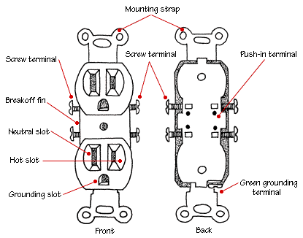
T0A03 - In the United States, what circuit does black wire insulation indicate in a three-wire 120 V cable?
A. Neutral
B. Hot
C. Equipment ground
D . The white wire

Slide 9
T0A04 - What is the purpose of a fuse in an electrical circuit?
A. To prevent power supply ripple from damaging a circuit
B. To interrupt power in case of overload
C. To limit current to prevent shocks
D. All of these choices are correct

Slide 10
T0A04 - What is the purpose of a fuse in an electrical circuit?
A. To prevent power supply ripple from damaging a circuit
B. To interrupt power in case of overload
C. To limit current to prevent shocks
D. All of these choices are correct

Slide 11
T0A05 - Why should a 5-ampere fuse never be replaced with a 20-ampere fuse?
A. The larger fuse would be likely to blow because it is rated for higher current
B. The power supply ripple would greatly increase
C. Excessive current could cause a fire
D. All of these choices are correct

Slide 12
T0A05 - Why should a 5-ampere fuse never be replaced with a 20-ampere fuse?
A. The larger fuse would be likely to blow because it is rated for higher current
B. The power supply ripple would greatly increase
C. Excessive current could cause a fire
D. All of these choices are correct

Slide 13
T0A06 - What is a good way to guard against electrical shock at your station?
A. Use three-wire cords and plugs for all AC powered equipment
B. Connect all AC powered station equipment to a common safety ground
C. Install mechanical interlocks in high-voltage circuits
D. All of these choices are correct

Slide 14
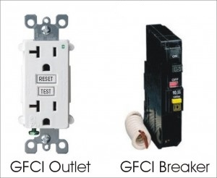
T0A06 - What is a good way to guard against electrical shock at your station?
A. Use three-wire cords and plugs for all AC powered equipment
B. Connect all AC powered station equipment to a common safety ground
C. Install mechanical interlocks in high-voltage circuits
D. All of these choices are correct

Slide 15
T0A07 – Where should a lightening arrester be installed in a coaxial feed line?
At the output connector of a transceiver
At the antenna feed point
C. At the AC power service panel
D. Oo a grounded panel near where feed lines enter the building

Slide 16
T0A07 – Where should a lightening arrester be installed in a coaxial feed line?
At the output connector of a transceiver
At the antenna feed point
C. At the AC power service panel
D. On a grounded panel near where feed lines enter the building

Slide 17
T0A08 – Where should a fuse or circuit breaker be installed in a 120V AC power circuit?
A. In series with the hot conductor only
B. In series with the hot and neutral conductors
C. In parallel with the hot conductor only
D. In parallel with the hot and neutual conductors

Slide 18
T0A08 – Where should a fuse or circuit breaker be installed in a 120V AC power circuit?
A. In series with the hot conductor only
B. In series with the hot and neutral conductors
C. In parallel with the hot conductor only
D. In parallel with the hot and neutual conductors

Slide 19
T0A09 - What should be done to all external ground rods or earth connections?
A. Waterproof them with silicone caulk or electrical tape
B. Keep them as far apart as possible
C. Bond them together with heavy wire or conductive strap
D. Tune them for resonance on the lowest frequency of operation

Slide 20
T0A09 - What should be done to all external ground rods or earth connections?
A. Waterproof them with silicone caulk or electrical tape
B. Keep them as far apart as possible
C. Bond them together with heavy wire or conductive strap
D. Tune them for resonance on the lowest frequency of operation

Slide 21
T0A10 – What hazard is caused by charging or discharging a battery too quickly?
A. Overheating or out-gassing
B. Excss output ripple
C. Half-wave rectification
D. Inverse memory effect

Slide 22
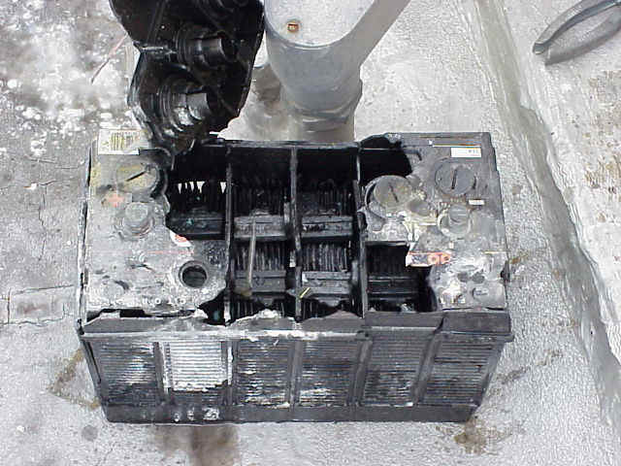
T0A10 – What hazard is caused by charging or discharging a battery too quickly?
A. Overheating or out-gassing
B. Excss output ripple
C. Half-wave rectification
D. Inverse memory effect

Slide 23
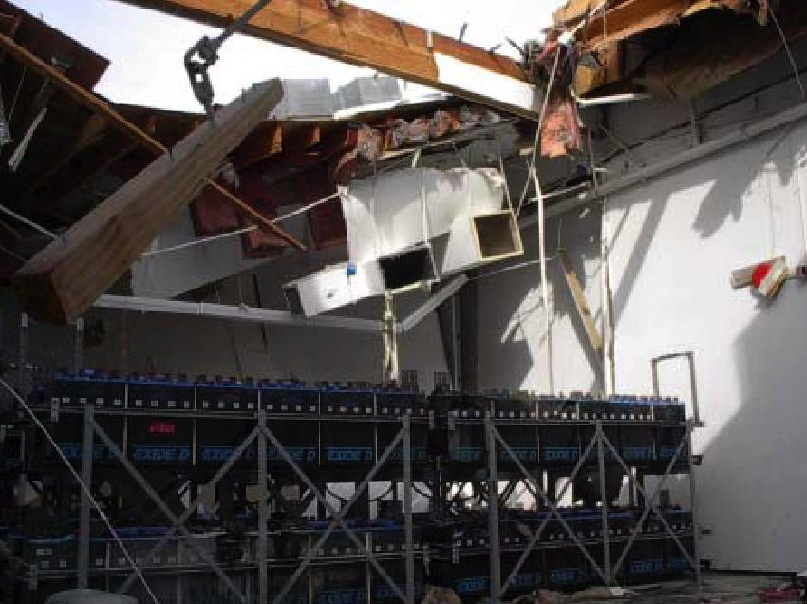
Hydrogen Gas Explosion
Notes:
The facility was formerly a large computer/data center with battery room and emergency generators in Sacramento, CA. The company vacated the building, moved out the computer equipment but left the battery backup system behind.
The ventilation for the battery room appeared to be tied to a hydrogen monitoring system (which is pretty common). The Hydrogen sensor was in alarm upon emergency responders arriving at the scene (post-explosion). 911 callers reporting the explosion also reported hearing an alarm for 3 days prior to the explosion. This appears to have been a local alarm as it was not relayed to the Fire Department. Given how slowly batteries generate hydrogen gas, it appears the batteries were charging for a long period of time with no ventilation - the detector was alarming and hydrogen gas continued to build up until it found an ignition source. The best guess is the ignition occurred at or near a grounding strap on the battery racks but in a room full of batteries and electrical equipment, ignition sources are plentiful...especially when considering the sensitivity of hydrogen.
The lesson to pass on is that ventilation is CRITICAL with lead acid batteries. Great care should be taken to insure ventilation is adequate or even better that the batteries can NOT be charged without the ventilation system properly working.

Slide 24
T0A11 - What hazard exist in a power supply immediately after turning it off?
A. Circulating currents in the DC filter
B. Leakage flux in the power transformer
C. Voltage transients from kickback diodes
D. Charge stored in filter capacitors

Slide 25
T0A11 - What hazard exist in a power supply immediately after turning it off?
A. Circulating currents in the DC filter
B. Leakage flux in the power transformer
C. Voltage transients from kickback diodes
D. Charge stored in filter capacitors

Slide 26
T0A12 – Which of the following precautions should be taken when measuring high voltages with a voltmeter?
A. Ensure that the voltmeter has very low impedance
B. Ensure that the voltmeter and leads are rated for use at the voltages to be measured
C. Ensure that the circuit is grounded through the voltmeter
D. Ensure that the voltmeter is set to the correct frequency

Slide 27
T0A12 – Which of the following precautions should be taken when measuring high voltages with a voltmeter?
A. Ensure that the voltmeter has very low impedance
B. Ensure that the voltmeter and leads are rated for use at the voltages to be measured
C. Ensure that the circuit is grounded through the voltmeter
D. Ensure that the voltmeter is set to the correct frequency

Slide 28
T10B – Antenna safety
tower safety and grounding;
installing antennas, antenna supports

Slide 29
T0B01 – Which of the following is good practice when installing ground wires on a tower for lightning protection?
A. Put a drip loop in the ground connection to prevent water damage to the ground system
B. Make sure all ground wire bends are tight angles
C. Ensure that connections are short and direct
D. All these choices are correct

Slide 30
T0B01 – Which of the following is good practice when installing ground wires on a tower for lightning protection?
A. Put a drip loop in the ground connection to prevent water damage to the ground system
B. Make sure all ground wire bends are tight angles
C. Ensure that connections are short and direct
D. All these choices are correct

Slide 31
T0B02 – What is required when climbing an antenna tower?
A. Have sufficient training on safe tower climbing techniques
B. Use appropriate tie-off to the tower at all times
C. Always wear an approved climbing harness
D. All of the these choices are correct

Slide 32
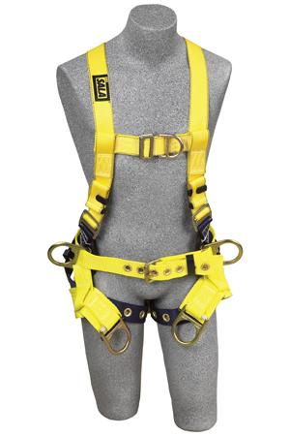
T0B02 – What is required when climbing an antenna tower?
A. Have sufficient training on safe tower climbing techniques
B. Use appropriate tie-off to the tower at all times
C. Always wear an approved climbing harness
D. All of the these choices are correct

Slide 33
T0B03 - Under what circumstances is it safe to climb a tower without a helper or observer?
A. When no electrical work is being performed
B. When no mechanical work is being performed
C. When the work being done is not more than 20 feet above the ground
D. Never

Slide 34
T0B03 - Under what circumstances is it safe to climb a tower without a helper or observer?
A. When no electrical work is being performed
B. When no mechanical work is being performed
C. When the work being done is not more than 20 feet above the ground
D. Never

Slide 35
T0B04 - Which of the following is an important safety precaution to observe when putting up an antenna tower?
A. Wear a ground strap connected to your wrist at all times
B. Insulate the base of the tower to avoid lightning strikes
C. Look for and stay clear of any overhead electrical wires
D. All of these choices are correct

Slide 36
T0B04 - Which of the following is an important safety precaution to observe when putting up an antenna tower?
A. Wear a ground strap connected to your wrist at all times
B. Insulate the base of the tower to avoid lightning strikes
C. Look for and stay clear of any overhead electrical wires
D. All of these choices are correct

Slide 37
T0B05 – What is the purpose of a safety wire through a turnbuckle used to tension guy lines?
A. Secure the guy line if the turnbuckle breaks
B. Prevent loosening of the turnbuckle from vibration
C. Provide a ground path for lightening strikes
D. Provide an ability to measure for preper tensioning

Slide 38
T0B05 – What is the purpose of a safety wire through a turnbuckle used to tension guy lines?
A. Secure the guy line if the turnbuckle breaks
B. Prevent loosening of the turnbuckle from vibration
C. Provide a ground path for lightening strikes
D. Provide an ability to measure for preper tensioning

Slide 39
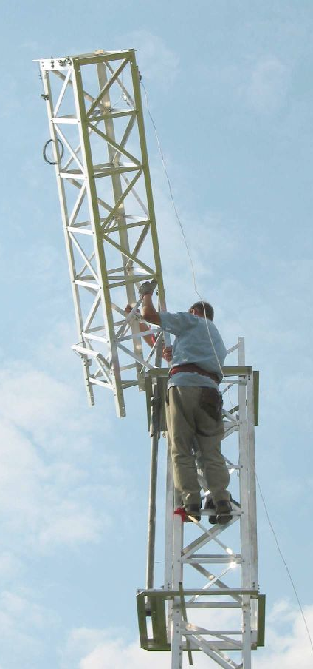
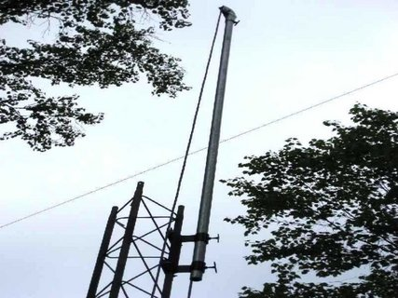
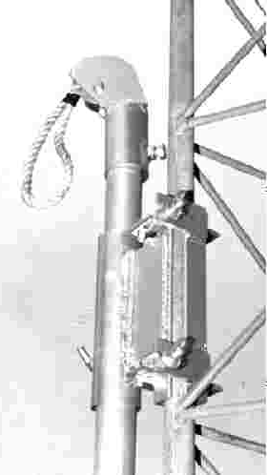
Using a Gin Pole
Full body harness

Slide 40
T0B06 - What is the minimum safe distance from a power line to allow when installing an antenna?
A. Add the height of the antenna to the height of the power line and multiple by a factor of 1.5
B. The height of the power line above ground
C. ½ wavelength at the operating frequency
D. Enough so that if the antenna falls, no part of it can come closer than 10 feet to the power wires

Slide 41
T0B06 - What is the minimum safe distance from a power line to allow when installing an antenna?
A. Add the height of the antenna to the height of the power line and multiple by a factor of 1.5
B. The height of the power line above ground
C. ½ wavelength at the operating frequency
D. Enough so that if the antenna falls, no part of it can come closer than 10 feet to the power wires

Slide 42
T0B07 - Which of the following is an important safety rule to remember when using a crank-up tower?
A. This type of tower must never be painted
B. This type of tower must never be grounded
C. This type of tower must never be climbed unless it is retracted or mechanical safety locking devices have been installed
D. All of these choices are correct

Slide 43
T0B07 - Which of the following is an important safety rule to remember when using a crank-up tower?
A. This type of tower must never be painted
B. This type of tower must never be grounded
C. This type of tower must never be climbed unless it is retracted or mechanical safety locking devices have been installed
D. All of these choices are correct

Slide 44
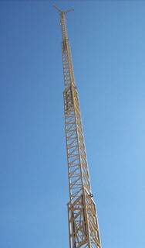
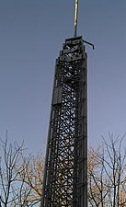
Crank Up Towers

Slide 45
T0B08 - Which is a proper grounding method for a tower?
A. A single four-foot ground rod, driven into the ground no more than 12 inches from the base
B. A ferrite-core RF choke connected between the tower and ground
C . A connection between the tower base and a cold water pipe
D. Separate eight-foot long ground rods for each tower leg, bonded to the tower and each other

Slide 46
T0B08 - Which is a proper grounding method for a tower?
A. A single four-foot ground rod, driven into the ground no more than 12 inches from the base
B. A ferrite-core RF choke connected between the tower and ground
C . A connection between the tower base and a cold water pipe
D. Separate eight-foot long ground rods for each tower leg, bonded to the tower and each other

Slide 47
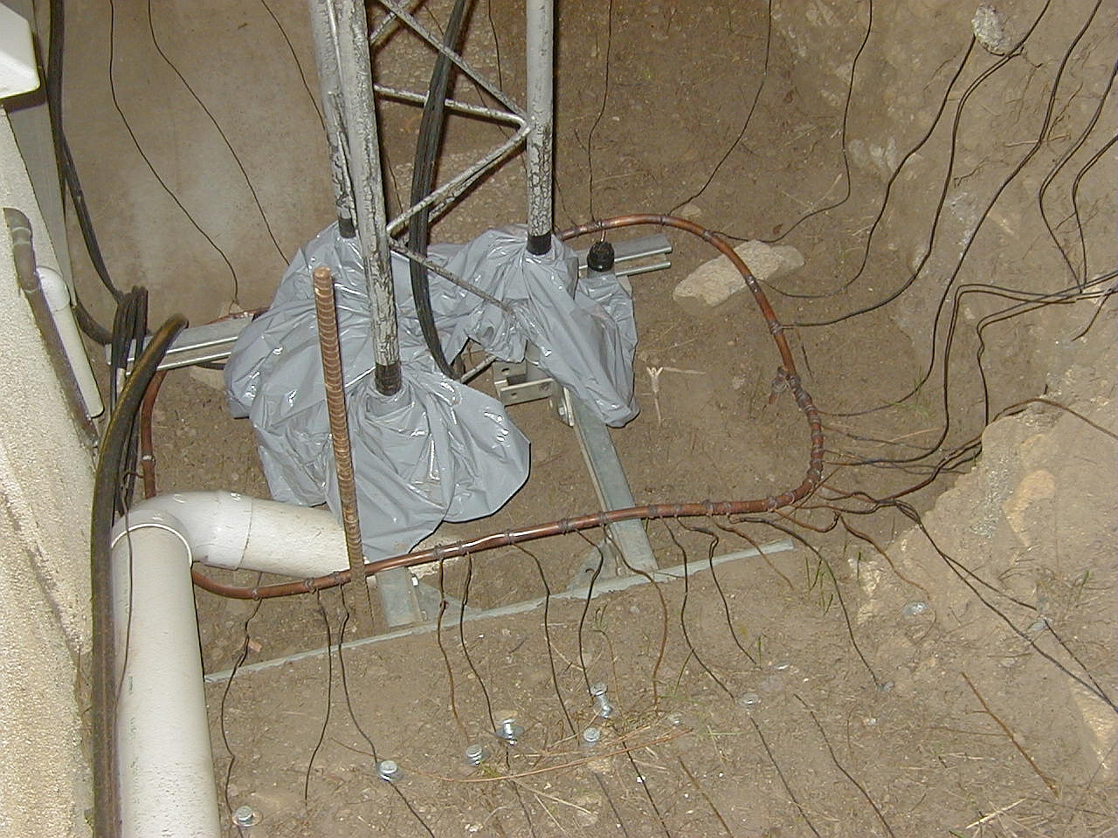
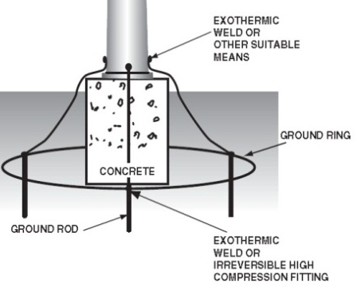
Tower Base and Grounding
Ground rods are 8 foot long and bonded together

Slide 48
T0B09 - Why should you avoid attaching an antenna to a utility pole?
A. The antenna will not work properly because of induced voltages
B. The 60 Hz radiations from the feed line may increase the SWR
C. The antenna could contact high-voltage power wires
D. All of these choices are correct

Slide 49
T0B09 - Why should you avoid attaching an antenna to a utility pole?
A. The antenna will not work properly because of induced voltages
B. The 60 Hz radiations from the feed line may increase the SWR
C. The antenna could contact high-voltage power wires
D. All of these choices are correct

Slide 50
T0B10 - Which of the following is true when installing grounding conductors used for lightening pretection?
A. Use only non-insulated wire
B. Wires must be carefully routed with precise right-angle bends
C. Sharp bends must be avoided
D. Common grounds must be avoided

Slide 51
T0B10 - Which of the following is true when installing grounding conductors used for lightening pretection?
A. Use only non-insulated wire
B. Wires must be carefully routed with precise right-angle bends
C. Sharp bends must be avoided
D. Common grounds must be avoided

Slide 52
T0B11 - Which of the following establishes grounding requirements for an amateur radio tower or antenna?
A. FCC Part 97 Rules
B. Local electrical codes
C. FAA tower lighting regulations
D. UL recommended practices

Slide 53
T0B11 - Which of the following establishes grounding requirements for an amateur radio tower or antenna?
A. FCC Part 97 Rules
B. Local electrical codes
C. FAA tower lighting regulations
UL recommended practices
In Washington the Department of Labor regulates electrical, tower antenna and radio room safety. They follow the National Electrical Code ( NEC ) book

Slide 54
T10C - RF hazards
radiation exposure;
proximity to antennas;
recognized safe power levels;
radiation types;
duty cycle

Slide 55
T0C01 - What type of radiation are radio signals?
A. Gamma radiation
B. Ionizing radiation
C. Alpha radiation
D. Non-ionizing radiation

Slide 56
T0C01 - What type of radiation are radio signals?
A. Gamma radiation
B. Ionizing radiation
C. Alpha radiation
D. Non-ionizing radiation

Slide 57
T0C02 – At which of the following frequencies does maximum permissible exposure have the lowest valve?
A. 3.5 MHz
B. 50 MHz
C. 440 MHz
D. 1296 MHz

Slide 58
T0C02 – At which of the following frequencies does maximum permissible exposure have the lowest valve?
A. 3.5 MHz
B. 50 MHz
C. 440 MHz
D. 1296 MHz

Slide 59
Power Thresholds for Routine Evaluation
Band (Wavelength) | Transmitter Power (Watts)
160 m | 500
75 m | 500
80 m | 500
40 m | 500
30 m | 425
20 m | 225
17 m | 125
15 m | 100
12 m | 75
10 m | 50
6 - 1.23 m | 50
70 cm | 70
33 cm | 150
23 cm | 200
13 cm and up | 250
The FCC requires a station RF safety evaluation if these power levels are exceeded
Note power level varies by band because the human body is more sensitive (Specific Absorption Rate or SAR) to some frequencies than others
59
Notes:
Notice that power levels that trigger a station evaluation vary with frequency
59

Slide 60
Duty Cycle
Duty cycle refers to both the transmit vs. receive time and the average power level during transmission. Because CW has gaps between symbols the average power is less than 100%. SSB power output varies with modulation. FM is full power regardless of modulation.
Mode | Duty Cycle
CW Morse telegraphy | 40%
SSB voice | 20%
SSB voice, heavy speech processing | 50%
SSB AFSK | 100%
SSB SSTV | 100%
FM voice or data | 100%
FSK | 100%
AM voice, 50% modulation | 50%
AM voice, 100% modulation | 30%

Slide 61
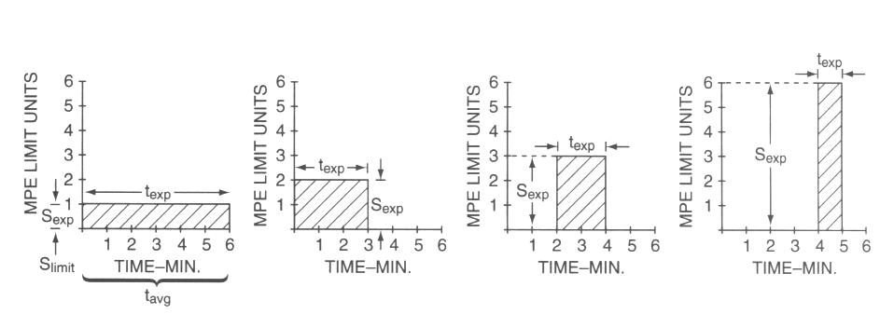
Time Averaged Exposure Calculations
The FCC averages RF exposure times over a 10 and 30 minute periods. These graphs show the same exposure amount whether long, low-level or short, high-level. Lower duty cycle modes cause lower exposures.
Notes:
The vertical axis is power level, with time on the horizontal axis. The shaded areas in the diagrams above represent RF exposure. As power or duty cycle is decreased, exposure time can be increased and maintain a comparable exposure level. Time, field strength, frequency and specific absorption rate (SAR) are critical factors to consider. The body is most sensitive to VHF frequencies (30-300 MHZ). The eyes are particularly sensitive to energy at 1270MHz which can cause cataracts.

Slide 62
T0C03 – How does the allowable power density for RF safety change if duty cycle changes from 100 percent to 50 percent?
A. It increasers by a factor of 3
B. It decreases by 50 percent
C. It increases by a factor of 2
D. There is no adjustment allowed for lower duty cycle

Slide 63
T0C03 – How does the allowable power density for RF safety change if duty cycle changes from 100 percent to 50 percent?
A. It increasers by a factor of 3
B. It decreases by 50 percent
C. It increases by a factor of 2
D. There is no adjustment allowed for lower duty cycle

Slide 64
T0C04 - What factors affect the RF exposure of people near an amateur station antenna?
A. Frequency and power level of the RF field
B. Distance from the antenna to a person
C. Radiation pattern of the antenna
D. All of these choices are correct

Slide 65
T0C04 - What factors affect the RF exposure of people near an amateur station antenna?
A. Frequency and power level of the RF field
B. Distance from the antenna to a person
C. Radiation pattern of the antenna
D. All of these choices are correct

Slide 66
T0C05 - Why do exposure limits vary with frequency?
A. Lower frequency RF fields have more energy than higher frequency fields
B. Lower frequency RF fields do not penetrate the human body
C. Higher frequency RF fields are transient in nature
D. The human body absorbs more RF energy at some frequencies than at others

Slide 67
T0C05 - Why do exposure limits vary with frequency?
A. Lower frequency RF fields have more energy than higher frequency fields
B. Lower frequency RF fields do not penetrate the human body
C. Higher frequency RF fields are transient in nature
D. The human body absorbs more RF energy at some frequencies than at others

Slide 68
T0C06 - Which of the following is an acceptable method to determine that your station complies with FCC RF exposure regulations?
A. By calculation based on FCC OET Bulletin 65
B. By calculation based on computer modeling
C. By measurement of field strength using calibrated equipment
D. All of these choices are correct

Slide 69
T0C06 - Which of the following is an acceptable method to determine that your station complies with FCC RF exposure regulations?
A. By calculation based on FCC OET Bulletin 65
B. By calculation based on computer modeling
C. By measurement of field strength using calibrated equipment
D. All of these choices are correct

Slide 70
T0C07 – What hazard is created by touching an antenna during a transmission?
A. Electrocution
B. RF burn to skin
C. Radiation poisoning
D. All of these choices are correct

Slide 71
T0C07 – What hazard is created by touching an antenna during a transmission?
A. Electrocution
B. RF burn to skin
C. Radiation poisoning
D. All of these choices are correct

Slide 72
T0C08 - Which of the following actions can reduce exposure to RF radiation?
A. Relocate antennas
B. Relocate the transmitter
C. Increase the duty cycle
D. All of these choices are correct

Slide 73
T0C08 - Which of the following actions can reduce exposure to RF radiation?
A. Relocate antennas
B. Relocate the transmitter
C. Increase the duty cycle
D. All of these choices are correct

Slide 74
T0C09 - How can you make sure your station stays in compliance with RF safety regulations?
A. By informing the FCC of any changes made in your station
B. By re-evaluating the station whenever an item of equipment is changed
C. By making sure your antennas have low SWR
D. All of these choices are correct

Slide 75
T0C09 - How can you make sure your station stays in compliance with RF safety regulations?
A. By informing the FCC of any changes made in your station
B By re-evaluating the station whenever an item of equipment is changed
C. By making sure your antennas have low SWR
D. All of these choices are correct

Slide 76
T0C10 - Why is duty cycle one of the factors used to determine safe RF radiation exposure levels?
A. It affects the average exposure to radiation
B. It affects the peak exposure to radiation
C. It takes into account the antenna feed line loss
D. It takes into account the thermal effects of the final amplifier

Slide 77
T0C10 - Why is duty cycle one of the factors used to determine safe RF radiation exposure levels?
A. It affects the average exposure to radiation
B. It affects the peak exposure to radiation
C. It takes into account the antenna feed line loss
D. It takes into account the thermal effects of the final amplifier

Slide 78
T0C11 - What is the definition of duty cycle during the averaging time for RF exposure?
A. The difference between the lowest power output and the highest power output of a transmitter
B. The difference between the PEP and average power output of a transmitter
C. The percentage of time that a transmitter is transmitting
D. The percentage of time that a transmitter is not transmitting

Slide 79
T0C11 - What is the definition of duty cycle during the averaging time for RF exposure?
A. The difference between the lowest power output and the highest power output of a transmitter
B. The difference between the PEP and average power output of a transmitter
C. The percentage of time that a transmitter is transmitting
D. The percentage of time that a transmitter is not transmitting

Slide 80
T0C12 - How does RF radiation differ from ionizing radiation (radioactivity)?
A. RF radiation does not have sufficient energy to cause genetic damage
B. RF radiation can only be detected with an RF dosimeter
C. RF radiation is limited in range to a few feet
D. RF radiation is perfectly safe

Slide 81
T0C12 - How does RF radiation differ from ionizing radiation (radioactivity)?
A. RF radiation does not have sufficient energy to cause genetic damage
B. RF radiation can only be detected with an RF dosimeter
C. RF radiation is limited in range to a few feet
D. RF radiation is perfectly safe

Slide 82
T0C13 – Who is responsible for ensuring that no person is exposed to RF energy above the FCC exposure limits?
A. The FCC
B. The station licensee
C. Anyone who is near an antenna
D. The local zoning board

Slide 83
T0C13 – Who is responsible for ensuring that no person is exposed to RF energy above the FCC exposure limits?
A. The FCC
B. The station licensee
C. Anyone who is near an antenna
D. The local zoning board

Slide 84
End of
SUBELEMENT T10
Electrical safety: AC and DC power circuits; antenna installation; RF hazards

