Slide 1
SUBELEMENT T2
Operating Procedures
[3 Exam Questions - 3 Groups]
Notes:
Subelement T2 Operating Procedures. Technician Training Slides for 2022 Question Pool Good through June 30, 2026 Assembled by western Washington Ham Trainers Team, Daniel Stevens KL7WM

Slide 2
T2A - Station operation: choosing an operating frequency; calling another station; test transmissions; band plans; calling frequencies; repeater offsets
T2B – VHF/UHF operating practices: FM repeater; simplex; reverse splits, Access tones, CTCSS; DTMF; DMR operation; Receiving operational problem resolution; Q signals
T2C – Public service: emergency operations; applicability of FCC rules; RACES and ARES; net and traffic procedures; operating restrictions during emergencies, use of phonetics in message handling

Slide 3
Section T2A
Station operation: choosing an operating frequency; calling another station; test transmissions; band plans; calling frequencies; repeater offsets

Slide 4
ITU Phonetic Alphabet
A Alfa AL FAH
B Bravo BRAH VOH
C Charlie CHAR LEE
D Delta DELL TAH
E Echo ECK OH
F Foxtrot FOKS TROT
G Golf GOLF
H Hotel HOH TELL
I India IN DEE AH
J Juliet JEW LEE ETT
K Kilo KEY LOH
L Lima LEE MAH
M Mike MIKE
N November NO VEM BER
O Oscar OSS CAH
P Papa PAH PAH
Q Quebec KEH BECK
R Romeo ROW ME OH
S Sierra SEE AIR RAH
T Tango TANG GO
U Uniform YOU NEE FORM
V Victor VIK TAH
W Whiskey WISS KEY
X X-Ray ECKS RAY
Y Yankee YANG KEY
Z Zulu ZOO LOO
Agreed upon words to represent the letters of the “roman alphabet”.
The boldfaced syllables are emphasized. The pronunciations shown in this table were designed for those who speak any of the international languages.
The pronunciations given for “Oscar”, “Papa” and “Victor” may seem awkward to English-speaking people in the US.

Slide 5
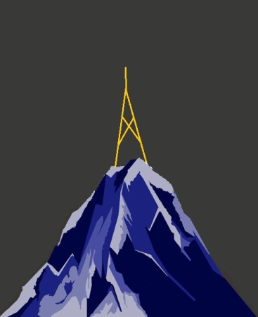
VHF/UHF Propagation
VHF / UHF signals typically travel by line of sight propagation
VHF / UHF signals can be blocked by and/or reflected off mountains and large buildings.

Slide 6
VHF/UHF Propagation
Input Freq
144.61 MHz
Output Freq
145.21 MHz
Offset
- 600 kHz
60+ Miles Distance

Slide 7
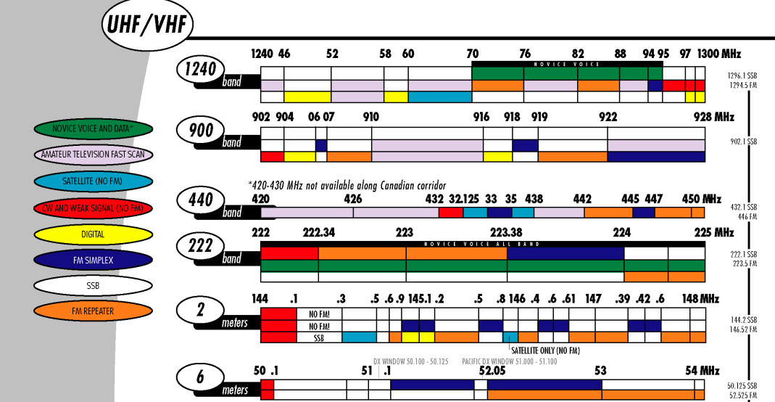

Slide 8
T2A01 - What is the most common repeater frequency offset in the 2 meter band?
A. Plus or minus 5 MHz
B. Plus or minus 600 kHz
C. Plus or minus 500 kHz
D. Plus or minus 1 MHz

Slide 9
T2A01 - What is the most common repeater frequency offset in the 2 meter band?
A. Plus or minus 5 MHz
B. Plus or minus 600 kHz
C. Plus or minus 500 kHz
D. Plus or minus 1 MHz

Slide 10
T2A02 What is the national calling frequency for FM simplex operations in the 2 meter band?
A. 146.520 MHz
B. 145.000 MHz
C. 432.100 MHz
D. 446.000 MHz

Slide 11
T2A02 What is the national calling frequency for FM simplex operations in the 2 meter band?
A. 146.520 MHz
B. 145.000 MHz
C. 432.100 MHz
D. 446.000 MHz

Slide 12
T2A03 - What is a common repeater frequency offset in the 70 cm band?
A. Plus or minus 5 MHz
B. Plus or minus 600 kHz
C. Plus or mnus 500 kHz
D. Plus or minus 1 MHz

Slide 13
T2A03 - What is a common repeater frequency offset in the 70 cm band?
A. Plus or minus 5 MHz
B. Plus or minus 600 kHz
C. Plus or mnus 500 kHz
D. Plus or minus 1 MHz

Slide 14
G2A01 Which sideband is most commonly used for voice Communications on frequencies of 14 MHz or higher?
  A. Upper sideband
  B. Lower sideband
  C. Vestigial sideband
  D. Double sideband

Slide 15
G2A01 Which sideband is most commonly used for voice Communications on frequencies of 14 MHz or higher?
  A. Upper sideband
  B. Lower sideband
  C. Vestigial sideband
  D. Double sideband

Slide 16
T2A04 - What is an appropriate way to call another station on a repeater if you know the other station's call sign?
A. Say break, break then say the station's call sign
B. Say the station's call sign then identify with your call sign
C. Say CQ three times then the other station's call sign
D. Wait for the station to call CQ then answer

Slide 17
T2A04 - What is an appropriate way to call another station on a repeater if you know the other station's call sign?
A. Say break, break then say the station's call sign
B. Say the station's call sign then identify with your call sign
C. Say CQ three times then the other station's call sign
D. Wait for the station to call CQ then answer

Slide 18
T2A05 - How should you respond to a station calling CQ?
A. Transmit CQ followed by the other station’s call sign
B. Transmit your call sign followed by the other station’s call sign
C. Transmit the other station’s call sign followed by your call sign
D. Transmit a signal report followed by your call sign

Slide 19
T2A05 - How should you respond to a station calling CQ?
A. Transmit CQ followed by the other station’s call sign
B. Transmit your call sign followed by the other station’s call sign
C. Transmit the other station’s call sign followed by your call sign
D. Transmit a signal report followed by your call sign

Slide 20
T2A06 Which of the following is required when making on-the-air test transmissions?
A. Identify the transmitting station
B. Conduct tests only between 10 p.m. and 6 a.m. local time
C. Notify the FCC of the transmissions
D. All of these choices are correct

Slide 21
T2A06 Which of the following is required when making on-the-air test transmissions?
A. Identify the transmitting station
B. Conduct tests only between 10 p.m. and 6 a.m. local time
C. Notify the FCC of the transmissions
D. All of these choices are correct

Slide 22
T2A07 What is meant by "repeater offset?"
A. The difference between a repeater’s transmit and receive frequencies
B. The repeater has a time delay to prevent interference
C. The repeater station identification is done on a separate frequency
D. The number of simultaneous transmit frequencies used by a repeater

Slide 23
T2A07 What is meant by "repeater offset?"
A. The difference between a repeater’s transmit and receive frequencies
B. The repeater has a time delay to prevent interference
C. The repeater station identification is done on a separate frequency
D. The number of simultaneous transmit frequencies used by a repeater

Slide 24
Repeater Input/Output Offsets
Band Offset
6 meters 1 MHz
2 meters 600 kHz
1.25 meters 1.6 MHz
70 cm 5 MHz
33 cm 12 MHz
23 cm 20 MHz

Slide 25
T2A08 What is the meaning of the procedural signal “CQ”?
A. Call on the quarter hour
B. Test transmission, no replty expected
C. Only the called station should transmit
D. Calling any station

Slide 26
T2A08 What is the meaning of the procedural signal “CQ”?
A. Call on the quarter hour
B. Test transmission, no replty expected
C. Only the called station should transmit
D. Calling any station

Slide 27
T2A09 Which of the following indicates that a station is listening on a repeater and looking for a contact?
A. “CQ CQ” followed by the repeater’s call sign
B. The station’s call sign followed by the word “monitoring”
C. The repeater call sign followed by the station’ call sign
D. “QSY” followed by your call sign

Slide 28
T2A09 Which of the following indicates that a station is listening on a repeater and looking for a contact?
A. “CQ CQ” followed by the repeater’s call sign
B. The station’s call sign followed by the word “monitoring”
C. The repeater call sign followed by the station’ call sign
D. “QSY” followed by your call sign

Slide 29
T2A10 - What is a band plan, beyond the privileges established by the FCC?
A. A voluntary guideline for using different modes or activities within an amateur band
B. A ist of operating schedules
C. A list of available net frequencies
D. A plan devised by a club to indicate frequency band usage

Slide 30
T2A10 - What is a band plan, beyond the privileges established by the FCC?
A. A voluntary guideline for using different modes or activities within an amateur band
B. A ist of operating schedules
C. A list of available net frequencies
D. A plan devised by a club to indicate frequency band usage

Slide 31
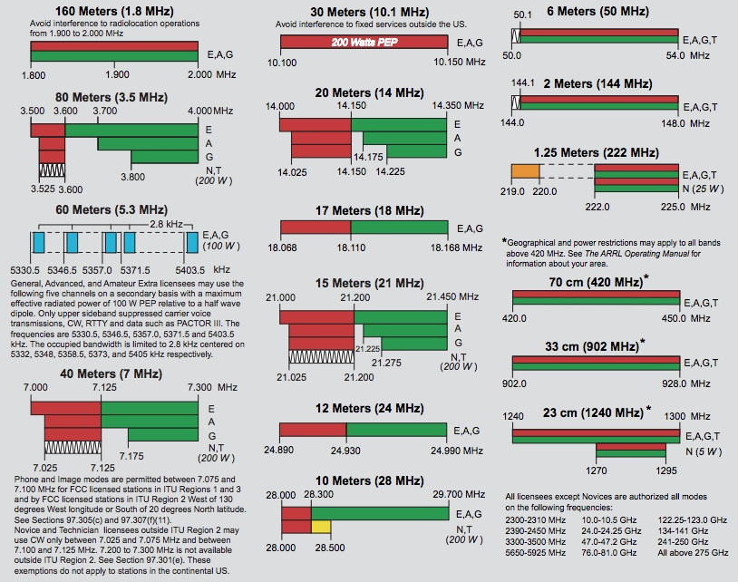
ARRL Band Plan

Slide 32
VHF/UHF Band Plan

Slide 33
T2A11 What term describes an amateur station that is transmitting and receiving on the same frequency?
A. Full duplex
B. Diplex
C. Simplex
D. Multiplex

Slide 34
T2A11 What term describes an amateur station that is transmitting and receiving on the same frequency?
A. Full duplex
B. Diplex
C. Simplex
D. Multiplex

Slide 35
T2A12 – What should you do before calling CQ?
A. Listen first to be sure that no one else is using the frequency
B. Ask if the frequency is in use
C. Make sure you are authorized to use that frequency
D. All these choices are correct

Slide 36
T2A12 – What should you do before calling CQ?
A. Listen first to be sure that no one else is using the frequency
B. Ask if the frequency is in use
C. Make sure you are authorized to use that frequency
D. All these choices are correct

Slide 37
T2B – VHF/UHF operating practices:
FM repeater; simplex; reverse splits, Access tones, CTCSS; DTMF; DMR operation; Receiving operational problem resolution; Q signals

Slide 38
T2B01 How is a VHF/UHF transmitter’s “reverse” function used?
A. Reduce power output
B. Increase power output
C. Listen on a repeater’s input frequency
D. Listen on a repeater’s output frequency

Slide 39
T2B01 How is a VHF/UHF transmitter’s “reverse” function used?
A. Reduce power output
B. Increase power output
C. Listen on a repeater’s input frequency
D. Listen on a repeater’s output frequency

Slide 40
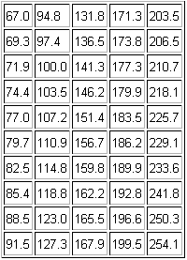
Repeater Access Tone
Continuous Tone Coded Squelch System (CTCSS) tones are sub-audible tones added to an FM carrier.
Some repeater systems require CTCSS tones to access.
To access a repeater, in addition to knowing the repeater offset or shift, as previously discussed, you must also know if a tone is required and what it is.

Slide 41
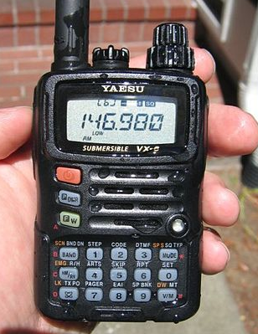
Repeater Offset +/-
Tone
Frequency

Slide 42
T2B02 - What term describes the use of a sub-audible tone transmitted along with normal voice audio to open the squelch of a receiver?
A. Carrier squelch
B. Tone burst
C. DTMF
D. CTCSS

Slide 43
T2B02 - What is the term used to describe the use of a sub-audible tone transmitted with normal voice audio to open the squelch of a receiver?
A. Carrier squelch
B. Tone burst
C. DTMF
D. CTCSS
Continuous Tone Coded Squelch System (CTCSS) tones are sub-audible tones added to an FM carrier.

Slide 44
T2B03 Which of the following describes a linked repeater network?
A network of repeaters in which signals received by one repeater are transmitted by all repeaters in the network
A single repeater with more than one receiver
Multiple repeaters with one control operator
A system of repeaters linked by APRS

Slide 45
T2B03 Which of the following describes a linked repeater network?
A network of repeaters in which signals received by one repeater are transmitted by all repeaters in the network
A single repeater with more than one receiver
Multiple repeaters with one control operator
A system of repeaters linked by APRS

Slide 46
T2B04 Which of the following could be the reason you are unable to access a repeater whose output you can hear?
A. Improper transceiver offset
B. You are using the wrong CTCSS tone
C. You are using the wrong DCS code
D. All these choices are correct

Slide 47
T2B04 Which of the following could be the reason you are unable to access a repeater whose output you can hear?
A. Improper transceiver offset
B. You are using the wrong CTCSS tone
C. You are using the wrong DCS code
D. All these choices are correct

Slide 48
T2B05 What would cause your FM transmission audio to be distorted on voice praks?
A. Your repeater offset invertrd
B. You need to talk louder
C. You are talking too loudly
D. Your transmit power is too high

Slide 49
T2B05 What would cause your FM transmission audio to be distorted on voice praks?
A. Your repeater offset invertrd
B. You need to talk louder
C. You are talking too loudly
D. Your transmit power is too high

Slide 50
T2B06 What type of signaling uses pairs of audio tones?
A. DTMF
B. CTCSS
C. GPRS
D. D-STAR

Slide 51
T2B06 What type of signaling uses pairs of audio tones?
A. DTMF
B. CTCSS
C. GPRS
D. D-STAR

Slide 52
T2B07 How can you join a digital repeater’s “talkgroup”?
A. Register your radio with the local FCC office
B. Join the repeater owner’s club
C. Program your radio with the group’s ID or code
D. Sign your call after the courtesy tone

Slide 53
T2B07 How can you join a digital repeater’s “talkgroup”?
A. Register your radio with the local FCC office
B. Join the repeater owner’s club
C. Program your radio with the group’s ID or code
D. Sign your call after the courtesy tone

Slide 54
T2B08 - Which of the following applies when two stations transmitting on the same frequency interfere with each other?
A. The stations should negotiate the continued use of the frequency
B. Both stations should choice another frequency to avoid conflict
C. Interference is inevitable, so no action is required
D. Use subaudible tones so both stations can share the frequency

Slide 55
T2B08 - Which of the following applies when two stations transmitting on the same frequency interfere with each other?
A. The stations should negotiate the continued use of the frequency
B. Both stations should choice another frequency to avoid conflict
C. Interference is inevitable, so no action is required
D. Use subaudible tones so both stations can share the frequency

Slide 56
T2B09 Why are simplex channels designated in th VHF/UHF band plans?
A. So stations within range of each other can communicate without tying up a repeater
B. For contest operation
C. For working DX only
D. So stations with simple transmitters can access the repeater without automatic offset

Slide 57
T2B09 Why are simplex channels designated in th VHF/UHF band plans?
A. So stations within range of each other can communicate without tying up a repeater
B. For contest operation
C. For working DX only
D. So stations with simple transmitters can access the repeater without automatic offset

Slide 58
CW Prosigns
DX – Distant station (outside the country)
CQ – Calling any station
AR – "+" over, end of message
K – go, invite any station to transmit
KN – "(" go only, invite a specific station to transmit
BK – invite receiving station to transmit
AS – please stand by
SK – end of contact (sent before call)
CL – going off the air (clear)

Slide 59
Q Signals
QRM | Man-made noise | QRN | Atmospheric noise
QSY | Change frequency | QTH | Current/home location
QSB | Atmospheric fading | QSL | Confirmation of report
QSK | Full break-in keying | QRV | Ready to receive
QRS | Send more slowly | QRQ | Send more quickly

Slide 60
T2B10 - Which Q signal indicates that you are receiving interference from other stations?
A. QRM
B. QRN
C. QTH
D. QSB

Slide 61
T2B10 - Which Q signal indicates that you are receiving interference from other stations?
A. QRM
B. QRN
C. QTH
D. QSB

Slide 62
T2B11 - Which Q signal indicates that you are changing frequency?
A. QRU
B. QSY
C. QSL
D. QRZ

Slide 63
T2B11 - Which Q signal indicates that you are changing frequency?
A. QRU
B. QSY
C. QSL
D. QRZ

Slide 64
G2B06 What is a practical way to avoid harmful interference when selecting a frequency to call CQ on CW or phone?
  A. Send "QRL?" on CW, followed by your call sign; or, if using phone, ask if the frequency is in use, followed by your call sign
  B. Listen for 2 minutes before calling CQ
  C. Send the letter "V" in Morse code several times and listen for a response
  D. Send “QSY” on CW or if using phone, announce “the frequency is in use”, then send your call and listen for a response

Slide 65
G2B06 What is a practical way to avoid harmful interference when selecting a frequency to call CQ on CW or phone?
  A. Send "QRL?" on CW, followed by your call sign; or, if using phone, ask if the frequency is in use, followed by your call sign
  B. Listen for 2 minutes before calling CQ
  C. Send the letter "V" in Morse code several times and listen for a response
  D. Send “QSY” on CW or if using phone, announce “the frequency is in use”, then send your call and listen for a response

Slide 66
T2B12 What is the purpose of color code used on DMR repeaters?
Must match the repeater color code for access
Defines the frequency pair to use
Identifies the color used
Defines the minimum signal level required for access

Slide 67
T2B12 What is the purpose of color code used on DMR repeaters?
Must match the repeater color code for access
Defines the frequency pair to use
Identifies the color used
Defines the minimum signal level required for access

Slide 68
T2B13 What is the purpose of a squelch function?
A. Reduce a CW transmitter’s key clicks
B. Mute the receiver audio when a signal is not present
C. Eliminate paracitic oscillations in an FR amplifier
D. Reduce interference from impulse noise

Slide 69
T2B13 What is the purpose of a squelch function?
A. Reduce a CW transmitter’s key clicks
B. Mute the receiver audio when a signal is not present
C. Eliminate paracitic oscillations in an FR amplifier
D. Reduce interference from impulse noise

Slide 70
T2C – Public service:
emergency operations; applicability of FCC rules; RACES and ARES; net and traffic procedures; operating restrictions during emergencies, use of phonetics in message handling

Slide 71
T2C01 - When do the FCC rules NOT apply to the operation of an amateur station?
A. When operating a RACES station
B. When operating under special FEMA rules
C. When operating under special ARES rules
D. Never, FCC rules always apply

Slide 72
T2C01 - When do the FCC rules NOT apply to the operation of an amateur station?
A. When operating a RACES station
B. When operating under special FEMA rules
C. When operating under special ARES rules
D. FCC rules always apply

Slide 73
T2C02 Which of the following are typical duties of a Net Control Station?
A. Choose the regular net meeting time and frequency
B. Ensure that all stations checking into the net are properly licensed for operation on the net frequency
C. Call the net to order and direct communications between stations checking in
D. All these choices are correct

Slide 74
T2C02 Which of the following are typical duties of a Net Control Station?
A. Choose the regular net meeting time and frequency
B. Ensure that all stations checking into the net are properly licensed for operation on the net frequency
C. Call the net to order and direct communications between stations checking in
D. All these choices are correct

Slide 75
T2C03 What technique is used to ensure that voice messages containing unusual words are received correctly?
Send the words by voice and Morse code
Speak very loudly into the microphone
Spell the words using a standard phonetic alphabet
All these choices are correct

Slide 76
T2C03 What technique is used to ensure that voice messages containing unusual words are received correctly?
Send the words by voice and Morse code
Speak very loudly into the microphone
Spell the words using a standard phonetic alphabet
All these chooies are correct

Slide 77
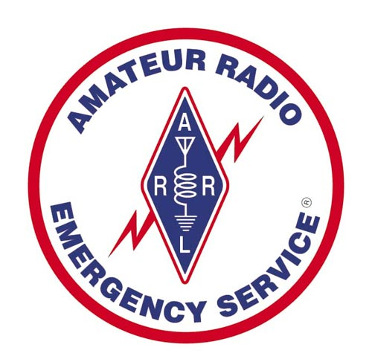

RACES / ARES
RACES – Radio Amateur Civil Emergency Service
  Work with local, state and federal government only
  When activated, you work for the government (Restricted)
  When activated, mission participants are covered by government insurance
ARES - Amateur Radio Emergency Service
  Health and welfare
  Work with government and NGO (Red Cross, Salvation Army) and support services
  When activated, you still are a civilian
Note – both groups do good work, and many hams belong to both groups,
also both groups are often combined.

Slide 78
T2C04 - What is RACES?
An emergency organization containing amateur radio and citizens band operators and frequencies
An international radio experimentation society
A radio contest held in a short period, sometimes called a “sprint”
An FCC part 97 amateur radio service for civil defense communication during national emergencies

Slide 79
T2C04 - What is RACES?
An emergency organization containing amateur radio and citizens band operators and frequencies
An international radio experimentation society
A radio contest held in a short period, sometimes called a “sprint”
An FCC part 97 amateur radio service for civil defense communication during national emergencies

Slide 80
T2C05 What does the term “traffic” refer to in net operation?
A. Messages exchanged by net stations
B. The number of stations checking in and out of a net
C. Operation by mobile or portable stations
D. Requests to activate the net by a served agency
~~

Slide 81
T2C05 What does the term “traffic” refer to in net operation?
A. Messages exchanged by net stations
B. The number of stations checking in and out of a net
C. Operation by mobile or portable stations
D. Requests to activate the net by a served agency
~~

Slide 82
G2B10 When may the FCC restrict normal frequency operations of amateur stations participating in RACES?
  A. When they declare a temporary state of communication emergency
  B. When they seize your equipment for use in disaster communications
  C. Only when all amateur stations are instructed to stop transmitting
  D. When the President’s War Emergency Powers have been invoked

Slide 83
G2B10 When may the FCC restrict normal frequency operations of amateur stations participating in RACES?
  A. When they declare a temporary state of communication emergency
  B. When they seize your equipment for use in disaster communications
  C. Only when all amateur stations are instructed to stop transmitting
  D. When the President’s War Emergency Powers have been invoked

Slide 84
T2C06 – What is Amateur Radio Emergency Service (ARES)?
A group of licensed amateur who have voluntarily registered their qualifications and equipment for communication duty in the public service
A group of licensed amateur who are members of the military and who voluntarily agreed to provide message handling services in the case of an emergency
A training program that provides licensing courses for those interested in obtaining an amateur license to use during emergencies
A training program that certifies amateur operators for membership in the Radio Amateur Civil Emergency Service

Slide 85
T2C06 – What is Amateur Radio Emergency Service (ARES)?
A group of licensed amateur who have voluntarily registered their qualifications and equipment for communication duty in the public service
A group of licensed amateur who are members of the military and who voluntarily agreed to provide message handling services in the case of an emergency
A training program that provides licensing courses for those interested in obtaining an amateur license to use during emergencies
A training program that certifies amateur operators for membership in the Radio Amateur Civil Emergency Service

Slide 86
T2C07 - Which of the following is a standard practice when you participate in a net?
A. When first responding to the net control station, transmit your call sign, name, and address as in the FCC database
B. Record the time of each of your transmissions
C Unless you are reporting an emergency, transmit only when directed by the net control station
D. All these choices are correct

Slide 87
T2C07 - Which of the following is a standard practice when you participate in a net?
A. When first responding to the net control station, transmit your call sign, name, and address as in the FCC database
B. Record the time of each of your transmissions
C Unless you are reporting an emergency, transmit only when directed by the net control station
D. All these choices are correct

Slide 88
T2C08 - Which of the following is a characteristic of good emergency traffic handling?
A. Passing messages exactly as received
B. Making decisions as to whether messages are worthy of relay or delivery
C. Ensuring that any newsworthy messages are relayed to the news media
D. All these choices are correct

Slide 89
T2C08 - Which of the following is a characteristic of good emergency traffic handling?
A. Passing messages exactly as received
B. Making decisions as to whether messages are worthy of relay or delivery
C. Ensuring that any newsworthy messages are relayed to the news media
D. All these choices are correct

Slide 90
T2C09 - Are amateur station control operators ever permitted to operate outside the frequency privileges of their license class?
A. No
B. Yes, but only when part of a FEMA emergency plan
C. Yes, but only when part of a RACES emergency plan
D. Yes, but only if necessary in situations involving the immediate safety of human life or protection of property

Slide 91
T2C09 - Are amateur station control operators ever permitted to operate outside the frequency privileges of their license class?
A. No
B. Yes, but only when part of a FEMA emergency plan
C. Yes, but only when part of a RACES emergency plan
D. Yes, but only if necessary in situations involving the immediate safety of human life or protection of property

Slide 92
T2C10 What information is contained in the preamble of a formal traffic message?
A. The email address of the originating station
B. The address of the intended recipient
C. The telephone number of the addressee
D. The information needed to track the message

Slide 93
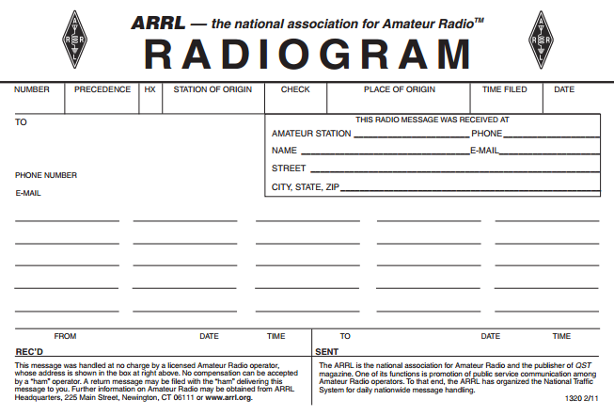
Formal Message Traffic
Preamble
Check is the word count in the message a provides basic error-checking

Slide 94
T2C10 What information is contained in the preamble of a formal traffic message?
A. The email address of the originating station
B. The address of the intended recipient
C. The telephone number of the addressee
D. The information needed to track the message

Slide 95
T2C11 - What is meant by “check” in a radiogram header?
A. The check is a count of the number of words or word equivalents in the text portion of the message
B. The check is the value of a money order attached to the message
C. The check is a list of stations that have relayed the message
D. The check is a box on the message form that tells you the message was received

Slide 96
T2C11 - What is meant by “check” in a radiogram header?
A. The check is a count of the number of words or word equivalents in the text portion of the message
B. The check is the value of a money order attached to the message
C. The check is a list of stations that have relayed the message
D. The check is a box on the message form that tells you the message was received

Slide 97
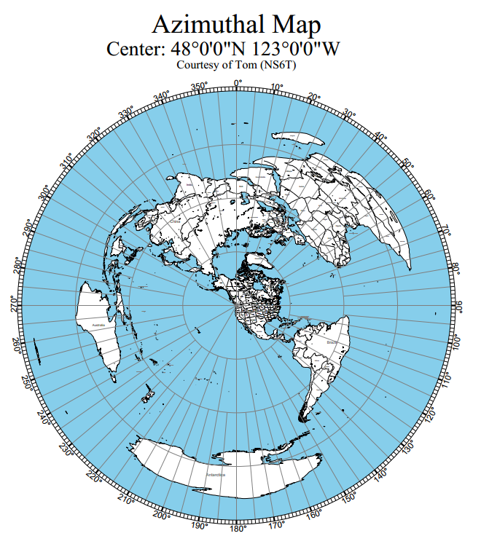
Azimuthal Map
The Azimuthal Projection provides accurate antenna bearings to other locations on the globe via “great circle” routes
Short path and long path bearings are easily found

Slide 98
G2D04 Which of the following describes an azimuthal projection map?
  A. A world map that shows accurate land masses
  B. A world map projection centered on a particular location
  C. A world map that shows the angle at which an amateur satellite crosses the equator
  D. A world map that shows the number of degrees longitude that an amateur satellite appears to move westward at the equator with each orbit

Slide 99
G2D04 Which of the following describes an azimuthal projection map?
  A. A world map that shows accurate land masses
  B. A world map projection centered on a particular location
  C. A world map that shows the angle at which an amateur satellite crosses the equator
  D. A world map that shows the number of degrees longitude that an amateur satellite appears to move westward at the equator with each orbit

Slide 100
End of
SUBELEMENT T2
Operating Procedures

