Slide 1
SUBELEMENT T4
Amateur radio practices and station set up
[2 Exam Questions - 2 Groups]
Amateur Radio Practices 2022
Notes:
Subelement T4 Amateur Radio Practices. Technician Training Slides for 2022 Question Pool Good through June 30, 2026 Assembled by Washington Ham Trainers, Daniel Stevens KL7WM, Howard Schultz, W7HS.

Slide 2
T4A – Station setup: connecting microphones; a power source, a computer, digital equipment, an SWR; meter, bonding; Mobile radio installation
T4B - Operating controls: frequency tuning, use of filters;, squelch function; AGC; memory channels, noise lblanker, microphone gain, receiver incremental tuning (RIT) bandwidth selection, digital transceiver configuration
Amateur Radio Practices 2022
2

Slide 3
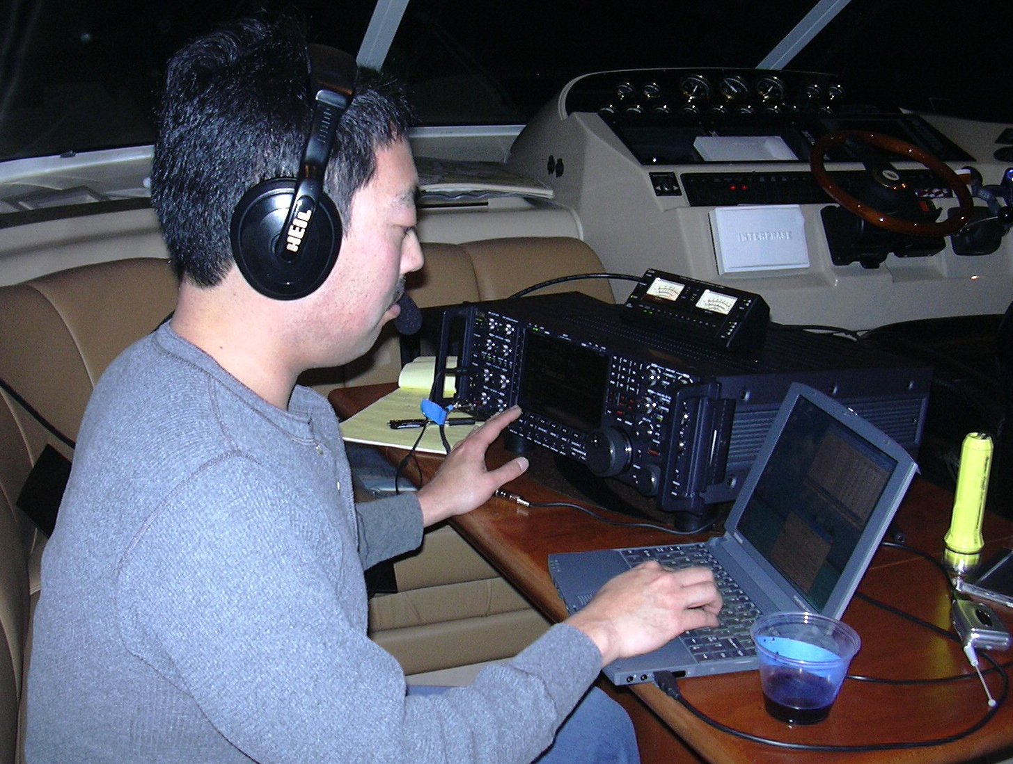
Communications Headset
HiFi headphones are designed to cover the entire range of human hearing (20-20,000Hz) equally well. Communications headphones are only designed to reproduce the 300-3000Hz voice frequencies which helps reduce non-voice noise that might come out of the receiver. This model includes a boom microphone that minimizes background noise and insures consistent voice quality.
Push-to-Talk (PTT) is via a foot switch on the floor to leave the operators hands free.
Notes:
Good communications headphones are not the same as HiFi headphones. HiFi headphones are designed to cover the entire range of human hearing (20-20,000Hz) equally well. Communications headphones are only designed to reproduce the 300-3000Hz voice frequencies which helps reduce non-voice noise that might come out of the receiver. This model includes a boom microphone that minimizes background noise and insures consistent voice quality. Push-to-Talk (PTT) is via a foot switch on the floor to leave the operators hands free.

Slide 4
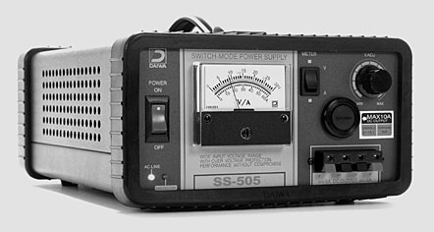
Power Supply
This Daiwa 12v regulated power supply has a meter that can display voltage and current
Notes:
If your power supply has volt and ammeters, it can be used to calculate power consumption of your rig at various power levels. This will help determine proper fuse sizing, appropriate wire gauge, anticipated battery life, etc.

Slide 5
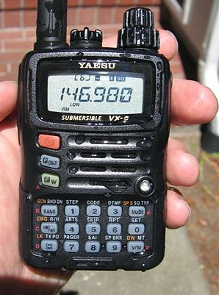
Listen on 146.980 (- .600) Talk on 146.380
Offset
Tone Enabled
103.5
Freq.

Slide 6
Repeater Input/Output Offsets
Band Offset
6 meters 1 MHz
2 meters 600 kHz
1.25 meters 1.6 MHz
70 cm 5 MHz
33 cm 12 MHz
23 cm 20 MHz
Notes:
This is the national band plan. Note that Western Washington uses a different split on 6 meters.

Slide 7
Low Pass (top), High Pass Filters
Low Pass
0 dB
-3 dB
Pass Band
Stop Band
40 dB
f_{c}
Frequency
High Pass
0 dB
-3 dB
Stop Band
Pass Band
40 dB
f_{c}
Frequency

Slide 8
Band Pass Filter
0 dB
-3 dB
Stop Band
Pass Band
Stop Band
40 dB
Low Frequency
f_{c}
f_{c}
High Frequency

Slide 9
Notch (Band Stop) Filter
There are notch filters built to notch out the powerful pager transmitters located just above the 2m band.
Very effective notch filters can be made with a 1/2 wavelength piece of coax shorted on one end connected to a coaxial “T” connector on the other. These are often called “stubs”.
0 dB
-3 dB
Pass Band
Stop Band
Pass Band
40 dB
f_{c}
f_{c}
Low Frequency
High Frequency
Repeaters use cavity notch filters that have very sharp skirts to keep the transmitter from interfering with the receiver, since they’re both active at the same time on very close frequencies.

Slide 10
T4A01 Which of the following is an appropriate power supply rating for a typical 50 watt output mobile FM transceiver?
24.0 volts at 4 amperes
13.8 volts at 4 amperes
24.0 volts at 12 amperes
13.8 volts at 12 amperes
Amateur Radio Practices 2022
10

Slide 11
T4A01 Which of the following is an appropriate power supply rating for a typical 50 watt output mobile FM transceiver?
24.0 volts at 4 amperes
13.8 volts at 4 amperes
24.0 volts at 12 amperes
13.8 volts at 12 amperes
Amateur Radio Practices 2022
11

Slide 12
T4A02 Which of the following should be considered when selecting an accessory SWR meter?
The frequency and power level at which the measurements will be made
The distance that the meter will be located from the antenna
The type of modulation being used at the station
All these choices are correct
Amateur Radio Practices 2022
12

Slide 13
T4A02 Which of the following should be considered when selecting an accessory SWR meter?
The frequency and power level at which the measurements will be made
The distance that the meter will be located from the antenna
The type of modulation being used at the station
All these choices are correct
Amateur Radio Practices 2022
13

Slide 14
T4A03 Why are short heavy-gauge wires used for a transceiver’s DC power connections??
To minimize voltage drop when transmitting
To provide a good counterpoise for the antenna
To avoid RF interference
All these choices are correct
Amateur Radio Practices 2022
14

Slide 15
T4A03 Why are short heavy-gauge wires used for a transceiver’s DC power connections??
To minimize voltage drop when transmitting
To provide a good counterpoise for the antenna
To avoid RF interference
All these choices are correct
Amateur Radio Practices 2022
15

Slide 16
T4A04 How are the transceiver audio input and output connected in a station configured to operate using FT8?
To a computer running a terminal program and connected to a terminal node controller unit
To the audio input and output of a computer running WSJT-X software
To an FT8 conversion unit, a keyboard, and a computer monitor
To a computer connected to the DT8converter.com website
Amateur Radio Practices 2022
16

Slide 17
T4A04 How are the transceiver audio input and output connected in a station configured to operate using FT8?
To a computer running a terminal program and connected to a terminal node controller unit
To the audio input and output of a computer running WSJT-X software
To an FT8 conversion unit, a keyboard, and a computer monitor
To a computer connected to the DT8converter.com website
Amateur Radio Practices 2022
17

Slide 18
T4A05 Where should an RF power meter be installed?
In the feed line, between the transmitter and antenna
At the power supply output
In parallel with the push-to-talk line and the antenna
In the power supply cable, as close as possible to the radio
Amateur Radio Practices 2022
18

Slide 19
T4A05 Where should an RF power meter be installed?
In the feed line, between the transmitter and antenna
At the power supply output
In parallel with the push-to-talk line and the antenna
In the power supply cable, as close as possible to the radio
Amateur Radio Practices 2022
19

Slide 20
T4A06 What signals are used in a computer-radio interface for digital mode operation?
Receive and transmit mode, statis, and location
Antenna and RF power
Receive audio, transmit audio, and transmitter keying
NMEA GPS location and DC power
Amateur Radio Practices 2022
20

Slide 21
T4A06 What signals are used in a computer-radio interface for digital mode operation?
Receive and transmit mode, statis, and location
Antenna and RF power
Receive audio, transmit audio, and transmitter keying
NMEA GPS location and DC power
Amateur Radio Practices 2022
21

Slide 22
T4A07 Which of the following connections is made between a computer and a transceiver to use computer software when operating digital modes?
Computer “line out” to transceiver push-to-talk
Computer “line in’ to transceiver push-to-talk
Computer “line in” to transceiver speaker connector
Computer “line out” to transceiver speaker connector
Amateur Radio Practices 2022
22

Slide 23
T4A07 Which of the following connections is made between a computer and a transceiver to use computer software when operating digital modes?
Computer “line out” to transceiver push-to-talk
Computer “line in’ to transceiver push-to-talk
Computer “line in” to transceiver speaker connector
Computer “line out” to transceiver speaker connector
Amateur Radio Practices 2022
23

Slide 24
T4A08 Which of the following conductors is preferred for bonding at RF?
Copper braid removed from coaxial; cable
Steel wire
Twisted-pair cable
Flat copper strap
Amateur Radio Practices 2022
24

Slide 25
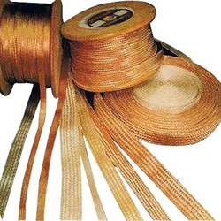
T4A08 Which of the following conductors is preferred for bonding at RF?
Copper braid removed from coaxial; cable
Steel wire
Twisted-pair cable
Flat copper strap
Amateur Radio Practices 2022
25

Slide 26
T4A09 How can you determine the length of time that equipment can be powered from a battery?
Divide the watt-hour rating of the battery by the peak power consumption of the equipment
Divide the battery ampere-hour rating by the average current draw of the equipment
Multiply the watts per hour consumed by the equipment by the battery’s power rating
Multiply the square of the current rating of the battery by the input resistance of the equipment
Amateur Radio Practices 2022
26

Slide 27
T4A09 How can you determine the length of time that equipment can be powered from a battery?
Divide the watt-hour rating of the battery by the peak power consumption of the equipment
Divide the battery ampere-hour rating by the average current draw of the equipment
Multiply the watts per hour consumed by the equipment by the battery’s power rating
Multiply the square of the current rating of the battery by the input resistance of the equipment
Amateur Radio Practices 2022
27

Slide 28
T4A10 What function is preformed with a transceiver and a digital mode hot spot?
Communication using digital voice or data systems via the internet
FT8 digital communication via AFSK
RTTY encoding and decoding without a computer
High-speed digital communication for meteor scatter
Amateur Radio Practices 2022
28

Slide 29
T4A10 What function is preformed with a transceiver and a digital mode hot spot?
Communication using digital voice or data systems via the internet
FT8 digital communication via AFSK
RTTY encoding and decoding without a computer
High-speed digital communication for meteor scatter
Amateur Radio Practices 2022
29

Slide 30
T4A11 Where should the negative power return of a mobile transceiver be connected to a vehicle?
At the 12 volt battery chassis ground
At thew antenna mount
To any metal part of the vehicle
Through the transceiver’s mounting bracket
Amateur Radio Practices 2022
30

Slide 31
T4A11 Where should the negative power return of a mobile transceiver be connected to a vehicle?
At the 12 volt battery chassis ground
At thew antenna mount
To any metal part of the vehicle
Through the transceiver’s mounting bracket
Amateur Radio Practices 2022
31

Slide 32
T4A12 What is an electronic keyer?
A devise for switching antennas from transmit to receive
A device for voice activated switching from receive to transmit
A device that assist in manual sending of Morse code
An interlock to prevent unauthorized use of a radio
Amateur Radio Practices 2022
32

Slide 33
T4A12 What is an electronic keyer?
A devise for switching antennas from transmit to receive
A device for voice activated switching from receive to transmit
A device that assist in manual sending of Morse code
An interlock to prevent unauthorized use of a radio
Amateur Radio Practices 2022
33

Slide 34
T4B - Operating controls
frequency tuning, use of filters;, squelch function; AGC; memory channels, noise lblanker, microphone gain, receiver incremental tuning (RIT) bandwidth selection, digital transceiver configuration
Amateur Radio Practices 2022
34

Slide 35
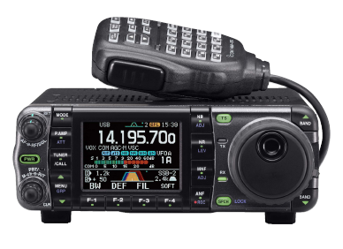
Icom IC-7000 Multimode Transceiver
Keypad for band changes
and frequency entry
Up/Down Buttons
Volume/Squelch
Control
Noise Blanker
Tune Step
(TS)
RIT
VFO or
Tuning Knob

Slide 36
T4B01 What is the effect of excessive microphone gain on SSB transmissions?
Frequency instability
Distorted transmitted audio
Increased SWRT
All these choices are correct
Amateur Radio Practices 2022
36

Slide 37
T4B01 What is the effect of excessive microphone gain on SSB transmissions?
Frequency instability
Distorted transmitted audio
Increased SWRT
All these choices are correct
Amateur Radio Practices 2022
37

Slide 38
T4B02 - Which of the following can be used to enter a transceiver’s operating frequency?
The keypad or VFO knob
The CTCSS or DTMF encoder
The Automatic Frequency Control
All these choices are correct
Amateur Radio Practices 2022
38

Slide 39
T4B02 - Which of the following can be used to enter a transceiver’s operating frequency?
The keypad or VFO knob
The CTCSS or DTMF encoder
The Automatic Frequency Control
All these choices are correct
Amateur Radio Practices 2022
39

Slide 40
T4B03 - How is squelch adjusted so that a weak FM signal can be heard?
Set the squelch threshold so that receiver output audio is on all the time
Turn up the audio level until is overcomes the squelch threshold
Turn on the anti-squelch function
Enable squelch enhancement
Amateur Radio Practices 2022
40

Slide 41
T4B03 - How is squelch adjusted so that a weak FM signal can be heard?
Set the squelch threshold so that receiver output audio is on all the time
Turn up the audio level until is overcomes the squelch threshold
Turn on the anti-squelch function
Enable squelch enhancement
Amateur Radio Practices 2022
41

Slide 42
T4B04 What is a way to enable quick access to a favorite frequency or channel on your transceiver?
Enable the frequency offset
Store it in a memory channel
Enable the VOX
Use the scan mode to select the desired frequency
Amateur Radio Practices 2022
42

Slide 43
T4B04 What is a way to enable quick access to a favorite frequency or channel on your transceiver?
Enable the frequency offset
Store it in a memory channel
Enable the VOX
Use the scan mode to select the desired frequency
Amateur Radio Practices 2022
43

Slide 44
G4A01 What is the purpose of the "notch filter" found on many HF transceivers?
  A. To restrict the transmitter voice bandwidth
  B. To reduce interference from carriers in the receiver passband
  C. To eliminate receiver interference from impulse noise sources
  D. To enhance the reception of a specific frequency on a crowded band
Amateur Radio Practices 2022
44

Slide 45
G4A01 What is the purpose of the "notch filter" found on many HF transceivers?
  A. To restrict the transmitter voice bandwidth
  B. To reduce interference from carriers in the receiver passband
  C. To eliminate receiver interference from impulse noise sources
  D. To enhance the reception of a specific frequency on a crowded band
Amateur Radio Practices 2022
45

Slide 46
T4B05 What does the scanning function of an FM transceiver do?
Checks incoming signal deviation
Prevents interference to nearby repeaters
Tunes through a range of frequencies to check for activity
Checks for messages left on a digital bulletin board
Amateur Radio Practices 2022
46

Slide 47
T4B05 What does the scanning function of an FM transceiver do?
Checks incoming signal deviation
Prevents interference to nearby repeaters
Tunes through a range of frequencies to check for activity
Checks for messages left on a digital bulletin board
Amateur Radio Practices 2022
47

Slide 48
T4B06 Which of the following controls could be used if the voice pitch of a single-sideband signal returning to your CQ call seems too high or low?
A. The AGC or limiter
B. The bandwidth selection
C. The tone squelch
D. The receiver RIT or clarifier
Amateur Radio Practices 2022
48

Slide 49
T4B06 Which of the following controls could be used if the voice pitch of a single-sideband signal returning to your CQ call seems too high or low?
A. The AGC or limiter
B. The bandwidth selection
C. The tone squelch
D. The receiver RIT or clarifier
Amateur Radio Practices 2022
49

Slide 50
T4B07 - What does a DMR “code plug” contain?
Your call sign in CW for automatic identification
Access information for repeaters and talkgroups
The codec for digitizing audio
The DMR software version
Amateur Radio Practices 2022
50

Slide 51
T4B07 - What does a DMR “code plug” contain?
Your call sign in CW for automatic identification
Access information for repeaters and talkgroups
The codec for digitizing audio
The DMR software version
Amateur Radio Practices 2022
51

Slide 52
Mode Channel Width
Mode | Type | Bandwidth | Content
CW | Telegraphy | 10 Hz | Text Data
SSB | Telephony | 2800 Hz | Voice
AM | Telephony | 6 kHz | Voice
FM | Telephony | 5-15 kHz | Voice
SSTV / Fax | Image | 2800 Hz | Image
ATV | Image | 6 MHz | Image
PSK31 | Data | 31 Hz | Text Data
RTTY | Data | 250 Hz | Text Data
Pactor (I, II, III) | Data | 500-2800 Hz | Binary Data
AX.25 Packet | Data | 10-20 kHz | Binary Data

Slide 53
T4B08 What is the advantage of having multiple receive bandwidth choices on a multimode transceiver?
Permit monitoring several modes at once by selecting a separate filter for each mode
Permit noise or interference reduction by selecting a bandwidth matching the mode
Increases the number of frequencies that can be stored in memory
Increases the amount of offset between receive and transmit frequencies
Amateur Radio Practices 2022
53

Slide 54
T4B08 What is the advantage of having multiple receive bandwidth choices on a multimode transceiver?
Permit monitoring several modes at once by selecting a separate filter for each mode
Permit noise or interference reduction by selecting a bandwidth matching the mode
Increases the number of frequencies that can be stored in memory
Increases the amount of offset between receive and transmit frequencies
Amateur Radio Practices 2022
54

Slide 55
T4B09 How is a specific group of stations selected on a digital voice transceiver?
By retrieving the frequencies from transceiver memory
By enabling the group’s CTCSS tone
By entering the group’s identification code
By activating automatic identification
Amateur Radio Practices 2022
55

Slide 56
T4B09 How is a specific group of stations selected on a digital voice transceiver?
By retrieving the frequencies from transceiver memory
By enabling the group’s CTCSS tone
By entering the group’s identification code
By activating automatic identification
Amateur Radio Practices 2022
56

Slide 57
T4B10 Which of the following receiver filter bandwidths provides the best signal-to-noise ratio for SSB reception?
500 Hz
1000 Hz
2400 Hz
5000 Hz
Amateur Radio Practices 2022
57

Slide 58
T4B10 Which of the following receiver filter bandwidths provides the best signal-to-noise ratio for SSB reception?
500 Hz
1000 Hz
2400 Hz
5000 Hz
Amateur Radio Practices 2022
58

Slide 59
T4B12 Which of the following must be programmed into a D-STAR digital transceiver before transmitting?
Your call sign
Your output power
The codec type being used
All these choices are correct
Amateur Radio Practices 2022
59

Slide 60
T4B12 Which of the following must be programmed into a D-STAR digital transceiver before transmitting?
Your call sign
Your output power
The codec type being used
All these choices are correct
Amateur Radio Practices 2022
60

Slide 61
T4B12 What is the result of tuning an FM receiver above or below a signal’s frequency?
Change is audio pitch
Sideband inversion
Generation of a heterodyne tone
Distortion of the signal’s audio
Amateur Radio Practices 2022
61

Slide 62
T4B12 What is the result of tuning an FM receiver above or below a signal’s frequency?
Change is audio pitch
Sideband inversion
Generation of a heterodyne tone
Distortion of the signal’s audio
Amateur Radio Practices 2022
62

Slide 63
Test Gear Used by Hams
Ocilloscope
Field Strength Meter
Multimeter
Bidirectional Watt Meter
Antenna Analyzer
Station Grounding
DSP - Digital Signal Processor
Speech Processor

Slide 64
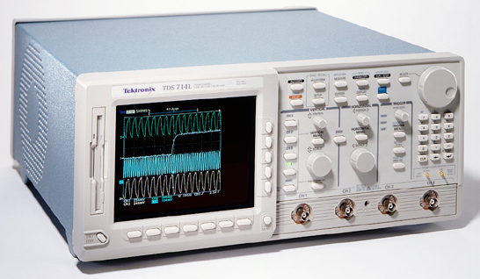
Oscilloscope
An Oscilloscope has the ability to display complex waveforms. Signals are fed into the scope and the internal horizontal and vertical amplifiers generate the display of waveform amplitude vertically and time horizontally.
By connecting the RF output of a transmitter (through appropriate connections) to the vertical input of the scope, the quality of a transmitted signal can be seen on the display.
Amateur Radio Practices
Notes:
64
This is a current model Tektronix oscilloscope. It has four signal inputs along the lower right edge and can display the waveforms from those inputs. There are three main sections to the right of the screen; vertical, horizontal and trigger. The horizontal and vertical controls adjust how the waveform appears on the screen by adjusting the horizontal and vertical amplifiers. The trigger controls allow the oscilloscope to synchronize to external events.
Newer oscilloscopes are digital and can record data to the floppy seen here on the left or send to other external devices. By connecting the RF output of a transmitter (through appropriate connections) to the vertical input of the scope, the quality of a transmitted signal can be seen on the display.

Slide 65
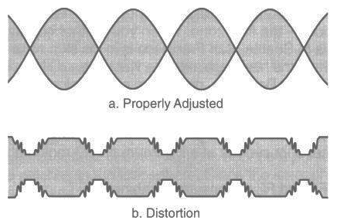
Audio Distortion
Two tone audio tests are used on an oscilloscope to test proper linearity. The pure tones fed in will give you a stable picture on the scope if the amplifier is properly adjusted. The lower image shows a signal with some noise that it also overdriven (overmodulated) and is clipping or flattopping.
Any two audio tones may be used, but they must be within the transmitter audio passband, and should not be harmonically related.
65
Amateur Radio Practices
Notes:
65
Two tone audio tests are used on an oscilloscope to test proper linearity. The pure tones fed in will give you a stable picture on the scope if the amplifier is properly adjusted. The lower image shows a signal with some noise that it also overdriven (overmodulated) and is clipping or flattopping. Any two audio tones may be used, but they must be within the transmitter audio passband, and should not be harmonically related.
Speech Processors are used to keep input audio close to a perfect level for 100% modulation. If they are not adjusted properly, they can cause the distortion seen here. Overdriving causes very distorted audio and no additional power output.

Slide 66
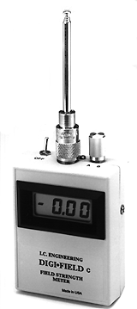
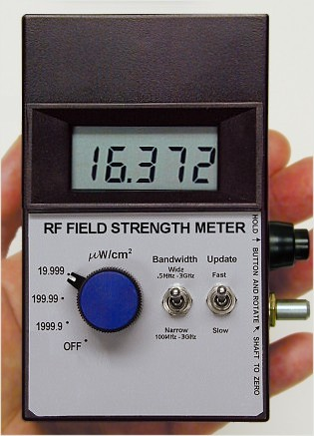
Field Strength Meter
Here are two digital Field Strength Meter models. Some SWR meters and frequency counters can also be used as field strength meters.
Field Strength Meters are used to test the density of an RF field when near the transmitter (near field). This can help determine the radiation pattern of an antenna and locate a nearby transmitter.
66
Amateur Radio Practices
Notes:
66
Here are two digital Field Strength Meter models. Some SWR meters and frequency counters can also be used as field strength meters. Field Strength Meters are used to test the density of an RF field. This allows testing of antenna patterns and ambient RF levels at repeater and home sites to insure safe levels.

Slide 67
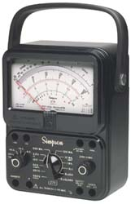
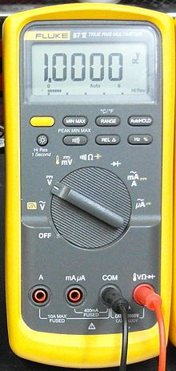
Multimeter
Multimeters generally include voltmeters, ammeters and can measure resistance. They have a high internal impedance in voltage mode to minimize impact on the circuit under test.
Digital models can be very precise but analog models are often favored for tuning circuits.
Amateur Radio Practices 2022

Slide 68
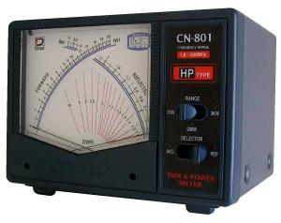
Directional Wattmeter
A directional wattmeter can measure both forward (to the load/antenna) and reflected power. This ratio determines the Standing Wave Ratio (SWR). A perfect match will have all forward power and none reflected or a 1:1 SWR. The meter installs between the transmitter and antenna.
This unit has two needles. One shows forward power, the other reflected. The SWR can be read where they cross (on the red scale).
Amateur Radio Practices 2022
Notes:
This Diawa meter has two meters. One reads forward power and the other reflected power and SWR can be read where the needles cross in the middle.

Slide 69
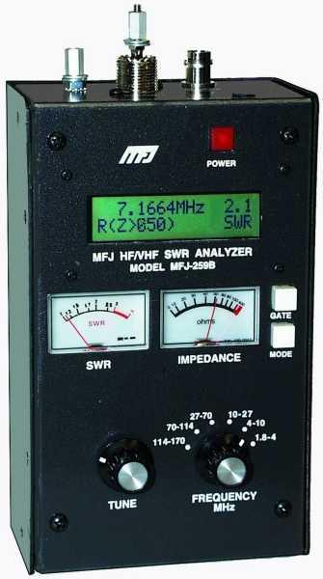
Antenna Analyzer
Antenna analyzers can be used to verify antenna impedance (match). The connect directly to the antenna and use a small internal transmitter to read the resulting match.
This does make them sensitive to other transmitters operating in the area.
They can also be used to read the impedance of connectors and coax.
Amateur Radio Practices 2022

Slide 70
Station Grounding
A common RF ground reduces shock/RF burn hazard and hum in devices
70
Amateur Radio Practices
Notes:
70
For a proper RF ground, it’s important to use a heavy gauge copper (not aluminum) braid or foil and keep the run length to a minimum. Standard wire, even heavy gauge, or long runs can cause your ground lead to act as an antenna and resonate. A good ground will reduce RFI to other equipment, minimize the risk of shock and reduce electrical interference. At a minimum a ground rod should be 8 feet long. This can be difficult to achieve in some locations and multiple shorter rods tied together can be used.

Slide 71
Icom IC-756ProIII IF DSP Receiver
Once the signal has been digitized, Digital Signal Processing (DSP) notch filter, adjustable bandpass filters and noise reduction filters can be applied. The primary advantage of an IF DSP system is that virtually any type of filter can be created and the unwanted signals can be removed without affecting AGC performance. DSP filtering allows virtually any filter shape to be created including a dual peak filter specifically to filter the mark and space tones of an RTTY signal.
71
Amateur Radio Practices
Notes:
71
This is the 2nd IF (intermediate frequency) stage of the Icom IC-756ProIII receiver. The 455kHz IF frequency is converted to 36kHz and digitized through an analog to digital converter. Once the signal has been digitized, DSP notch filter, adjustable bandpass filters and noise reduction filters can be applied.
The level of the resulting signal is sampled and used to determine the gain of the first IF stage. This level information is fed back through a digital to analog converter to the automatic gain control circuit on the 1st IF stage. Finally the signal is fed through the DSP detector, then a digital to analog converter to convert the signal back to analog audio and sent to the amplifier and speaker.
The primary advantage of an IF DSP system is that virtually any type of filter can be created and the unwanted signals can be removed without affecting AGC performance. Common filters include manual and automatic notch filters, noise reduction filters and adjustable bandpass filters. DSP filtering allows virtually any filter shape to be created including a dual peak filter specifically to filter the mark and space tones of an RTTY signal.
Although many of these filters can be implemented more easily in the AF (audio frequency) stage, any desense caused by large interfering signals will have already impacted the AGC. AF DSP is effective at reducing listener fatigue but cannot actually improve system performance.

Slide 72
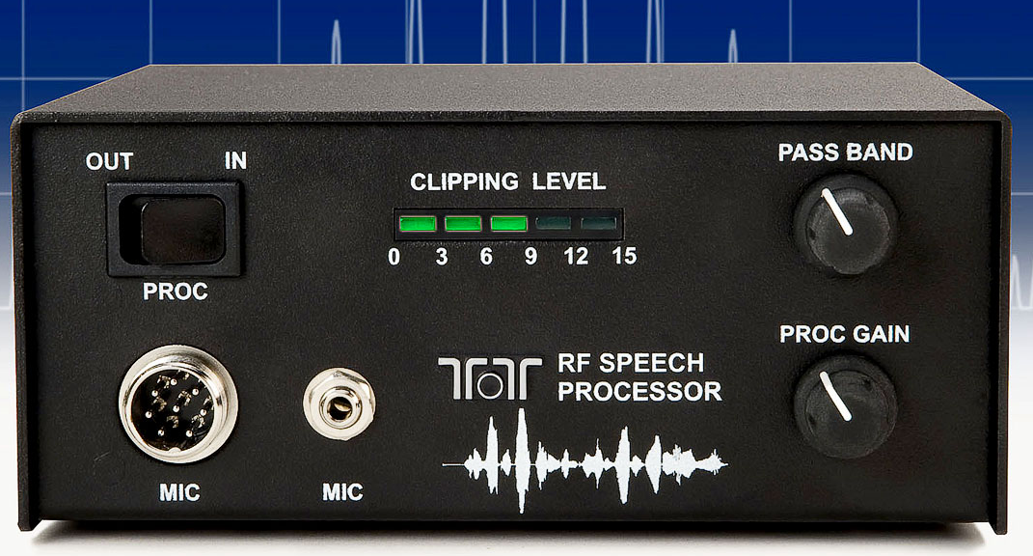
Speech Processor
A speech processor is internal to modern radios and is designed to compress the dynamic range of transmitted audio which increases the average power output. When properly adjusted, this will increase the signal intelligibility. They are often overused to the point of distortion.
Amateur Radio Practices 2022
72

Slide 73
End of
SUBELEMENT T4
Amateur radio practices and station set up
Amateur Radio Practices 2022
73

