Slide 1
SUBELEMENT T6
Electronic and Electrical components;
[4 Exam Questions - 4 Groups]
Notes:
Subelement T6 Electronic and Electrical Components. Technician Training Slides for 2022 Question Pool Good through June 30, 2026 Assembled by Washington Ham Trainers, Daniel Stevens KL7WM, Howard Schultz, W7HS.

Slide 2
T6A - Electrical components: fixed and variable resistors; capacitors and inductors; fuses; switches; batteries
T6B – Semiconductors: basic principles and applications of solid state devices; diodes and transistors
T6C - Circuit diagrams: use of schematics, Schematic symbols of basic components
T6D - Component functions: rectifiers, relay, voltage regulators, meters, indicators, integrated circuits, transformers; Resonant circuit; Shielding

Slide 3
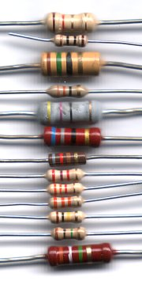
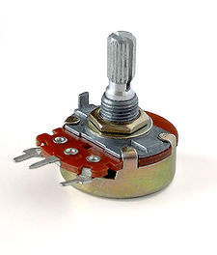
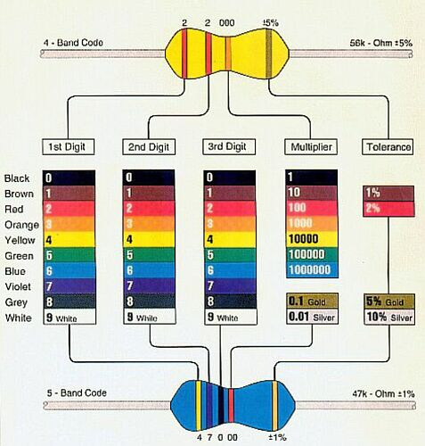
Resistors
Resistors oppose the flow of current in a DC (or AC) circuit). Their values are represented with the colored strips or numbers and will vary slightly with temperature.
A variable resistor is called a potentiometer and is often used for volume controls

Slide 4

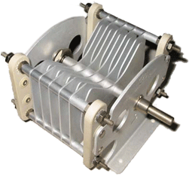
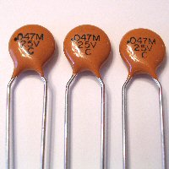
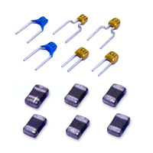
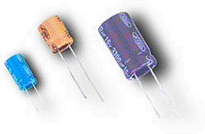
Capacitors
Air Variable Capacitor
Ceramic capacitors
Capacitors are conductive plates separated by an insulator and stores energy in an electric field (electrostatically)
Electrolytic capacitors
(polarized)

Slide 5

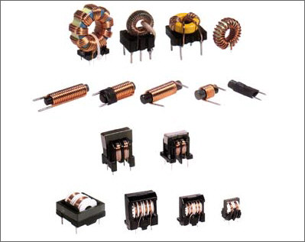
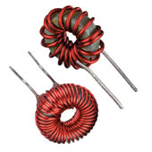
Inductors
Inductors are generally coils of wire that store energy in a magnetic field

Slide 6
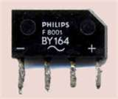
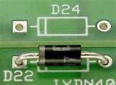
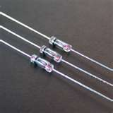
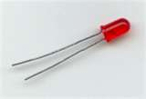
Diode
  Electronic one-way “valve”, used e.g. in rectifiers
  Mostly made of Si, Ga
  Different types: PN diodes, Schottky
  Electrodes are called anode and cathode with the cathode indicated by a stripe

Slide 7
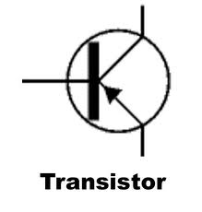
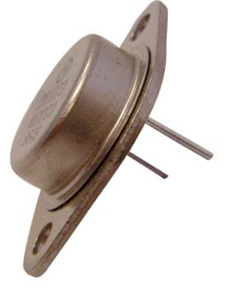
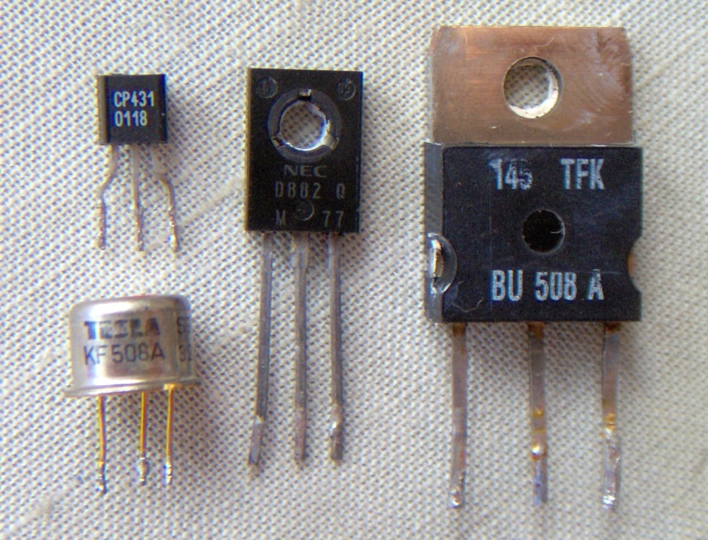
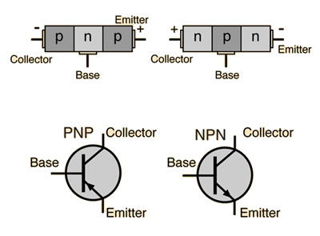
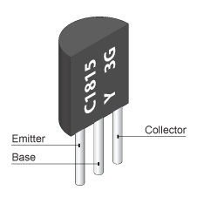
Transistors (Bipolar)
Can be used as an electronic switch or amplifier
Comprised of three layers of semiconductor (PNP, NPN)
Generally have three electrodes (emitter, base, collector)
Field Effect Transistors (FET) have source, drain and gate instead

Slide 8
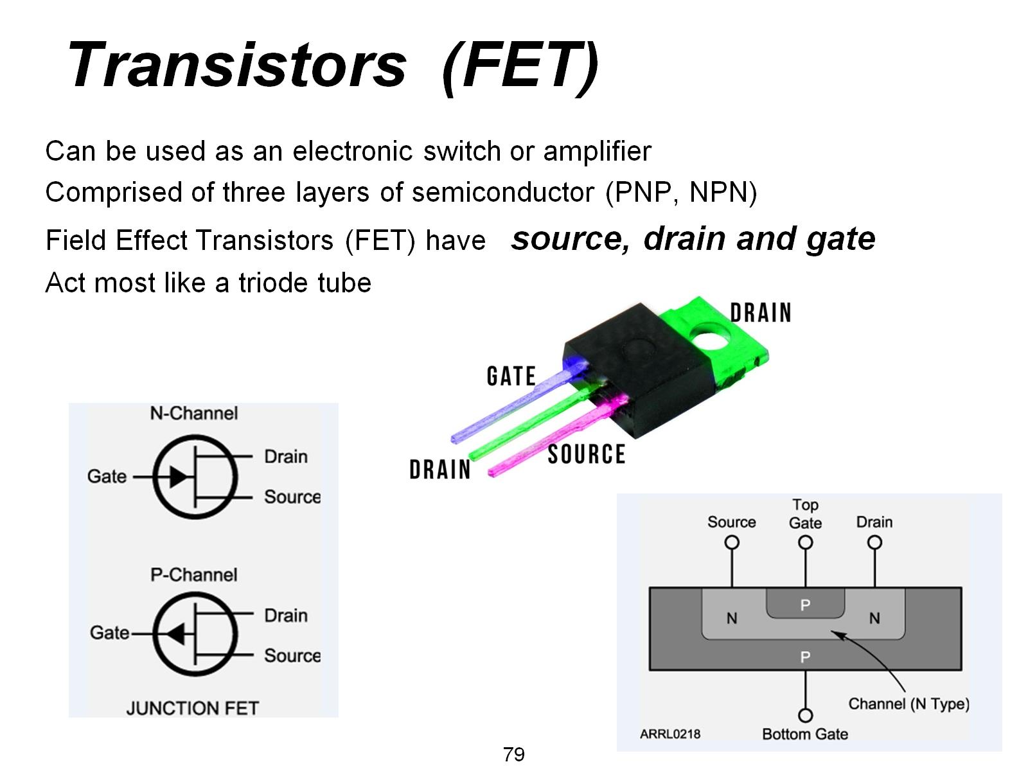
Transistors (FET)

Slide 9
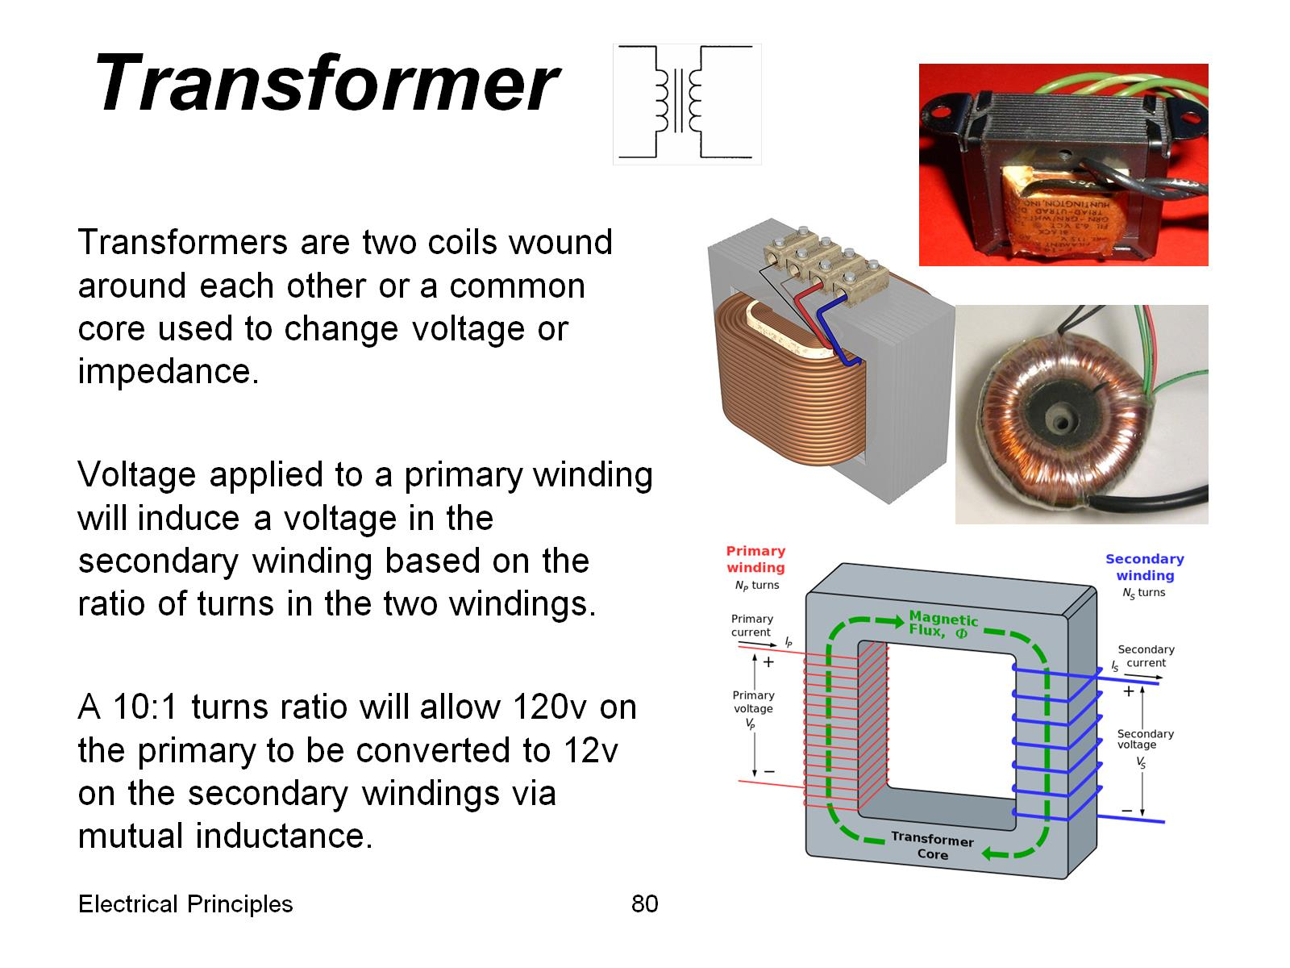
Transformer

Slide 10
T6A01 - What electrical component opposes the flow of current in a DC circuit?
A. Inductor
B. Resistor
C. Inverter
D. Transformer

Slide 11
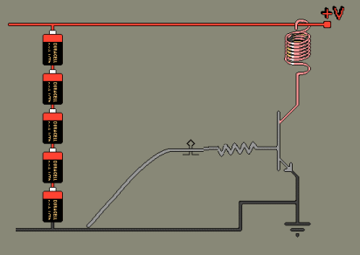
T6A01 - What electrical component opposes the flow of current in a DC circuit?
A. Inductor
B. Resistor
C. Inverter
D. Transformer

Slide 12
T6A02 - What type of component is often used as an adjustable volume control?
A. Fixed resistor
B. Power resistor
C. Potentiometer
D. Transformer

Slide 13
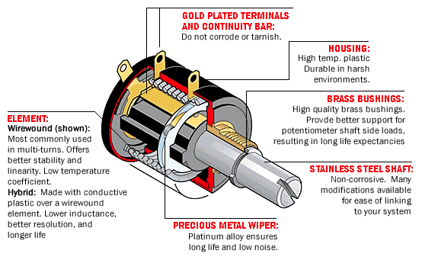
T6A02 - What type of component is often used as an adjustable volume control?
A. Fixed resistor
B. Power resistor
C. Potentiometer
D. Transformer

Slide 14
T6A03 - What electrical parameter is controlled by a potentiometer?
A. Inductance
B. Resistance
C. Capacitance
D. Field strength

Slide 15
T6A03 - What electrical parameter is controlled by a potentiometer?
A. Inductance
B. Resistance
C. Capacitance
D. Field strength

Slide 16
T6A04 - What electrical component stores energy in an electric field?
A. Varistor
B. Capacitor
C. Inductor
D. Diode

Slide 17
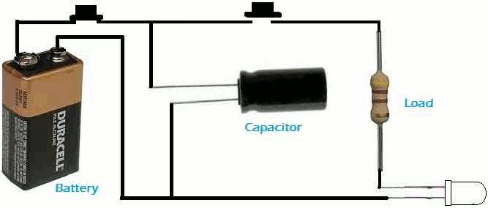
T6A04 - What electrical component stores energy in an electric field?
A. Varistor
B. Capacitor
C. Inductor
D. Diode

Slide 18
T6A05 - What type of electrical component consists of conductive surfaces separated by an insulator?
A. Resistor
B. Potentiometer
C. Oscillator
D. Capacitor

Slide 19
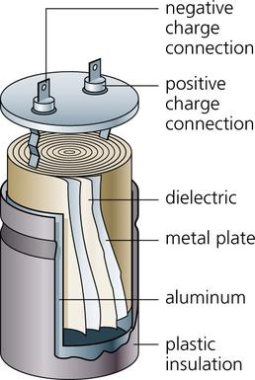
T6A05 - What type of electrical component consists of conductive surfaces separated by an insulator?
A. Resistor
B. Potentiometer
C. Oscillator
D. Capacitor

Slide 20
T6A06 - What type of electrical component stores energy in a magnetic field?
A. Varistor
B. Capacitor
C. Inductor
D. Diode

Slide 21
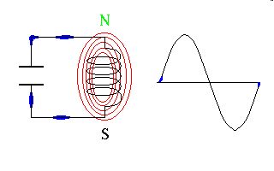
T6A06 - What type of electrical component stores energy in a magnetic field?
A. Varistor
B. Capacitor
C. Inductor
D. Diode

Slide 22
T6A07 - What electrical component is typically constructed of a coil of wire?
A. Switch
B. Capacitor
C. Diode
D. Inductor

Slide 23
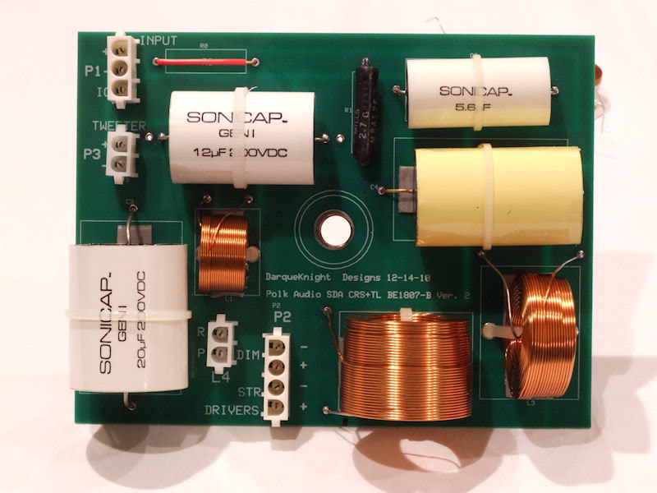
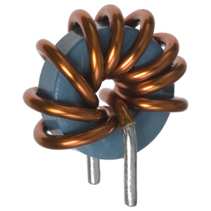
T6A07 - What electrical component is typically constructed of a coil of wire?
A. Switch
B. Capacitor
C. Diode
D. Inductor

Slide 24
T6A08 - What is the function of an SPDT switch?
A. A single circuit if opened or closed
B. Two circuits are opened or closed
C. A single circuit is switched between one of two other circuits
D. Two circuits are each switched between one of two other circuits

Slide 25
T6A08 - What is the function of an SPDT switch?
A. A single circuit if opened or closed
B. Two circuits are opened or closed
C. A single circuit is switched between one of two other circuits
D. Two circuits are each switched between one of two other circuits

Slide 26
T6A09 - What electrical component is used to protect other circuit components from current overloads?
A. Fuse
B. Thyrathon
C. Varactor
D. All of these choices are correct

Slide 27
T6A09 - What electrical component is used to protect other circuit components from current overloads?
A. Fuse
B. Thyrathon
C. Varactor
D. All of these choices are correct

Slide 28
T6A10 - Which of the following battery chemistries is rechargeable?
A. Nickel-metal hydride
B. Lithium-ion
C. Lead-acid gel-cell
D. All of these choices are correct

Slide 29
T6A10 - Which of the following battery chemistries is rechargeable?
A. Nickel-metal hydride
B. Lithium-ion
C. Lead-acid gel-cell
D. All of these choices are correct

Slide 30
T6A11 - Which of the following battery chemistries is not rechargeable?
A. Nickel-cadmium
B. Carbon-zinc
C. Lead-acid
D. Lithium-ion

Slide 31
T6A11 - Which of the following battery chemistries is not rechargeable?
A. Nickel-cadmium
B. Carbon-zinc
C. Lead-acid
D. Lithium-ion

Slide 32
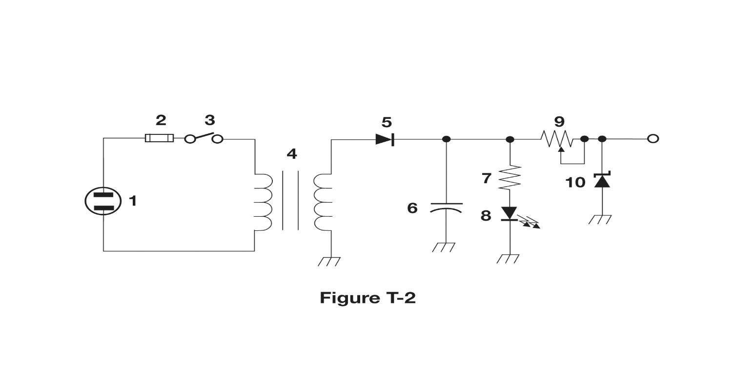
T6A12 – What type of switch is represented by component 3 in figure T-2?
A. Single-pole single-throw
B. Single-pole double-throw
C. Double-pole single-throw
D. Double-pole double-throw

Slide 33
T6A12 – What type of switch is represented by component 3 in figure T-2?
A. Single-pole single-throw
B. Single-pole double-throw
C. Double-pole single-throw
D. Double-pole double-throw

Slide 34
T6B – Semiconductors:
basic principles and applications of solid state devices; diodes and transistors

Slide 35
T6B01 - What is true about forward voltage drop in a diode?
A. It is lower in some diode types than is others
B. It is proportional to peak inverse voltage
C. It indicates that the diode is defective
D. It has no impact on the voltage delivered to the load

Slide 36
T6B01 - What is true about forward voltage drop in a diode?
A. It is lower in some diode types than is others
B. It is proportional to peak inverse voltage
C. It indicates that the diode is defective
D. It has no impact on the voltage delivered to the load

Slide 37
T6B02 - What electronic component allows current to flow in only one direction?
A. Resistor
B. Fuse
C. Diode
D. Driven Element

Slide 38
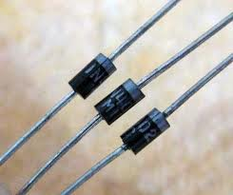
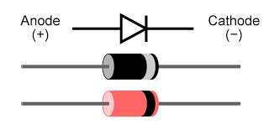
T6B02 - What electronic component allows current to flow in only one direction?
A. Resistor
B. Fuse
C. Diode
D. Driven Element

Slide 39
T6B03 - Which of these components can be used as an electronic switch or amplifier?
A. Varistor
B. Potentiometer
C. Transistor
D. Thermistor

Slide 40
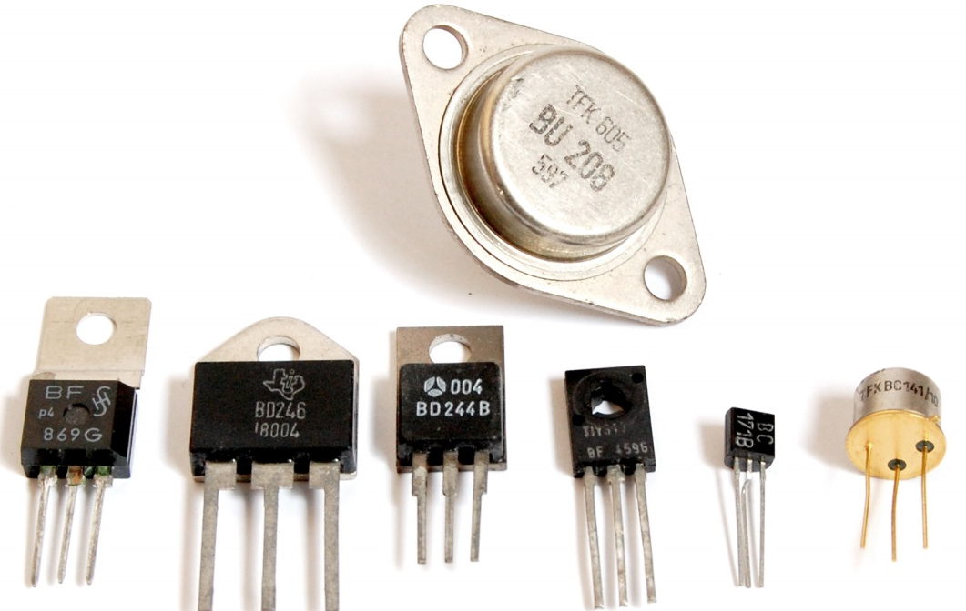
T6B03 - Which of these components can be used as an electronic switch or amplifier?
A. Varistor
B. Potentiometer
C. Transistor
D. Thermistor

Slide 41
T6B04 - Which of the following components can consist of three layers of semiconductor material?
A. Alternator
B. Transistor
C. Triode
D. Pentagrid converter

Slide 42
T6B04 - Which of the following components can consist of three layers of semiconductor material?
A. Alternator
B. Transistor
C. Triode
D. Pentagrid converter

Slide 43
T6B05 – What type of transistor has a gate, drain, and source?
A. Varistor
B. Field-effect
C. Telsa-effect
D. Bipolar junction

Slide 44
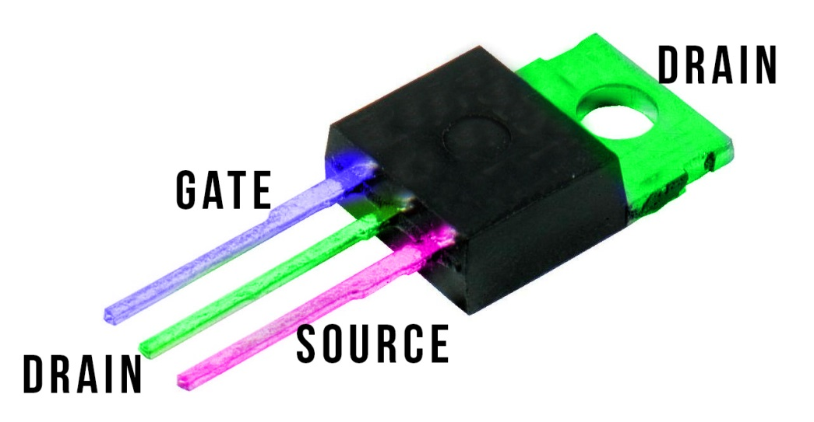
T6B05 – What type of transistor has a gate, drain, and source?
A. Varistor
B. Field-effect
C. Telsa-effect
D. Bipolar junction

Slide 45
T6B06 - How is the cathode lead of a semiconductor diode often marked on the package?
A. With the word cathode
B. With a stripe
C. With the letter C
D. With the letter K

Slide 46
T6B06 - How is the cathode lead of a semiconductor diode often marked on the package?
A. With the word cathode
B. With a stripe
C. With the letter C
D. With the letter K

Slide 47
T6B07 - What causes a light-emitting diode
( LED ) to omit light?
A. Forward current
B. Reverse current
C. Capacitively-coupled RF signal
D. Inductively-coupled RF signal

Slide 48
T6B07 - What causes a light-emitting diode
( LED ) to omit light?
A. Forward current
B. Reverse current
C. Capacitively-coupled RF signal
D. Inductively-coupled RF signal

Slide 49
T6B08 - What does the abbreviation FET stand for?
A. Frequency Emission Transmitter
B. Fast Electron Transistor
C. Free Electron Transition
D. Field Effect Transistor

Slide 50
T6B08 - What does the abbreviation FET stand for?
A. Frequency Emission Transmitter
B. Fast Electron Transistor
C. Free Electron Transition
D. Field Effect Transistor

Slide 51
T6B09 - What are the names of the electrodes of a diode?
A. Plus and minus
B. Source and drain
C. Anode and cathode
D. Gate and base

Slide 52

T6B09 - What are the names of the electrodes of a diode?
A. Plus and minus
B. Source and drain
C. Anode and cathode
D. Gate and base

Slide 53
T6B10 Which of the following can provide power gain?
A. Transformer
B. Transistor
C. Reactor
D. Resistor

Slide 54
T6B10 Which of the following can provide power gain?
A. Transformer
B. Transistor
C. Reactor
D. Resistor

Slide 55
T6B11 What is the term that describes a device's ability to amplify a signal?
A. Gain
B. Forward resistance
C. Forward voltage drop
D. On resistance

Slide 56
T6B11 What is the term that describes a device's ability to amplify a signal?
A. Gain
B. Forward resistance
C. Forward voltage drop
D. On resistance

Slide 57
T6B12 What are the names of the electrodes of a bipolar junction ttransistor?
A. Signal, bias, power
B. Emitter, base, collector
C. Input, output, supply
D. Pole one, pole two, output

Slide 58
T6B12 What are the names of the electrodes of a bipolar junction ttransistor?
A. Signal, bias, power
B. Emitter, base, collector
C. Input, output, supply
D. Pole one, pole two, output

Slide 59
T6C - Circuit diagrams; use of schematics, basic structure; Schematic symbols of basic components

Slide 60
Schematic Symbols
Resistor |  | Capacitor |  | SPST Switch
Variable Resistor |  | Lamp |  | LED
Transistor |  | Transformer |  | Antenna
Battery |  | Variable Inductor

Slide 61
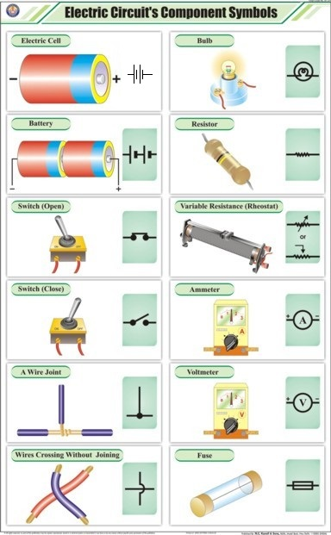
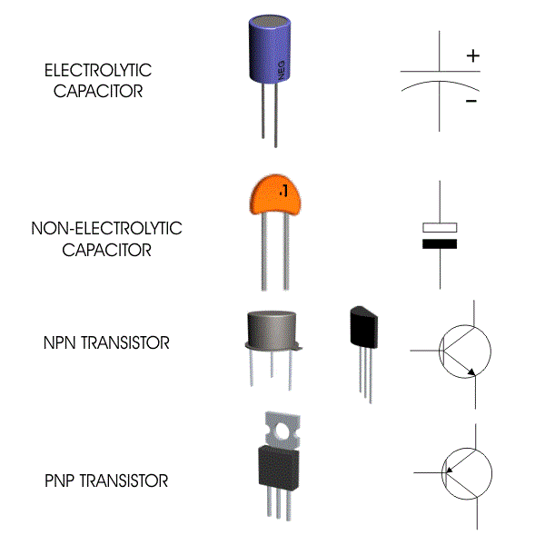
Other Circuit Information

Slide 62
T6C01 - What is the name of electrical wiring diagram that uses standard component symbols?
A. Bill of materials
B. Connector pinout
C. Schematic symbols
D. Low charts

Slide 63
T6C01 - What is the name of electrical wiring diagram that uses standard component symbols?
A. Bill of materials
B. Connector pinout
C. Schematic symbols
D. Low charts

Slide 64
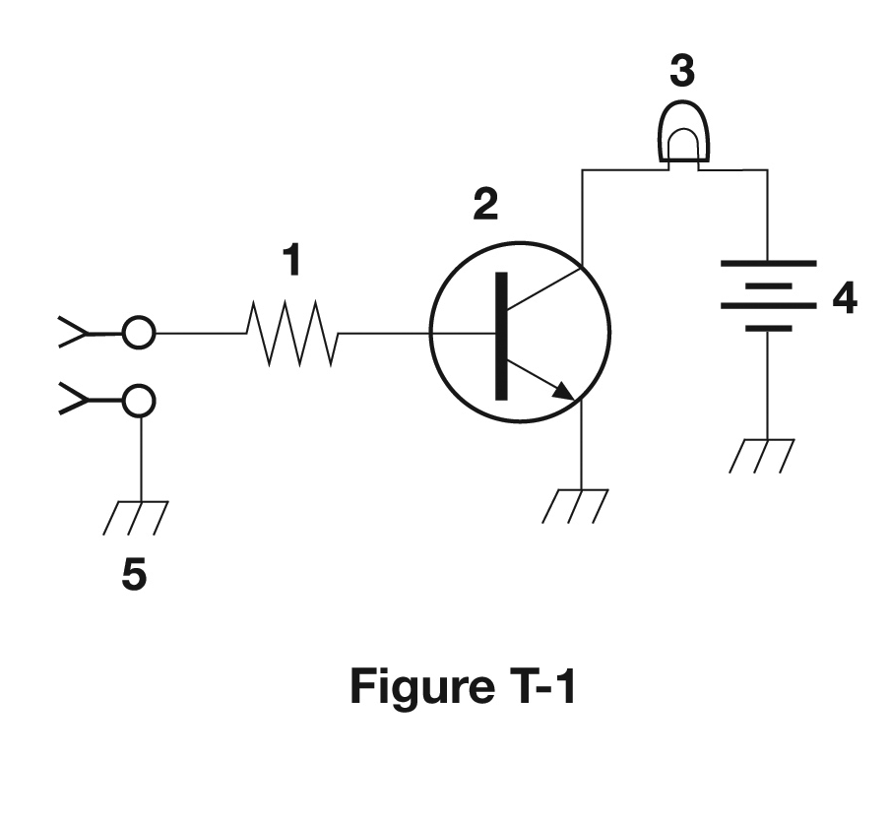
T6C02 - What is component 1 in figure T1?
A. Resistor
B. Transistor
C. Battery
D. Connector

Slide 65
T6C02 - What is component 1 in figure T1?
A. Resistor
B. Transistor
C. Battery
D. Connector

Slide 66
T6C03 - What is component 2 in figure T1?
A. Resistor
B. Transistor
C. Indicator lamp
D. Connector

Slide 67
T6C03 - What is component 2 in figure T1?
A. Resistor
B. Transistor
C. Indicator lamp
D. Connector

Slide 68
T6C04 - What is component 3 in figure T1?
A. Resistor
B. Transistor
C. Lamp
D. Ground symbol

Slide 69
T6C04 - What is component 3 in figure T1?
A. Resistor
B. Transistor
C. Lamp
D. Ground symbol

Slide 70
T6C05 - What is component 4 in figure T1?
A. Resistor
B. Transistor
C. Ground symbol
D. Battery

Slide 71
T6C05 - What is component 4 in figure T1?
A. Resistor
B. Transistor
C. Ground symbol
D. Battery

Slide 72

T6C06 - What is component 6 in figure T2?
A. Resistor
B. Capacitor
C. Regulator IC
D. Transistor

Slide 73
T6C06 - What is component 6 in figure T2?
A. Resistor
B. Capacitor
C. Regulator IC
D. Transistor

Slide 74
T6C07 - What is component 8 in figure T2?
A. Resistor
B. Inductor
C. Regulator IC
D. Light emitting diode

Slide 75
T6C07 - What is component 8 in figure T2?
A. Resistor
B. Inductor
C. Regulator IC
D. Light emitting diode

Slide 76
T6C08 - What is component 9 in figure T2?
A. Variable capacitor
B. Variable inductor
C. Variable resistor
D. Variable transformer

Slide 77
T6C08 - What is component 9 in figure T2?
A. Variable capacitor
B. Variable inductor
C. Variable resistor
D. Variable transformer

Slide 78
T6C09 - What is component 4 in figure T2?
A. Variable inductor
B. Double-pole switch
C. Potentiometer
D. Transformer

Slide 79
T6C09 - What is component 4 in figure T2?
A. Variable inductor
B. Double-pole switch
C. Potentiometer
D. Transformer

Slide 80
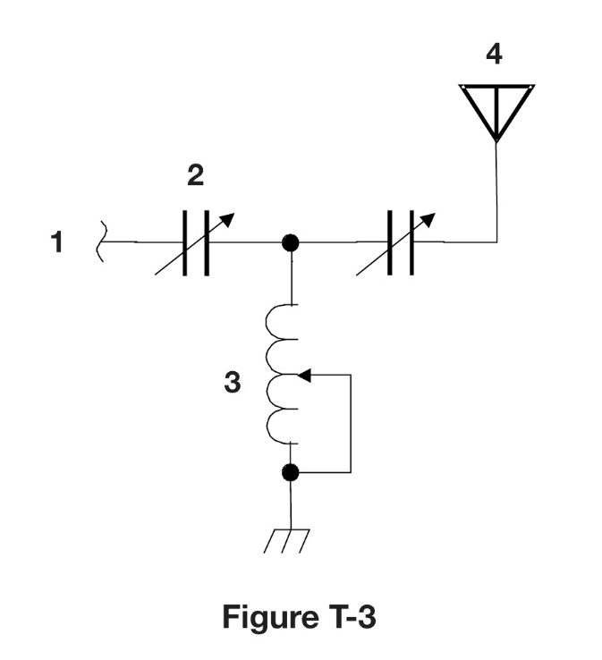
T6C10 - What is component 3 in figure T3?
A. Connector
B. Meter
C. Variable capacitor
D. Variable inductor

Slide 81
T6C10 - What is component 3 in figure T3?
A. Connector
B. Meter
C. Variable capacitor
D. Variable inductor

Slide 82
T6C11 - What is component 4 in figure T3?
A. Antenna
B. Transmitter
C. Dummy load
D. Ground

Slide 83
T6C11 - What is component 4 in figure T3?
A. Antenna
B. Transmitter
C. Dummy load
D. Ground

Slide 84
T6C12 – Which of the following is accurately represented in electrical schematics?
A. Wire lengths
B. Physical appearance of components
C. Component connections
D. All these choices are correct

Slide 85
T6C12 – Which of the following is accurately represented in electrical schematics?
A. Wire lengths
B. Physical appearance of components
C. Component connections
D. All these choices are correct

Slide 86
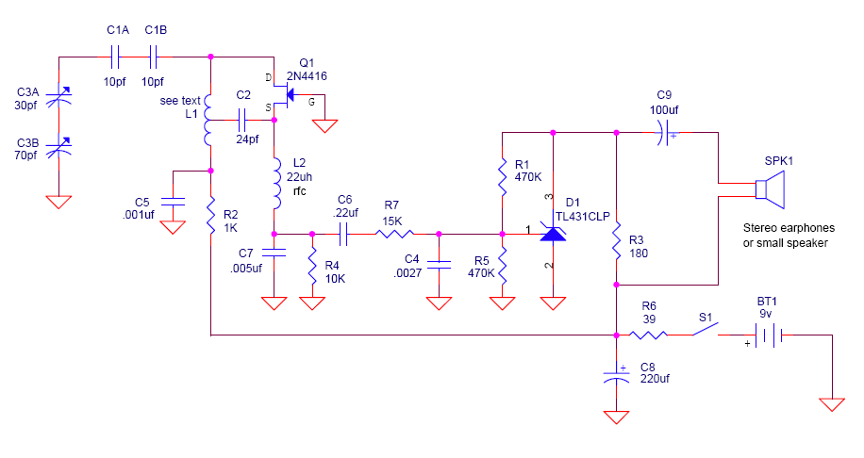
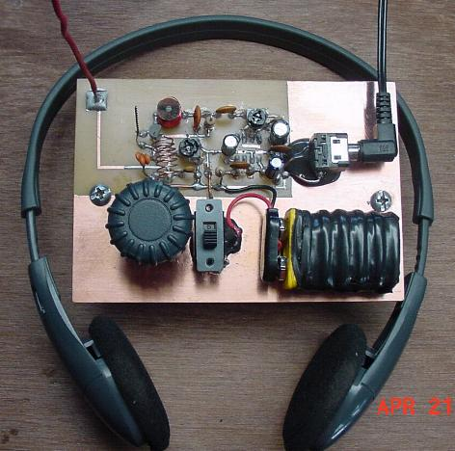
Simple AM radio

Slide 87
T6D - Component functions
rectifiers, relay, voltage regulators, meters, indicators, integrated circuits, transformers; Resonant circuit; Shielding

Slide 88
T6D01 - Which of the following devices or circuits changes an alternating current into a varying direct current signal?
A. Transformer
B. Rectifier
C. Amplifier
D. Reflector

Slide 89
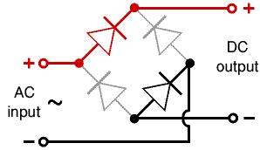
T6D01 - Which of the following devices or circuits changes an alternating current into a varying direct current signal?
A. Transformer
B. Rectifier
C. Amplifier
D. Reflector

Slide 90
T6D02 - What is a relay?
A. A electrically controlled switch
B. A current controlled amplifier
C. An inverting amplifier
D. A pass transistor

Slide 91
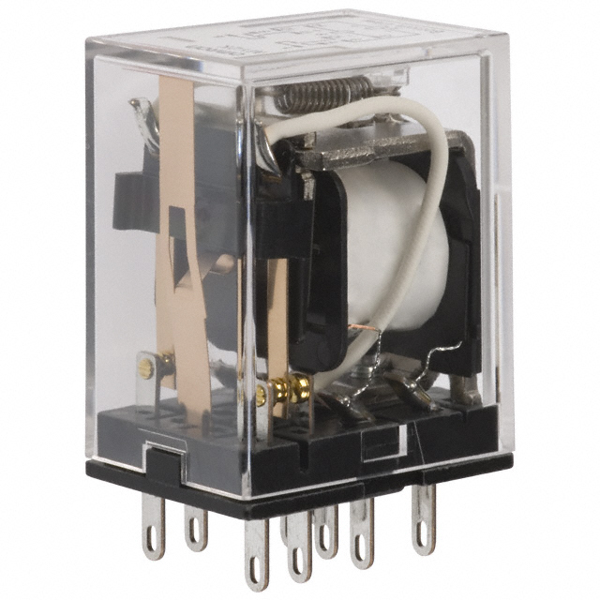
T6D02 - What is a relay?
A. A electrically controlled switch
B. A current controlled amplifier
C. An inverting ampofier
D. A pass transistor

Slide 92
T6D03 – Which of the following is a reason to use shielded wire?
A. To decrease the resistance of DC power connections
B. To increase the current carrying capability of the wire
C. To prevent coupling of unwanted signals to or from the wire
D. To couple the wire to other siognals

Slide 93
T6D03 – Which of the following is a reason to use shielded wire?
A. To decrease the resistance of DC power connections
B. To increase the current carrying capability of the wire
C. To prevent coupling of unwanted signals to or from the wire
D. To couple the wire to other siognals

Slide 94
T6D04 - Which of the following displays an electrical quantity as a numeric value?
A. Potentiometer
B. Transistor
C. Meter
D. Relay

Slide 95
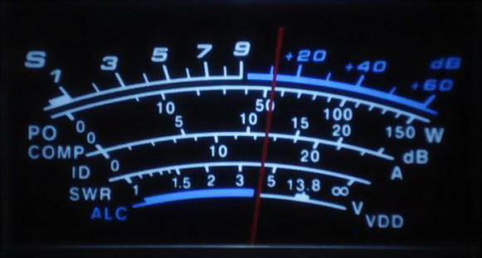
T6D04 - Which of the following displays an electrical quantity as a numeric value?
A. Potentiometer
B. Transistor
C. Meter
D. Relay

Slide 96
Receiver VU Meter

Slide 97
T6D05 - What type of circuit controls the amount of voltage from a power supply?
A. Regulator
B. Oscillator
C. Filter
D. Phase inverter

Slide 98
T6D05 - What type of circuit controls the amount of voltage from a power supply?
A. Regulator
B. Oscillator
C. Filter
D. Phase inverter

Slide 99
T6D06 - What component changes 120V AC power to a lower AC voltage for other uses?
A. Variable capacitor
B. Transformer
C. Transistor
D. Diode

Slide 100
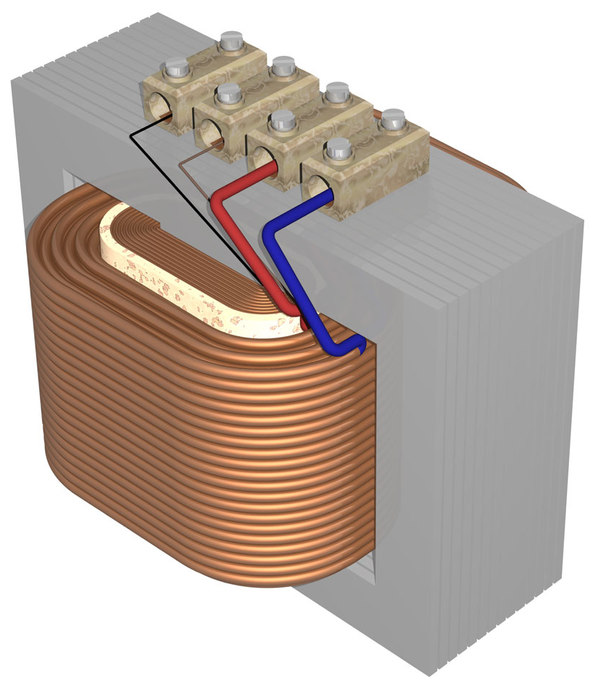
T6D06 - What component changes 120V AC power to a lower AC voltage for other uses?
A. Variable capacitor
B. Transformer
C. Transistor
D. Diode

Slide 101
T6D07 - Which of the following is commonly used as a visual indicator?
A. LED
B. FET
C. Zener diode
D. Bipolar transistor

Slide 102
T6D07 - Which of the following is commonly used as a visual indicator?
A. LED
B. FET
C. Zener diode
D. Bipolar transistor

Slide 103
T6D08 - Which of the following is combined with an inductor to make a tuned circuit?
A. Resistor
B. Zener diode
C. Potentiometer
D. Capacitor

Slide 104
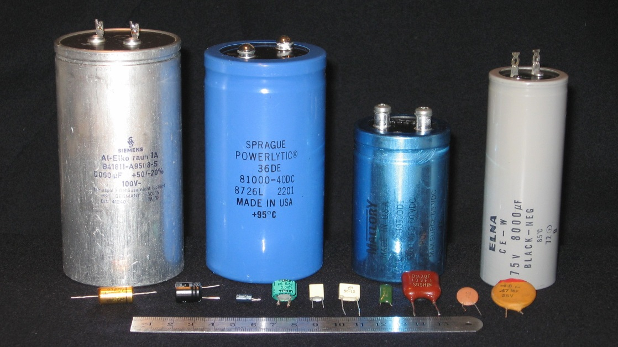
T6D08 - Which of the following is combined with an inductor to make a tuned circuit?
A. Resistor
B. Zener diode
C. Potentiometer
D. Capacitor

Slide 105
T6D09 - What is the name of a device that combines several semiconductors and other components into one package?
A. Transducer
B. Multi-pole relay
C. Integrated circuit
D. Transformer

Slide 106
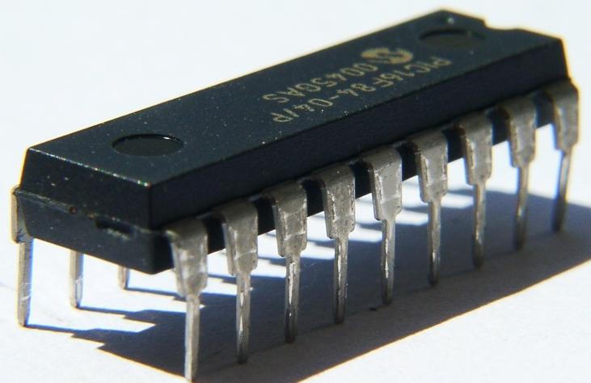
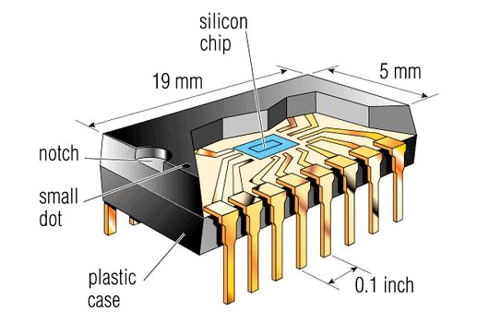
T6D09 - What is the name of a device that combines several semiconductors and other components into one package?
A. Transducer
B. Multi-pole relay
C. Integrated circuit
D. Transformer

Slide 107

T6D10 - What is the function of component 2 in Figure T1?
A. Give off light when current flows through it
B. Supply electrical energy
C. Control the flow of current
D. Convert electrical energy into radio waves

Slide 108
T6D10 - What is the function of component 2 in Figure T1?
A. Give off light when current flows through it
B. Supply electrical energy
C. Control the flow of current
D. Convert electrical energy into radio waves

Slide 109
T6D11 - What of the following is a resonant or tuned circuit?
A. An inductor and a capacitor in series or parallel
B. A type of voltage regulator
C. A resistor circuit used for reducing standing wave ratio
D. A circuit designed to provide high fidelity audio

Slide 110
T6D11 - What of the following is a resonant or tuned circuit?
A. An inductor and a capacitor in series or parallel
B. A type of voltage regulator
C. A resistor circuit used for reducing standing wave ratio
D. A circuit designed to provide high fidelity audio

Slide 111
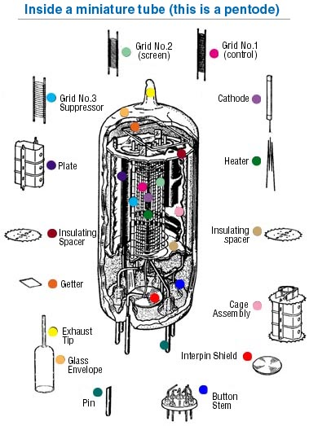
Vacuum Tubes
Tubes regulate current flow between cathode and plate with a control grid. Their size can also create unwanted capacitances. A screen grid can be added to reduce grid-to-plate capacitance.
Although still used in high power applications (large amplifiers), they have been largely replaced with transistors. The Field Effect Transistor (FET) has characteristics most similar to a tube.

Slide 112
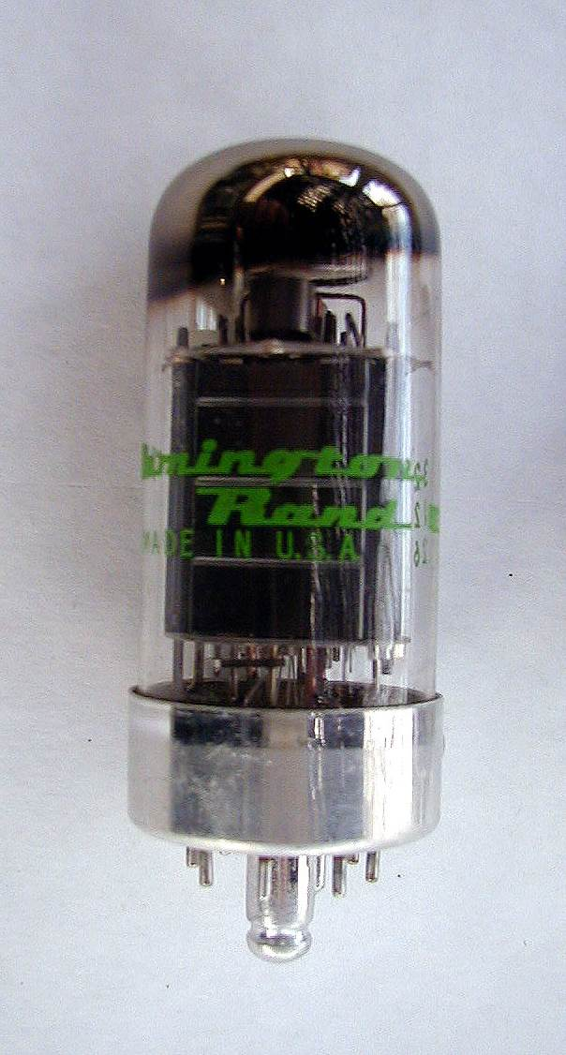
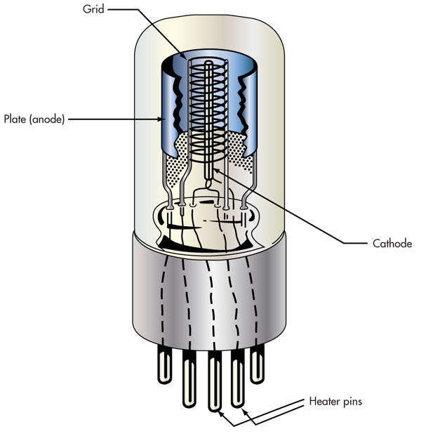
Vacuum Tubes

Slide 113
G6A07 Which of the following is a reason not to use wire-wound resistors in an RF circuit?
  A. The resistor's tolerance value would not be adequate for such a circuit
  B. The resistor's inductance could make circuit performance unpredictable
  C. The resistor could overheat
  D. The resistor's internal capacitance would detune the circuit

Slide 114
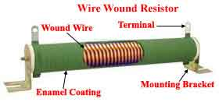
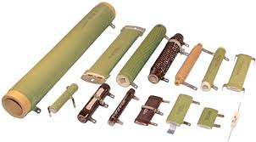
G6A07 Which of the following is a reason not to use wire-wound resistors in an RF circuit?
  A. The resistor's tolerance value would not be adequate for such a circuit
  B. The resistor's inductance could make circuit performance unpredictable
  C. The resistor could overheat
  D. The resistor's internal capacitance would detune the circuit

Slide 115
G6A08 Which of the following describes a thermistor?
  A. A resistor that is resistant to changes in value with temperature variations
  B. A device having a specific change in resistance with temperature variations
  C. A special type of transistor for use at very cold temperatures
  D. A capacitor that changes value with temperature

Slide 116
G6A08 Which of the following describes a thermistor?
  A. A resistor that is resistant to changes in value with temperature variations
  B. A device having a specific change in resistance with temperature variations
  C. A special type of transistor for use at very cold temperatures
  D. A capacitor that changes value with temperature

Slide 117
G6A11 Why would it be important to minimize the mutual inductance between two inductors?
  A. To increase the energy transfer between circuits
  B. To reduce unwanted coupling between circuits
  C. To reduce conducted emissions
  D. To increase the self-resonant frequency of the inductors

Slide 118

G6A11 Why would it be important to minimize the mutual inductance between two inductors?
  A. To increase the energy transfer between circuits
  B. To reduce unwanted coupling between circuits
  C. To reduce conducted emissions
  D. To increase the self-resonant frequency of the inductors

Slide 119
G6B02 What are two major ratings that must not be exceeded for silicon diode rectifiers?
  A. Peak inverse voltage; average forward current
  B. Average power; average voltage
  C. Capacitive reactance; avalanche voltage
  D. Peak load impedance; peak voltage

Slide 120
G6B02 What are two major ratings that must not be exceeded for silicon diode rectifiers?
  A. Peak inverse voltage; average forward current
  B. Average power; average voltage
  C. Capacitive reactance; avalanche voltage
  D. Peak load impedance; peak voltage

Slide 121






Connectors
DE-9 | Serial data | PL-259 | RF, Good to ~150MHz
DIN | Multiconductor audio/control | N | Waterproof RF, Good to ~10GHz
RCA | Audio/ Video | SMA | Small RF, Good to several GHz

Slide 122
End of
SUBELEMENT T6
Electrical components: semiconductors; circuit diagrams; component functions

