Slide 1
SUBELEMENT T7
Practical Circuits
[4 Exam Questions - 4 Groups]
Notes:
Subelement T7 Practical Circuits. Technician Training Slides for 2022 Question Pool Good through June 30, 2022 Assembled by Washington Ham Trainers, Daniel Stevens KL7WM, Howard Schultz, W7HS.

Slide 2
T7A – Station equipment: receivers; transceivers; transmitters amplifiers, receive amplifiers, transverters; Basic radio circuit concepts and terminology; sensitivity, selectivity, mixers, oscillators, PTT, modulations
T7B – Symtoms; causes and cures of common transmitter and receiver problems: overload and overdrive, distortion, interference and consumer electronics, RF feedback
T7C – Antenna and transmission line measurements and troubleshooting: measuring SWR, effects of high SWR, causes of feed ling failures; Basic coaxial cable characteristics; Use of dummy loads when testing
T7D – Using basic test instruments: voltmeter, ammeter, and ohmmeter; Soldering

Slide 3
Receiver Technology
Current receivers are largely superheterodyne
Superheterodyne receivers convert the receive frequency to lower Intermediate Frequencies (IF) to allow filtering
Multiple conversions makes a more selective receiver
The final stage includes a Detector that extracts the audio from the modulated carrier
A CW/SSB detector is called a Product Detector
An FM detector is called a Discriminator

Slide 4
T7A01 - Which term describes the ability of a receiver to detect the presence of a signal?
A. Linearity
B. Sensitivity
C. Selectivity
D. Total Harmonic Distortion

Slide 5
T7A01 - Which term describes the ability of a receiver to detect the presence of a signal?
A. Linearity
B. Sensitivity
C. Selectivity
D. Total Harmonic Distortion

Slide 6
T7A02 - What is a transceiver?
A. A device that combines a receiver and transmitter
B. A device for matching feed line impedance to 50 ohms
C. A device for automatically sending and decoding Morse code
D. A device for converting receiver and transmitter frequencies to another band

Slide 7
T7A02 - What is a transceiver?
A. A device that combines a receiver and transmitter
B. A device for matching feed line impedance to 50 ohms
C. A device for automatically sending and decoding Morse code
D. A device for converting receiver and transmitter frequencies to another band

Slide 8
T7A03 - Which of the following is used to convert a radio signal from one frequency to another?
A. Phase splitter
B. Mixer
C. Inverter
D. Amplifier

Slide 9
T7A03 - Which of the following is used to convert a radio signal from one frequency to another?
A. Phase splitter
B. Mixer
C. Inverter
D. Amplifier

Slide 10
T7A04 - Which term describes the ability of a receiver to discriminate between multiple signals?
A. Discrimination ratio
B. Sensitivity
C. Selectivity
D. Harmonic Distortion

Slide 11
T7A04 - Which term describes the ability of a receiver to discriminate between multiple signals?
A. Discrimination ratio
B. Sensitivity
C. Selectivity
D. Harmonic Distortion

Slide 12
T7A05 - What is the name of a circuit that generates a signal of a specific frequency?
A. Reactance modulator
B. Product detector
C. Low-pass filter
D. Oscillator

Slide 13
T7A05 - What is the name of a circuit that generates a signal of a specific frequency?
A. Reactance modulator
B. Product detector
C. Low-pass filter
D. Oscillator

Slide 14
T7A06 - What device converts the RF input and output of a transceiver to another band?
A. High-pass filter
B. Low-pass filter
C. Transverter
D. Phase converter

Slide 15
T7A06 - What device converts the RF input and output of a transceiver to another band?
A. High-pass filter
B. Low-pass filter
C. Transverter
D. Phase converter

Slide 16
T7A07 - What is the function of a transceiver’s “PTT” input?
A. Input for a key used to send CW
B. Switches transceiver from receive to transmit when grounded
Provides a transit tuning tone when grounded
Input for a preamplifier tuning tone

Slide 17
T7A07 - What is the function of a transceiver’s “PTT” input?
A. Input for a key used to send CW
B. Switches transceiver from receive to transmit when grounded
Provides a transit tuning tone when grounded
Input for a preamplifier tuning tone

Slide 18
T7A08 - Which of the following describes combining speech with an RF carrier signal?-
A. Impedance matching
B. Oscillation
C. Modulation
D. Low-pass filtering

Slide 19
T7A08 - Which of the following describes combining speech with an RF carrier signal?-
A. Impedance matching
B. Oscillation
C. Modulation
D. Low-pass filtering

Slide 20
T7A09 – What is the function of the SSB/CW – FM switch on a VHF power amplifier?
Change the mode of the transmitted signal
Set the amplifier for proper operation in the selected mode
Change the frequency range of the amplifier to operate in the proper segment of the band
Reduce the received signal noise

Slide 21
T7A09 – What is the function of the SSB/CW – FM switch on a VHF power amplifier?
Change the mode of the transmitted signal
Set the amplifier for proper operation in the selected mode
Change the frequency range of the amplifier to operate in the proper segment of the band
Reduce the received signal noise

Slide 22
T7A10 - What device increases the transmitted output power from a transceiver?
A. A voltage divider
B. An RF power amplifier
C. An impedance network
D. All of these choices are correct

Slide 23
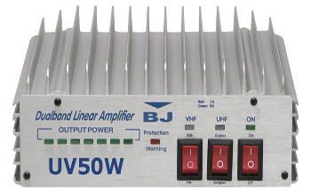
T7A10 - What device increases the transmitted output power from a transceiver?
A. A voltage divider
B. An RF power amplifier
C. An impedance network
D. All of these choices are correct

Slide 24
T7A11 - Where is an RF preamplifier installed?
A. Between the antenna and receiver
B. At the output of the transmitter's power amplifier
C. Between a transmitter and antenna tuner
D. At the output of the receiver audio ampplifier

Slide 25
T7A11 - Where is an RF preamplifier installed?
A. Between the antenna and receiver
B. At the output of the transmitter's power amplifier
C. Between a transmitter and antenna tuner
D. At the output of the receiver audio ampifier

Slide 26
T7B – Symptoms:
causes and cures of common transmitter and receiver problems: overload and overdrive, distortion, interference and consumer electronics, RF feedback

Slide 27
T7B01 - What can you do if you are told your FM handheld or mobile transceiver is over-deviating?
A. Talk louder into the microphone
B. Let the transceiver cool off
C. Change to a higher power level
D. Talk farther away from the microphone

Slide 28
T7B01 - What can you do if you are told your FM handheld or mobile transceiver is over-deviating?
A. Talk louder into the microphone
B. Let the transceiver cool off
C. Change to a higher power level
D. Talk farther away from the microphone

Slide 29
T7B02 - What would cause a broadcast AM or FM radio to receive an amateur radio transmission unintentionally?
A. The receiver is unable to reject strong signals outside the AM or FM band
B. The microphone gain of the transmitter is turned up too high
C. The audio amplifier of the transmitter is overloaded
D. The deviation of an FM transmitter is set too low

Slide 30
T7B02 - What would cause a broadcast AM or FM radio to receive an amateur radio transmission unintentionally?
A. The receiver is unable to reject strong signals outside the AM or FM band
B. The microphone gain of the transmitter is turned up too high
C. The audio amplifier of the transmitter is overloaded
D. The deviation of an FM transmitter is set too low

Slide 31
T7B03 - Which of the following may be a cause of radio frequency interference?
A. Fundamental overload
B. Harmonics
C. Spurious emissions
D. All of these choices are correct

Slide 32
T7B03 - Which of the following may be a cause of radio frequency interference?
A. Fundamental overload
B. Harmonics
C. Spurious emissions
D. All of these choices are correct

Slide 33
T7B04 - Which of the following could you use to cure distorted audio caused by RF current on the shield of a microphone cable?
A. Band-pass filter
B. Low-pass filter
C. Preamplifier
D. Ferrite choke

Slide 34
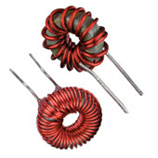
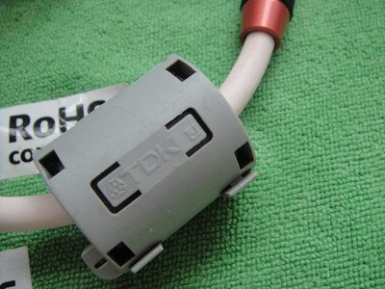
T7B04 - Which of the following could you use to cure distorted audio caused by RF current on the shield of a microphone cable?
A. Band-pass filter
B. Low-pass filter
C. Preamplifier
D. Ferrite choke

Slide 35
T7B05 - How can fundamental overload of a non-amateur radio or TV receiver by an amateur signal be reduced or eliminated?
A. Block the amateur signal with a filter at the antenna input of the affected receiver
B. Block the interfering signal with a filter on the amateur transmitter
C. Switch the transmitter from FM to SSB
D. Switch the transmitter to a narrow-band mode

Slide 36
T7B05 - How can fundamental overload of a non-amateur radio or TV receiver by an amateur signal be reduced or eliminated?
A. Block the amateur signal with a filter at the antenna input of the affected receiver
B. Block the interfering signal with a filter on the amateur transmitter
C. Switch the transmitter from FM to SSB
D. Switch the transmitter to a narrow-band mode

Slide 37
T7B06 - Which of the following actions should you take if a neighbor tells you that your station’s transmissions are interfering with their radio or TV reception?
A. Make sure that your station is functioning properly and that it does not cause interference to your own radio or television when it is tuned to the same channel
B. Immediately turn off your transmitter and contact the nearest FCC office for assistance
C. Install a harmonic doubler on the output of your transmitter and tune it until the interference is eliminated
D. All these choices are correct

Slide 38
T7B06 - Which of the following actions should you take if a neighbor tells you that your station’s transmissions are interfering with their radio or TV reception?
A. Make sure that your station is functioning properly and that it does not cause interference to your own radio or television when it is tuned to the same channel
B. Immediately turn off your transmitter and contact the nearest FCC office for assistance
C. Install a harmonic doubler on the output of your transmitter and tune it until the interference is eliminated
D. All these choices are correct

Slide 39
T7B07 - Which of the following can reduce overload of a VHF transceiver by a nearby FM broadcast station?
Installing an RF preamplifier
Using double-shielded coaxial cable
Installing bypass capacitors on the microphone cable
Installing a band-reject filter

Slide 40
T7B07 - Which of the following can reduce overload of a VHF transceiver by a nearby FM broadcast station?
Installing an RF preamplifier
Using double-shielded coaxial cable
Installing bypass capacitors on the microphone cable
Installing a band-reject filter

Slide 41
T7B08 - What should you do if something in a neighbor’s home is causing harmful interference to your amateur station?
A. Work with your neighbor to identify the offending device
B. Politely inform your neighbor that FCC rules prohibit the use of devices that cause interference
C. Make sure your station meets the standards of good amateur practice
D. All of these choices are correct

Slide 42
T7B08 - What should you do if something in a neighbor’s home is causing harmful interference to your amateur station?
A. Work with your neighbor to identify the offending device
B. Politely inform your neighbor that FCC rules prohibit the use of devices that cause interference
C. Make sure your station meets the standards of good amateur practice
D. All of these choices are correct

Slide 43
T7B09 – What should be the first step to resolve non-fiber optic cable TV interference caused by your amateur radio transmission?
A. Add a low-pass filter to the TV antenna input
B. Add a high-pass filter to the TV antenna input
C. Add a preamplifier to the TV antenna input
D. Be sure all TV feed line coaxial connectors are installed properly

Slide 44
T7B09 – What should be the first step to resolve non-fiber optic cable TV interference caused by your amateur radio transmission?
A. Add a low-pass filter to the TV antenna input
B. Add a high-pass filter to the TV antenna input
C. Add a preamplifier to the TV antenna input
D. Be sure all TV feed line coaxial connectors are installed properly

Slide 45
T7B10 - What might be the problem if you receive a report that your audio signal through an FM repeater is distorted or unintelligible?
A. Your transmitter may be slightly off frequency
B. Your batteries are running low
C. You could be in a bad location
D. All of these choices are correct

Slide 46
T7B10 - What might be the problem if you receive a report that your audio signal through an FM repeater is distorted or unintelligible?
A. Your transmitter may be slightly off frequency
B. Your batteries are running low
C. You could be in a bad location
D. All of these choices are correct

Slide 47
T7B11 - What is a symptom of RF feedback in a transmitter or transceiver?
A. Excessive SWR at the antenna connection
B. The transmitter will not stay on the desired frequency
C. Reports of garbled, distorted, or unintelligible transmissions
D. Frequent blowing of power supply fuses

Slide 48
T7B11 - What is a symptom of RF feedback in a transmitter or transceiver?
A. Excessive SWR at the antenna connection
B. The transmitter will not stay on the desired frequency
C. Reports of garbled, distorted, or unintelligible transmissions
D. Frequent blowing of power supply fuses

Slide 49
T7C – Antenna and transmissions line measurements and troubleshooting
measuring SWR, effects of high SWR, causes of feed line failures; Basic coaxial cable characteristics; Use of dummy loads when testing

Slide 50
Feedlines
Feedlines carry RF signals from the radio to the antenna
Common feedlines are coax, twin lead, ladder or window line
The longer the feedline, the more loss that occurs
Larger feedlines generally have less loss
Loss is caused by RF energy being converted to heat
Feedline impedance must match the radio and antenna for maximum power transfer
Air dielectric in coax is low loss but may allow water entry
Ultraviolet light degrades insulation which may crack and allow water entry
Corrosion from water exposure is the #1 coax killer

Slide 51
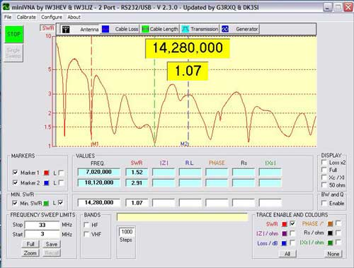
Antenna Analyzer and SWR
Antenna analyzers can be used to verify antenna impedance (match).
A perfect SWR of 1:1 is ideal but anything less than 2:1 is OK and over 3:1 the antenna should be checked.
SWR is not a performance measurement
Dummy loads are perfect at 1:1 but don’t transmit

Slide 52
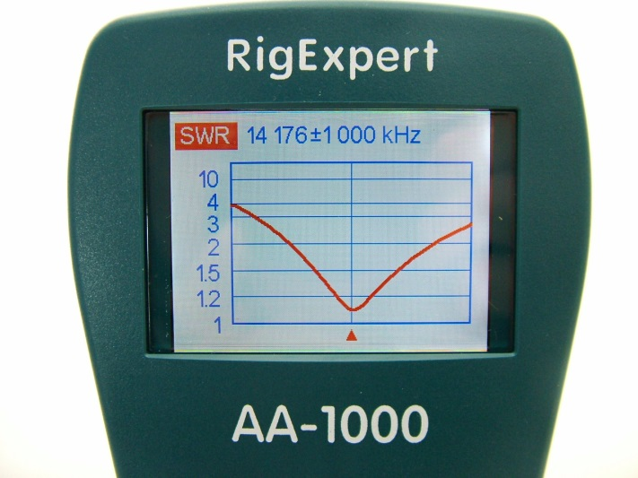
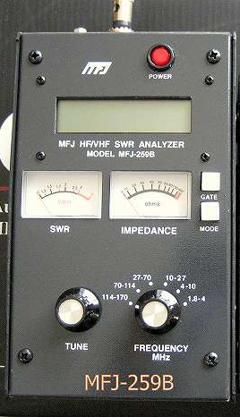
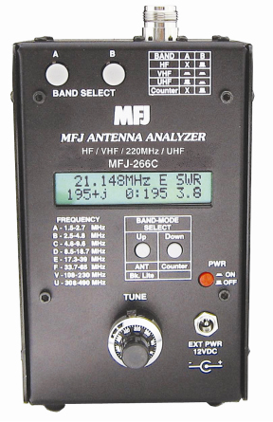
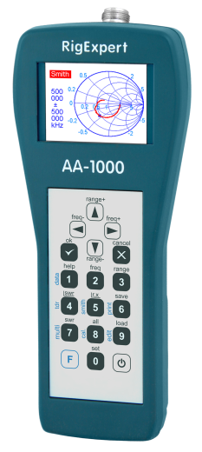
Antenna and SWR Analyzers

Slide 53
T7C01 - What is the primary purpose of a dummy load?
A. To prevent transmitting signa;ls over the air when making test
B. To prevent over-modulation of your transmitter
C. To improve the efficiency of an antenna
D. To improve the signal to noise ratio of your receiver

Slide 54
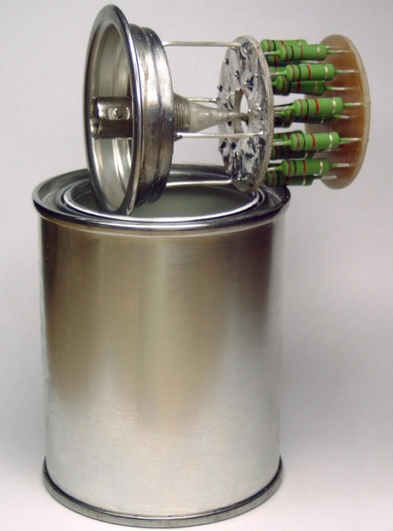
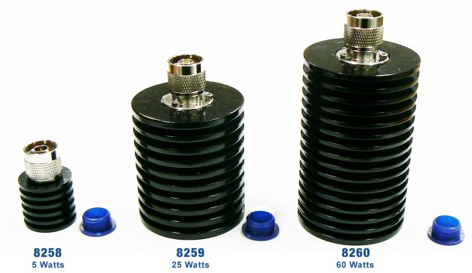
T7C01 - What is the primary purpose of a dummy load?
A. To prevent transmitting signals over the air when making test
B. To prevent over-modulation of your transmitter
C. To improve the efficiency of an antenna
D. To improve the signal to noise ratio of your receiver

Slide 55
T7C02 - Which of the following is used to determine if an antenna is resonant at the desired operating frequency?
A. A VTVM
B. An antenna analyzer
C. A Q meter
D. A frequency counter

Slide 56
T7C02 - Which of the following is used to determine if an antenna is resonant at the desired operating frequency?
A. A VTVM
B. An antenna analyzer
C. A Q meter
D. A frequency counter

Slide 57
T7C03 – What does a dummy load consist of?
A. A high-gain amplifier and a TR switch
B. A non-inductive resistor mounted on a heat sink
A low-voltage power supply and a DC relay
A 50-ohm reactance used t terminate a transmission line

Slide 58

T7C03 – What does a dummy load consist of?
A. A high-gain amplifier and a TR switch
B. A non-inductive resistor mounted on a heat sink
A low-voltage power supply and a DC relay
A 50-ohm reactance used t terminate a transmission line

Slide 59
T7C04 - What reading on an SWR meter indicates a perfect impedance match between the antenna and the feed line?
A. 50:50
B. Zero
C. 1 to 1
D. Full Scale

Slide 60
T7C04 - What reading on an SWR meter indicates a perfect impedance match between the antenna and the feed line?
A. 50:50
B. Zero
C. 1 to 1
D. Full Scale

Slide 61
T7C05 – Why do most solid-state transmitters reduce output power as SWR increases beyond a certain level?
To protect the output amplifier transistors
To comply with FCC rules on spectral purity
Because power supplies cannot supply enough current at high SWR
To lower the SWR on the transmission line

Slide 62
T7C05 – Why do most solid-state transmitters reduce output power as SWR increases beyond a certain level?
To protect the output amplifier transistors
To comply with FCC rules on spectral purity
Because power supplies cannot supply enough current at high SWR
To lower the SWR on the transmission line

Slide 63
T7C06 - What does an SWR reading of 4:1 indicate?
A. Loss of -4dB
B. Good impedance match
C. Gain of +4dB
D. Impedance mismatch

Slide 64
T7C06 - What does an SWR reading of 4:1 indicate?
A. Loss of -4dB
B. Good impedance match
C. Gain of +4dB
D. Impedance mismatch

Slide 65
T7C07 - What happens to power lost in a feed line?
A. It increases the SWR
B. It is radiated as harmonics
C. It is converted into heat
D. It distorts the signal

Slide 66
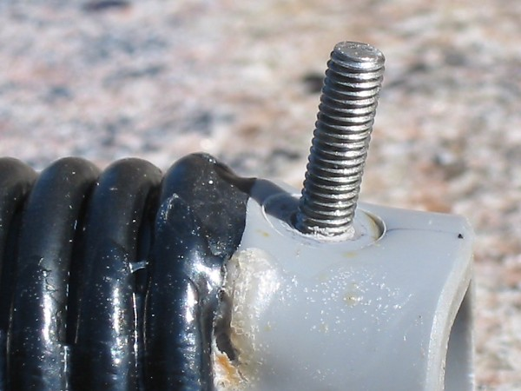
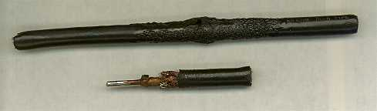
T7C07 - What happens to power lost in a feed line?
A. It increases the SWR
B. It is radiated as harmonics
C. It is converted into heat
D. It distorts the signal

Slide 67
T7C08 - What instrument can be use to determine SWR?
A. Voltmeter
B. Ohmmeter
C. Iambic pentameter
D. Directional wattmeter

Slide 68
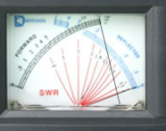
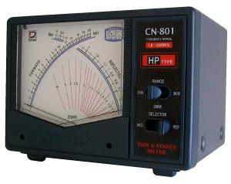
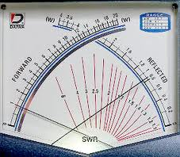
T7C08 - What instrument can be use to determine SWR?
A. Voltmeter
B. Ohmmeter
C. Iambic pentameter
D. Directional wattmeter
Notes:
Note: The upper right meter shows a good low SWR. The forward power needle (right one) is full scale and pointig to 11:30. The Reflected power needle is resting on the 0 Wattage line. This SWR is read where the needles cross, or on the 1 to 1 line.
The lower center meter shows high SWR. Forward power needle is on 1 and the Reverse power needle is by the 0.6 point These needles cross by the 5 to 1 line, which is high SWR.

Slide 69
T7C09 - Which of the following causes failure of coaxial cables?
A. Moisture contamination
Solder flux contamination
Rapid fluctuation in the transmitter output power
D. Operation at 100% duty cycle for an extended period

Slide 70
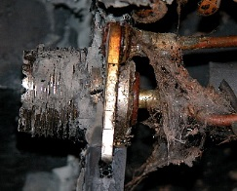
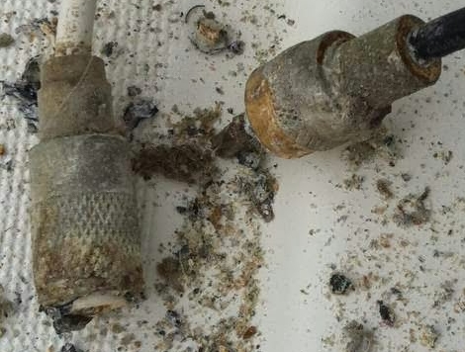
T7C09 - Which of the following causes failure of coaxial cables?
A. Moisture contamination
Solder flux contamination
Rapid fluctuation in the transmitter output power
D. Operation at 100% duty cycle for an extended period

Slide 71
T7C10 - Why should the outer jacket of coaxial cable be resistant to ultraviolet light?
A. Ultraviolet resistant jackets prevent harmonic radiation
B. Ultraviolet light can increase losses in the cable’s jacket
C. Ultraviolet and RF signals can mix, causing interference
D. Ultraviolet light can damage the jacket and allow water to enter the cable

Slide 72
T7C10 - Why should the outer jacket of coaxial cable be resistant to ultraviolet light?
A. Ultraviolet resistant jackets prevent harmonic radiation
B. Ultraviolet light can increase losses in the cable’s jacket
C. Ultraviolet and RF signals can mix, causing interference
D. Ultraviolet light can damage the jacket and allow water to enter the cable

Slide 73
T7C11 - What is a disadvantage of air core coaxial cable when compared to foam or solid dielectric types?
A. It has more loss per foot
B. It cannot be used for VHF or UHF antennas
C. It requires special techniques to prevent water absorption
D. It cannot be used at below freezing temperatures

Slide 74
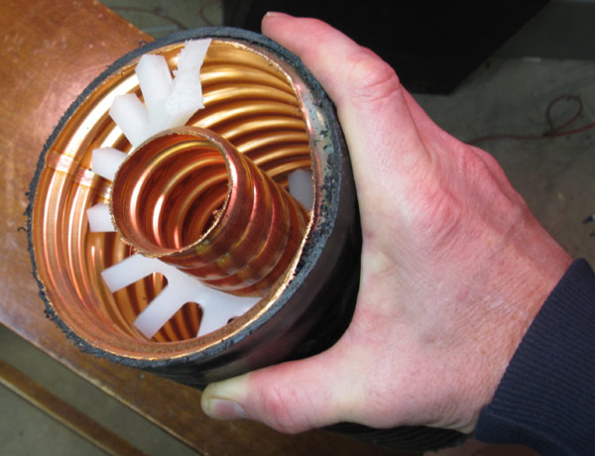
T7C11 - What is a disadvantage of air core coaxial cable when compared to foam or solid dielectric types?
A. It has more loss per foot
B. It cannot be used for VHF or UHF antennas
C. It requires special techniques to prevent water absorption
D. It cannot be used at below freezing temperatures

Slide 75
T7D – Using basic test instruments
Voltmeters ammeter, and ohmmeter; Soldering

Slide 76
T7D01 - Which instrument would you use to measure electric potential?
A. An ammeter
B. A voltmeter
C. A wavemeter
D. An ohmmeter

Slide 77
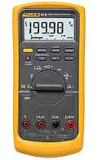
T7D01 - Which instrument would you use to measure electric potential?
A. An ammeter
B. A voltmeter
C. A wavemeter
D. An ohmmeter

Slide 78
T7D02 - How is a voltmeter connected to a component to measure applied voltage?
A. In series
B. In parallel
C. In quadrature
D. In phase

Slide 79
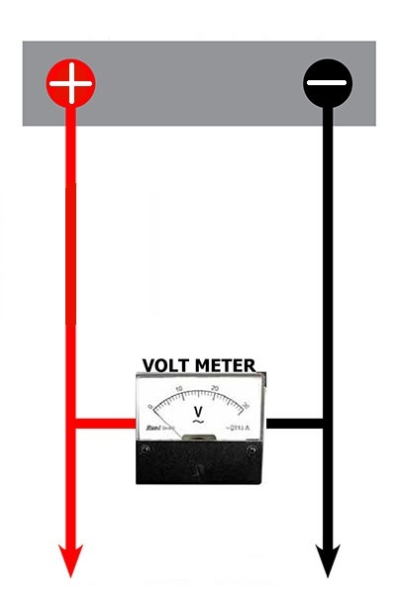
T7D02 - How is a voltmeter connected to a component to measure applied voltage?
A. In series
B. In parallel
C. In quadrature
D. In phase

Slide 80
T7D03 – When configured to measure current, how is a multimeter connected to a component?
A. In series
B. In parallel
C. In quadrature
D. In phase

Slide 81
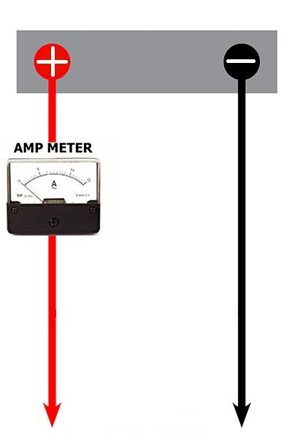
T7D03 – When configured to measure current, how is a multimeter connected to a component?
A. In series
B. In parallel
C. In quadrature
D. In phase

Slide 82
T7D04 - Which instrument is used to measure electric current?
A. An ohmmeter
B. A electrometer
C. A voltmeter
D. An ammeter

Slide 83
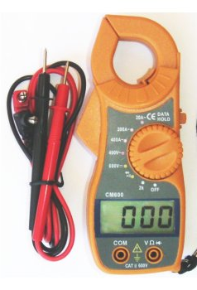
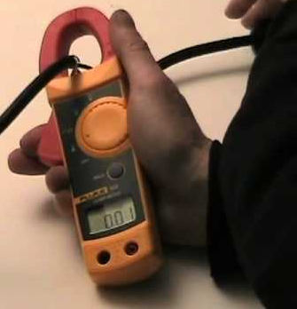
T7D04 - Which instrument is used to measure electric current?
A. An ohmmeter
B. A electrometer
C. A voltmeter
D. An ammeter

Slide 84
T7D06 - Which of the following can damage a multimeter?
A. Attempting to measure resistance using the voltage setting
B. Failing to connect one of the probes to ground
C. Attempting to measure voltage when using the resistance setting
D. Not allowing it to warm up properly

Slide 85
T7D06 - Which of the following can damage a multimeter?
A. Attempting to measure resistance using the voltage setting
B. Failing to connect one of the probes to ground
C. Attempting to measure voltage when using the resistance setting
D. Not allowing it to warm up properly

Slide 86
T7D07 - Which of the following measurements are made using a multimeter?
A. Signal strength and noise
B. Impedance and reactance
C. Voltage and resistance
D. All these choices are correct

Slide 87
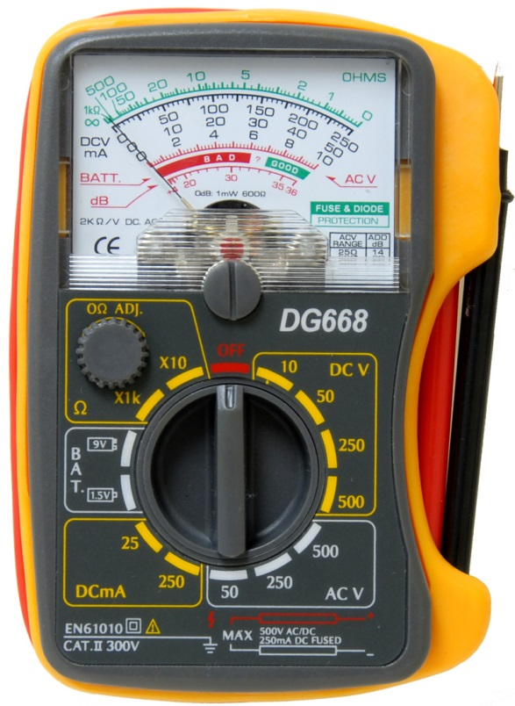
T7D07 - Which of the following measurements are made using a multimeter?
A. Signal strength and noise
B. Impedance and reactance
C. Voltage and resistance
D. All these choices are correct

Slide 88
T7D08 - Which of the following types of solder should not be used for radio and electronic applications?
A. Acid-core solder
B. Lead-tin solder
C. Rosin-core solder
D. Tin-copper solder

Slide 89
T7D08 - Which of the following types of solder should not be used for radio and electronic applications?
A. Acid-core solder
B. Lead-tin solder
C. Rosin-core solder
D. Tin-copper solder

Slide 90
T7D09 - What is the characteristic appearance of a cold tin-lead solder joint?
A. Dark black spots
B. A bright or shiny surface
C. A rough or lumpy surface
D. Excessive solder

Slide 91
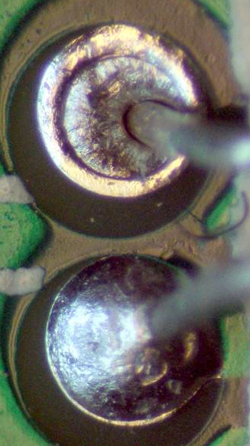
T7D09 - What is the characteristic appearance of a cold tin-lead solder joint?
A. Dark black spots
B. A bright or shiny surface
C. A rough or lumpy surface
D. Excessive solder

Slide 92
T7D10 - What reading indicates that an ohmmeter is connected across a large, discharged capacitor?
A. Increasing resistance with time
B. Decreasing resistance with time
C. Steady full-scale reading
D. Alternating between open and short circuit

Slide 93
T7D10 - What reading indicates that an ohmmeter is connected across a large, discharged capacitor?
A. Increasing resistance with time
B. Decreasing resistance with time
C. Steady full-scale reading
D. Alternating between open and short circuit

Slide 94
T7D11 - Which of the following precautions should be taken when measuring in-circuit resistance with an ohmmeter?
A. Ensure that the applied voltages are correct
B. Ensure that the circuit is not powered
C. Ensure that the circuit is grounded
D. Ensure that the circuit is operating at the correct frequency

Slide 95
T7D11 - Which of the following precautions should be taken when measuring in-circuit resistance with an ohmmeter?
A. Ensure that the applied voltages are correct
B. Ensure that the circuit is not powered
C. Ensure that the circuit is grounded
D. Ensure that the circuit is operating at the correct frequency

Slide 96
End of
SUBELEMENT T7
Station equipment: common transmitter and receiver problems; antenna measurements; troubleshooting; basic repair and testing

