Slide 1
SUBELEMENT T8
Signals and Emissions
[4 Exam Questions - 4 Groups]
Notes:
Subelement T8 Signals and Emissions. Technician Training Slides for 2022 Question Pool Good through June 30, 2026 Assembled by Washington Ham Trainers, Daniel Stevens KL7WM, Howard Schultz, W7HS.

Slide 2
T8A – Basic characteristic of FM and SB: bandwidth of various modulation modes; CW, SSB, FM, fast-scan TV; Choice of emission type: selection of USB vs LSB, use of SSB for weak signal work, use of FM for VHF packet and repeaters
T8B - Amateur satellite operation: Doppler shift, basic orbits, operating protocols; modulation mode selection, transmitter power considerations, telemetry and telecommand, satellite tracking programs, beacons, uplink and downlink mode definitions, spin fading, definition of “LEO”, setting uplink powers
T8C – Operating activities: radio direction finding;,contests, linking over the internet, exchanging grid locators
T8D – Non-voice communications: image signals and definition of NTSC, CW, packet radio, PSK, APRS, error-detection and correction, amateur radio networking, Digital Mobile Radio, WSJT modes, Broadband-Hamnet

Slide 3
Sample Emission Modes
Mode | Type | Bandwidth | Content
CW | Telegraphy | 10 Hz | Text Data
SSB | Telephony | 2800 Hz | Voice
AM | Telephony | 6 kHz | Voice
FM | Telephony | 5-15 kHz | Voice
SSTV / Fax | Image | 2800 Hz | Image
ATV | Image | 6 MHz | Image
PSK31 | Data | 31 Hz | Text Data
RTTY | Data | 250 Hz | Text Data
Pactor (I, II, III) | Data | 500-2800 Hz | Binary Data
AX.25 Packet | Data | 10-20 kHz | Binary Data

Slide 4
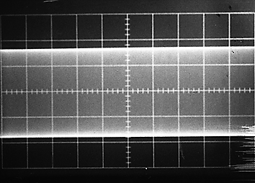
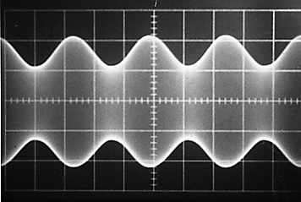
Amplitude Modulation
An unmodulated RF
carrier wave
A carrier wave amplitude
modulated (AM) with a simple audio tone
Notes:
Note the identical sidebands. They peak and dip together.

Slide 5
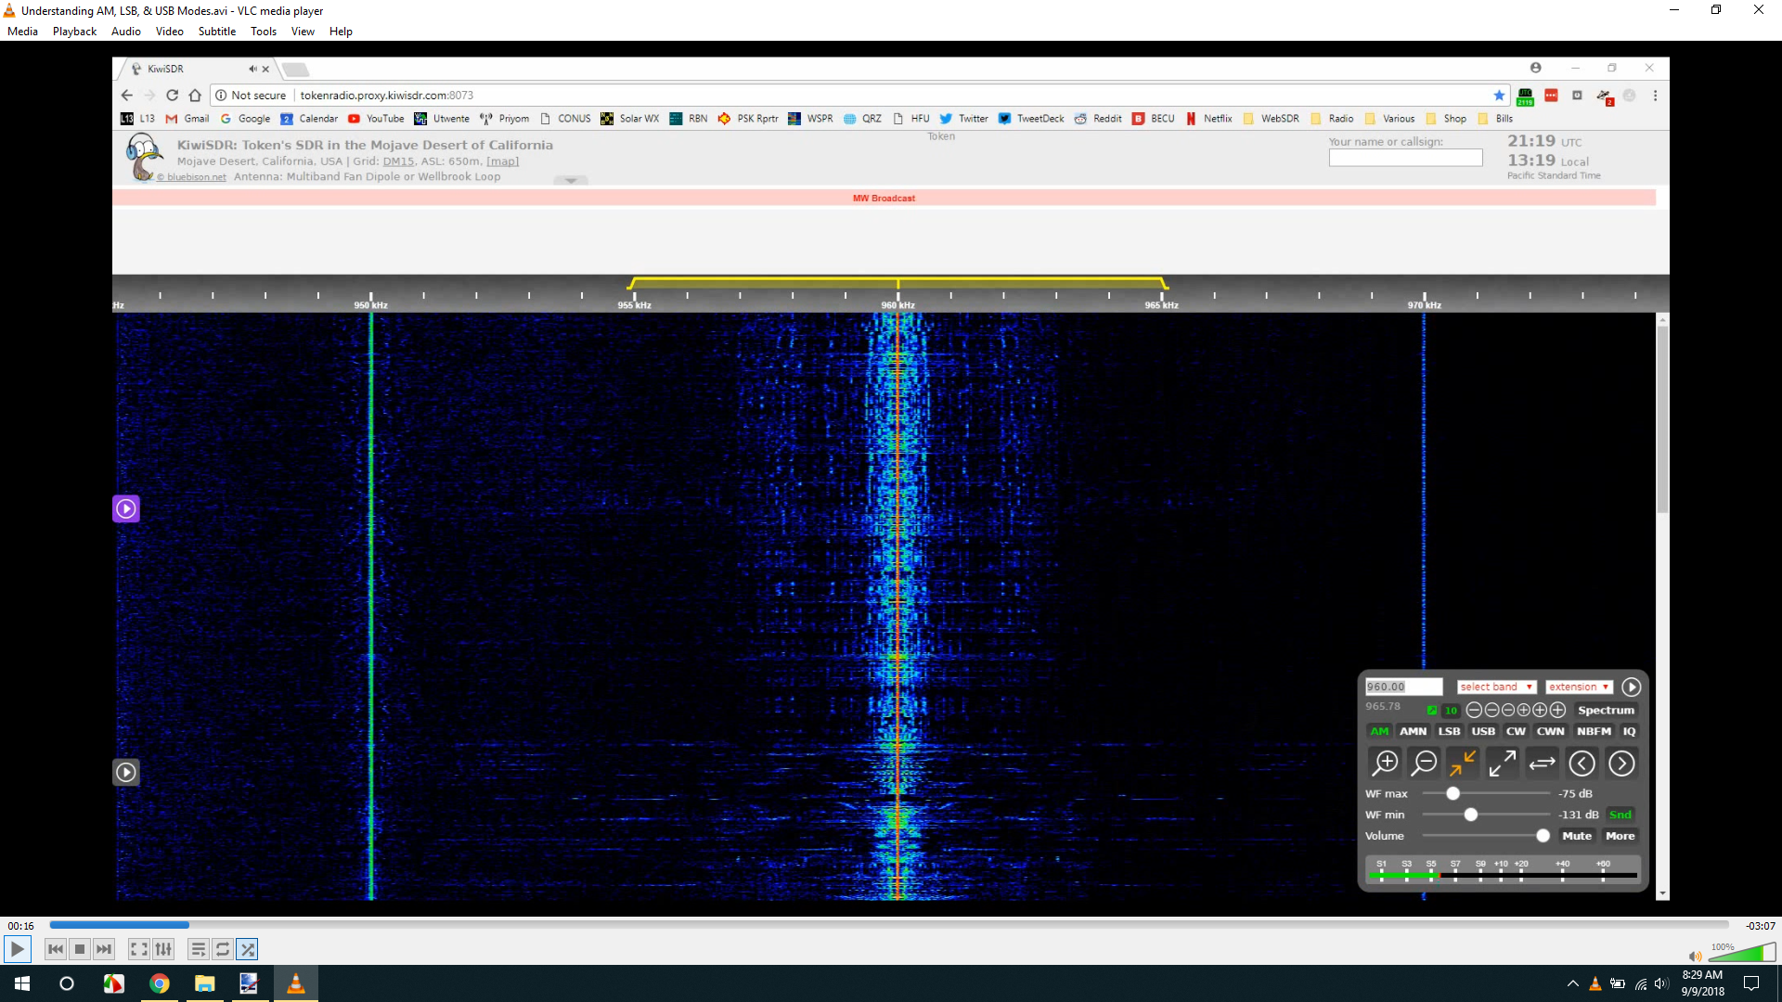
SDR AM Signal

Slide 6
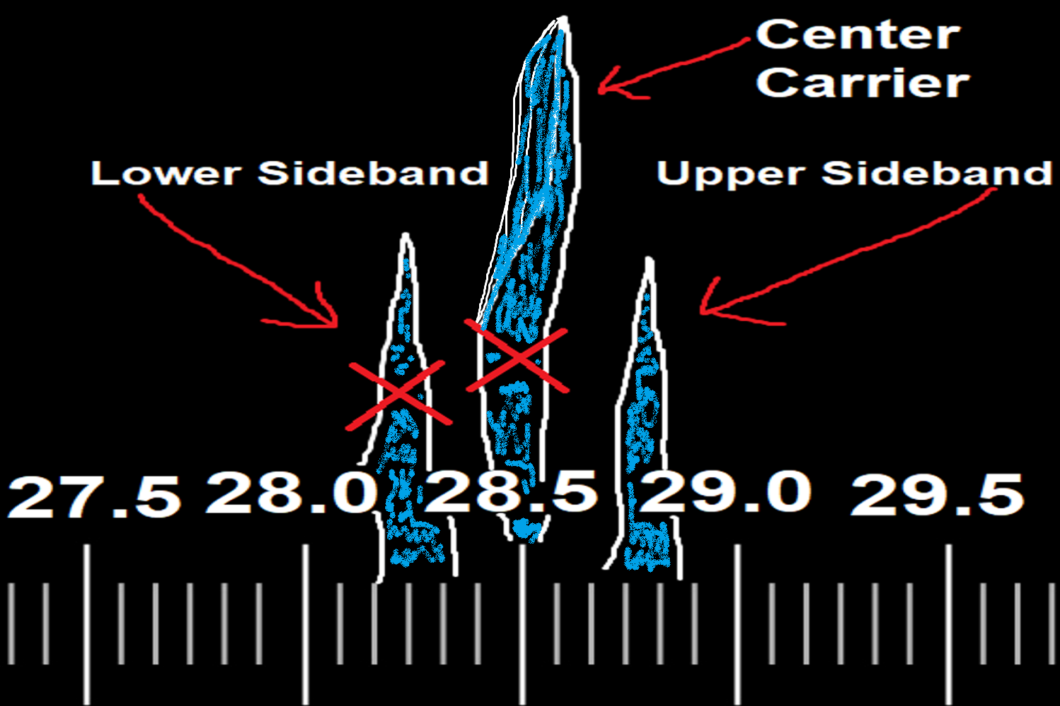
SSB Signal

Slide 7
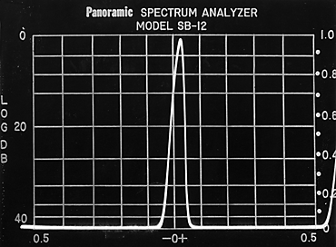
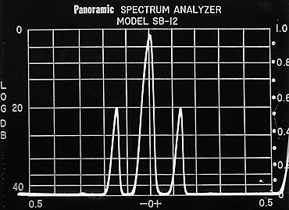
Amplitude Modulation
An unmodulated RF
carrier requires narrow
bandwidth
Modulation of the carrier
creates sidebands. This
requires more bandwidth.
Transmitter power is spread across this bandwidth

Slide 8

AM and SSB
The carrier contains no
audio information.
The sidebands contain
duplicate audio information
By filtering out the carrier and one sideband,
we save spectrum and concentrate our RF
energy into a narrower bandwidth. SSB is
therefore more efficient.

Slide 9
Frequency Modulation
Unmodulated carrier, full power at all times
Waveform of modulating signal
Modulated carrier with frequency deviation and constant amplitude
“Over modulation” called “over deviation” on FM, causes the signal to become wider and potentially cause adjacent channel interference. Phase Modulation (PM) uses a reactance modulator and is similar to FM and can be received with the same equipment.

Slide 10
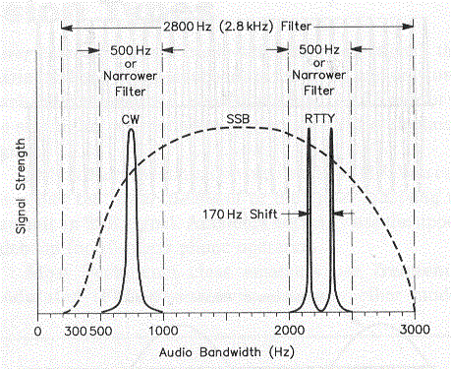
Common Required Bandwidth
CW – 5-10Hz
Phone / Voice
  SSB - 2-3 kHz
  AM – 4-6 kHz
  FM – 5-15 kHz
Digital
  PSK31 – 31 Hz
  RTTY – 250 Hz
Slow Scan TV – 3 KHz
Fast Scan TV – 6 Mhz

Slide 11
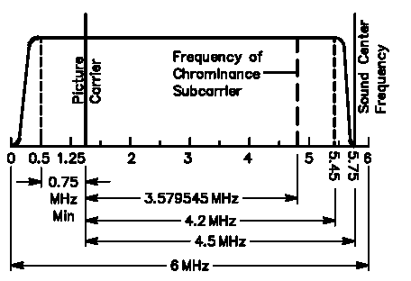
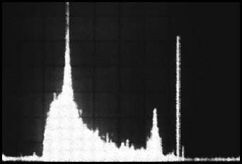
Amateur Television Signal
A 6 MHz ATV video channel with the video carrier 1.25 MHz up from the lower edge. The color subcarrier is at 3.58 MHz and the sound subcarrier at 4.5 MHz above the video carrier.
The Luminance, Chrominance and Audio carriers are visible in the spectrum plot at left

Slide 12
T8A01 - Which of the following is a form of amplitude modulation?
A. Spread-spectrum
B. Packet radio
C. Single sideband
D. Phase shift keying

Slide 13
T8A01 - Which of the following is a form of amplitude modulation?
A. Spread-spectrum
B. Packet radio
C. Single sideband
D. Phase shift keying

Slide 14
T8A02 - What type of modulation is commonly used for VHF packet radio transmissions?
A. FM or PM
B. SSB
C. AM
D. PSK

Slide 15
T8A02 - What type of modulation is commonly used for VHF packet radio transmissions?
A. FM or PM
B. SSB
C. AM
D. PSK

Slide 16
T8A03 - Which type of voice mode is often used for long-distance (weak signal) contacts on the VHF and UHF bands?
A. FM
B. DRM
C. SSB
D. PM

Slide 17
T8A03 - Which type of voice mode is often used for long-distance (weak signal) contacts on the VHF and UHF bands?
A. FM
B. DRM
C. SSB
D. PM

Slide 18
T8A04 - Which type of modulation is commonly used for VHF and UHF voice repeaters?
A. AM
B. SSB
C. PSK
D. FM or PM

Slide 19
T8A04 - Which type of modulation is commonly used for VHF and UHF voice repeaters?
A. AM
B. SSB
C. PSK
D. FM or PM

Slide 20
T8A05 - Which of the following types of signal has the narrowest bandwidth?
A. FM voice
B. SSB voice
C. CW
D. Slow-scan TV

Slide 21
T8A05 - Which of the following types of signal has the narrowest bandwidth?
A. FM voice
B. SSB voice
C. CW
D. Slow-scan TV

Slide 22
T8A06 - Which sideband is normally used for 10 meter HF, VHF and UHF single-sideband communications?
A. Upper sideband
B. Lower sideband
C. Suppressed sideband
D. Inverted sideband

Slide 23
T8A06 - Which sideband is normally used for 10 meter HF, VHF and UHF single-sideband communications?
A. Upper sideband
B. Lower sideband
C. Suppressed sideband
D. Inverted sideband

Slide 24
T8A07 - What is a characteristic of single sideband (SSB) compare to FM?
A. SSB signals are easier to tune
B. SSB signals are less susceptible to interference
C. SSB signals have narrower bandwidth
D. All of these choices are correct

Slide 25
T8A07 - What is a characteristic of single sideband (SSB) compare to FM?
A. SSB signals are easier to tune
B. SSB signals are less susceptible to interference
C. SSB signals have narrower bandwidth
D. All of these choices are correct

Slide 26
T8A08 - What is the approximate bandwidth of a typical single sideband ( SSB ) voice signal?
A. 1 kHz
B. 3 kHz
C. 6 kHz
D. 15 kHz

Slide 27
T8A08 - What is the approximate bandwidth of a typical single sideband ( SSB ) voice signal?
A. 1 kHz
B. 3 kHz
C. 6 kHz
D. 15 kHz

Slide 28
T8A09 - What is the approximate bandwidth of a VHF repeater FM voice signal?
A. Less than 500 Hz
B. About 150 kHz
C. Between 10 and 15 kHz
D. Between 50 and 125 kHz

Slide 29
T8A09 - What is the approximate bandwidth of a VHF repeater FM voice signal?
A. Less than 500 Hz
B. About 150 kHz
C. Between 10 and 15 kHz
D. Between 50 and 125 kHz

Slide 30
T8A10 - What is the approximate bandwidth of AM fast-scan TV transmissions?
A. More than 10 MHz
B. About 6 MHz
C. About 3 MHz
D. About 1 MHz

Slide 31
T8A10 - What is the approximate bandwidth of AM fast-scan TV transmissions?
A. More than 10 MHz
B. About 6 MHz
C. About 3 MHz
D. About 1 MHz

Slide 32
T8A11 - What is the approximate bandwidth required to transmit a CW signal?
A. 2.4 kHz
B. 150 Hz
C. 1000 Hz
D. 15 kHz

Slide 33
T8A11 - What is the approximate bandwidth required to transmit a CW signal?
A. 2.4 kHz
B. 150 Hz
C. 1000 Hz
D. 15 kHz

Slide 34
T8A12 – Which of the following is a disadvantage of FM compared with single sideband?
A. Voice quality is poorer
B. Only one signal can be received at a time
C. FM signals are harder to tune
D. All these choices ae corect

Slide 35
T8A12 – Which of the following is a disadvantage of FM compared with single sideband?
A. Voice quality is poorer
B. Only one signal can be received at a time
C. FM signals are harder to tune
D. All these choices ae corect

Slide 36
G4D11 How close to the upper edge of the 20 meter General Class band should your displayed carrier frequency be when using 3 kHz wide USB?
  A. 3 kHz above the edge of the band
  B. 3 kHz below the edge of the band
  C. Your displayed carrier frequency may be set at the edge of the band
  D. Center your signal on the edge of the band

Slide 37
G4D11 How close to the upper edge of the 20 meter General Class band should your displayed carrier frequency be when using 3 kHz wide USB?
  A. 3 kHz above the edge of the band
  B. 3 kHz below the edge of the band
  C. Your displayed carrier frequency may be set at the edge of the band
  D. Center your signal on the edge of the band

Slide 38
G8A12 What signal(s) would be found at the output of a properly adjusted balanced modulator?
  A. Both upper and lower sidebands
  B. Either upper or lower sideband, but not both
  C. Both upper and lower sidebands and the carrier
  D. The modulating signal and the unmodulated carrier

Slide 39
G8A12 What signal(s) would be found at the output of a properly adjusted balanced modulator?
  A. Both upper and lower sidebands
  B. Either upper or lower sideband, but not both
  C. Both upper and lower sidebands and the carrier
  D. The modulating signal and the unmodulated carrier

Slide 40
T8B - Amateur satellite operation
Doppler shift, basic orbits, operating protocols; modulation mode selection, transmitter power considerations, telemetry and telecommand, satellite tracking programs, beacons, uplink and downlink mode definitions, spin fading, definition of “LEO”, setting uplink powers

Slide 41
G8B01 What receiver stage combines a 14.250 MHz input signal with a 13.795 MHz oscillator signal to produce a 455 kHz intermediate frequency (IF) signal?
  A. Mixer
  B. BFO
  C. VFO
  D. Discriminator

Slide 42
G8B01 What receiver stage combines a 14.250 MHz input signal with a 13.795 MHz oscillator signal to produce a 455 kHz intermediate frequency (IF) signal?
  A. Mixer
  B. BFO
  C. VFO
  D. Discriminator

Slide 43
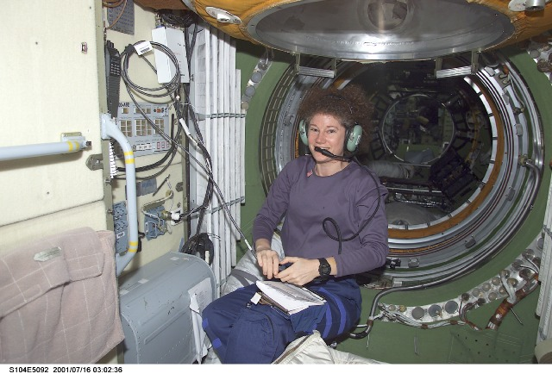
Susan J. Helms, KC7NHZ
Flight Engineer - ISS
Notes:
Most astronauts are licensed hams. Most often they get their Technician licenses so they are allowed to operate the ISS radio station.
Photo from NASA

Slide 44
T8B01 What telemetry information is typically transmitted by satellite beacons?
A. The signal strength of received signals
B. Time of day accurate to plus or minus 1/10 second
C. Health and status of the satellite
D. All of these choices are correct

Slide 45
T8B01 What telemetry information is typically transmitted by satellite beacons?
A. The signal strength of received signals
B. Time of day accurate to plus or minus 1/10 second
C. Health and status of the satellite
D. All of these choices are correct

Slide 46
T8B02 What is the impact of using excessive effective radiated power on a satellite uplink?
A. Possibility of commanding the satellite to an improper mode
B. Blocking access by other users
C. Overloading the satellite batteries
D. Possibility of rebooting the satellite control computer

Slide 47
T8B02 What is the impact of using excessive effective radiated power on a satellite uplink?
A. Possibility of commanding the satellite to an improper mode
B. Blocking access by other users
C. Overloading the satellite batteries
D. Possibility of rebooting the satellite control computer

Slide 48
T8B03 - Which of the following are provided by satellite tracking programs?
A. Maps showing the real-time position of the satellite track over the earth
B. The time, azimuth, and elevation of the start, maximum altitude, and end of a pass
C. The apparent frequency of the satellite transmission, including effects of Doppler shift
D. All of these answers are correct

Slide 49
T8B03 - Which of the following are provided by satellite tracking programs?
A. Maps showing the real-time position of the satellite track over the earth
B. The time, azimuth, and elevation of the start, maximum altitude, and end of a pass
C. The apparent frequency of the satellite transmission, including effects of Doppler shift
D. All of these answers are correct

Slide 50
T8B04 What mode of transmission is commonly used by amateur radio satellites?
A. SSB
B. FM
C. CW/data
D. All of these choices are correct

Slide 51
T8B04 What mode of transmission is commonly used by amateur radio satellites?
A. SSB
B. FM
C. CW/data
D. All of these choices are correct

Slide 52
T8B05 - What is a satellite beacon?
A. The primary transmit antenna on the satellite
B. An indicator light that that shows where to point your antenna
C. A reflective surface on the satellite
D. A transmission from a space satellite that contains status information

Slide 53
T8B05 - What is a satellite beacon?
A. The primary transmit antenna on the satellite
B. An indicator light that that shows where to point your antenna
C. A reflective surface on the satellite
D. A transmission from a satellite that contains status information

Slide 54
T8B06 - Which of the following are inputs to a satellite tracking program?
A. The satellite transmitted power
B. The Keplerian elements
C. The last observed time of zero Doppler shift
D. All of these answers are correct

Slide 55
T8B06 - Which of the following are inputs to a satellite tracking program?
A. The satellite transmitted power
B. The Keplerian elements
C. The last observed time of zero Doppler shift
D. All of these answers are correct

Slide 56
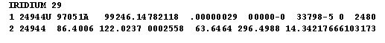
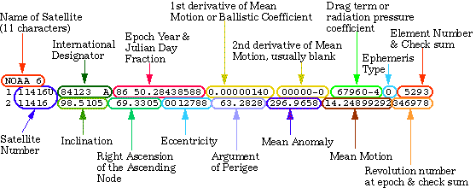
Keplerian Data Sample

Slide 57

Doppler Shift
Doppler shift is a change in frequency as an object moves. The wave in front of the object is compressed and expanded behind.
To a fixed observer, the shortened wavelength in front causes the frequency to increase. As the object passes, the longer wavelength behind will cause the frequency to shift down.

Slide 58
T8B07 - With is Doppler shift in reference to satellite communications?
A. A change in the satellite orbit
B. A mode where the satellite receives signals on one band and transmits on another
C. An observed change in signal frequency caused by relative motion between the satellite and the earth station
D. A special digital communications mode for some satellites

Slide 59
T8B07 - With is Doppler shift in reference to satellite communications?
A. A change in the satellite orbit
B. A mode where the satellite receives signals on one band and transmits on another
C. An observed change in signal frequency caused by relative motion between the satellite and the earth station
D. A special digital communications mode for some satellites

Slide 60
T8B08 - What is meant by the statement that a satellite is operating in mode U/V?
A. The satellite uplink is in the 15 meter band and the downlink is in the 10 meter band
B. The satellite uplink is in the 70 cm band and the downlink is in the 2 meter band
C. The satellite operates using ultraviolet frequencies
D. The satellite frequencies are usually variable

Slide 61
T8B08 - What is meant by the statement that a satellite is operating in mode U/V?
A. The satellite uplink is in the 15 meter band and the downlink is in the 10 meter band
B. The satellite uplink is in the 70 cm band and the downlink is in the 2 meter band
C. The satellite operates using ultraviolet frequencies
D. The satellite frequencies are usually variable

Slide 62
T8B09 - What causes spin fading of satellite signals?
A. Circular polarized noise interference radiated from the sun
B. Rotation of the satellite and its antennas
C. Doppler shift of the received signal
D. Interfering signals within the satellite uplink band

Slide 63
T8B09 - What causes spin fading of satellite signals?
A. Circular polarized noise interference radiated from the sun
B. Rotation of the satellite and its antennas
C. Doppler shift of the received signal
D. Interfering signals within the satellite uplink band

Slide 64
T8B10 - What is a LEO satellite?
A sun synchronous satellite
A highly elliptical orbit satellite
C. A satellite in low energy operation mode
D. A satellite in low earth orbit

Slide 65
T8B10 - What is a LEO satellite?
A sun synchronous satellite
A highly elliptical orbit satellite
C. A satellite in low energy operation mode
D. A satellite in low earth orbit

Slide 66
T8B11 - Who may receive telemetry from a space station?
A. Anyone
B. A licensed radio amateur with a transmitter equipped for interrogating the satellite
C. A licensed radio amateur who has been certified by the protocol developer
D. A licensed radio amateur who has registered for an access code from AMSAT

Slide 67
T8B11 - Who may receive telemetry from a space station?
A. Anyone
B. A licensed radio amateur with a transmitter equipped for interrogating the satellite
C. A licensed radio amateur who has been certified by the protocol developer
D. A licensed radio amateur who has registered for an access code from AMSAT

Slide 68
T8B12 Which of the following is a way to determine whether your uplink power is neither too low nor too high?
A. Check your signal strength report in the telemetry data
B. Listen for distortion on your downlink signal
C. Your signal strength on the downlink should be about the same as the beacon
D. All of these choices are correct

Slide 69
T8B12 Which of the following is a way to determine whether your uplink power is neither too low nor too high?
A. Check your signal strength report in the telemetry data
B. Listen for distortion on your downlink signal
C. Your signal strength on the downlink should be about the same as the beacon
D. All of these choices are correct

Slide 70
T8C – Operating activities
radio direction finding; radio control; contests; linking over the Internet; exchanging grid locators

Slide 71
T8C01 - Which of the following methods is used to locate sources of noise interference or jamming?
A. Echolocation
B. Doppler radar
C. Radio direction finding
D. Phase locking

Slide 72
T8C01 - Which of the following methods is used to locate sources of noise interference or jamming?
A. Echolocation
B. Doppler radar
C. Radio direction finding
D. Phase locking

Slide 73
T8C02 - Which of these items would be useful for a hidden transmitter hunt?
A. Calibrated SWR meter
B. A directional antenna
C. A calibrated noise bridge
D. All of these choices are correct

Slide 74
T8C02 - Which of these items would be useful for a hidden transmitter hunt?
A. Calibrated SWR meter
B. A directional antenna
C. A calibrated noise bridge
D. All of these choices are correct

Slide 75
T8C03 - What operating activity involves contacting as many stations as possible during a specified period?
A. Simulated emergency exercises
B. Net operations
C. Public service events
D. Contesting

Slide 76
T8C03 - What operating activity involves contacting as many stations as possible during a specified period?
A. Simulated emergency exercises
B. Net operations
C. Public service events
D. Contesting

Slide 77
T8C04 - Which of the following is good procedure when contacting another station in a contest?
A. Sign only the last two letters of your call if there are many other stations calling
B. Contact the station twice to be sure that you are in his log
C. Send only the minimum information needed for proper identification and the contest exchange
D. All of these choices are correct

Slide 78
T8C04 - Which of the following is good procedure when contacting another station in a contest?
A. Sign only the last two letters of your call if there are many other stations calling
B. Contact the station twice to be sure that you are in his log
C. Send only the minimum information needed for proper identification and the contest exchange
D. All of these choices are correct

Slide 79
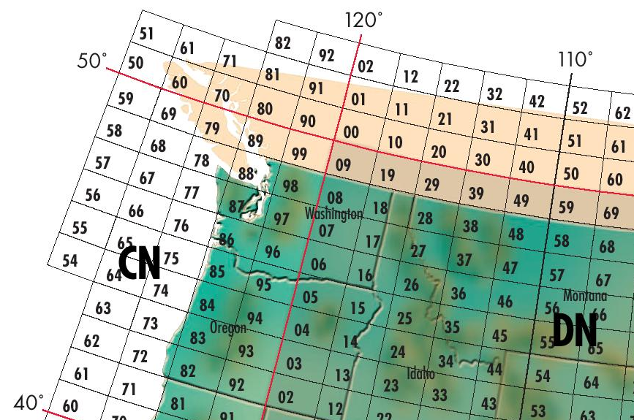
Maidenhead Grids
Two letters and two numbers define an area 1° latitude x 2° longitude anywhere in the world. Seattle is CN87, Portland CN85
Notes:
This grid map is courtesy Icom America and is downloadable from their web site at http://www.icomamerica.com.
Two letter designator followed by a number ranging from 1 to 100 representing 1° latitude x 2° longitude square area of the earth.
The earth is divided into 20° Latitude x 10° Longitude squares starting on the date line at the south pole and going North and East.
Each square is given a two letter designator labeled East and North starting with AA and Ending with RR
An – In are West of GMT, Jn – Rn are east of GMT
nA – n I are South of the equator, nJ – nR are North of the equator
Each square is further divided into 100 1°x2° squares and given a number starting in the lower left corner of the square and are labeled up and right
Seattle is in CN-87, Los Angles DM-04
Spokane is in DN-17

Slide 80
T8C05 - What is a grid locator?
A. A letter-number designator assigned to a geographic location
B. A letter-number designator assigned to an azimuth and elevation
C. An instrument for neutralizing a final amplifier
D. An instrument for radio direction finding

Slide 81
T8C05 - What is a grid locator?
A. A letter-number designator assigned to a geographic location
B. A letter-number designator assigned to an azimuth and elevation
C. An instrument for neutralizing a final amplifier
D. An instrument for radio direction finding

Slide 82
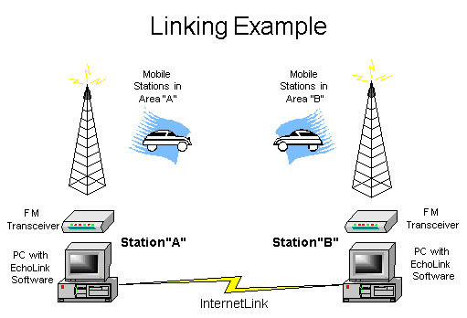
EchoLink® and IRLP
EchoLink® software allows licensed Amateur Radio stations to communicate with one another over the Internet, using voice-over-IP (VoIP) technology.
Gateway
Gateway

Slide 83
T8C06 - How is over the air to IRLP node accomplished?
A. By obtaining a password which is sent via voice to the node
B. By using DTMF signals
C. By entering the proper Internet password
D . By using CTCSS tone codes

Slide 84

T8C06 - How is over the air to IRLP node accomplished?
A. By obtaining a password which is sent via voice to the node
B. By using DTMF signals
C. By entering the proper Internet password
D . By using CTCSS tone codes

Slide 85
T8C07 - What is Voice Over Internet Protocol
( VoIP ) ?
A. A set of rules specifying how to identify your station when linked over the internet to another station
B. A technique employed to “spot” DX stations via the internet
C. A technique for measuring the modulation quality of a transmitter using remote sites monitored via the internet
D. A method of delivering voice communications over the internet using digital techniques

Slide 86
T8C07 - What is Voice Over Internet Protocol
( VoIP ) ?
A. A set of rules specifying how to identify your station when linked over the internet to another station
B. A technique employed to “spot” DX stations via the internet
C. A technique for measuring the modulation quality of a transmitter using remote sites monitored via the internet
D. A method of delivering voice communications over the internet using digital techniques

Slide 87
T8C08 - What is the Internet Radio Linking Project
( IRLP ) ?
A. A technique to connect amateur radio systems, such as repeaters, via the internet using Voice Over Internet Protocol ( VoIP )
B. A system for providing access to websites via amateur radio
C. A system for informing amateurs in real time of the frequency of active DX stations
D. A technique for measuring signal strength of an amateur transmitter via the internet

Slide 88
T8C08 - What is the Internet Radio Linking Project
( IRLP ) ?
A. A technique to connect amateur radio systems, such as repeaters, via the internet using Voice Over Internet Protocol ( VoIP )
B. A system for providing access to websites via amateur radio
C. A system for informing amateurs in real time of the frequency of active DX stations
D. A technique for measuring signal strength of an amateur transmitter via the internet

Slide 89
EchoLink® and IRLP
EchoLink® software allows licensed Amateur Radio stations to communicate with one another over the Internet, using voice-over-IP (VoIP) technology.
Gateway
Gateway

Slide 90
T8C09 – Which of the following protocols enables an amateur station to transmit through a repeater without using a radio to initate the transmission?
IRLP
D-STAR
DMR
Echolink

Slide 91
T8C09 – Which of the following protocols enables an amateur station to transmit through a repeater without using a radio to initate the transmission?
IRLP
D-STAR
DMR
Echolink

Slide 92
T8C10 - What is required before using EchoLink system?
A. Complete the required EchoLink training
B. Purchased a license to use the EchoLink software
C. Register your call sign and provide proof of license
D. All these choices are correct

Slide 93
T8C10 - What is required before using EchoLink system?
A. Complete the required EchoLink training
B. Purchased a license to use the EchoLink software
C. Register your call sign and provide proof of license
D. All these choices are correct

Slide 94
T8C11 - What is an amateur radio station that connects other amateur stations to the Internet?
A. A gateway
B. A repeater
C. A digipeater
D. A beacon

Slide 95
T8C11 - What is an amateur radio station that connects other amateur stations to the Internet?
A. A gateway
B. A repeater
C. A digipeater
D. A beacon

Slide 96
T8D – Non-voice communications
Non-voice and digital communications; image signals and definition of NTSC, CW, packet radio, PSK, APRS, error-detection and correction, amateur radio networking, Digital Mobile Radio, WSJT ,odes, Broadband-Hamnet

Slide 97
T8D01 - Which of the following is a digital communications mode?
A. Packet radio
B. IEEE 802.11
C. FT8
D. All of these choices are correct

Slide 98
T8D01 - Which of the following is a digital communications mode?
A. Packet radio
B. IEEE 802.11
C. FT8
D. All of these choices are correct

Slide 99
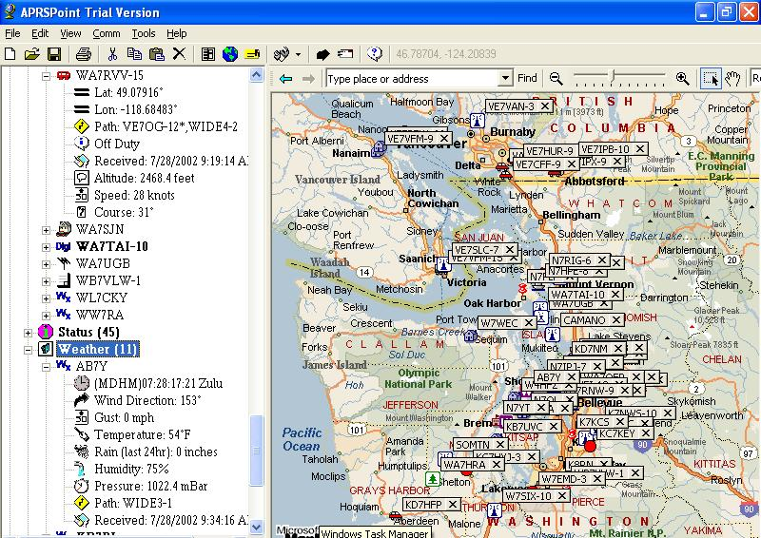
APRS
Automatic Position Reporting System
Real-time
location
Mapping
Texting

Slide 100
T8D02 - What is a “talkgroup” on a DMR repeater?
A. A group of operators sharing common interests
B. A way for groups of users to share a channel at different times without hearing other users on the channel
C. A protocol that increases the signal-to-noise ration when multiple repeaters are linked together
D. A net that meets at a specified time

Slide 101
T8D02 - What is a “talkgroup” on a DMR repeater?
A. A group of operators sharing common interests
B. A way for groups of users to share a channel at different times without hearing other users on the channel
C. A protocol that increases the signal-to-noise ration when multiple repeaters are linked together
D. A net that meets at a specified time

Slide 102
T8D03 – What kind of data can be transmitted by APRS?
A. GPS position data
B. Text messages
C. Weather data
D. All these choices are correct

Slide 103
T8D03 – What kind of data can be transmitted by APRS?
A. GPS position data
B. Text messages
C. Weather data
D. All these choices are correct

Slide 104
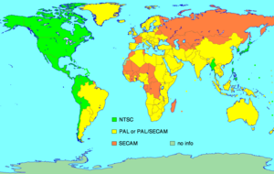
National Television Systems Committee
(NTSC)
Television Standards
  NTSC – Canada, US, Japan, South Korea
  PAL
  SECAM

Slide 105
T8D04 - What type of transmission is indicated by the term NTSC?
A. A Normal Transmission mode in Static Circuit
B. A special mode for earth satellite uplink
C. An analog fast scan color TV signal
D. A frame compression scheme for TV signals

Slide 106
T8D04 - What type of transmission is indicated by the term NTSC?
A. A Normal Transmission mode in Static Circuit
B. A special mode for earth satellite uplink
C. An analog fast scan color TV signal
D. A frame compression scheme for TV signals

Slide 107
T8D05 - Which of the following is an application of APRS?
A. Providing real time tactical digital communications in conjunction with a map showing the locations of stations
B. Showing automatically the number of packets transmitted via PACTOR during a specific time interval
C. Providing voice over Internet connection between repeaters
D. Providing information on the number of stations signed into a repeater

Slide 108
T8D05 - Which of the following is an application of APRS?
A. Providing real time tactical digital communications in conjunction with a map showing the locations of stations
B. Showing automatically the number of packets transmitted via PACTOR during a specific time interval
C. Providing voice over Internet connection between repeaters
D. Providing information on the number of stations signed into a repeater

Slide 109


PSK31 Digital Mode
PSK31 is a low speed, narrow bandwidth data mode that provides VERY EFFICIENT keyboard to keyboard chat capability. PSK31 is not error-corrected.

Slide 110
T8D06 - What does the abbreviation PSK mean?
A. Pulse Shift Keying
B. Phase Shift Keying
C. Packet Short Keying
D. Phased Slide Keying

Slide 111
T8D06 - What does the abbreviation PSK mean?
A. Pulse Shift Keying
B. Phase Shift Keying
C. Packet Short Keying
D. Phased Slide Keying

Slide 112
T8D07 - Which of the following describes DMR ?
A. A technique for time-multiplexing two digital voice signals on a single 12.5 kHz repeater channel
B. An automatic position tracking mode for FM mobiles communicating through repeaters
C. An automatic computer logging technique for hands-off logging when communicating while operating a vehicle
D. A digital technique for transmitting on two repeater inputs simultaneously for automatic error correction

Slide 113
T8D07 - Which of the following describes DMR ?
A. A technique for time-multiplexing two digital voice signals on a single 12.5 kHz repeater channel
B. An automatic position tracking mode for FM mobiles communicating through repeaters
C. An automatic computer logging technique for hands-off logging when communicating while operating a vehicle
D. A digital technique for transmitting on two repeater inputs simultaneously for automatic error correction

Slide 114
T8D08 - Which of the following is included in packet transmissions?
A. A check sum which permits error detection
B. A header which contains the call sign of the station to which the information is being sent
C. Automatic repeat request in case of error
D. All of these choices are correct

Slide 115
T8D08 - Which of the following is included in packet transmissions?
A. A check sum which permits error detection
B. A header which contains the call sign of the station to which the information is being sent
C. Automatic repeat request in case of error
D. All of these choices are correct

Slide 116
T8D09 - What is CW?
A. A type of electromagnetic propagation
B. A digital mode used primarily on 2 meter FM
C. A technique for coil winding
D. Another name for a Morse code transmission

Slide 117
T8D09 - What is CW?
A. A type of electromagnetic propagation
B. A digital mode used primarily on 2 meter FM
C. A technique for coil winding
D. Another name for a Morse code transmission

Slide 118
T8D10 - Which of the following operating activities is supported by digital mode software in the WSJT suite?
A. Earth-Moon-Earth
B. Weak-signal propagation beacons
C. Meteor scatter
D. All of these choices are correct

Slide 119
T8D10 - Which of the following operating activities is supported by digital mode software in the WSJT suite?
A. Earth-Moon-Earth
B. Weak-signal propagation beacons
C. Meteor scatter
D. All of these choices are correct

Slide 120
T8D11 - What is an ARQ transmission system?
A. A special transmission format limited to video signals
B. A system used to encrypt command signals to an amateur radio satellite
C. An error correction method in which the receiving station detects errors and sends a request for retransmission
D. A method of compressing data using autonomous reiterative Q codes prior to final encoding

Slide 121
T8D11 - What is an ARQ transmission system?
A. A special transmission format limited to video signals
B. A system used to encrypt command signals to an amateur radio satellite
C. An error correction method in which the receiving station detects errors and sends a request for retransmission
D. A method of compressing data using autonomous reiterative Q codes prior to final encoding

Slide 122
T8D12 - Which of the following best describes an amateur radio mesh network?
A. An amateur-radio-based data network using commercial Wi-Fi gear with modified firmware
B. A wide-bandwidth digital voice mode employing DRM protocols
C. A satellite communications network using modified commercial satellite TV hardware
D. An internet linking protocol used to network repeaters

Slide 123
T8D12 - Which of the following best describes an amateur radio mesh network?
A. An amateur-radio-based data network using commercial Wi-Fi gear with modified firmware
B. A wide-bandwidth digital voice mode employing DRM protocols
C. A satellite communications network using modified commercial satellite TV hardware
D. An internet linking protocol used to network repeaters

Slide 124
T8D13 - What is FT8?
A. A wideband FM voice mode
B. A digital mode capable of operating in low signal-to-noise conditions
C. An eight channel multiplex mode for FM repeaters
D. A digital slow scan TV mode with forward error correction and automatic color compensation

Slide 125
T8D13 - What is FT8?
A. A wideband FM voice mode
B. A digital mode capable of operating in low signal-to-noise conditions
C. An eight channel multiplex mode for FM repeaters
D. A digital slow scan TV mode with forward error correction and automatic color compensation

Slide 126
G8B11 How does forward error correction allow the receiver to correct errors in received data packets?
  A. By controlling transmitter output power for optimum signal strength
  B. By using the varicode character set
  C. By transmitting redundant information with the data
  D. By using a parity bit with each character

Slide 127
G8B11 How does forward error correction allow the receiver to correct errors in received data packets?
  A. By controlling transmitter output power for optimum signal strength
  B. By using the varicode character set
  C. By transmitting redundant information with the data
  D. By using a parity bit with each character

Slide 128
G8B12 What is the relationship between transmitted symbol rate and bandwidth?
  A. Symbol rate and bandwidth are not related
  B. Higher symbol rates require higher bandwidth
  C. Lower symbol rates require higher bandwidth
  D. Bandwidth is constant for data mode signals

Slide 129
G8B12 What is the relationship between transmitted symbol rate and bandwidth?
  A. Symbol rate and bandwidth are not related
  B. Higher symbol rates require higher bandwidth
  C. Lower symbol rates require higher bandwidth
  D. Bandwidth is constant for data mode signals

Slide 130
End of
SUBELEMENT T8
Modulation modes: amateur satellite operation; operating activities; non-voice communications

