Slide 1
SUBELEMENT T9
ANTENNAS AND FEED LINES
[2 Exam Questions - 2 Groups]
Notes:
Subelement T9 ANTENNAS AND FEED LINES. Technician Training Slides for 2022 Question Pool Good through June 30, 2026 Assembled by Washington Ham Trainers, Daniel Stevens KL7WM.

Slide 2
T9A – Antennas: vertical and horizontal polarization; concept of antenna gain, definition and types of beam antennas, antenna loading, common portable and mobile antennas, relationships between resonant length and frequency, dipole pattern
T9B – Feed lines: types, attenuation vs frequency, selecting; SWR concepts; Antenna tuners (couplers); RF Connectors: selecting, weather protection

Slide 3
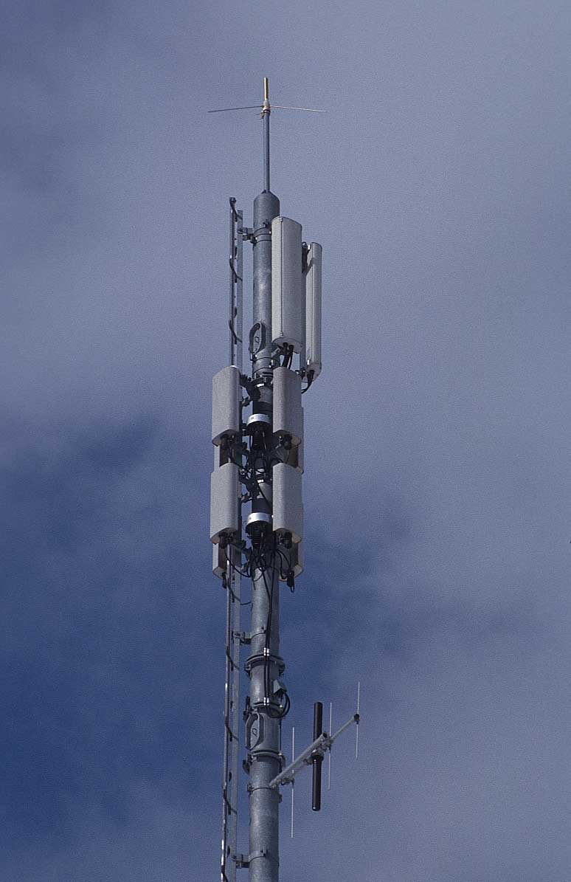
Antenna Classifications
Orientation
  Horizontal – parallel to the Earth
  Vertical – perpendicular to the Earth
Directivity (Beam)
  Yagi, Log Periodic, Quad, Dish
Size
  Wavelength – λ
  ½ λ, ¼ λ, ⅝ λ, …
Notes:
Antennas can be classified in any number of ways. For example their orientation, size, shape. We can also classify them by and operation parameter such as gain, directivity, impedance. We can also arrange them by physical properties line flexible, shortened, loaded, active, etc. There are lots of ways to classify them.
For the test, there are three thing we care about: Orientation, Directivity and Size.

Slide 4
Horizontal Antennas
Half Wavelength Dipole Antenna)
Half wavelength
from formula
Solder
Spacer
Open wire
feeder
Half wavelength
300
F (MHz)
Wavelength (meters) =
Meters to inches
½λ Dipole length (inches) = Wavelength / 2 x 39
Notes:
The actual physical length will be slightly smaller because electron flow through a conductor is slower than the speed of light. This decrease in speed is called “velocity factor” and is expressed as a percentage. Copper has a velocity factor near 95 or 95% of the speed of light. That also means an antenna made of copper will be about 95% the size of the theoretical value above.

Slide 5
½ λ Dipole Radiation
Radiation pattern for a dipole placed ½ λ
above ground looking down from above the antenna.
Looks like a doughnut around the wire in 3D space.
Pattern distorts to omnidirectional when placed low to the ground.
Notes:
A dipole is a a half wavelength piece of wire connected at the center (1/4 wave on each side). If the dipole antenna was the red line, the lobes above and below show the radiation pattern at ½ wavelength above the ground. This pattern actually rotates around the wire like a donut. As the antenna is lowered below ½ wavelength, the lobes flatten until it becomes nearly omnidirectional.

Slide 6
Vertical Antennas
(Quarter Wavelength Vertical)
Radials
Ground Plane
Ground
Marconi
Ground Plane
Quarter wavelength
300
F (MHz)
Wavelength (meters) =
Meters to inches
¼λ vertical length (inches) = Wavelength / 4 x 39
Notes:
The actual physical length will be slightly smaller because electron flow through a conductor is slower than the speed of light. This decrease in speed is called “velocity factor” and is expressed as a percentage. Copper has a velocity factor near 95 or 95% of the speed of light. That also means an antenna made of copper will be about 95% the size of the theoretical value above.

Slide 7
Quarter Wave Vertical Radiation
Perfect Ground
Average Ground

Elevation
Maximum Radiation Angle
0 dB= 5.10 dBi
7.150 MHz
A side view of the radiation pattern of a 1/4 wave vertical. From above the pattern is round like a doughnut. A perfect ground would be the center of a metal car roof at VHF/UHF
Notes:
Notice how ground affects the performance of the system. Over an average ground the maximum strength is 6dB less (4 fold) and has a higher radiation angle.

Slide 8
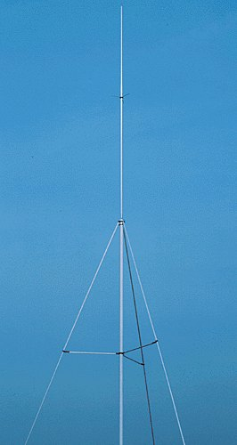
Vertical Antenna
  Standard ¼ wave vertical has a feedpoint impedance of ~35 ohms
  Sloping ground radials downward raises feedpoint impedance
Notes:
If the vertical is ground mounted, the radials should be on or near the surface of the ground.

Slide 9
Beam Antennas
(Yagi Antenna)
Driven Element
The reflector
acts like a
mirror
The director
acts like a
lens
Boom
Gain
Reflector
Director
Feedline
Notes:
Note the driven element with the balun attached, the smaller directors, larger reflector and the pattern with a large front lobe. The driven element is approximately a half have dipole. As parasitic elements (directors and reflectors) are added and the boom length is increased, the more gain is provided by the antenna. Reflectors are placed behind the driven element to reflect the power forward and the directors act as conductors in front of the wave. Reflectors are generally ~3% longer than the driven element and directors ~3% shorter. Five element yagis like this one yield 10-12dB gain over a dipole, based on the design of the antenna.
Antenna designers have to balance forward gain, front-to-back ratio, bandwidth and feedpoint impedance when designing an antenna. Some antennas will be optimized for maximum forward gain to improve their output and others may have better front-to-back rations to improve their noise rejection. Antenna bandwidth can be increased by using larger diameter elements. Gain is largely a function of boom length.

Slide 10
Yagi Radiation Pattern
The yagi antenna focuses RF energy in one direction, giving the appearance of
getting “free power.”
This free power or Effective Radiated Power (ERP) can be expressed as antenna Gain in Decibels (dB) over a dipole (dBd) or isotropic resonator (dBi).
Notes:
An isotropic resonator is an imaginary point in free space that radiates equally well in all directions. Since this isn’t an a physical antenna and the “performance” is poor, manufacturers often use it for comparison. To convert dBi to dBd, subtract 2.15 dB from the dBi value. If a manufacturer publishes dBd values, they are likely honest values because they’re lower.

Slide 11
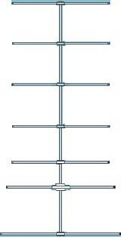
Yagi Radiation Pattern
The yagi antenna focuses RF energy in one direction, giving the appearance of
getting “free power.”
This free power or Effective Radiated Power (ERP) can be expressed as antenna Gain in Decibels (dB) over a dipole (dBd) or isotropic resonator (dBi).
Notes:
An isotropic resonator is an imaginary point in free space that radiates equally well in all directions. Since this isn’t an a physical antenna and the “performance” is poor, manufacturers often use it for comparison. To convert dBi to dBd, subtract 2.15 dB from the dBi value. If a manufacturer publishes dBd values, they are likely honest values because they’re lower.

Slide 12
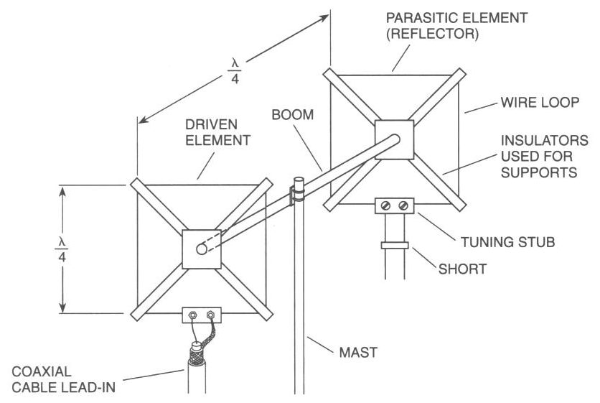
Quad Antenna
12
G9 - Antennas
Notes:
12
The driven element of a quad is a full wave loop, so each side is quarter wave. In this picture the feed is along the bottom, horizontal wire. This means the polarization of this antenna is horizontal. If the antenna were rotated 90 degrees so the feed were on a vertical side, the polarization would be vertical. Like the Yagi, reflector elements are ~3% larger and director elements are ~3% smaller than driven elements.

Slide 13
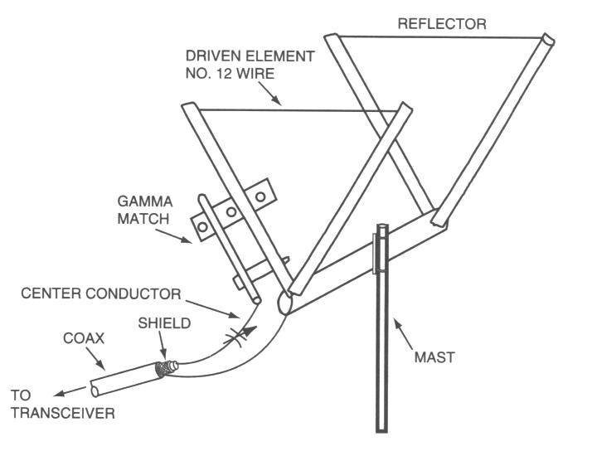
Delta Loop
13
G9 - Antennas
Notes:
13
Delta loop antennas also have full wave elements and offer performance similar to quad antennas. Because of the large elements, 2 element quads and deltas offer similar performance to a 3 element yagi. In reference to the test questions, quads and deltas have nearly identical characteristics to yagis, just a bit more gain.

Slide 14
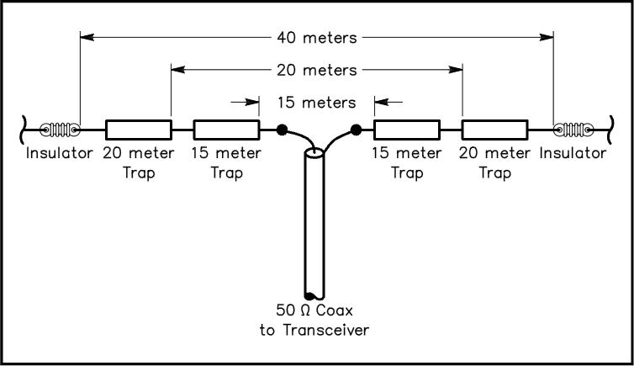
Antenna Traps
Dipole, vertical and yagi antennas can contain tuned traps in their driven elements. The traps block (or trap) energy of a given frequency making a physically longer appear shorter electrically.
In the dipole shown, any energy on the 15m band will stop at the 15m trap and the antenna will only appear to be the width of a 15m antenna. Similarly, 20m signals will stop at the 20m traps and only see the antenna between the traps. Only 40m signals will pass along the entire length.

Slide 15
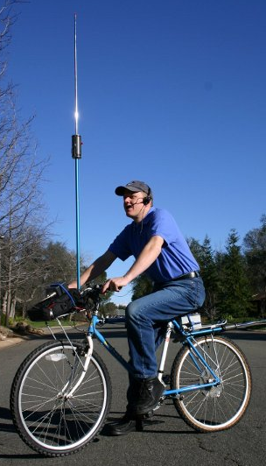
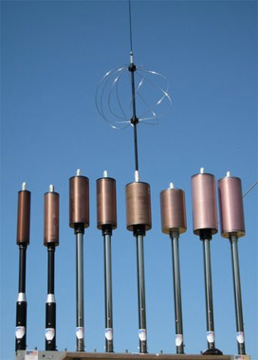
Loaded Antennas
“Rubber duck” antennas are loaded antennas where the antenna is wound into a coil to shorten it physically. This is not an efficient radiator and narrows the bandwidth but does allow portable operation. This is particularly important on the HF bands.
The antennas on the left are called “screwdrivers” and use a motor and wiper inside the coil to adjust the amount of loading based on frequency. The center antenna has the whip attached with a “capacitance hat” to provide capacitance to counteract inductance in the load coil and improve performance.

Slide 16
T9A01 - What is a beam antenna?
A. An antenna built from aluminum I-beams
B. An omnidirectional antenna invented by Clarence Beam
C. An antenna that concentrates signals in one direction
D. An antenna that reverses the phase of received signals

Slide 17
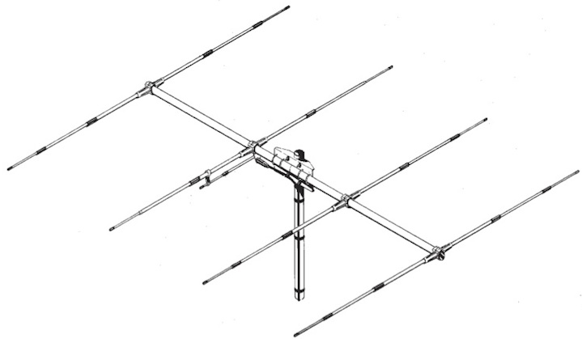
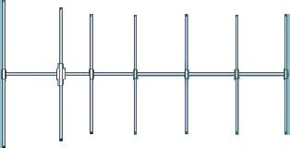
T9A01 - What is a beam antenna?
A. An antenna built from aluminum I-beams
B. An omnidirectional antenna invented by Clarence Beam
C. An antenna that concentrates signals in one direction
D. An antenna that reverses the phase of received signals

Slide 18
T9A02 Which of the following describes a type of antenna loading?
A. Electrically lengthening by inserting inductors in radiating elements
B. Inserting a resistor in the radiating portion of the antenna to make it resonant
C. Installing a spring in the base of a mobile vertical antenna to make it more flexible
D. Strengthening the radiating elements of a beam antenna to better resist wind damage

Slide 19
T9A02 Which of the following describes a type of antenna loading?
A. Electrically lengthening by inserting inductors in radiating elements
B. Inserting a resistor in the radiating portion of the antenna to make it resonant
C. Installing a spring in the base of a mobile vertical antenna to make it more flexible
D. Strengthening the radiating elements of a beam antenna to better resist wind damage

Slide 20
T9A03 - Which of the following describes a simple dipole oriented parallel to the Earth's surface?
A. A ground wave antenna
B. A horizontally polarized antenna
C. A rhombic antenna
D. A vertically polarized antenna

Slide 21
T9A03 - Which of the following describes a simple dipole oriented parallel to the Earth's surface?
A. A ground wave antenna
B. A horizontally polarized antenna
C. A rhombic antenna
D. A vertically polarized antenna

Slide 22
T9A04 - What is a disadvantage of the short, flexible antenna supplied with most handheld radio transceivers, compared to a full-sized quarter-wave antenna?
A. It has low efficiency
B. It transmits a circularly polarized signal
C. It is mechanically fragile
D. All of these choices are correct

Slide 23
T9A04 - What is a disadvantage of the short, flexible antenna supplied with most handheld radio transceivers, compared to a full-sized quarter-wave antenna?
A. It has low efficiency
B. It transmits a circularly polarized signal
C. It is mechanically fragile
D. All of these choices are correct

Slide 24
T9A05 – Which of the following increases the resonant frequency of a dipole antanea?
A. Lengthen it
B. Inserting coils in series with radiating wires
C. Shorten it
D. Adding capacitive loading to the ends of the radiating wires

Slide 25
T9A05 – Which of the following increases the resonant frequency of a dipole antanea?
A. Lengthen it
B. Inserting coils in series with radiating wires
C. Shorten it
D. Adding capacitive loading to the ends of the radiating wires

Slide 26
T9A06 – Which of the following tpes of antenna offers the greatest gain?
A. 5/8 wave vertical
B. Isotopic
C. J pole
D. Yagi

Slide 27
T9A06 – Which of the following tpes of antenna offers the greatest gain?
A. 5/8 wave vertical
B. Isotopic
C. J pole
D. Yagi

Slide 28
T9A07 What is a disadvantage of using a handheld VHF transceiver, with a flexible antenna inside a vehicle?
A. Signals strength is reduced due to the shielding effect of the vehicle
B. The bandwidth of the antenna will decrease, increasing SWR
C. The SWR might decrease, decreasing the signal strength
D. All of these choices are correct

Slide 29
T9A07 What is a disadvantage of using a handheld VHF transceiver, with a flexible antenna inside a vehicle?
A. Signals strength is reduced due to the shielding effect of the vehicle
B. The bandwidth of the antenna will decrease, increasing SWR
C. The SWR might decrease, decreasing the signal strength
D. All of these choices are correct

Slide 30
T9A08 - What is the approximate length, in inches, of a quarter-wavelength vertical antenna for 146 MHz?
A. 112
B. 50
C. 19
D. 12

Slide 31
Calculating Vertical Antenna Length
Precisely:
300
F (MHz)
300
146
=
=
2.05 meter wavelength
2.05 meters / 4 x 39 inches = 20 inches
Approximately:
146 MHz is the 2m band
¼ of 2m is 0.5m
1m is 39 inches, so 0.5m is 19.5 inches
Note this is based on free space wavelength. A wave traveling through wire will be slower and have a shorter wavelength. A physical antenna will be smaller.

Slide 32
T9A08 - What is the approximate length, in inches, of a quarter-wavelength vertical antenna for 146 MHz?
A. 112
B. 50
C. 19
D. 12

Slide 33
T9A09 - What is the approximate length, in inches, of a 6 meter 1/2-wavelength wire dipole antenna?
A. 6
B. 50
C. 112
D. 236

Slide 34
Calculating Dipole Antenna Length
Precisely:
300
F (MHz)
300
50
=
=
6 meter wavelength
(6 meters / 2) x 39 inches = 117 inches
117 inches X 95% = 112 inches
Approximately:
6m band
½ of 6 m is 3 m
1 meter is 39 inches, so 3 m is 117 inches approx.
Note this is based on free space wavelength. A wave traveling through wire will be slower and have a shorter wavelength. A physical antenna will be smaller.
Notes:
Since wavelength is provided, this calculation is much simpler.

Slide 35
T9A09 - What is the approximate length, in inches, of a 6 meter 1/2-wavelength wire dipole antenna?
A. 6
B. 50
C. 112
D. 236

Slide 36
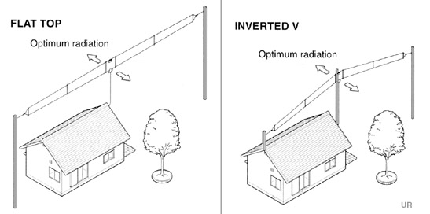
Half Wavelength Dipole Antenna
Notes:
The actual physical length will be slightly smaller because electron flow through a conductor is slower than the speed of light. This decrease in speed is called “velocity factor” and is expressed as a percentage. Copper has a velocity factor near 95 or 95% of the speed of light. That also means an antenna made of copper will be about 95% the size of the theoretical value above.

Slide 37
T9A10 - In which direction does a half-wave dipole antenna radiate the strongest signal?
A. Equally in all directions
B. Off the ends of the antenna
C. Broadside to the antenna
D. In the direction of the feed line

Slide 38
T9A10 - In which direction does a half-wave dipole antenna radiate the strongest signal?
A. Equally in all directions
B. Off the ends of the antenna
C. Broadside to the antenna
D. In the direction of the feed line

Slide 39
T9A11 - What is antenna gain?
A. The additional power that is added to the transmitter power
B. The additional power that is required in the antenna when transmitting on a higher frequency
C. The increase in signal strength in a specified direction when compared to a reference antenna
D. The increase in impedance on receive or transmit compared to a reference antenna

Slide 40
T9A11 - What is antenna gain?
A. The additional power that is added to the transmitter power
B. The additional power that is required in the antenna when transmitting on a higher frequency
C. The increase in signal strength in a specified direction when compared to a reference antenna
D. The increase in impedance on receive or transmit compared to a reference antenna

Slide 41
T9A12 - What is an advantage of a 5/8 wavelength whip antenna for VHF or UHF mobile service?
A. It has more gain than a 1/4 –wavelength antenna
B. It radiates at a very high angle
C. It eliminates distortion caused by reflected signals
D. It has 10 times the power gain of a 1/4 wavelength whip

Slide 42
T9A12 - What is an advantage of a 5/8 wavelength whip antenna for VHF or UHF mobile service?
A. It has more gain than a 1/4 –wavelength antenna
B. It radiates at a very high angle
C. It eliminates distortion caused by reflected signals
D. It has 10 times the power gain of a 1/4 wavelength whip

Slide 43
G9C10 Which of the following is a Yagi antenna design variable that could be adjusted to optimize forward gain, front-to-back ratio, or SWR bandwidth?
  A. The physical length of the boom
  B. The number of elements on the boom
  C. The spacing of each element along the boom
  D. All of these choices are correct

Slide 44
G9C10 Which of the following is a Yagi antenna design variable that could be adjusted to optimize forward gain, front-to-back ratio, or SWR bandwidth?
  A. The physical length of the boom
  B. The number of elements on the boom
  C. The spacing of each element along the boom
  D. All of these choices are correct

Slide 45
G9D01 What does the term "NVIS" mean as related to antennas?
  A. Nearly Vertical Inductance System
  B. Non-Visible Installation Specification
  C. Non-Varying Impedance Smoothing
  D. Near Vertical Incidence Sky wave

Slide 46
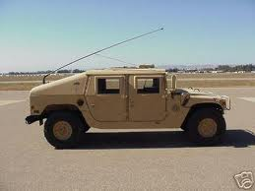
G9D01 What does the term "NVIS" mean as related to antennas?
  A. Nearly Vertical Inductance System
  B. Non-Visible Installation Specification
  C. Non-Varying Impedance Smoothing
  D. Near Vertical Incidence Sky wave

Slide 47
G9D04 What is the primary purpose of antenna traps?
  A. To permit multiband operation
  B. To notch spurious frequencies
  C. To provide balanced feed-point impedance
  D. To prevent out of band operation

Slide 48
G9D04 What is the primary purpose of antenna traps?
  A. To permit multiband operation
  B. To notch spurious frequencies
  C. To provide balanced feed-point impedance
  D. To prevent out of band operation

Slide 49
G9D05 What is the advantage of vertical stacking of horizontally polarized Yagi antennas?
  A. Allows quick selection of vertical or horizontal polarization
  B. Allows simultaneous vertical and horizontal polarization
  C. Narrows the main lobe in azimuth
  D. Narrows the main lobe in elevation

Slide 50
G9D05 What is the advantage of vertical stacking of horizontally polarized Yagi antennas?
  A. Allows quick selection of vertical or horizontal polarization
  B. Allows simultaneous vertical and horizontal polarization
  C. Narrows the main lobe in azimuth
  D. Narrows the main lobe in elevation

Slide 51
G9D06 Which of the following is an advantage of a log periodic antenna?
  A. Wide bandwidth
  B. Higher gain per element than a Yagi antenna
  C. Harmonic suppression
  D. Polarization diversity

Slide 52
G9D06 Which of the following is an advantage of a log periodic antenna?
  A. Wide bandwidth
  B. Higher gain per element than a Yagi antenna
  C. Harmonic suppression
  D. Polarization diversity

Slide 53
G9D10 Which of the following describes a Beverage antenna?
  A. A vertical antenna constructed from beverage cans
  B. A broad-band mobile antenna
  C. A helical antenna for space reception
  D. A very long and low directional receiving antenna

Slide 54
G9D10 Which of the following describes a Beverage antenna?
  A. A vertical antenna constructed from beverage cans
  B. A broad-band mobile antenna
  C. A helical antenna for space reception
  D. A very long and low directional receiving antenna

Slide 55
T9B – Feed lines
types,
attenuation vs frequency, selecting;
SWR concepts;
Antenna tuners (couplers);
RF Connectors:
selecting, weather protection

Slide 56
Load Matching
  Amateur transceivers have a 50 ohm output impedance
  Coax and antennas should be as close to 50 ohms as possible to insure maximum power transfer
  Any mismatch creates “standing waves” that can be measured with an SWR or directional watt meter
  An SWR of 1:1 indicates perfect power transfer
  As SWR increases above 2:1, modern transmitters will automatically reduce output to protect from damage
  All feed lines have “loss” that increases with frequency and length caused by resistance in the line
  Standing waves will eventually be either radiated or lost as heat in the feed line
Notes:
The 50 ohm impedance is important because it means using 75 ohm TV coax will cause a (small) impedance mismatch. Larger differences, like those from twin lead and ladder line, require a transformer to allow a proper match.

Slide 57
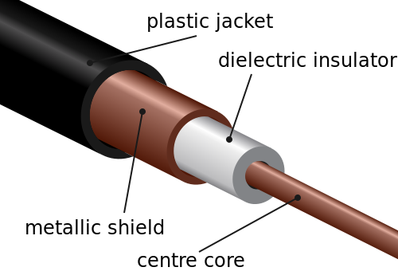
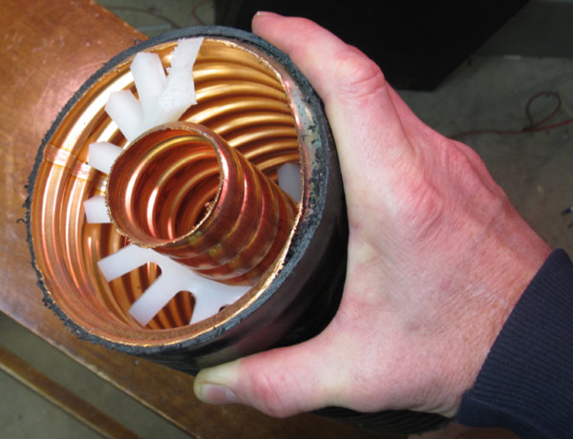
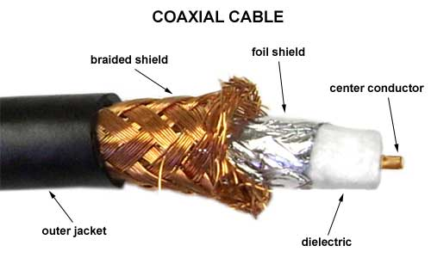

Slide 58
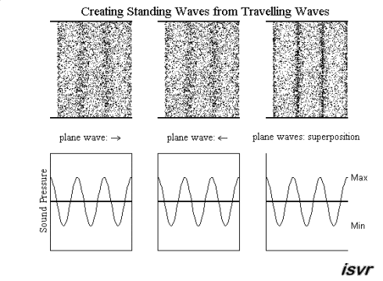
Standing Waves
Notes:
Waves traveling through a transmission line will continue until they meet an obstruction – a change in impedance. An open or short will result in the complete reflection of the wave shown above. This would create a perfect standing wave. In cases where there is simply an impedance mismatch, only some of the energy would be reflected creating smaller standing waves. These standing waves are energy lost, although whatever isn’t lost in the feed line will eventually will reflect and radiate.

Slide 59
T9B01 – What is a benefit of low SWR?
A. Reduce television interference
B. Reduce signal loss
C. Less antenna wear
D. All of these choices are correct

Slide 60
T9B01 – What is a benefit of low SWR?
A. Reduce television interference
B. Reduce signal loss
C. Less antenna wear
D. All of these choices are correct

Slide 61
T9B02 - What is the most commo impedance of coaxial cable in amateur radio?
A. 8 ohms
B. 50 ohms
C. 600 ohms
D. 12 ohms

Slide 62
T9B02 - What is the most commo impedance of coaxial cable in amateur radio?
A. 8 ohms
B. 50 ohms
C. 600 ohms
D. 12 ohms

Slide 63
T9B03 - Why is coaxial cable the most common feed line selected for amateur radio antenna systems?
A. It is easy to use and requires few special installation considerations
B. It has less loss than any other type of feed line
C. It can handle more power than any other type of feed line
D. It is less expensive than any other type of feed line

Slide 64
T9B03 - Why is coaxial cable the most common feed line selected for amateur radio antenna systems?
A. It is easy to use and requires few special installation considerations
B. It has less loss than any other type of feed line
C. It can handle more power than any other type of feed line
D. It is less expensive than any other type of feed line

Slide 65
T9B04 - What is the major function of an antenna tuner (antenna coupler)?
A. It matches the antenna system impedance to the transceiver's output impedance
B. It helps a receiver automatically tune in weak stations
C. It allows an antenna to be used on both transmit and receive
D. It automatically selects the proper antenna for the frequency band being used

Slide 66
T9B04 - What is the major function of an antenna tuner (antenna coupler)?
A. It matches the antenna system impedance to the transceiver's output impedance
B. It helps a receiver automatically tune in weak stations
C. It allows an antenna to be used on both transmit and receive
D. It automatically selects the proper antenna for the frequency band being used

Slide 67
T9B05 - What happens as the frequency of a signal in coaxial cable is increased?
A. The characteristic impedance decreases
B. The loss decreases
C. The characteristic impedance increases
D. The loss increases

Slide 68
T9B05 - What happens as the frequency of a signal in coaxial cable is increased?
A. The characteristic impedance decreases
B. The loss decreases
C. The characteristic impedance increases
D. The loss increases

Slide 69
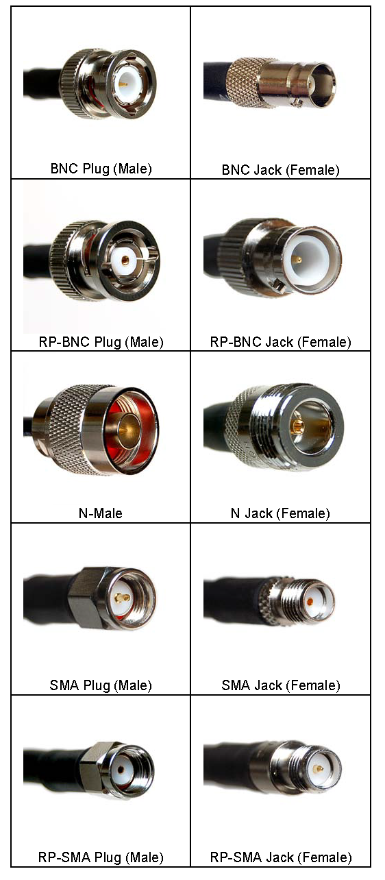
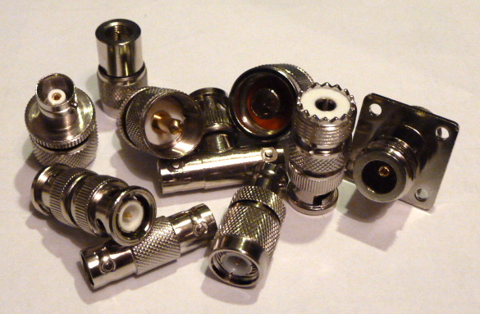
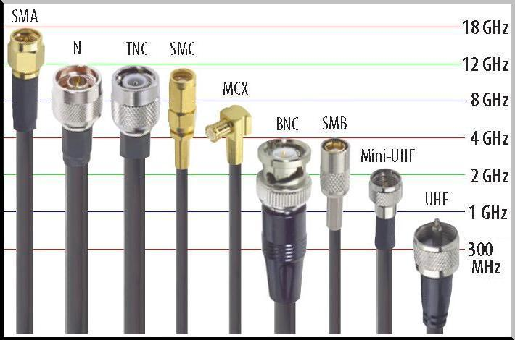
Connector Types

Slide 70
T9B06 - Which of the following RF connector types is most suitable for frequencies above 400 MHz?
A. UHF (PL-259/SO-239)
B. Type N
C. RS-213
D. DB-25

Slide 71
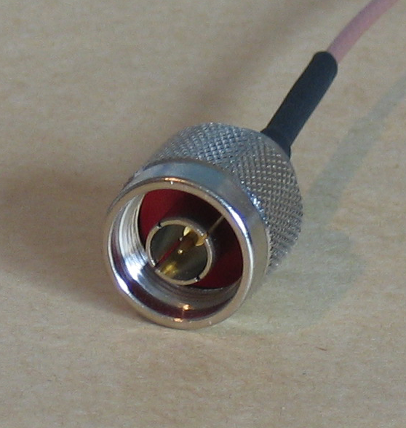
T9B06 - Which of the following RF connector types is most suitable for frequencies above 400 MHz?
A. UHF (PL-259/SO-239)
B. Type N
C. RS-213
D. DB-25

Slide 72
T9B07 - Which of the following is true of PL-259 type coax connectors?
A. They are preferred for microwave operation
B. They are watertight
C. They are commonly used at HF and VHF frequencies
D. They are a bayonet type connector

Slide 73
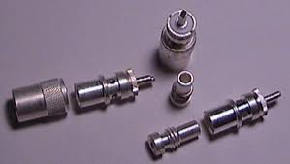
T9B07 - Which of the following is true of PL-259 type coax connectors?
A. They are preferred for microwave operation
B. They are watertight
C. They are commonly used at HF and VHF frequencies
D. They are a bayonet type connector

Slide 74
T9B08 – Which of the following is a source of loss in coaxial connectors?
A. Water intrusion into coaxial connectors
B. High SW
C. Multiple connectors in the line
D. All of these choices are correct

Slide 75
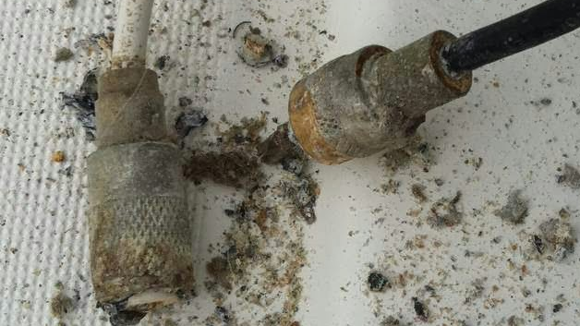
T9B08 – Which of the following is a source of loss in coaxial connectors?
A. Water intrusion into coaxial connectors
B. High SW
C. Multiple connectors in the line
D. All of these choices are correct

Slide 76
T9B09 - What can cause erratic changes in SWR?
A. Local thunderstorm
B. Loose connection in an antenna or feed line
C. Over modulation
D. Overload from a strong local station

Slide 77
T9B09 - What can cause erratic changes in SWR?
A. Local thunderstorm
B. Loose connection in an antenna or feed line
C. Over modulation
D. Overload from a strong local station

Slide 78
Coax Cable Signal Loss (Attenuation) in dB per 100ft
Loss | RG-174 | RG-58 | RG-8X | RG-213 | RG-6 | 9913 | LMR-400
O.D. | 0.100in | 0.195in | 0.242in | 0.405in | 0.270in | 0.405in | 0.405in
1MHz | 1.9dB | 0.4dB | 0.5dB | 0.2dB | 0.2dB | 0.2dB | 0.3dB
10MHz | 3.3dB | 1.4dB | 1.0dB | 0.6dB | 0.6dB | 0.4dB | 0.5dB
50MHz | 6.6dB | 3.3dB | 2.5dB | 1.6dB | 1.4dB | 0.9dB | 0.9dB
100MHz | 8.9dB | 4.9dB | 3.6dB | 2.2dB | 2.0dB | 1.4dB | 1.4dB
200MHz | 11.9dB | 7.3dB | 5.4dB | 3.3dB | 2.8dB | 1.8dB | 1.8dB
400MHz | 17.3dB | 11.2dB | 7.9dB | 4.8dB | 4.3dB | 2.6dB | 2.6dB
700MHz | 26.0dB | 16.9dB | 11.0dB | 6.6dB | 5.6dB | 3.6dB | 3.5dB
900MHz | 27.9dB | 20.1dB | 12.6dB | 7.7dB | 6.0dB | 4.2dB | 3.9dB
1GHz | 32.0dB | 21.5dB | 13.5dB | 8.3dB | 6.1dB | 4.5dB | 4.1dB
Imped | 50ohm | 50ohm | 50ohm | 50ohm | 75ohm | 50ohm | 50ohm
Notes:
Notice how losses go up as frequency increases for each coax type. Coax losses shown above are for 100 feet lengths. Loss is a length multiplier, so a 200 ft length would have twice the loss shown above and a 50 ft length would have half the loss. This multiplier factor is why you should keep cable installation lengths between radios and antennas as short as practical!
Most coax is 50 or 75 ohms, although there are a few other types. It’s important to match impedances thoughout the antenna system to insure maximum power transfer.

Slide 79
T9B10 - What is the electrical difference between RG-58 and RG-213 coaxial cable?
A. There is no significant difference between the two types
B. RG-58 cable has two shields
C. RG-213 cable has less loss at a given frequency
D. RG-58 cable can handle higher power levels

Slide 80
T9B10 - What is the electrical difference between RG-58 and RG-213 coaxial cable?
A. There is no significant difference between the two types
B. RG-58 cable has two shields
C. RG-213 cable has less loss at a given frequency
D. RG-58 cable can handle higher power levels

Slide 81
T9B11 - Which of the following types of feed line has the lowest loss at VHF and UHF?
A. 50-ohm flexible coax
B. Multi-conductor unbalanced cable
C. Air-insulated hard line
D. 75-ohm flexible coax

Slide 82
T9B11 - Which of the following types of feed line has the lowest loss at VHF and UHF?
A. 50-ohm flexible coax
B. Multi-conductor unbalanced cable
C. Air-insulated hard line
D. 75-ohm flexible coax

Slide 83
T9B12 – What is standing wave ratio
( SWR ) ?
A. A measure of how well a load is matched to a transmission line
B. The ratio of amplifier power output to input
C. The transmitter efficiency ratio
D. An indication of the quality of your station’s ground connection

Slide 84
T9B12 – What is standing wave ratio
( SWR ) ?
A. A measure of how well a load is matched to a transmission line
B. The ratio of amplifier power output to input
C. The transmitter efficiency ratio
D. An indication of the quality of your station’s ground connection

Slide 85
End of
SUBELEMENT T9
Antennas and feed lines

